Slide 1
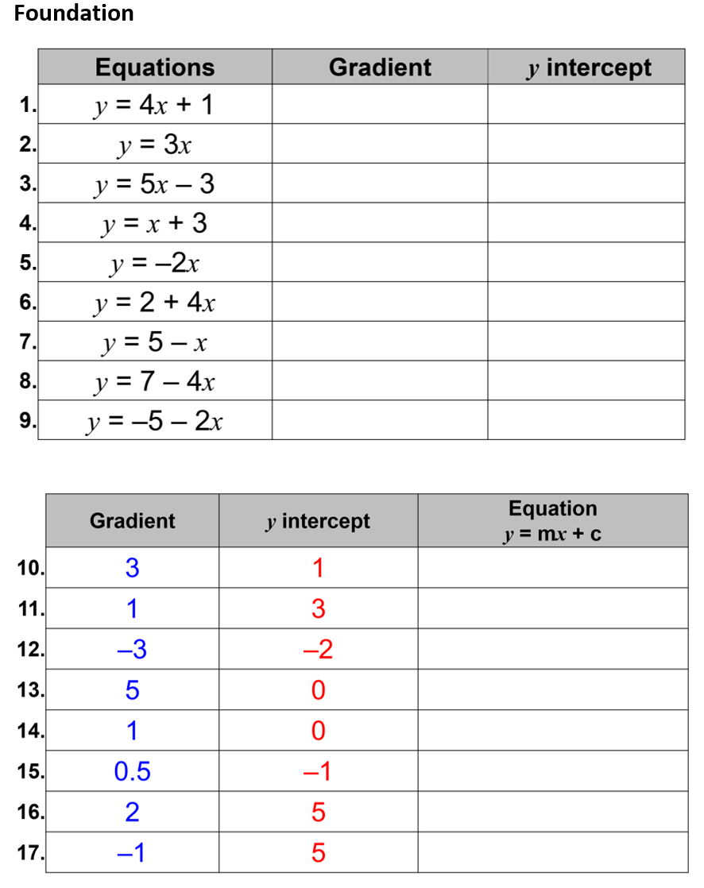
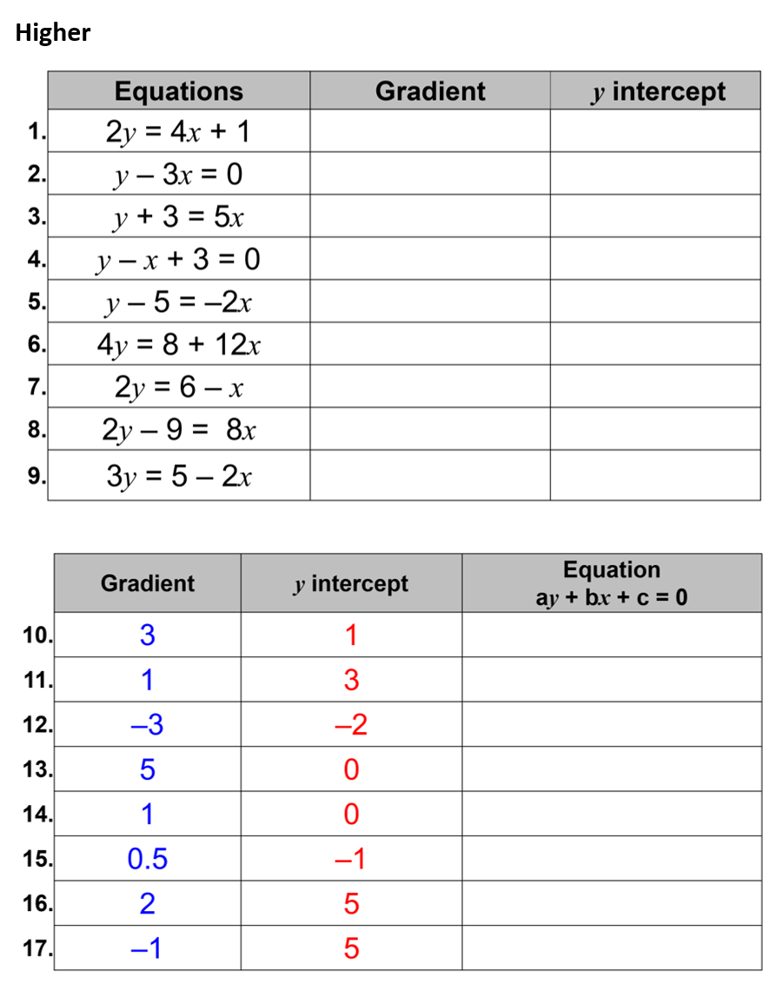

Slide 2
ANSWERS

Slide 3
 | Equations | Gradient | y intercept
1. | y = 4x + 1
2. | y = 3x
3. | y = 5x – 3
4. | y = x + 3
5. | y = –2x
6. | y = 2 + 4x
7. | y = 5 – x
8. | y = 7 – 4x
9. | y = –5 – 2x
4 | 1
3 | 0
5 | –3
1 | 3
–2 | 0
4 | 2
–1 | 5
–4 | 7
–2 | –5

Slide 4
 | Gradient | y intercept | Equation y = mx + c
10. | 3 | 1
11. | 1 | 3
12. | –3 | –2
13. | 5 | 0
14. | 1 | 0
15. | 0.5 | –1
16. | 2 | 5
17. | –1 | 5
y = 3x + 1
y = x + 3
y = –3x – 2
y = 5x
y = x
y = 0.5x – 1
y = 2x + 5
y = 5 – x

Slide 5
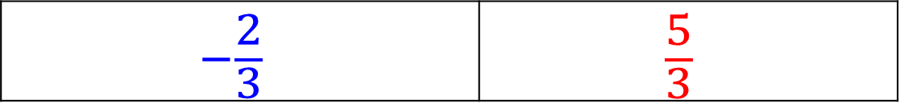
 | Equations | Gradient | y intercept
1. | 2y = 4x + 1
2. | y – 3x = 0
3. | y + 3 = 5x
4. | y – x + 3 = 0
5. | y – 5 = –2x
6. | 4y = 8 + 12x
7. | 2y = 6 – x
8. | 2y – 9 = 8x
9. | 3y = 5 – 2x
2 | 0.5
3 | 0
5 | –3
1 | –3
–2 | 5
3 | 2
–0.5 | 3
4 | 4.5
$$−\frac{2}{3}$$ | $$\frac{5}{3}$$

Slide 6
 | Gradient | y intercept | Equation ay + bx + c = 0
10. | 3 | 1
11. | 1 | 3
12. | –3 | –2
13. | 5 | 0
14. | 1 | 0
15. | 0.5 | –1
16. | 2 | 5
17. | –1 | 5
y – 3x – 1 = 0
y – x – 3 = 0
y + 3x + 2 = 0
y – 5x = 0
y – x = 0
y – 0.5x + 1 = 0
y – 2x – 5 = 0
y + x – 5 = 0

