Slide 1
Probability
Set Notation
Chapter 2
(Part 1 of 4)

Slide 2
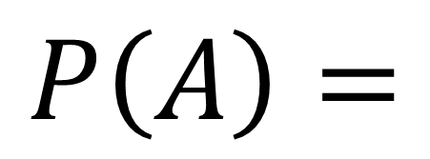
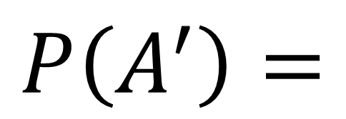


Set Notation
$$P\left(A\right)=$$
$$\text{Probability} \text{of} \text{Event} \text{A}$$
$$P\left(A^{′}\right)=$$
$$\text{Probability} \text{of} \text{Not} \text{Event} \text{A}$$

Slide 3

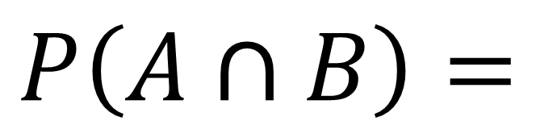

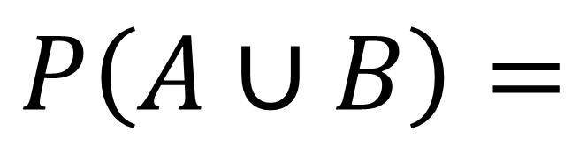
Set Notation
$$\text{Probability} \text{of}$$
$$\text{Event} \text{A} \text{and} \text{B}$$
$$P\left(A∪B\right)=$$
$$\text{Probability} \text{of}$$
$$\text{Event} \text{A} \text{or} \text{B}$$
$$P\left(A∩B\right)=$$

Slide 4
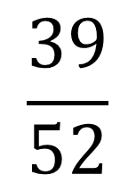

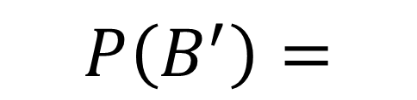

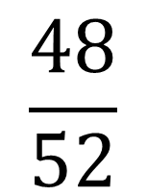
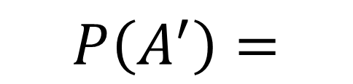
$$A$$
$$B$$
3
1
12
36
$$\frac{48}{52}$$
12 + 36 = 48
$$P\left(A^{′}\right)=$$
$$\frac{39}{52}$$
3 + 36 = 39
$$P\left(B^{′}\right)=$$

Slide 5
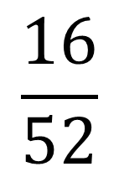
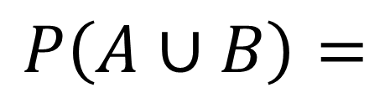
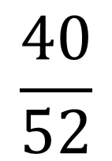
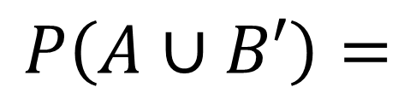
$$A$$
$$B$$
3
1
12
36
$$\frac{16}{52}$$
$$P\left(A∪B\right)=$$
3 + 1 + 12 = 16
$$\frac{40}{52}$$
$$P\left(A∪B′\right)=$$
3 + 1 + 36 = 40

Slide 6
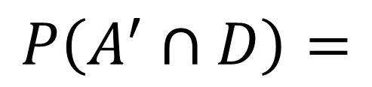
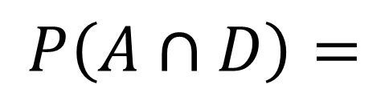
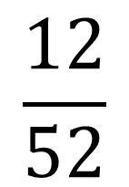
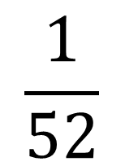
$$A$$
$$B$$
3
1
12
36
$$\frac{1}{52}$$
$$P\left(A∩D\right)=$$
$$\frac{12}{52}$$
$$P\left(A^{′}∩D\right)=$$

Slide 7
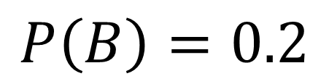
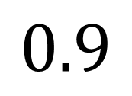

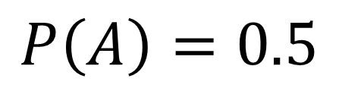
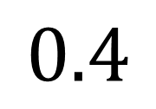

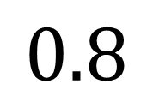
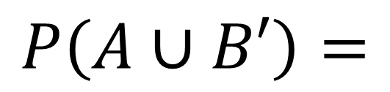
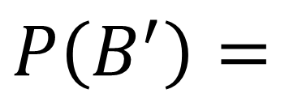
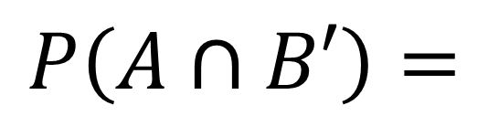
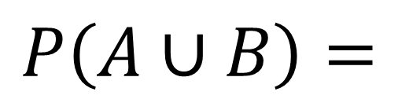
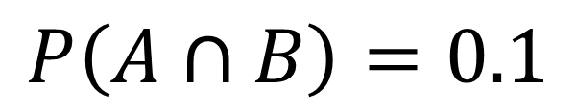
Complete the Venn Diagram
$$P\left(A\right)=0.5$$
$$P\left(B\right)=0.2$$
$$A$$
$$B$$
$$P\left(A∩B\right)=0.1$$
0.4
0.1
0.1
0.4
$$P\left(A∪B\right)=$$
0.6
0.4 + 0.1 + 0.1 = 0.6
$$P\left(B^{′}\right)=$$
$$0.8$$
0.4 + 0.4 = 0.8
$$P\left(A∩B′\right)=$$
$$0.4$$
$$P\left(A∪B′\right)=$$
$$0.9$$
0.4 + 0.1 + 0.4 = 0.9

Slide 8


Recap
If $A$ and $B$ are mutually exclusive then
$$P\left(A∪B\right)= P\left(A\right)+P\left(B\right)$$
If $A$ and $B$ are independent then
$$P\left(A∩B\right)= P\left(A\right)×P\left(B\right)$$

Slide 9
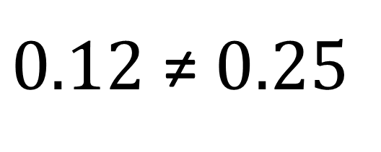
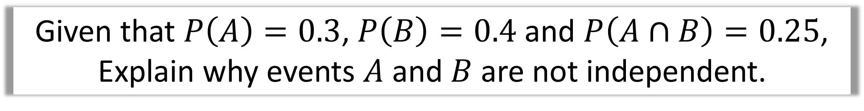
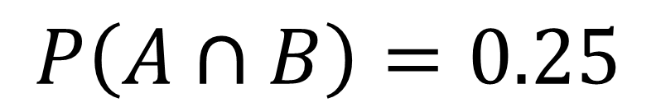
Given that $P\left(A\right)=0.3$, $P\left(B\right)=0.4$ and $P\left(A∩B\right)=0.25$,
Explain why events $A$ and $B$ are not independent.
$$P\left(A\right)×P\left(B\right)=0.3×0.4=0.12$$
$$P\left(A∩B\right)=0.25$$
$0.12$ ≠ $0.25$
Therefore, they are not independent

Slide 10
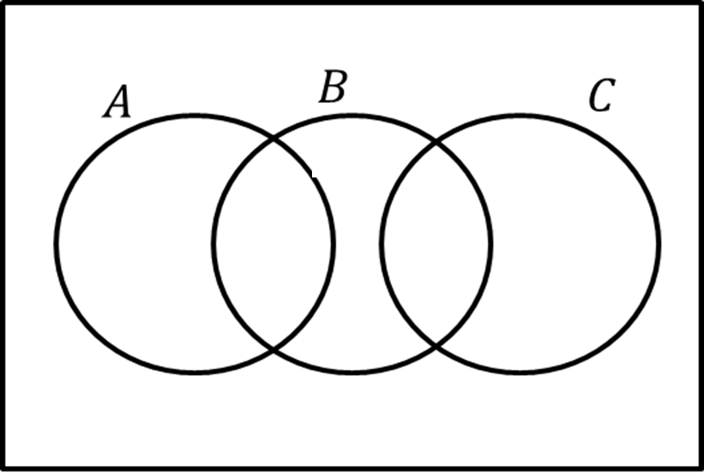
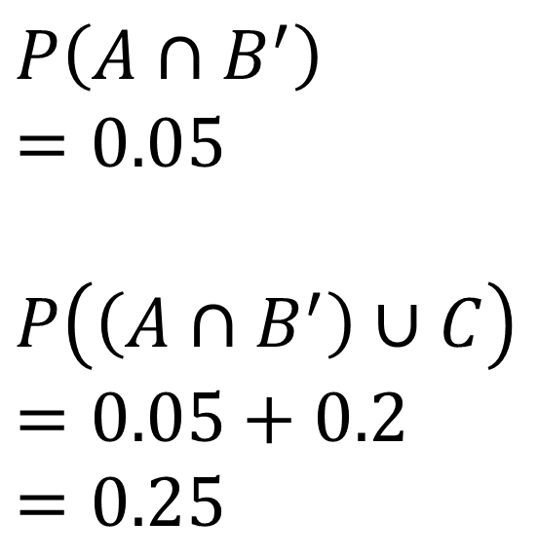
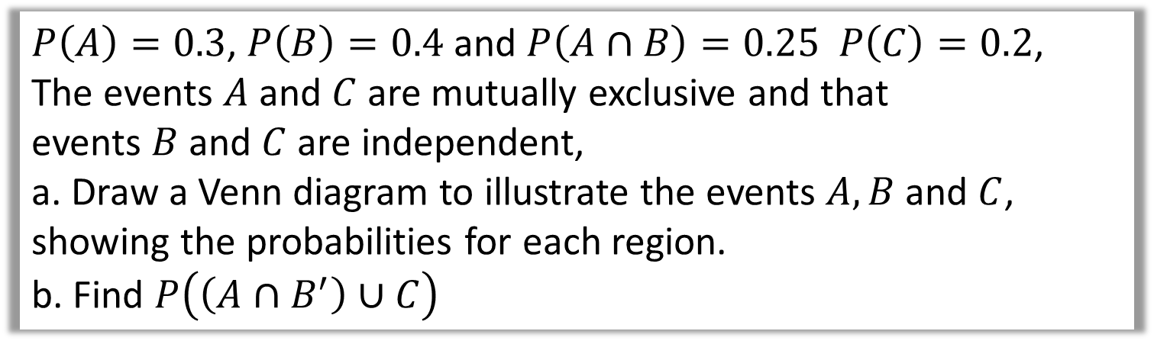
$P\left(A\right)=0.3$, $P\left(B\right)=0.4$ and $P\left(A∩B\right)=0.25 P\left(C\right)=0.2$,
The events $A$ and $C$ are mutually exclusive and that
events $B$ and $C$ are independent,
a. Draw a Venn diagram to illustrate the events $A, B$ and $C$,
showing the probabilities for each region.
b. Find $P\left(\left(A∩B^{′}\right)∪C\right)$
a)
b)
$$P\left(A∩B^{′}\right)$$
$$=0.05$$
$$P\left(\left(A∩B^{′}\right)∪C\right)$$
$$=0.05+0.2$$
$$=0.25$$
0.07
0.05
0.25
0.08
0.12
0.43

Slide 11
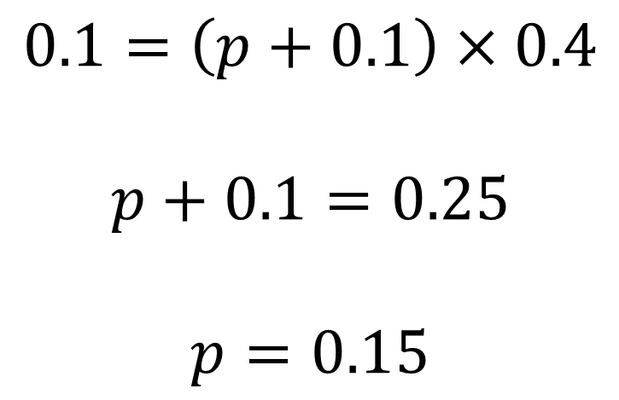
$$0.1=\left(p+0.1\right)×0.4$$
$$p+0.1=0.25$$
$$p=0.15$$
The Venn diagram in Figure 1 shows three events A, B and C and the probabilities associated with each region of B. The constants p, q and r each represent probabilities associated with the three separate regions outside B.
The events A and B are independent.
Find the value of p. (3)

