Slide 1
LO: Velocity/Speed
Time Graphs

Slide 2

What is the difference between velocity and speed?
They are both the rate at which an
object covers distance
Velocity is speed but with direction.

Slide 3
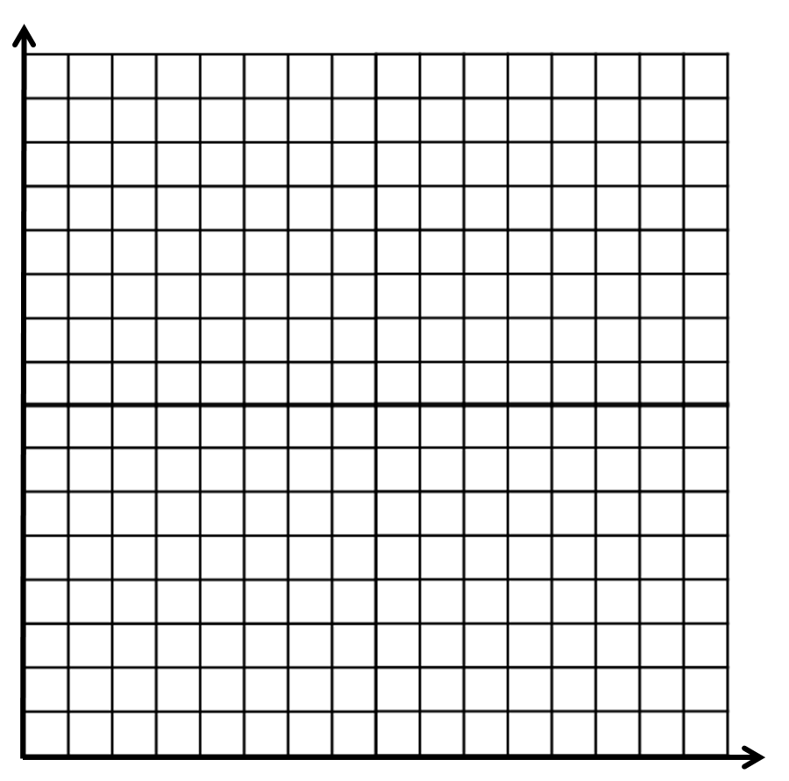
John takes his sports car for a spin!
Constant Speed
10
Velocity
(meters per second)
Constant Acceleration
Constant Deceleration
Describe what happens from the
velocity-time graph.
0
0
4
10
15
Time (seconds)

Slide 4
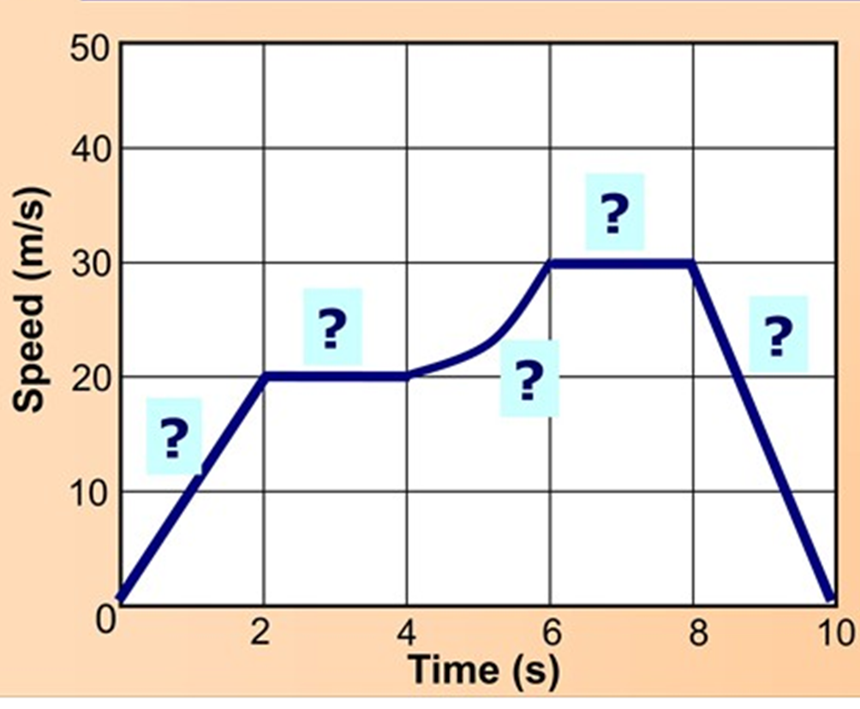
What is happening at the various stages?
A
Constant acceleration
D
B
Constant speed
B
E
C
Varying acceleration
C
A
D
Constant speed
E
Constant deceleration

Slide 5
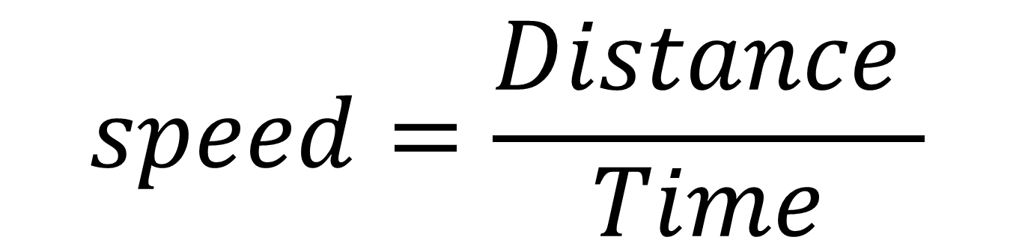
How do you calculate speed?
$$speed=\frac{Distance }{Time}$$
What are possible units for speed?
m/sec km/hour miles/hour m/min

Slide 6
The area under the graph is the distance travelled.
½ x 4 x 10 = 20
6 x 10 = 60
10
½ x 5 x 10 = 25
Velocity
(meters per second)
20 + 60 + 25 = 105m
0
0
4
10
15
Time (seconds)

Slide 7
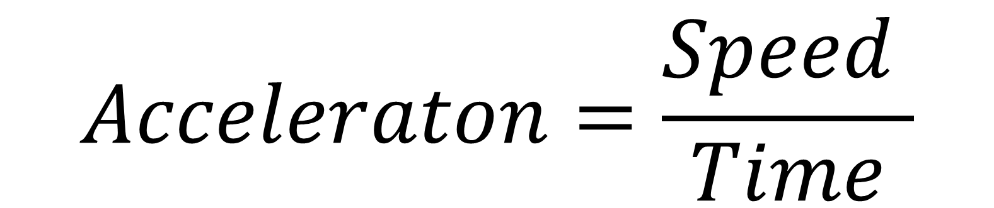
How do you calculate acceleration?
$$Acceleraton=\frac{Speed }{Time}$$
What are possible units for speed?
m/s per second
ms⁻²

Slide 8
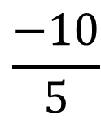
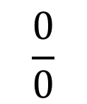
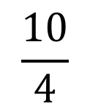
The acceleration is calculated from the gradient of the lines .
$$\frac{10}{4}$$
= 2.5 m/s⁻²
Acceleration
$$\frac{0}{0}$$
10
= 0 m/s⁻²
Velocity
(meters per second)
No Acceleration
$$\frac{−10}{5}$$
= -2 m/s⁻²
Deceleration
0
0
4
10
15
Time (seconds)

Slide 9
Velocity Time Graph
speed (ms⁻¹)
6
Distance travelled?
0
0
7
time (s)
A
6 m
B
42 m
C
48 m
D
7 m

Slide 10
Velocity Time Graph
speed (ms⁻¹)
7
Distance travelled?
5
0
0
8
time (s)
A
56 m
B
28 m
C
48 m
D
2 m

Slide 11
Velocity Time Graph
speed (ms⁻¹)
8
Distance travelled?
0
0
6
time (s)
A
24 m
B
28 m
C
48 m
D
21 m

Slide 12
Velocity Time Graph
speed (ms⁻¹)
6
Acceleration?
0
0
7
time (s)
A
0 ms⁻²
B
6 ms⁻²
C
7 ms⁻²
D
21 ms⁻²

Slide 13
Velocity Time Graph
speed (ms⁻¹)
7
Acceleration?
5
0
0
10
time (s)
A
0.7 ms⁻²
B
5 ms⁻²
C
0.2 ms⁻²
D
0.5 ms⁻²

Slide 14
Velocity Time Graph
speed (ms⁻¹)
8
Acceleration?
0
5
9
time (s)
A
2 ms⁻²
B
0.5 ms⁻²
C
−2 ms⁻²
D
−0.5 ms⁻²

Slide 15

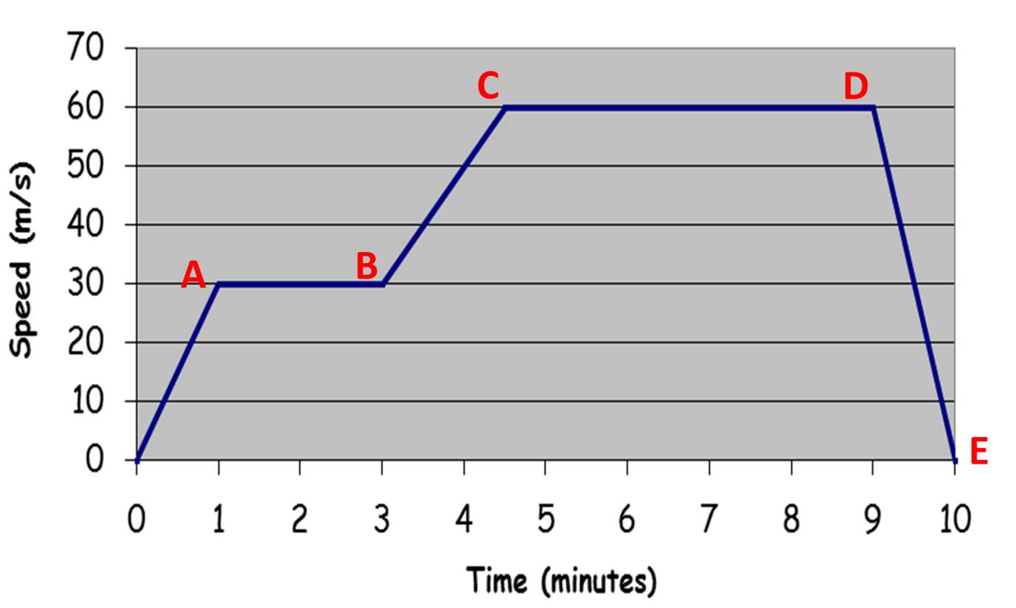
Are we there yet!?
A
=
900
C
=
8550
E
=
26550
B
=
4500
D
=
24750

