Slide 1
LO: Scatter Graphs

Slide 2


Describe the relationship
between the following:
Ice cream sales
and
temperature.

Slide 3


Describe the relationship
between the following:
Time playing
computer games
and
Time completing
homework

Slide 4
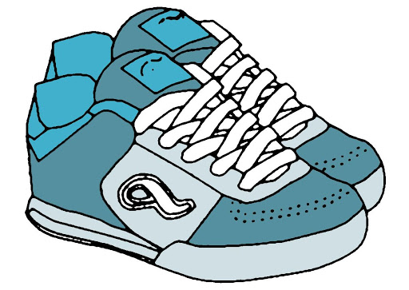

Describe the relationship
between the following:
The shoe size of a person
and
IQ

Slide 5
A scatter graph is a graph that shows the
relationship (correlation) between two pieces of data.
Positive Correlation
Negative Correlation
No Correlation

Slide 6
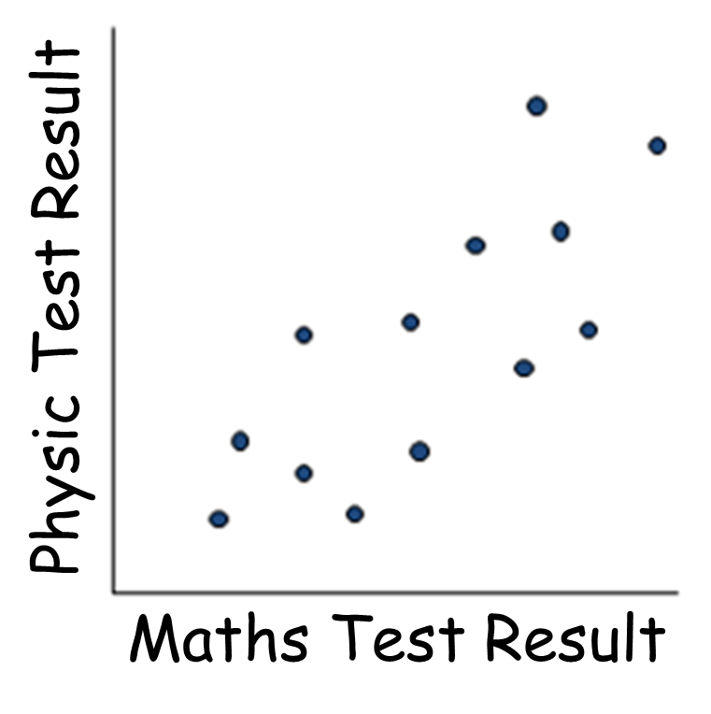
State the type of correlation.
Positive Correlation

Slide 7
Describe the relationship.
The better you do in the maths test
the better you do in the physics test.

Slide 8
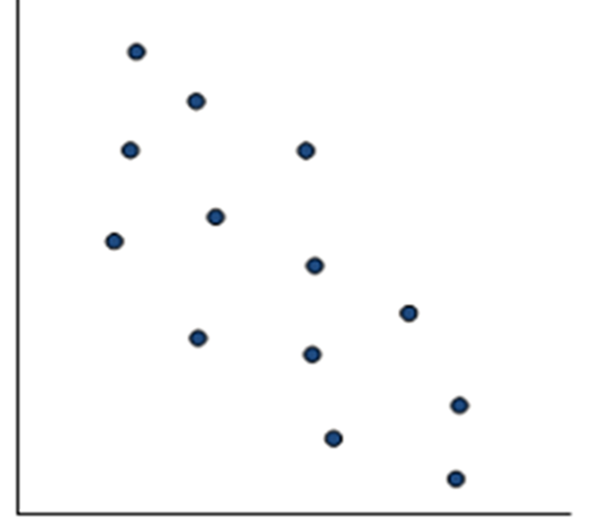
State the type of correlation.
Car Value
Age
Negative Correlation

Slide 9
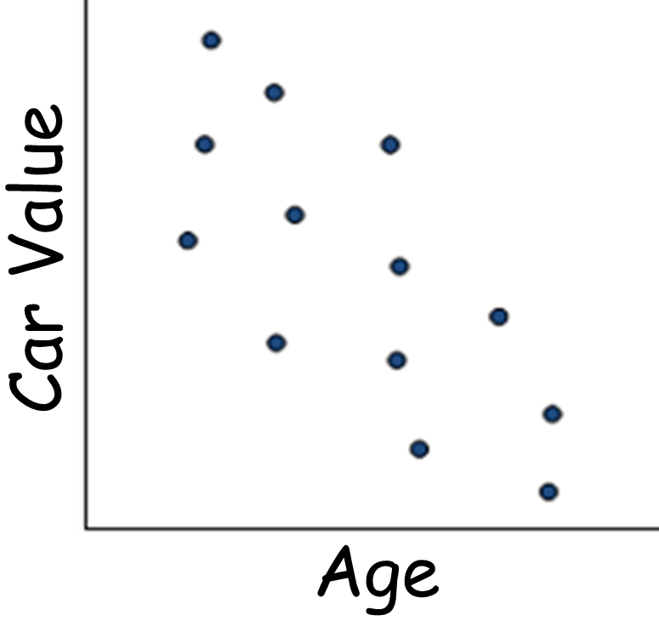
Describe the relationship.
As the age of the car increases
the car value decreases.

Slide 10
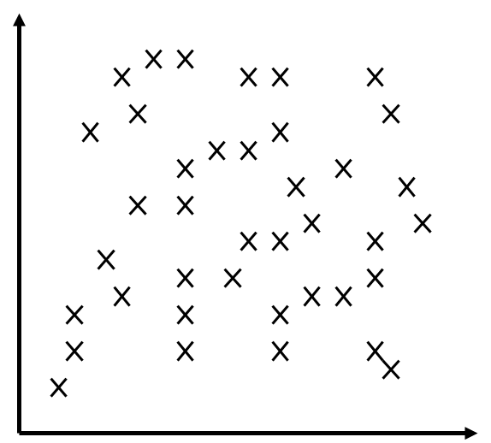
State the type of correlation.
IQ
Height
No Correlation

Slide 11
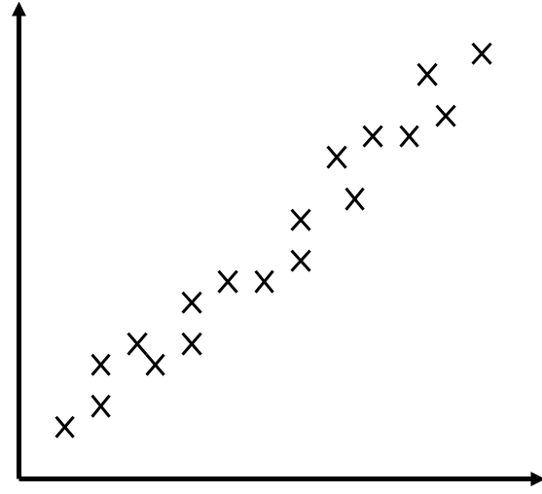
State the type of correlation.
Teachers in a School
Students in a School
Positive Correlation

Slide 12
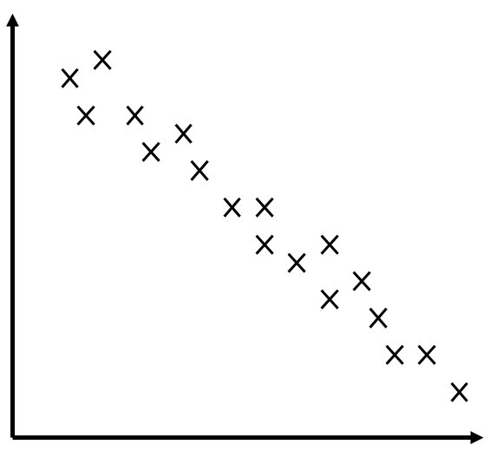
State the type of correlation.
Petrol in the Tank
Distance Travelled
Negative Correlation

Slide 13

Can you come up with pairs of data that have the following correlations?
A) Positive Correlation
B) Negative Correlation
C) No Correlation

Slide 14
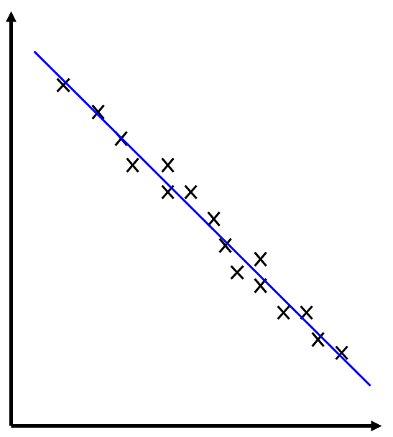
Estimating Values
By drawing a line of best you can estimate values.
Line of best fit
The line of best fit should try to pass through
the middle of all the points.

Slide 15
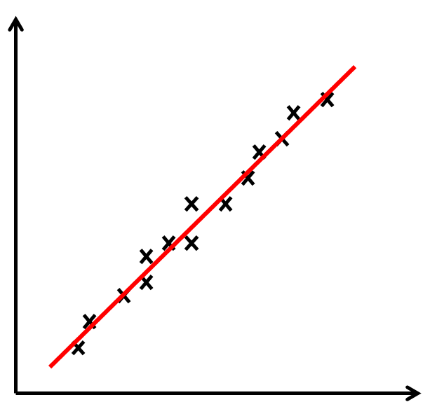
A Level Grade
GCSE Grade

Slide 16

Draw a scatter graph and describe the correlation:
Student | A | B | C | D | E | F | G | H
Maths mark | 56 | 73 | 51 | 62 | 24 | 67 | 94 | 35
Science mark | 62 | 68 | 45 | 68 | 35 | 73 | 88 | 32
100
90
80
70
60
Science mark
50
40
30
20
10
0
10
20
30
40
50
60
70
80
90
100
Maths mark

Slide 17
What correlation is there between the maths marks and the science marks?
Student | A | B | C | D | E | F | G | H
Maths mark | 56 | 73 | 51 | 62 | 24 | 67 | 94 | 35
Science mark | 62 | 68 | 45 | 68 | 35 | 73 | 88 | 32
100
90
Positive Correlation
80
70
60
Science mark
50
40
30
20
10
0
10
20
30
40
50
60
70
80
90
100
Maths mark

Slide 18
Imogen missed the Science test because she was ill.
She sat the Maths test and got 85.
Use your scatter graph to estimate what
Imogen would have achieved on the Science test.
100
90
Imogen’s estimation would
be 83
80
70
60
Science mark
50
40
30
20
10
0
10
20
30
40
50
60
70
80
90
100
Maths mark

