Slide 1
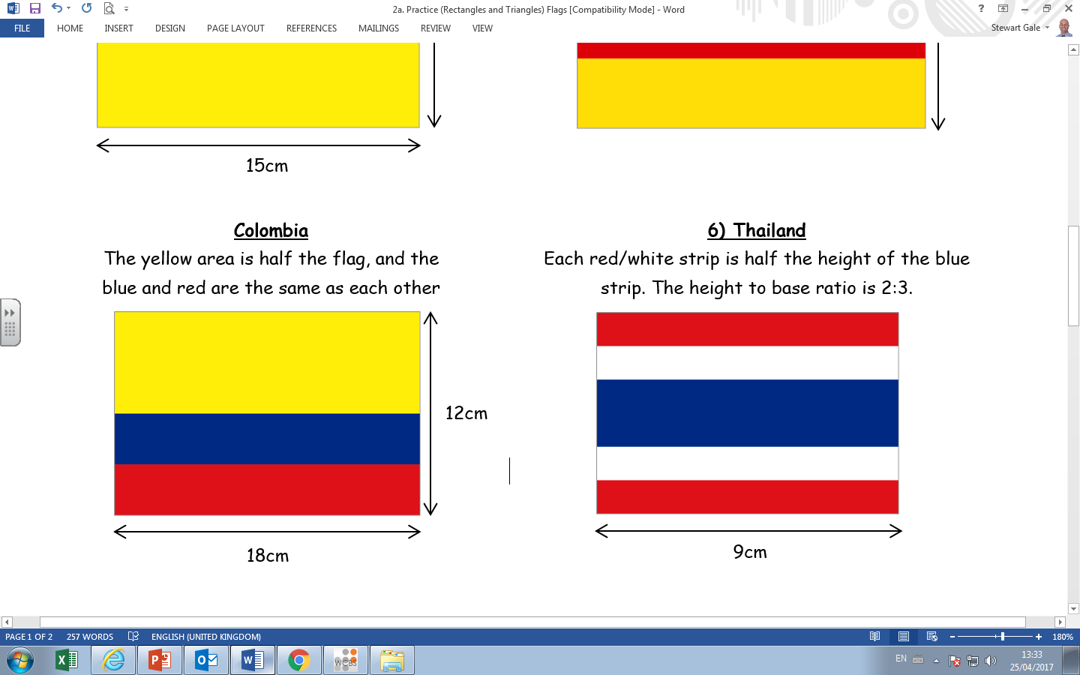
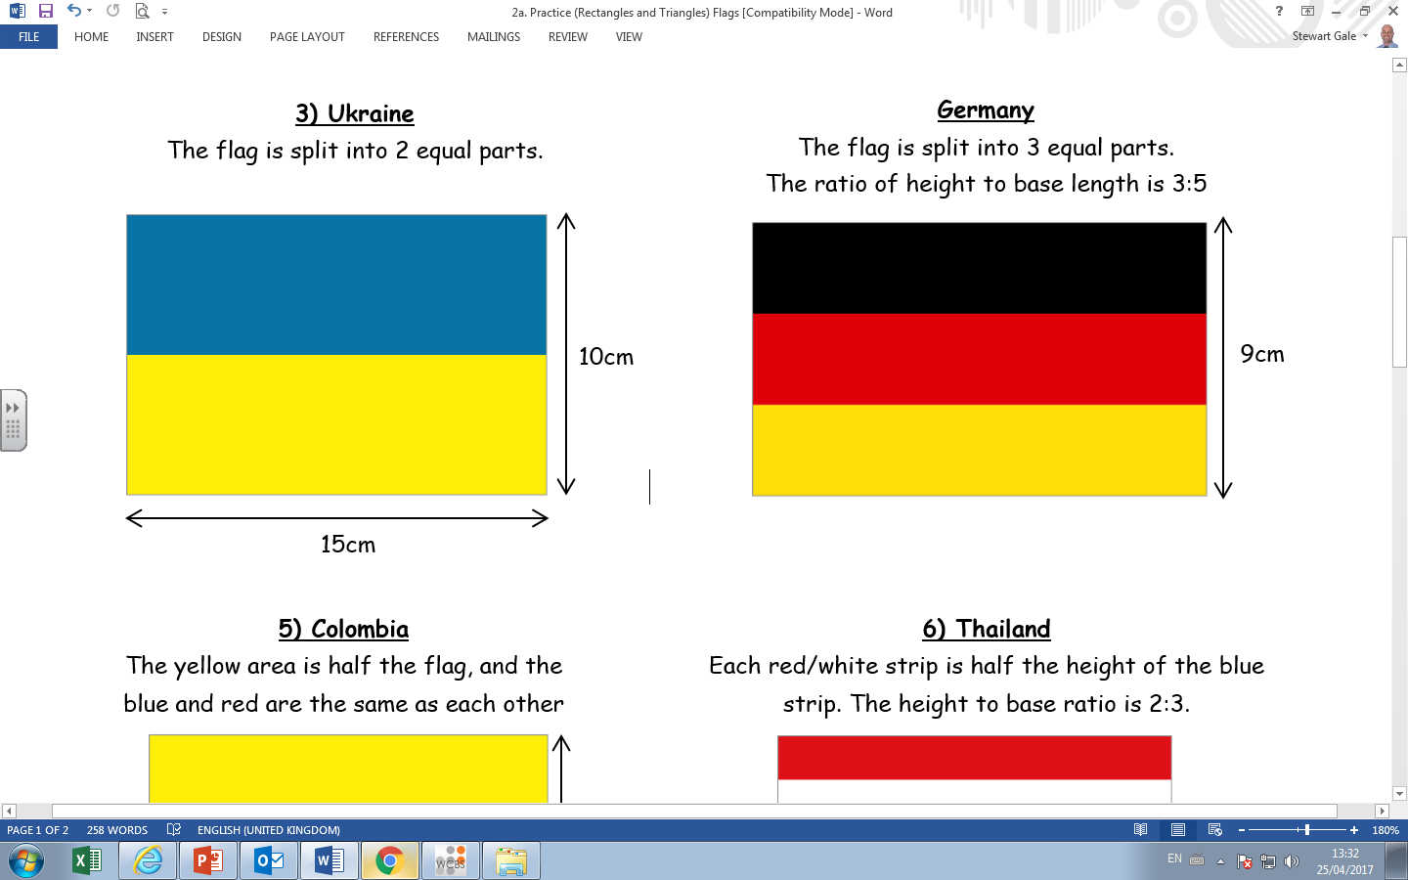
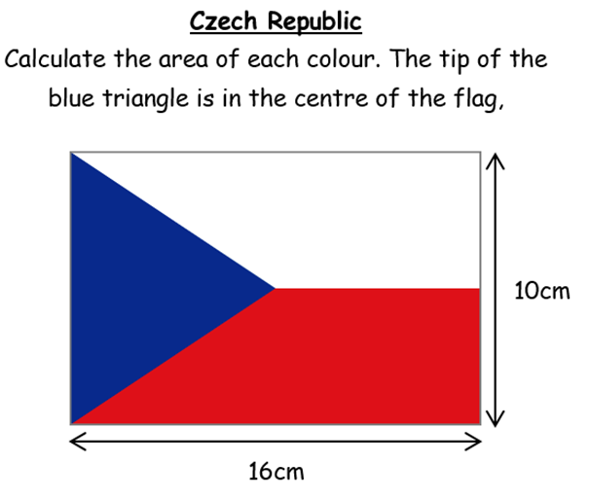
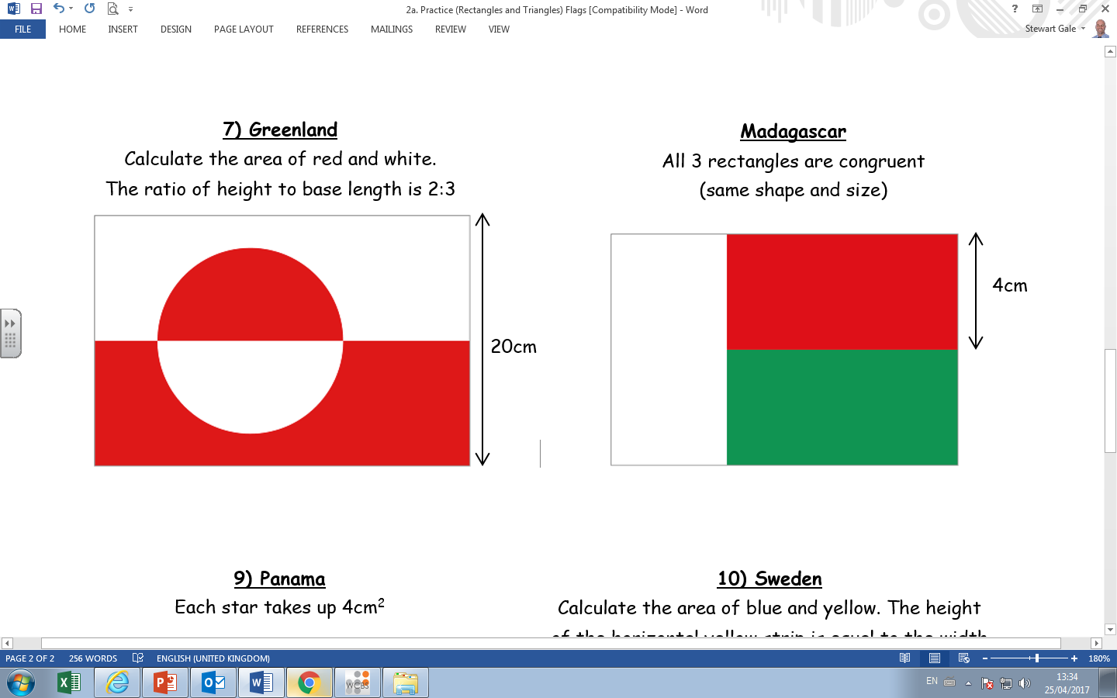
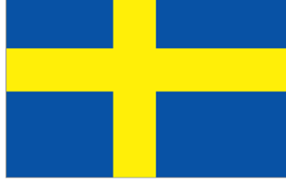
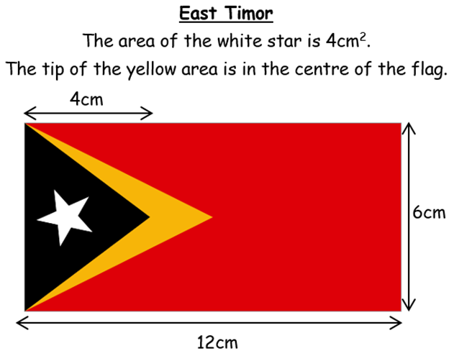
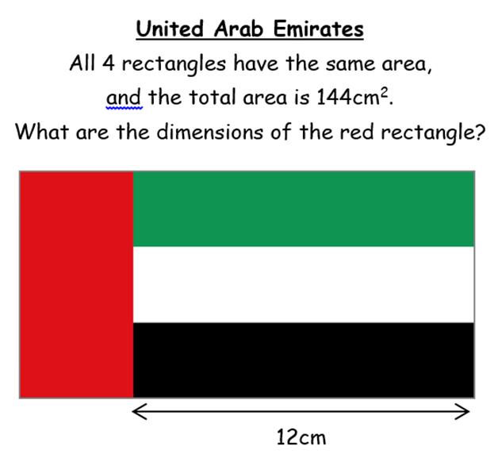
Czech Rep
Columbia
Germany
Madagascar
Sweden
East Timor
U.A.E

Slide 2
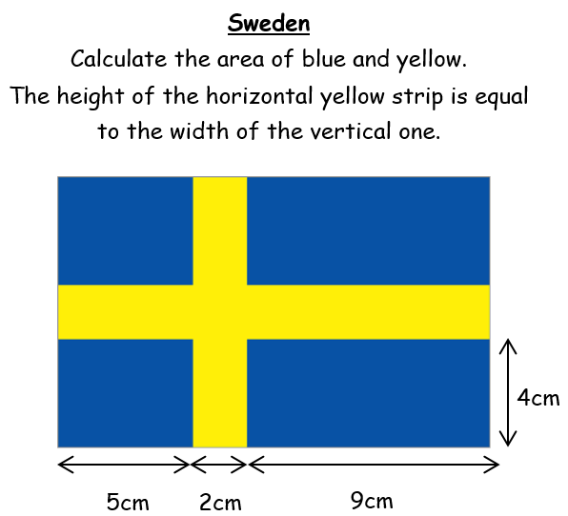


Slide 3
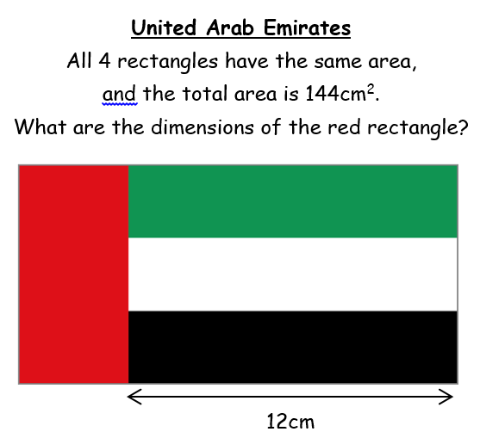
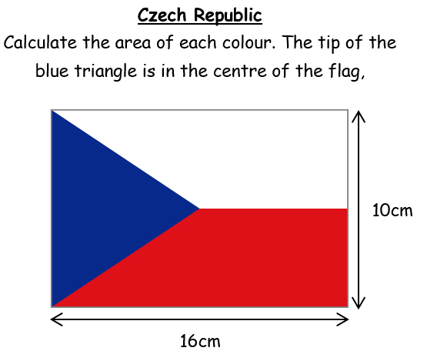
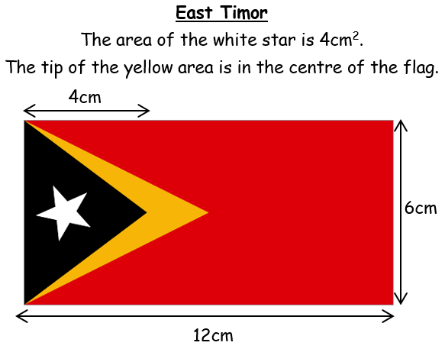
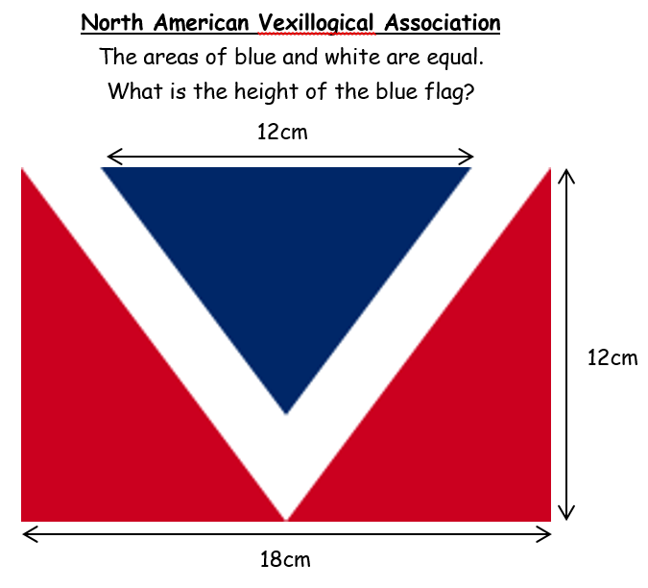

Slide 4
ANSWERS

Slide 5
Each colour = 45cm²
Yellow = 108cm²
Red = 54cm²
Blue = 54cm²

Slide 6
Each colour = 32cm²
Blue = 112cm²
Yellow = 48cm²

Slide 7
Blue = 40cm²
Red = 60cm²
White = 60cm²
Red Area = 4cm x 9cm

Slide 8
Black = 8cm²
Yellow = 6cm²
Red = 54cm²
Height of blue = 9cm

