Slide 1
FM: Circle Theorems

Slide 2
Arc
Sector
Radius
Segment
Chord
Diameter
Tangent
Circumference

Slide 3
When dealing with circles
there are certain properties
that can you help find
missing angles and sides.

Slide 4
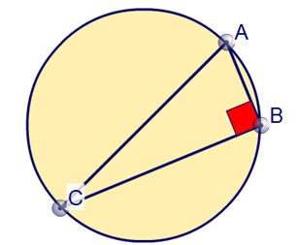
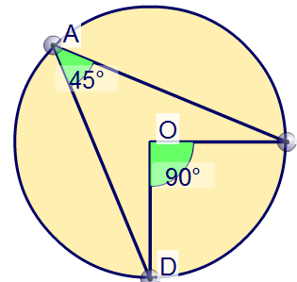
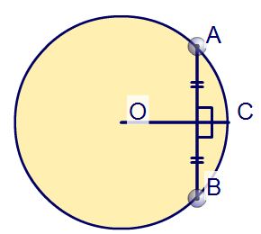
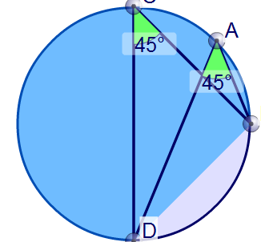
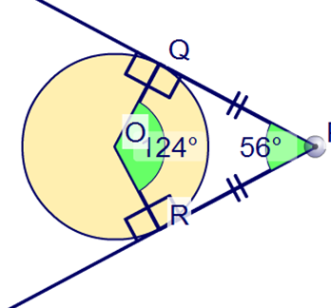
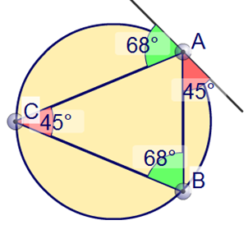
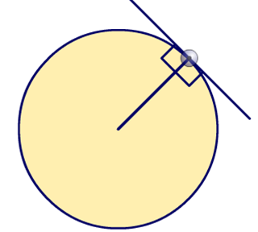
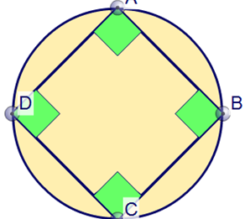
There are 8 theorems that can help you.
1
2
3
4
5
6
7
8

Slide 5
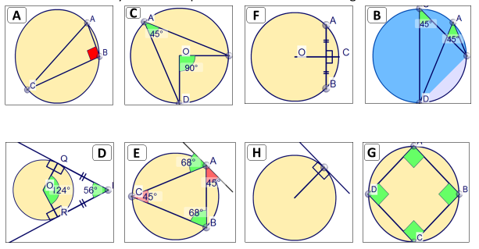
8 Circle Theorems in 4 Minutes
Click the picture below to learn everything
you need to know in 4 minutes!

Slide 6
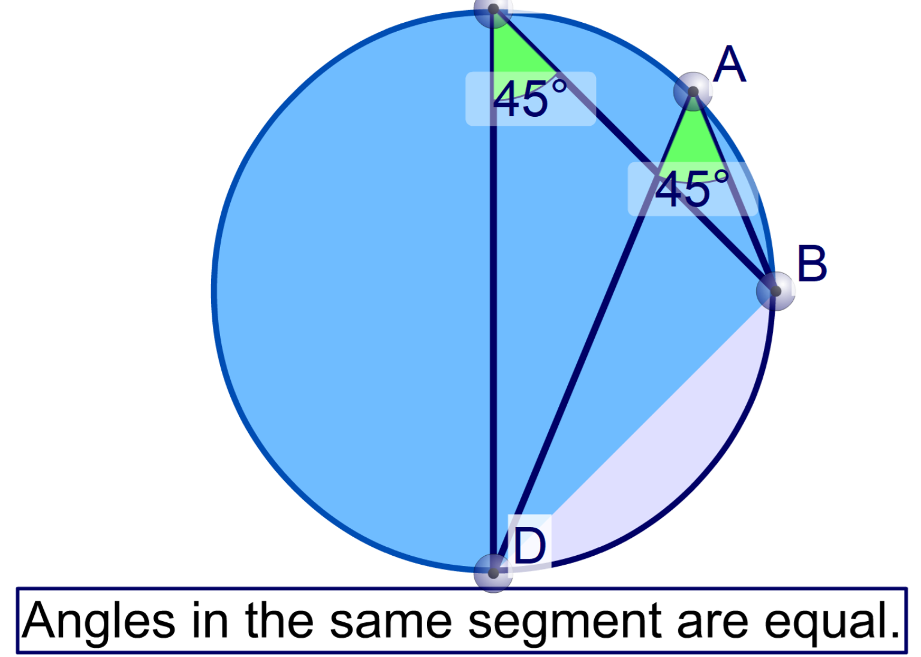
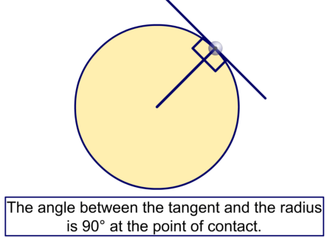
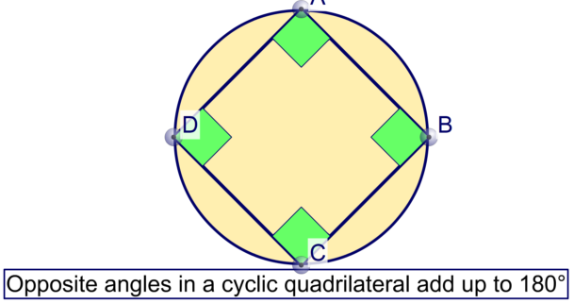

Slide 7
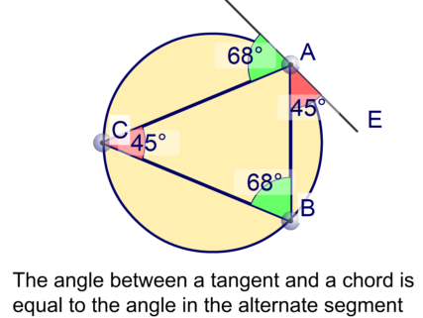
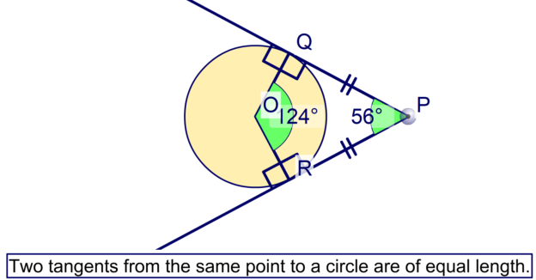
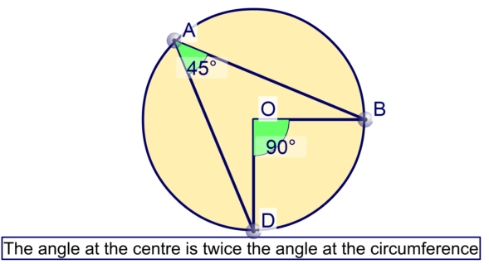
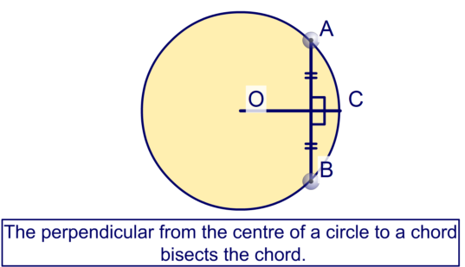

Slide 8
Notes:
Drag the points around the circumference of the circle to demonstrate this theorem.

Slide 9
Notes:
Drag the points around the circumference of the circle to demonstrate this theorem.
Hide one of the angles, modify the diagram and ask pupils to calculate the size of the missing angle.

Slide 10
Notes:
Drag the points around the circumference of the circle to demonstrate this theorem.
Hide some of the angles, modify the diagram and ask pupils to calculate the sizes of the missing angles.

Slide 11
Notes:
Change the position of the point where the tangent meets the radius to show that they are always at right angles.

Slide 12
Notes:
Change the position of P to demonstrate this theorem.
Ask pupils to explain why angles QPR and QOR are supplementary angles.
Hide one of the angles, modify the diagram and ask pupils to calculate the size of the missing angle.
Establish that the shape PQOR is a kite.

Slide 13
Notes:
Drag the end-point of the cord to investigate this theorem.

Slide 14
Notes:
Drag the point around the circumference of the circle to investigate the alternate segment theorem.
Hide some of the angles, modify the diagram and ask pupils to calculate the sizes of the missing angles.
A formal proof of this theorem is not required.

Slide 15
Notes:
Drag the points around the circumference of the circle to demonstrate this theorem.
Hide one of the angles, modify the diagram and ask pupils to calculate the size of the missing angle. Be aware that the angles have been given to the nearest degree.

Slide 16
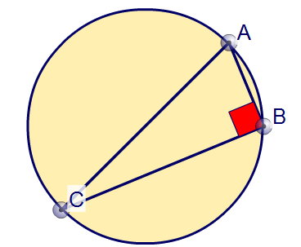
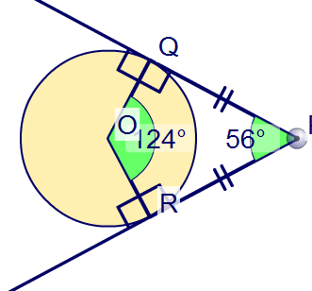
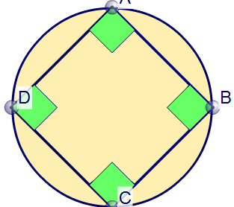
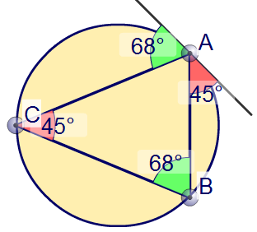
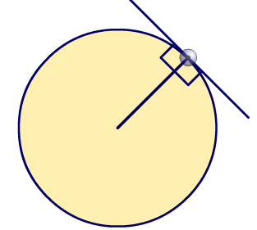
Match the theorems with the diagrams
C
4
F
7
1) Angle at the circumference in a semicircle is 90.
A
1
2) Opposite angles of a cyclic quadrilateral add up to 180.
3) Angles at the circumference from the same chord are equal
D
8
G
2
4) Angle at the centre is twice the angle at the circumference
5) A tangent will always meet the radius at 90.
B
3
6) Angles in opposite segments are equal
E
6
H
5
7) A perpendicular bisector of a chord is the diameter/radius
8) Tangents are equal when drawn from the same point

Slide 17
Which theorem?
y°
x°
A
Angle between the radius and a tangent at that point is 90°
B
Opposite angles in a cyclic quadrilateral add up to 180°
C
Angle at the centre is twice angle at circumference
D
Angle from chord to any point on circumference is equal

Slide 18
Which theorem?
x°
A
Angle in a semicircle is 90°
B
Opposite angles in a cyclic quadrilateral add up to 180°
C
Angle from chord to any point on circumference is equal
D
Angle between the radius and a tangent at that point is 90°

Slide 19
Which theorem?
x°
A
Angle at the centre is twice angle at circumference
B
Angle in a semicircle is 90°
C
Angle between the radius and a tangent at that point is 90°
Angle from chord to any point on circumference is equal

Slide 20
Which theorem?
y°
x°
A
Opposite angles in a cyclic quadrilateral add up to 180°
B
Angle at the centre is twice angle at circumference
C
Angle from chord to any point on circumference is equal
D
Angle in a semicircle is 90°

Slide 21
y°
Which theorem?
x°
A
Angle at the centre is twice angle at circumference
B
Angle from chord to any point on circumference is equal
C
Opposite angles in a cyclic quadrilateral add up to 180°
D
Angle between the radius and a tangent at that point is 90°

Slide 22
Which theorem?
x°
y°
A
Angle from chord to any point on circumference is equal
B
Angle between the radius and a tangent at that point is 90°
C
Angle at the centre is twice angle at circumference
D
Angle in a semicircle is 90°

Slide 23
Which theorem?
x°
A
Angle from chord to any point on circumference is equal
B
Angle between the radius and a tangent at that point is 90°
C
Angle in a semicircle is 90°
D
Opposite angles in a cyclic quadrilateral add up to 180°

Slide 24
Which theorem?
y°
x°
A
Angle between the radius and a tangent at that point is 90°
B
Opposite angles in a cyclic quadrilateral add up to 180°
C
Angle from chord to any point on circumference is equal
D
Angle at the centre is twice angle at circumference

Slide 25
y°
Which theorem?
x°
A
Angle in a semicircle is 90°
B
Angle between the radius and a tangent at that point is 90°
C
Opposite angles in a cyclic quadrilateral add up to 180°
D
Angle from chord to any point on circumference is equal

Slide 26
Which theorem?
x°
y°
A
Opposite angles in a cyclic quadrilateral add up to 180°
B
Angle from chord to any point on circumference is equal
C
Angle between the radius and a tangent at that point is 90°
D
Angle at the centre is twice angle at circumference

Slide 27
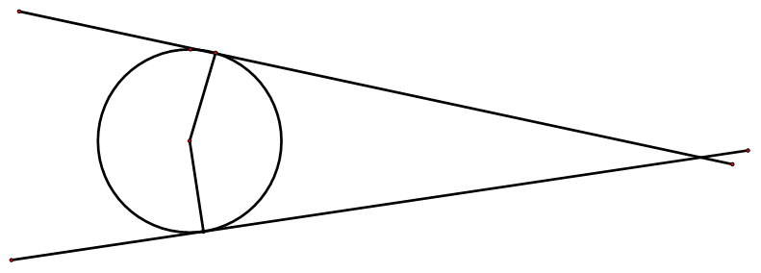
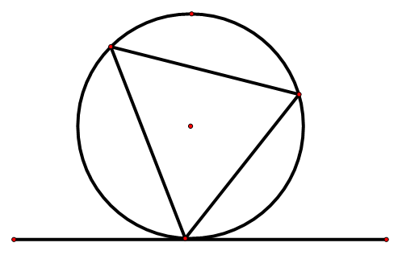
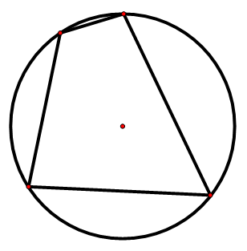
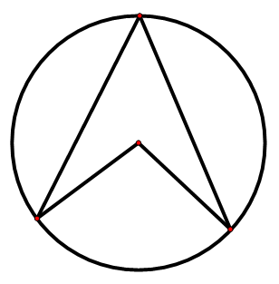
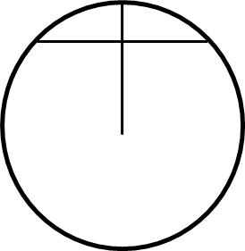
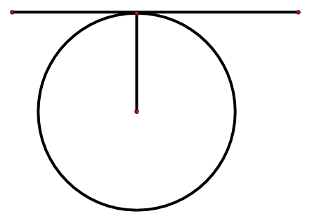
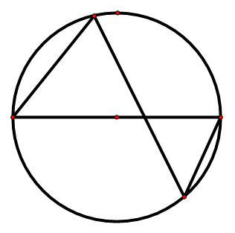
How many circle theorems you name/describe?

Slide 28
How many circle theorems did you get?
Angle at the circumference in a semicircle is 90.
Opposite angles of a cyclic quadrilateral add up to 180.
Angles at the circumference from the same chord are equal
Angle at the centre is twice the angle at the circumference
A tangent will always meet the radius at 90.
Angles in opposite segments are equal
A perpendicular bisector of a chord is the diameter
Tangents are equal when drawn from the same point

Slide 29
How many circle theorems can you draw?

Slide 30
Find the missing angle.
39
A
51
B
141
C
129
D

Slide 31
Find the missing angle.
33
A
57
B
123
C
67
D

Slide 32
Find the missing angle.
105
A
95
B
75
C
55
D

Slide 33
Find the missing angle.
120
A
60
B
240
C
50
D

Slide 34
Find the missing angle.
45
A
130
B
85
C
50
D

Slide 35
Find the missing angle.
65
A
130
B
115
C
230
D

Slide 36
Find the missing angle.
Not enough information
A
30
B
120
C
60
D

Slide 37
Find the missing angle.
188
A
94
B
86
C
96
D

Slide 38
How many circle theorems can you draw?
A
B
C
D
E
F
G
H

