Slide 1

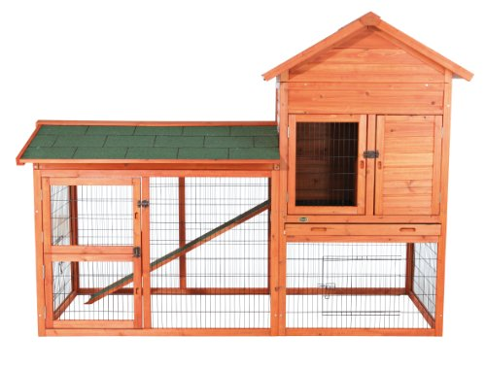

Rabbit Hutch Investigation
Find a home for Floppy and Jasmine.
REQUIREMENTS:
1) The hutch must be at least 120m³ but not bigger than 160m³
2) You also need to buy sawdust, a food bowl and a water bottle.
3) You can afford to spend up to £105,
but that includes the hutch and the accessories for it.
Identify what hutches are available for you to buy.
List the hutch, the volume and the total cost.

Slide 2
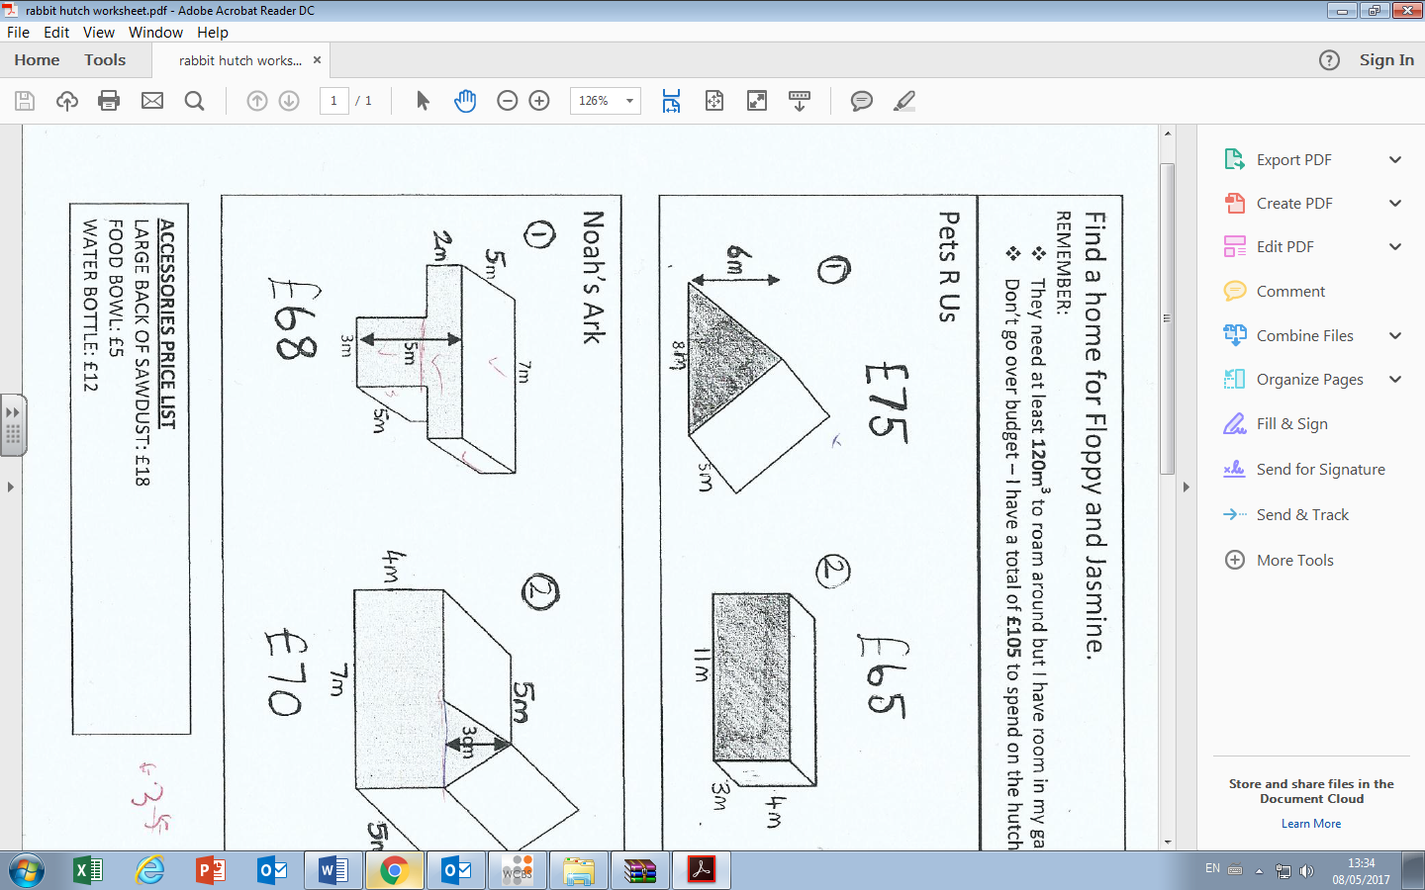
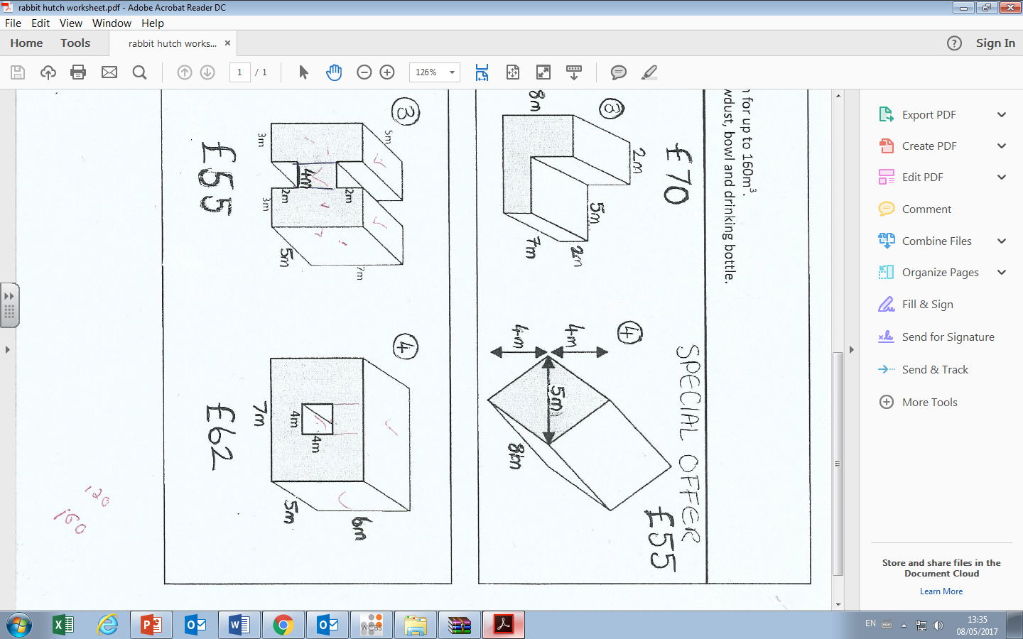
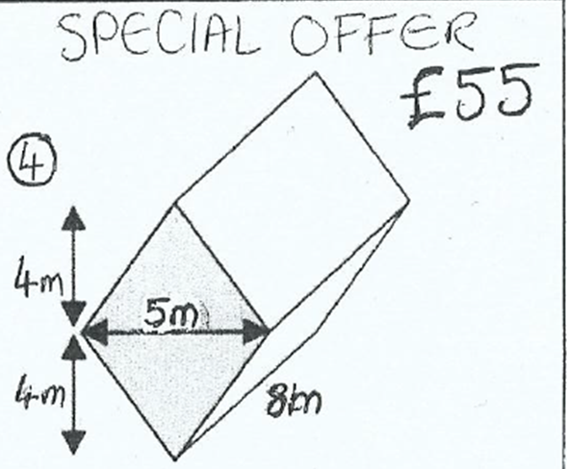
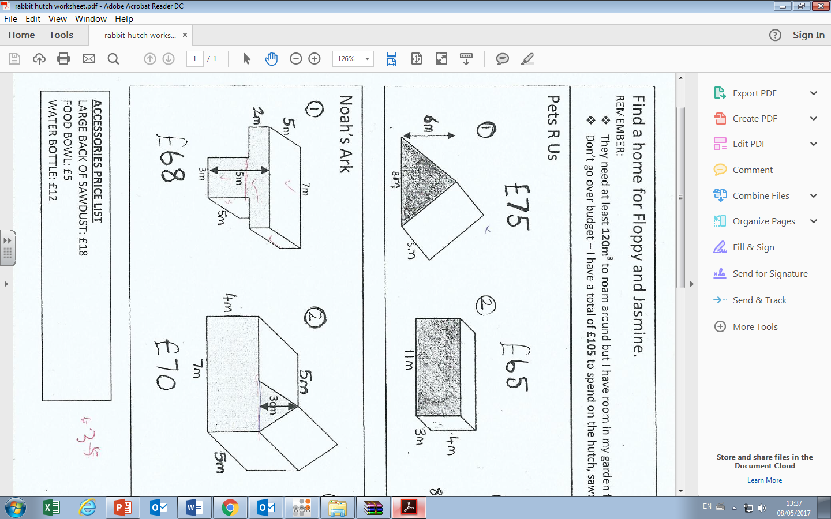

Pets R Us
Large bag sawdust = £18
Food Bowl = £5
Noah’s Ark
Water bottle = £12

Slide 3
ANSWERS

Slide 4
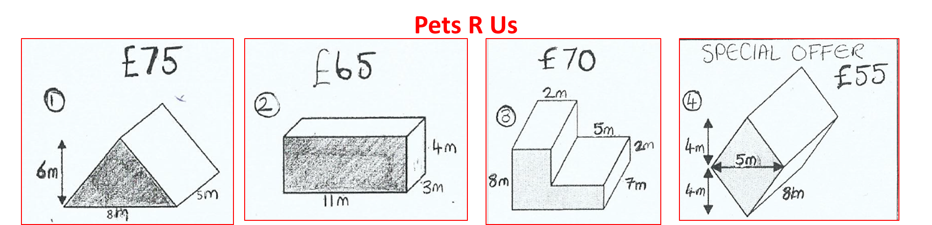
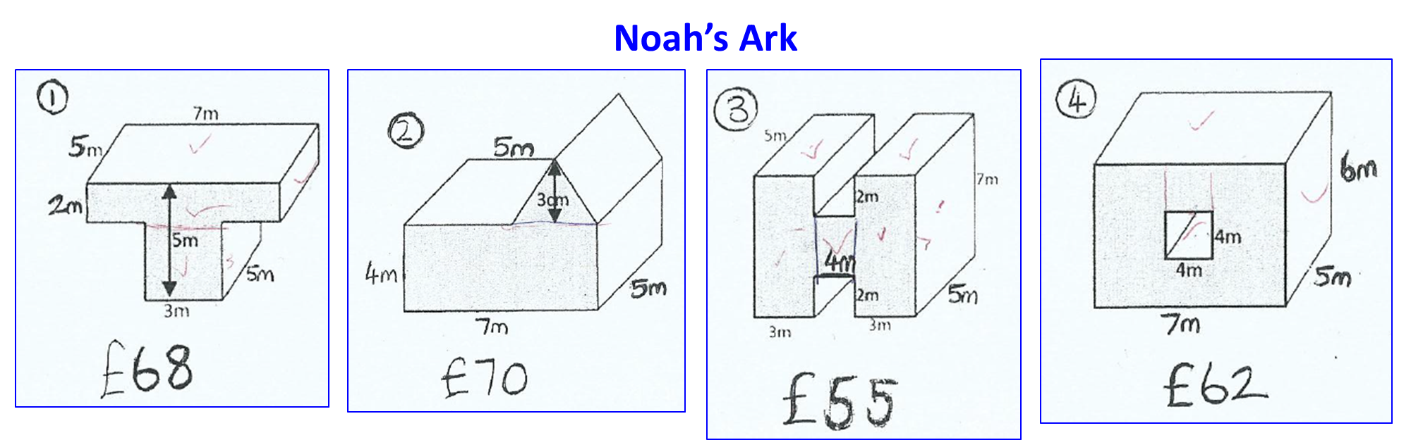
Option | Volume | Cost
1 | 120 | £110
2 | 132 | £100
3 | 182 | £105
4 | 160 | £90
Option | Volume | Cost
1 | 115 | £103
2 | 155 | £105
3 | 270 | £90
4 | 130 | £97
?
?
?
?
?
?
?
?

