Slide 1
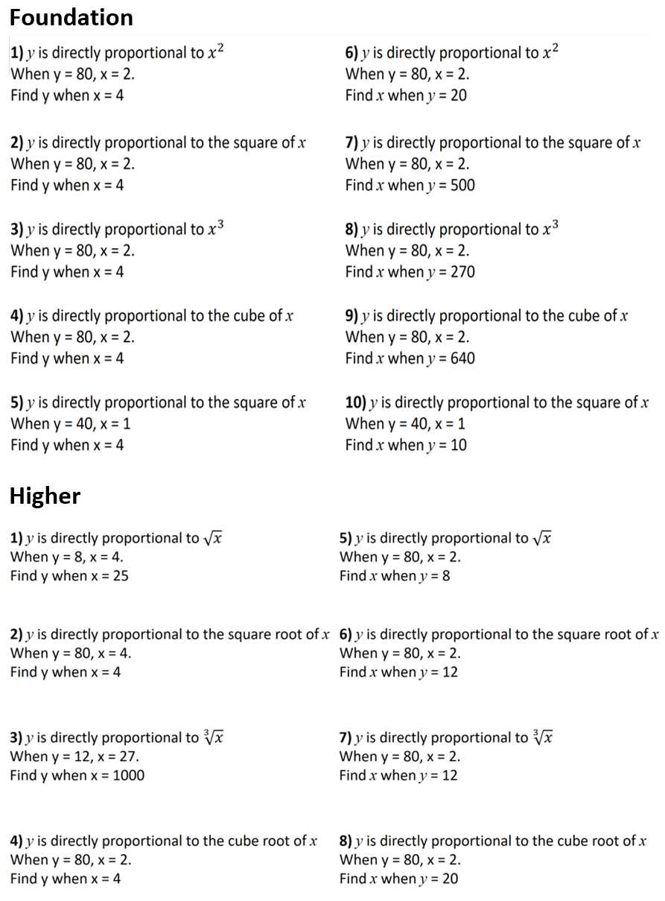

Slide 2
ANSWERS

Slide 3
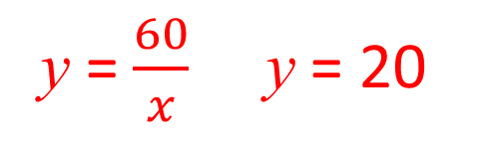
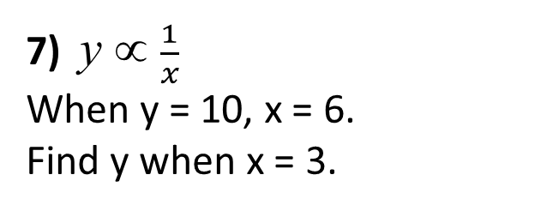
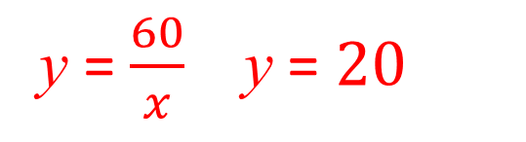
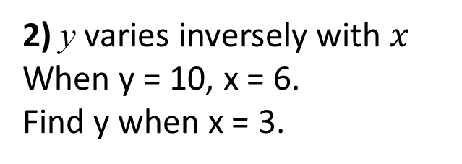
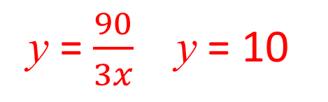
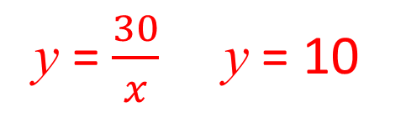
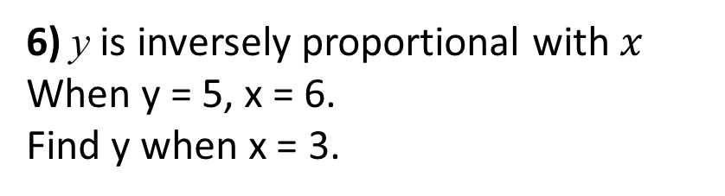

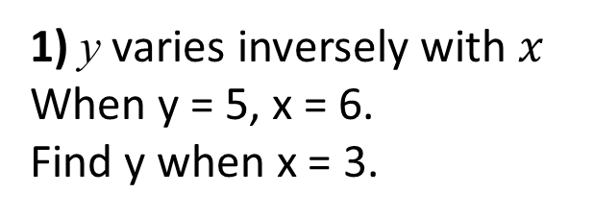
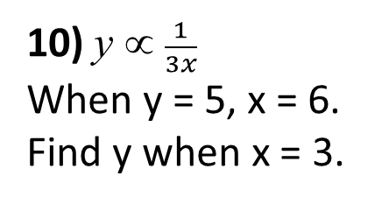
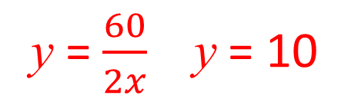
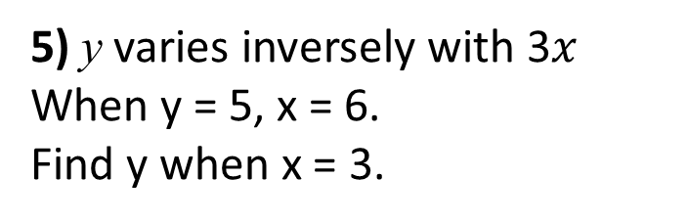
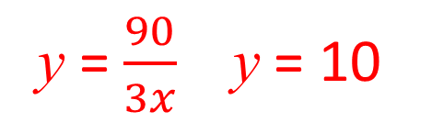
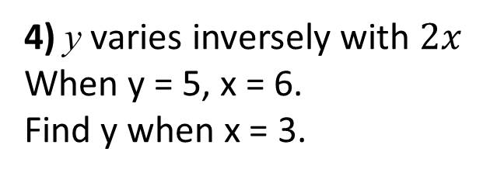
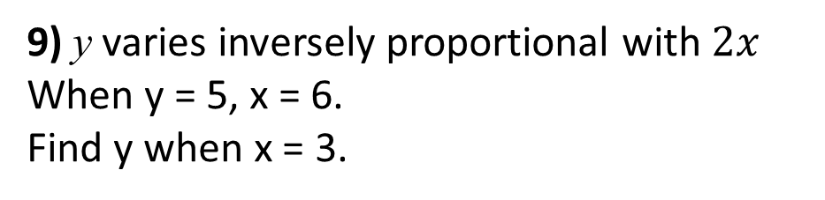
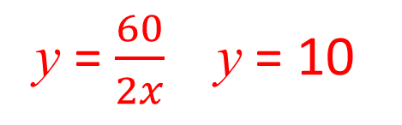
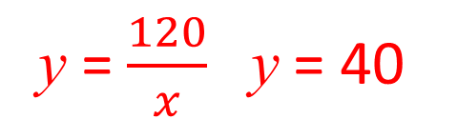
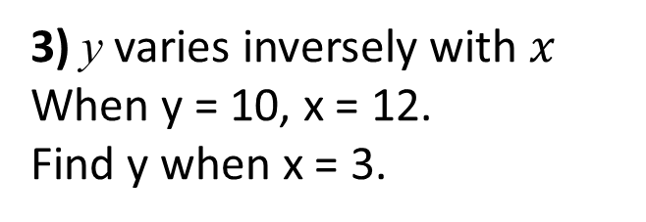
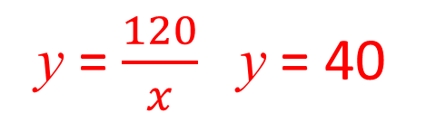
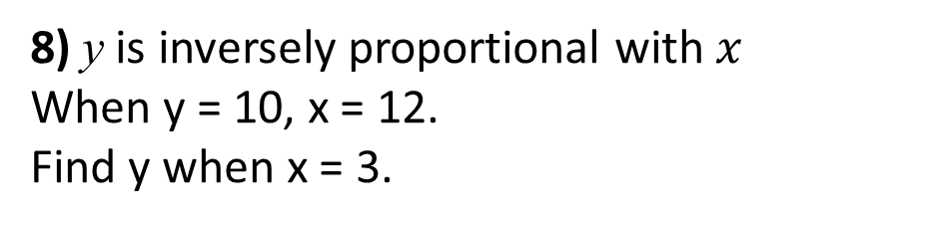
1) y varies inversely with $x$
When y = 5, x = 6.
Find y when x = 3.
6) y is inversely proportional with $x$
When y = 5, x = 6.
Find y when x = 3.
y = $\frac{30}{x}$ y = 10
y = $\frac{30}{x}$ y = 10
2) y varies inversely with $x$
When y = 10, x = 6.
Find y when x = 3.
7) y ∝ $\frac{1}{x}$
When y = 10, x = 6.
Find y when x = 3.
y = $\frac{60}{x}$ y = $20$
y = $\frac{60}{x}$ y = 20
3) y varies inversely with $x$
When y = 10, x = 12.
Find y when x = 3.
8) y is inversely proportional with $x$
When y = 10, x = 12.
Find y when x = 3.
y = $\frac{120}{x}$ y = 40
y = $\frac{120}{x}$ y = 40
4) y varies inversely with $2x$
When y = 5, x = 6.
Find y when x = 3.
9) y varies inversely proportional with $2x$
When y = 5, x = 6.
Find y when x = 3.
y = $\frac{60}{2x}$ y = 10
y = $\frac{60}{2x}$ y = 10
5) y varies inversely with 3$x$
When y = 5, x = 6.
Find y when x = 3.
10) y ∝ $\frac{1}{3x}$
When y = 5, x = 6.
Find y when x = 3.
y = $\frac{90}{3x}$ y = 10
y = $\frac{90}{3x}$ y = 10

Slide 4
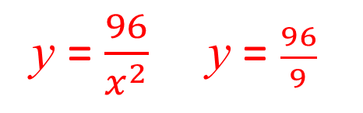
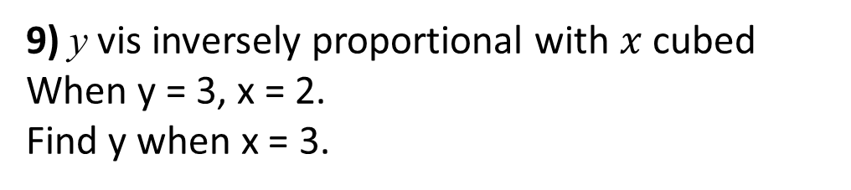
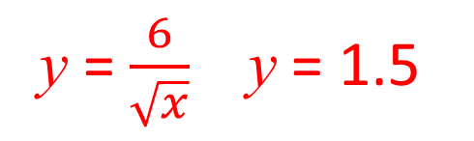
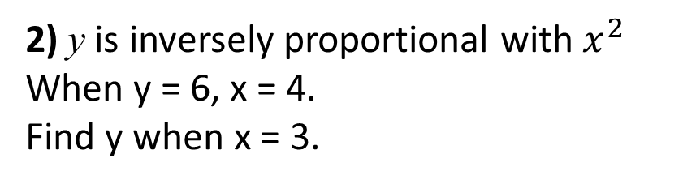
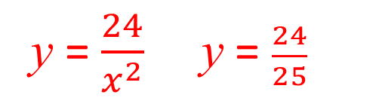
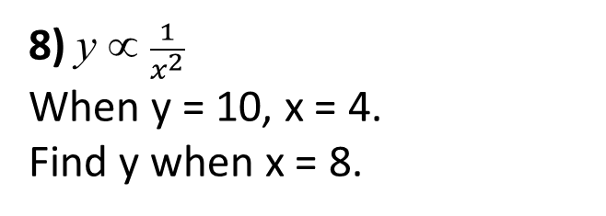
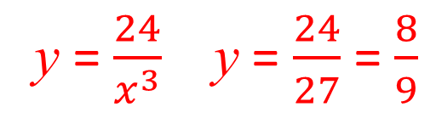
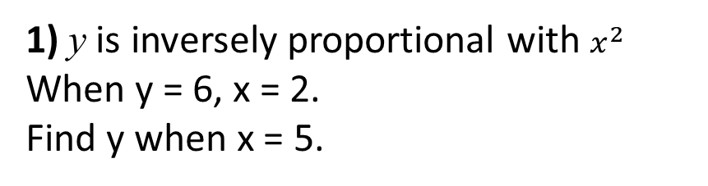
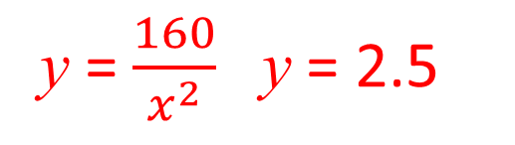
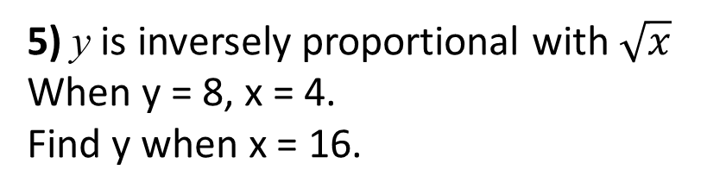
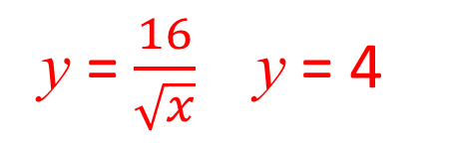
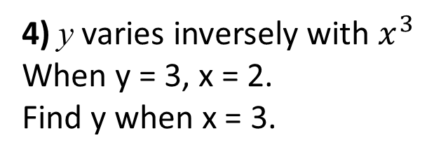
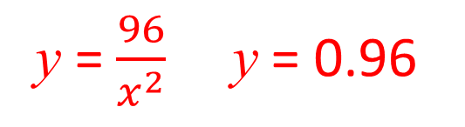
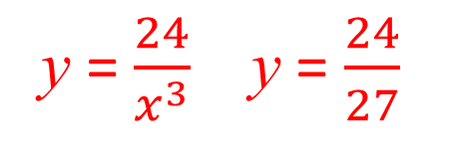
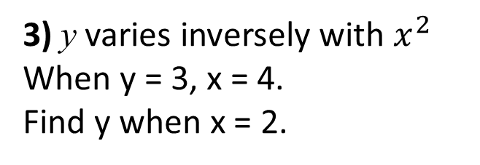
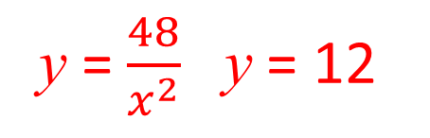
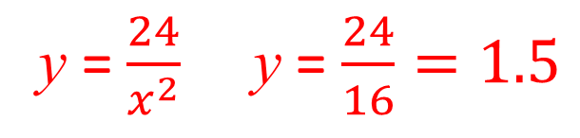
1) y is inversely proportional with $x^{2}$
When y = 6, x = 2.
Find y when x = 5.
6) y varies inversely with the square of x
When y = 6, x = 2.
Find y when x = 4.
y = $\frac{24}{x^{2}}$ y = $\frac{24}{25}$
y = $\frac{24}{x^{2}}$ y = $\frac{24}{16}=1.5$
2) y is inversely proportional with $x^{2}$
When y = 6, x = 4.
Find y when x = 3.
7) y is inversely proportional with the square of x
When y = 6, x = 4.
Find y when x = 10.
y = $\frac{96}{x^{2}}$ y = $\frac{96}{9}$
y = $\frac{96}{x^{2}}$ y = 0.96
3) y varies inversely with $x^{2}$
When y = 3, x = 4.
Find y when x = 2.
8) y ∝ $\frac{1}{x^{2}}$
When y = 10, x = 4.
Find y when x = 8.
y = $\frac{160}{x^{2}}$ y = 2.5
y = $\frac{48}{x^{2}}$ y = 12
4) y varies inversely with $x^{3}$
When y = 3, x = 2.
Find y when x = 3.
9) y vis inversely proportional with $x$ cubed
When y = 3, x = 2.
Find y when x = 3.
y = $\frac{24}{x^{3}}$ y = $\frac{24}{27}$
y = $\frac{24}{x^{3}}$ y = $\frac{24}{27}$ = $\frac{8}{9}$
5) y is inversely proportional with $\sqrt{x}$
When y = 8, x = 4.
Find y when x = 16.
10) y varies inversely with the square root of x
When y = 3, x = 4.
Find y when x = 16.
y = $\frac{16}{\sqrt{x}}$ y = 4
y = $\frac{6}{\sqrt{x}}$ y = 1.5

