Slide 1
LO: Solving Quadratics
(Quadratic Formula)

Slide 2
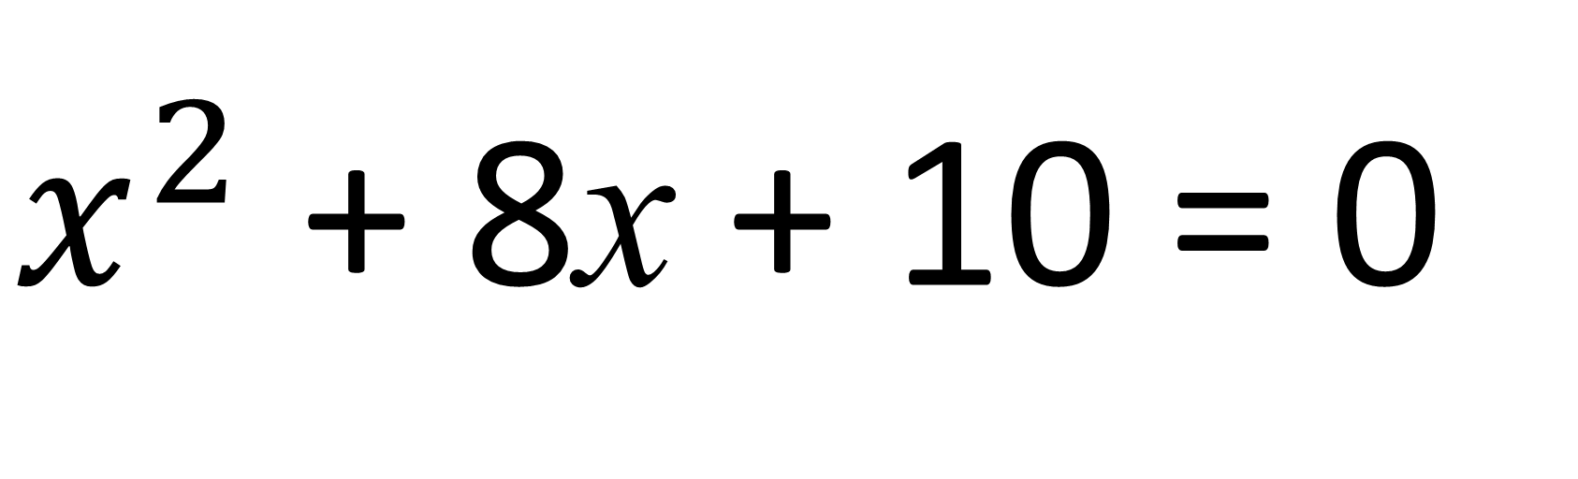
Solve by Factorise
$x^{2}$ + 8x + 10 = 0
You cant!

Slide 3
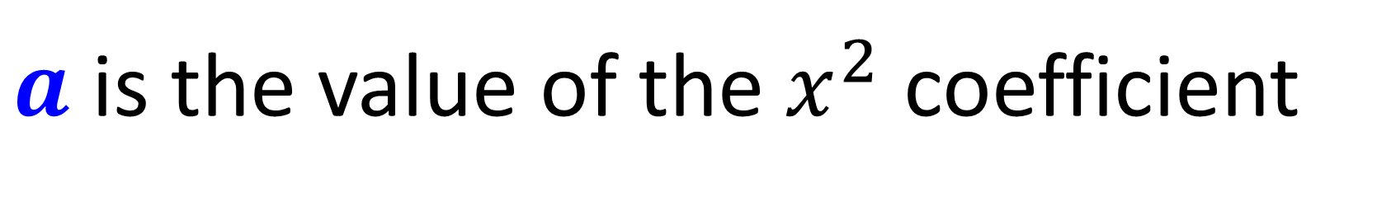
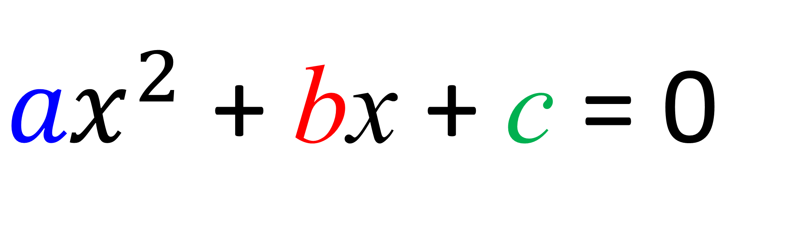


${ax}^{2}$ + bx + c = 0
$a$ is the value of the $x^{2}$ coefficient
$b$ is the value of the $x$ coefficient
$c$ is the value of the $x$ coefficient

Slide 4
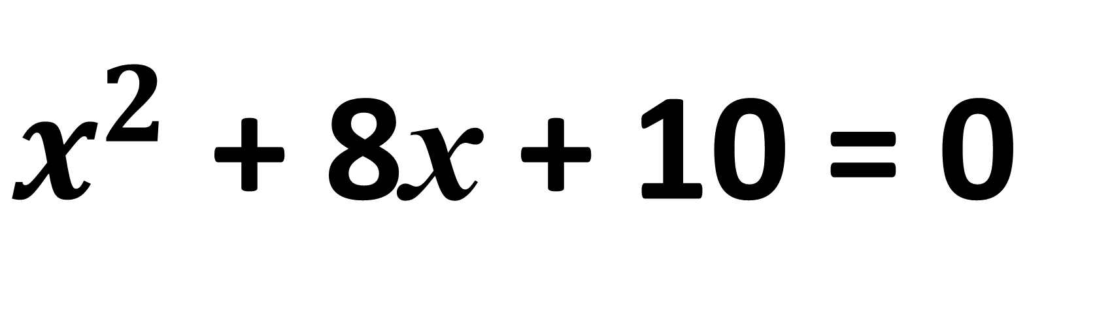
Identify a, b and c
$x^{2}$ + 8x + 10 = 0
a =
b =
c =
1
8
10

Slide 5
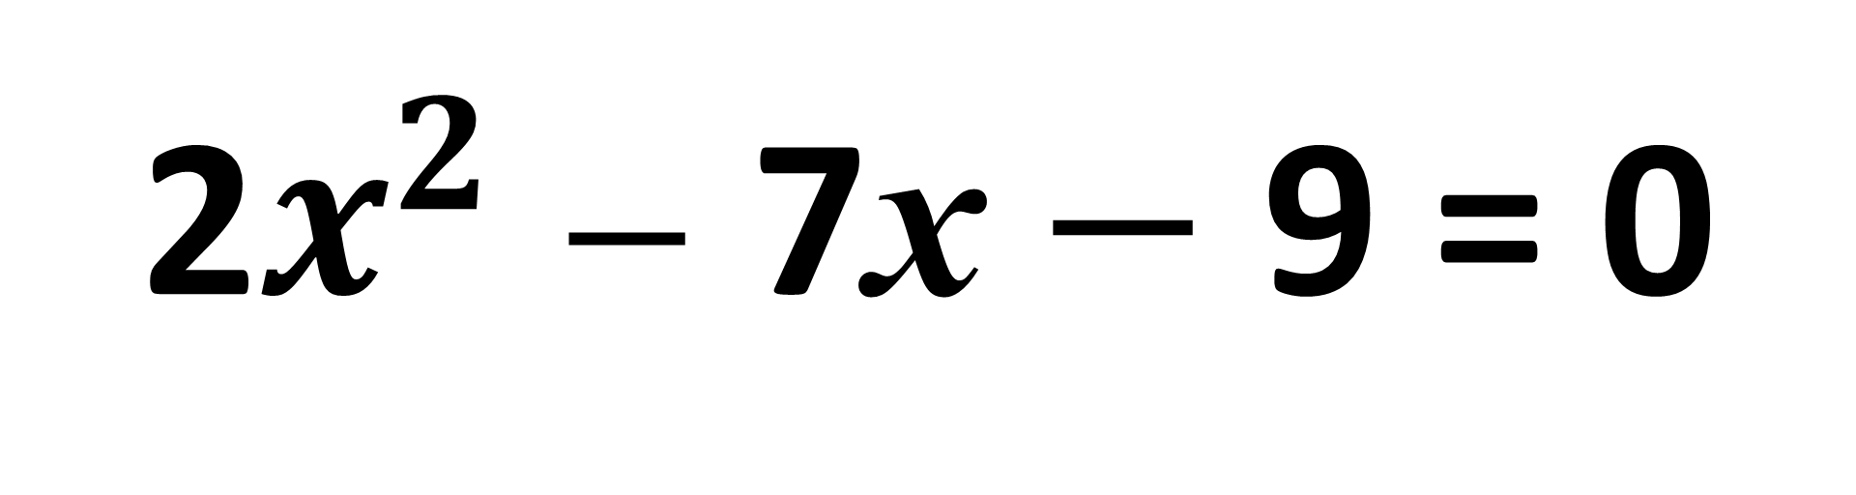
Identify a, b and c
2$x^{2}$ $−$ 7x $−$ 9 = 0
a =
b =
c =
2
-7
-9

Slide 6
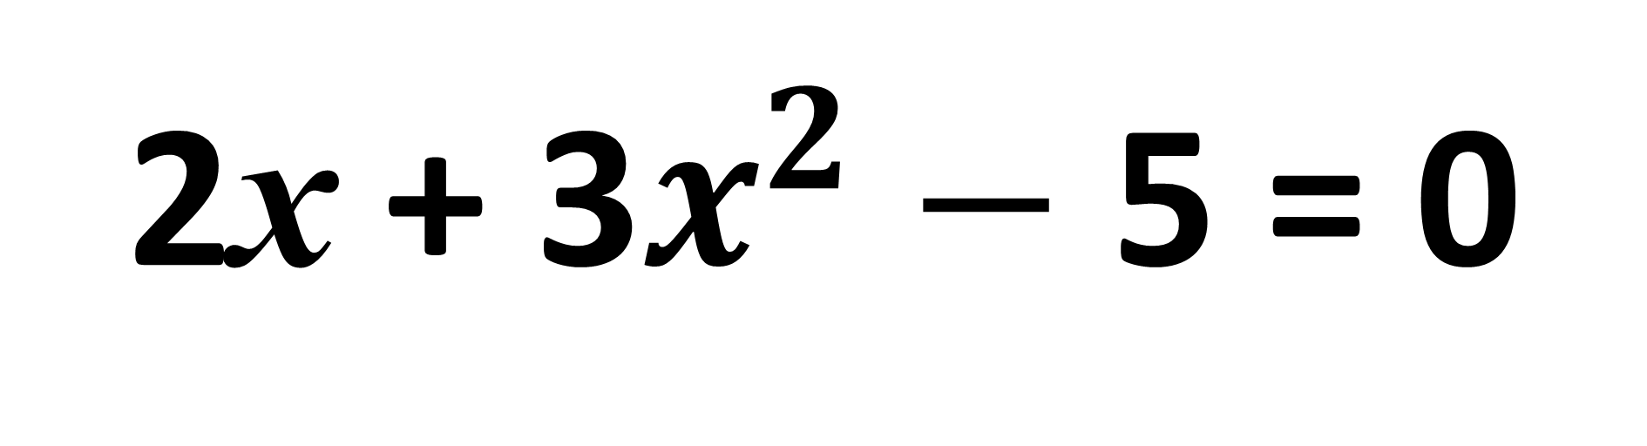
Identify a, b and c
2x + 3$x^{2}$ $−$ 5 = 0
a =
b =
c =
3
2
-5

Slide 7
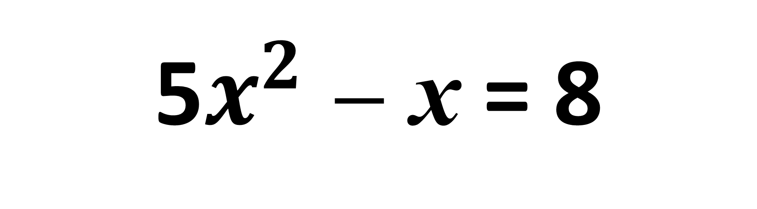
Identify a, b and c
5$x^{2}$ $−$ x = 8
a =
b =
c =
5
-1
-8

Slide 8
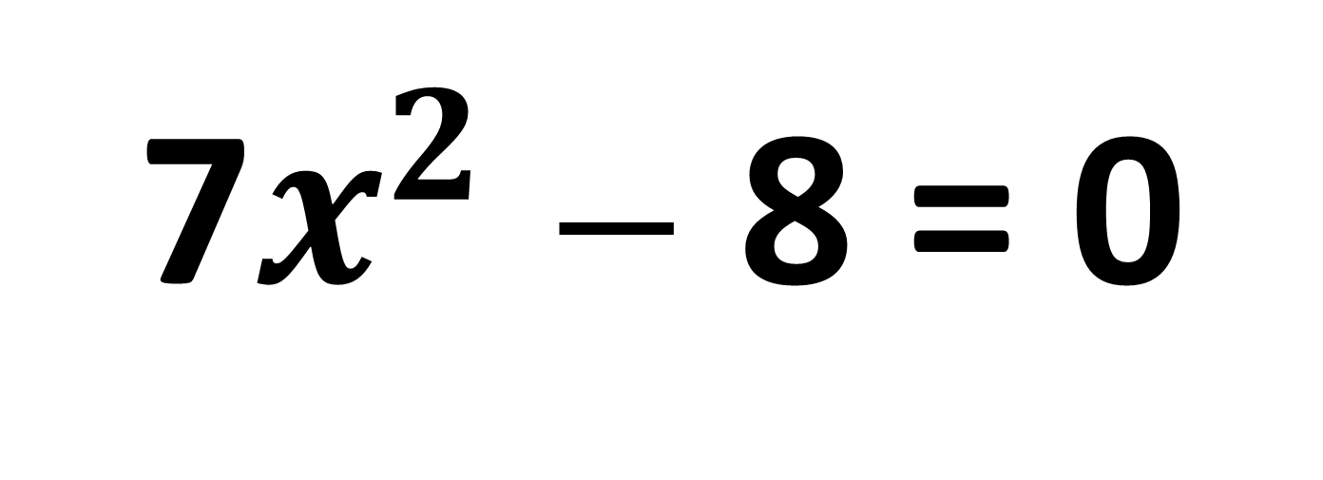
Identify a, b and c
7$x^{2}$ $−$ 8 = 0
a =
b =
c =
7
0
-8

Slide 9
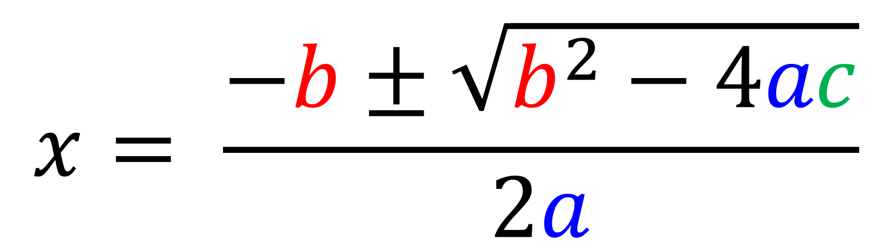
When you cant factorise,
you need the quadratic formula.
$$x= \frac{−b±\sqrt{b^{2}−4ac}}{2a}$$

Slide 10
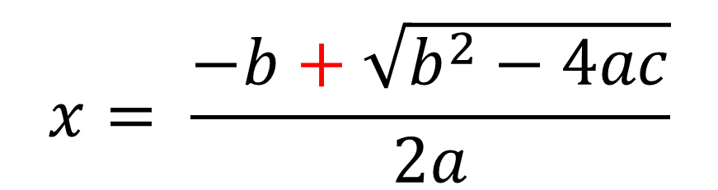


The quadratic formula produces 2 solutions.
$$x= \frac{−b±\sqrt{b^{2}−4ac}}{2a}$$
$$x= \frac{−b+\sqrt{b^{2}−4ac}}{2a}$$
$$x= \frac{−b−\sqrt{b^{2}−4ac}}{2a}$$
OR

Slide 11
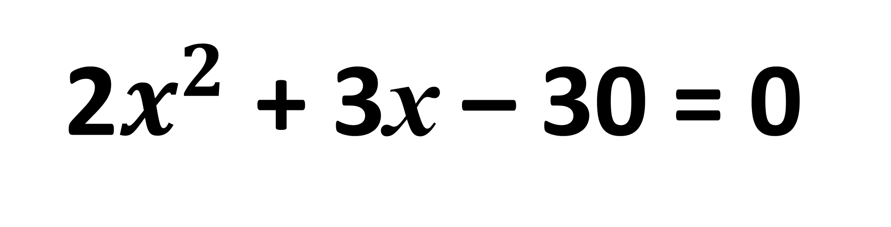
2$x^{2}$ + 3x – 30 = 0
3
2
– ±√ ²– 4x x
3
-30
x =
2
2 x
x = 3.2 or x = -4.7
Notes:
Tell pupils that they are not required to learn this formula since it is given in the examination.
It is a complex formula, however, and so stress that some practice is needed to use it correctly.
Ask pupils if they can see how this formula will lead to two solutions.
More able pupils could be asked to complete the square for the general quadratic equation to derive the formula.

Slide 12
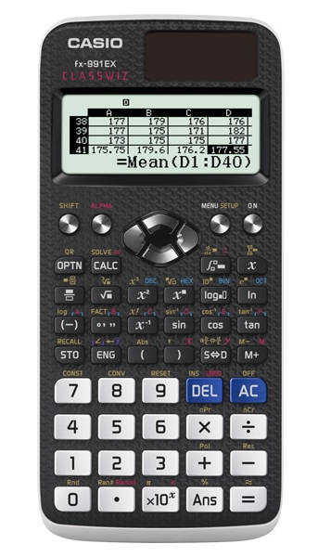
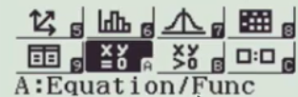
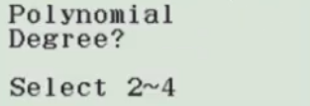

Using classwiz and the quadratic formula.
Step 1: Menu
Step 2:
Step 3:
2
Step 4:
Enter a, b and c
=
Step 5:

Slide 13
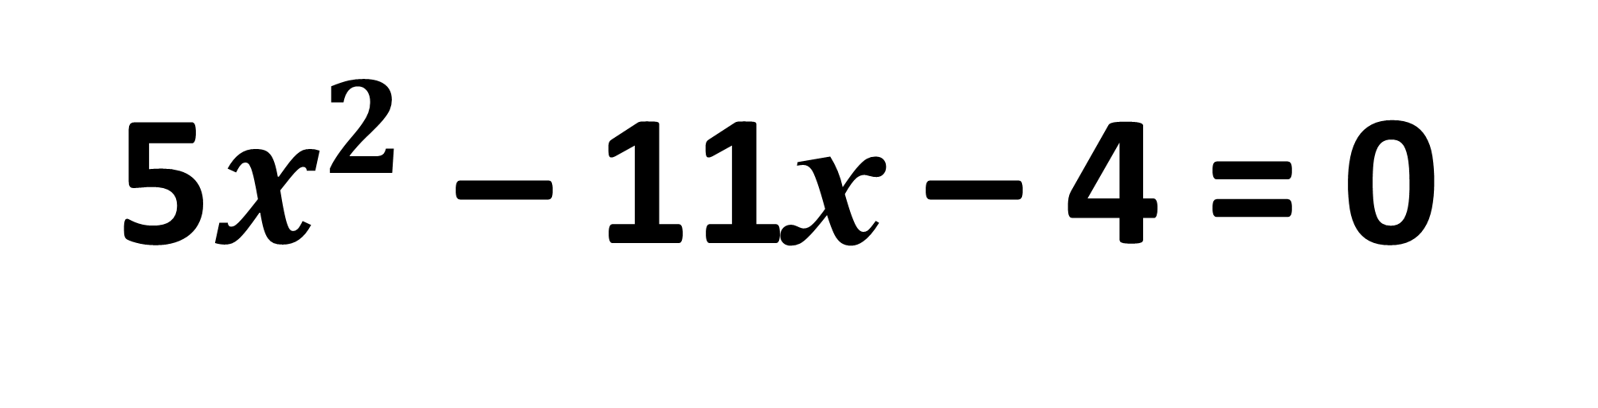
5$x^{2}$ – 11x – 4 = 0
– ±√ ²– 4x x
5
-4
x =
-11
(-11)
2 x
5
x = 2.52 or x = -0.32 (2dp)
Notes:
Tell pupils that they are not required to learn this formula since it is given in the examination.
It is a complex formula, however, and so stress that some practice is needed to use it correctly.
Ask pupils if they can see how this formula will lead to two solutions.
More able pupils could be asked to complete the square for the general quadratic equation to derive the formula.

Slide 14
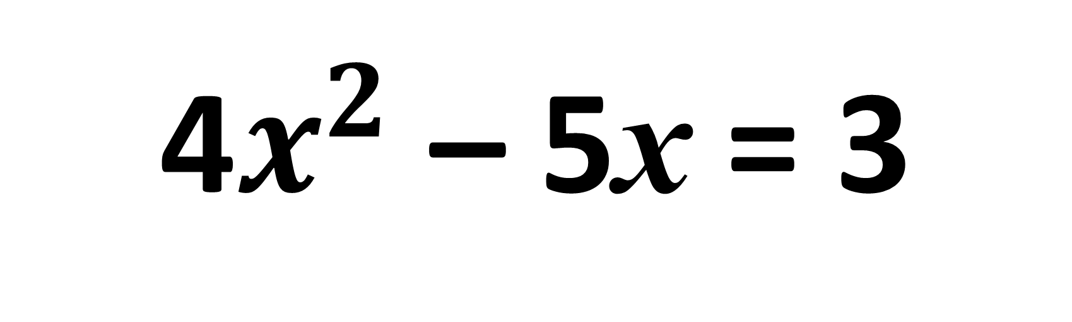
4$x^{2}$ – 5x = 3
– ±√ ²– 4x x
4
-3
x =
-5
(-5)
2 x
4
x = 1.69 or x = -0.44 (2dp)
Notes:
Tell pupils that they are not required to learn this formula since it is given in the examination.
It is a complex formula, however, and so stress that some practice is needed to use it correctly.
Ask pupils if they can see how this formula will lead to two solutions.
More able pupils could be asked to complete the square for the general quadratic equation to derive the formula.

