Slide 1
Further Kinematics
Variable Acceleration
Chapter 8
(Part 3 of 5)

Slide 2
Variable Acceleration
If you have
variable acceleration,
then do not use
suvat formulas.

Slide 3
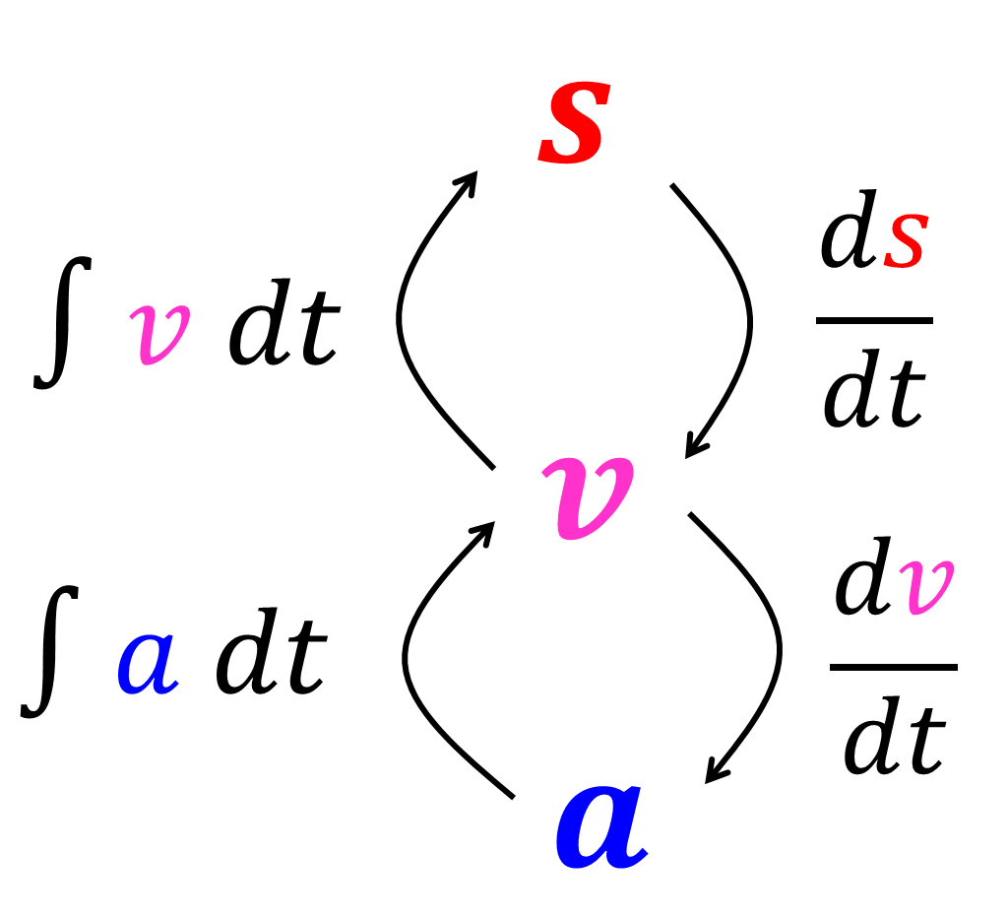

Slide 4
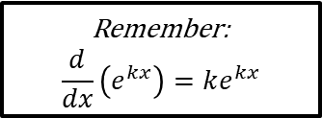
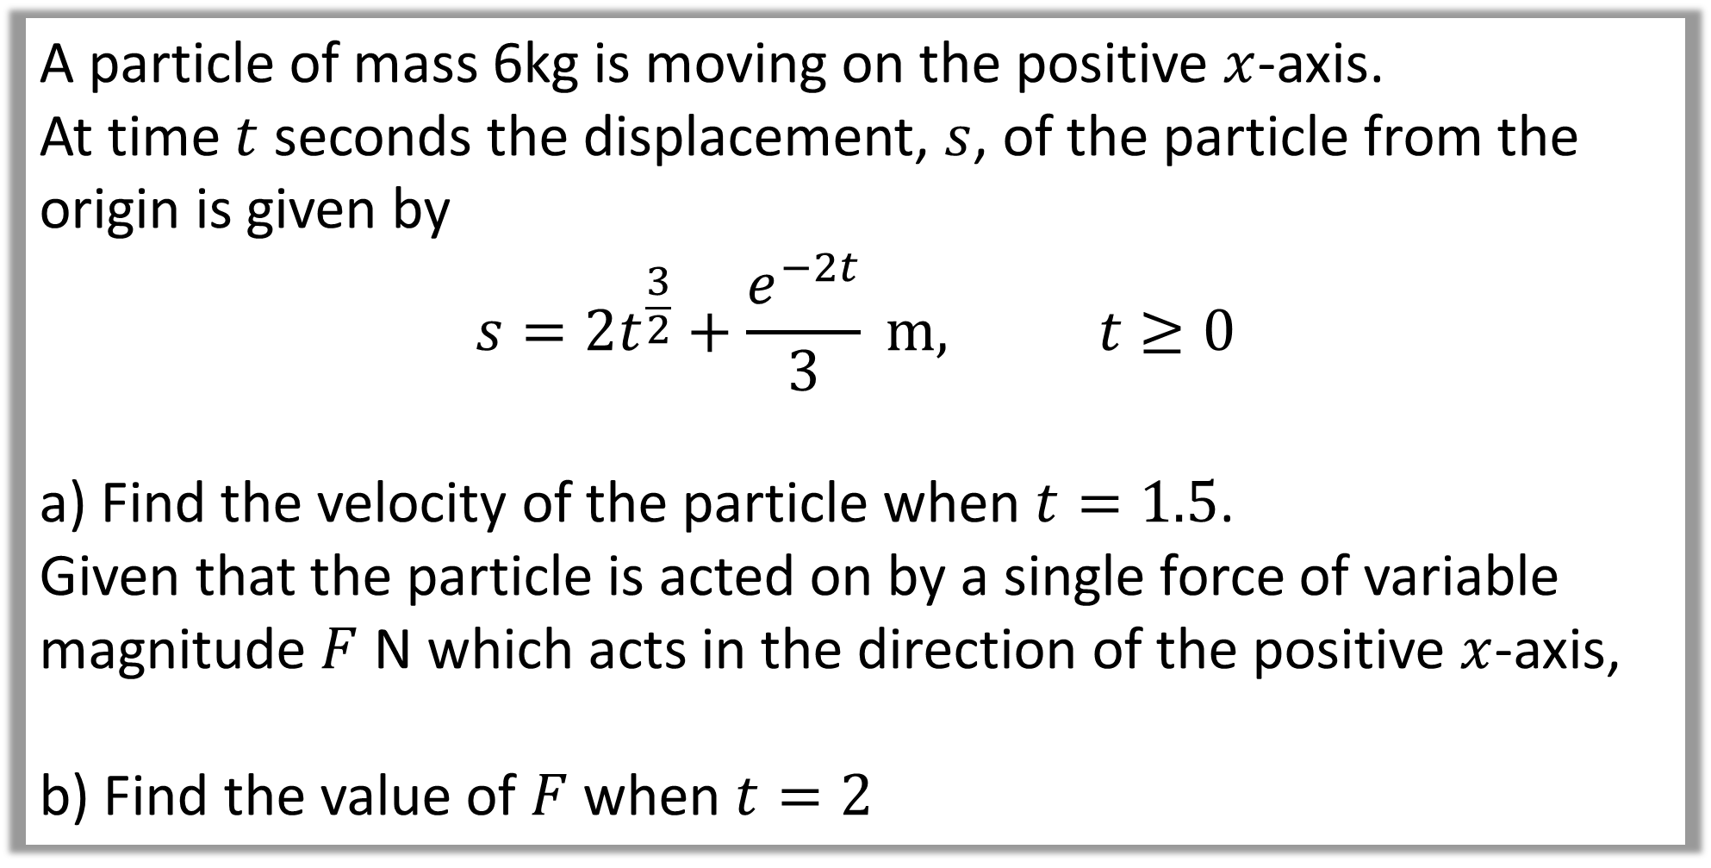
A particle of mass 6kg is moving on the positive $x$-axis.
At time $t$ seconds the displacement, $s$, of the particle from the origin is given by
$$s=2t^{\frac{3}{2}}+\frac{e^{−2t}}{3} m, t≥0$$
a) Find the velocity of the particle when $t=1.5$.
Given that the particle is acted on by a single force of variable magnitude $F$ N which acts in the direction of the positive $x$-axis,
b) Find the value of $F$ when $t=2$
Remember:
$$\frac{d}{dx}\left(e^{kx}\right)=ke^{kx}$$

Slide 5
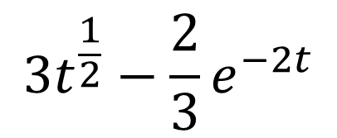
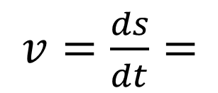

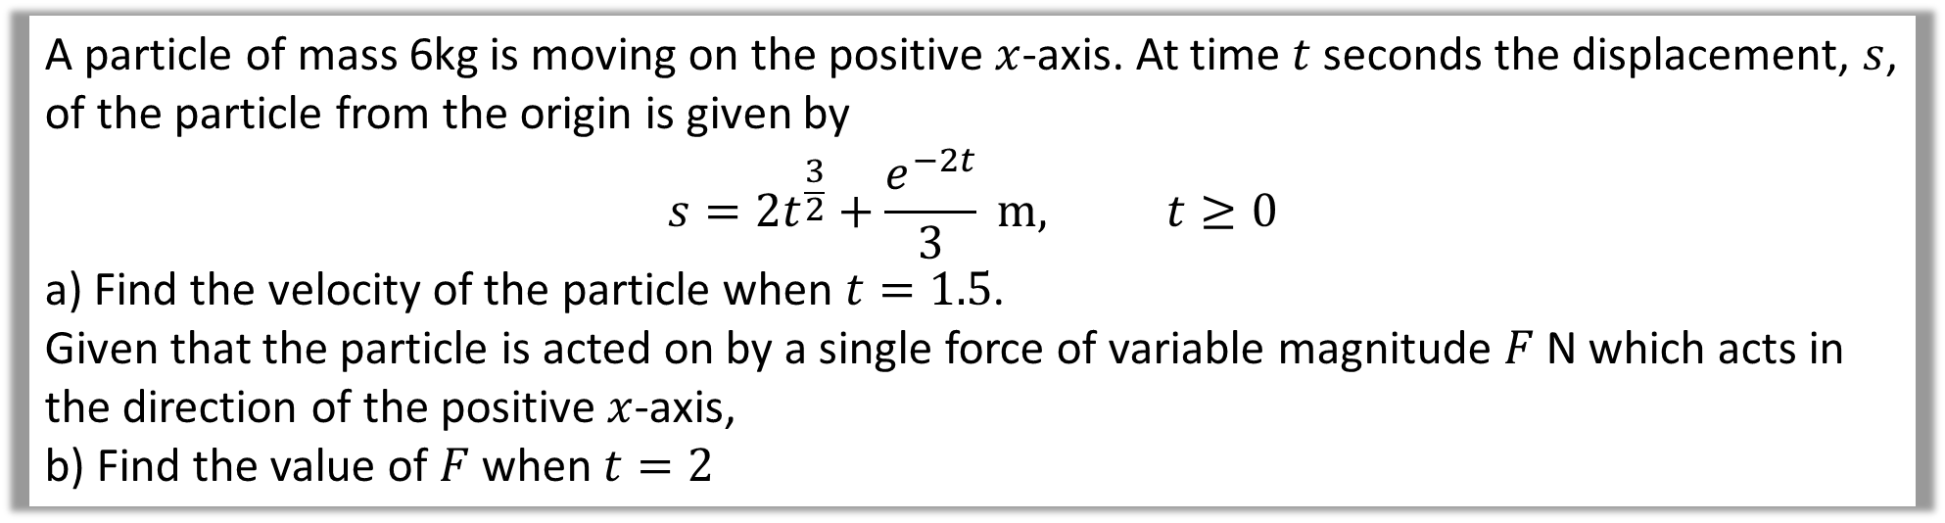
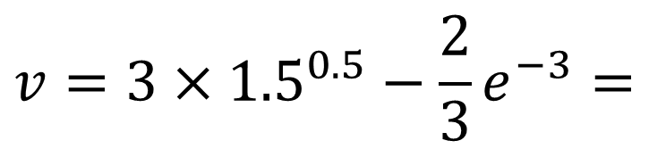

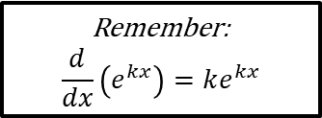
A particle of mass 6kg is moving on the positive $x$-axis. At time $t$ seconds the displacement, $s$, of the particle from the origin is given by
$$s=2t^{\frac{3}{2}}+\frac{e^{−2t}}{3} m, t≥0$$
a) Find the velocity of the particle when $t=1.5$.
Given that the particle is acted on by a single force of variable magnitude $F$ N which acts in the direction of the positive $x$-axis,
b) Find the value of $F$ when $t=2$
$v=\frac{ds}{dt}=$
$$3t^{\frac{1}{2}}−\frac{2}{3}e^{−2t}$$
a
Remember:
$$\frac{d}{dx}\left(e^{kx}\right)=ke^{kx}$$
When $t=1.5$ seconds
$$v=3×{1.5}^{0.5}−\frac{2}{3}e^{−3}=$$
$$3.64 ms^{−1}$$

Slide 6
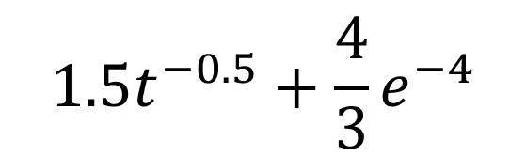
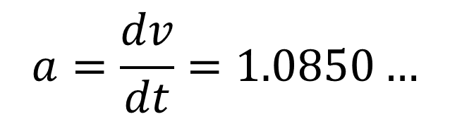
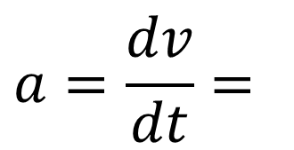



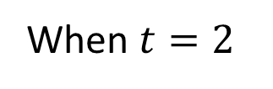
A particle of mass 6kg is moving on the positive $x$-axis. At time $t$ seconds the displacement, $s$, of the particle from the origin is given by
$$s=2t^{\frac{3}{2}}+\frac{e^{−2t}}{3} m, t≥0$$
a) Find the velocity of the particle when $t=1.5$.
Given that the particle is acted on by a single force of variable magnitude $F$ N which acts in the direction of the positive $x$-axis,
b) Find the value of $F$ when $t=2$
b
$$a=\frac{dv}{dt}=$$
$$1.5t^{−0.5}+\frac{4}{3}e^{−4}$$
$$F=ma$$
$$F=6×1.0850…$$
When $t=2$
$$F=6.51 N$$
$$a=\frac{dv}{dt}=1.0850…$$

Slide 7
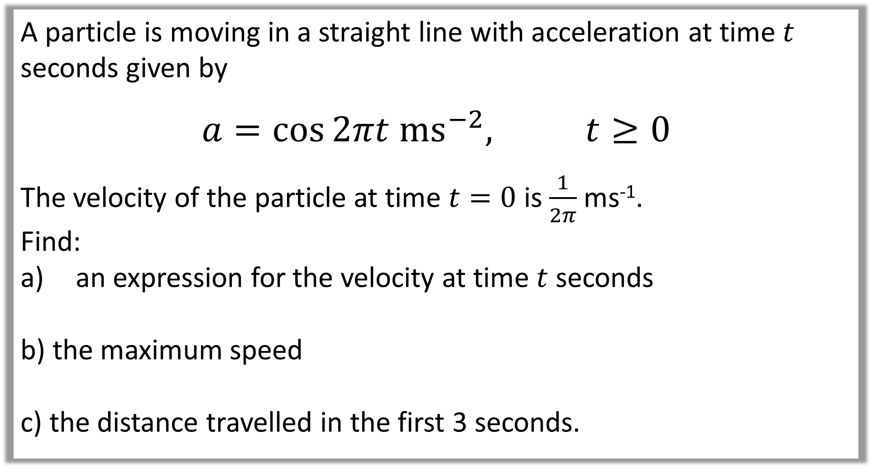
A particle is moving in a straight line with acceleration at time $t$ seconds given by
$$a=\cos{2πt ms^{−2}, t≥0}$$
The velocity of the particle at time $t=0$ is $\frac{1}{2π}$ ms⁻¹.
Find:
an expression for the velocity at time $t$ seconds
b) the maximum speed
c) the distance travelled in the first 3 seconds.

Slide 8
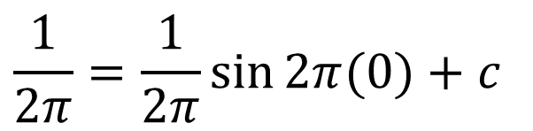
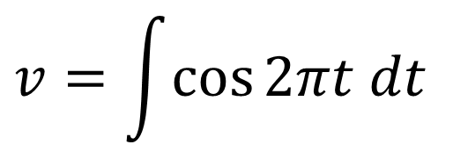
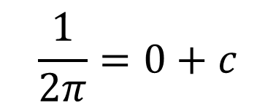
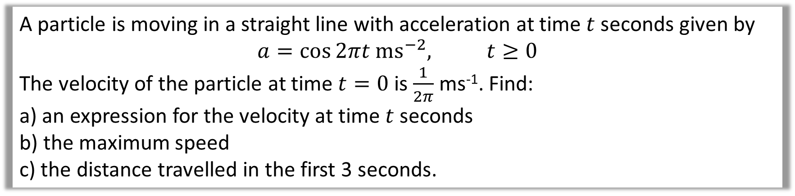
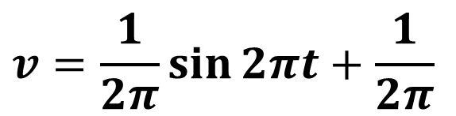
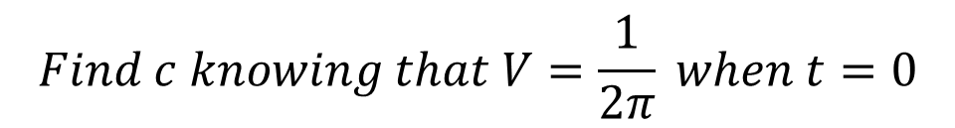
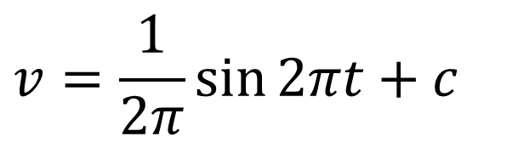
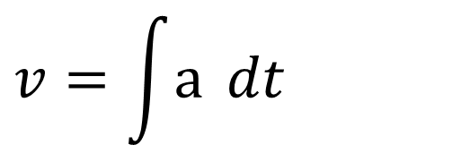
A particle is moving in a straight line with acceleration at time $t$ seconds given by
$$a=\cos{2πt ms^{−2}, t≥0}$$
The velocity of the particle at time $t=0$ is $\frac{1}{2π}$ ms⁻¹. Find:
a) an expression for the velocity at time $t$ seconds
b) the maximum speed
c) the distance travelled in the first 3 seconds.
$$v=\int{a{dt}}$$
$$Find c knowing that V=\frac{1}{2π} when t=0$$
a
$$\frac{1}{2π}=\frac{1}{2π}\sin{2π(0)}+c$$
$$v=\int{\cos{2πt dt}}$$
$$\frac{1}{2π}=0+c$$
$$v=\frac{1}{2π}\sin{2πt}+c$$
$$v=\frac{1}{2π}\sin{2πt}+\frac{1}{2π}$$

Slide 9

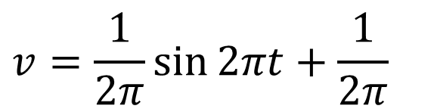
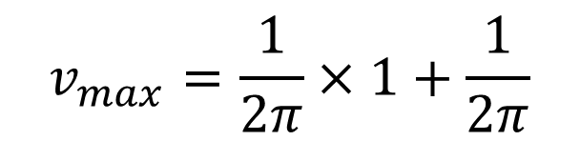
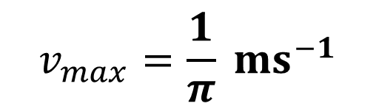
A particle is moving in a straight line with acceleration at time $t$ seconds given by
$$a=\cos{2πt ms^{−2}, t≥0}$$
The velocity of the particle at time $t=0$ is $\frac{1}{2π}$ ms⁻¹. Find:
a) an expression for the velocity at time $t$ seconds
b) the maximum speed
c) the distance travelled in the first 3 seconds.
$$v=\frac{1}{2π}\sin{2πt}+\frac{1}{2π}$$
b
Maximum value of $sin$ is 1, so
$$v_{max}=\frac{1}{2π}×1+\frac{1}{2π}$$
$$v_{max}=\frac{1}{π} ms^{−1}$$

Slide 10
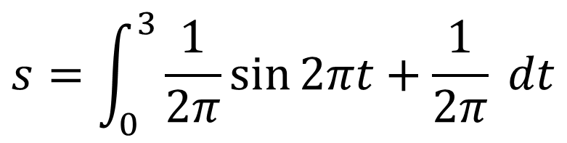

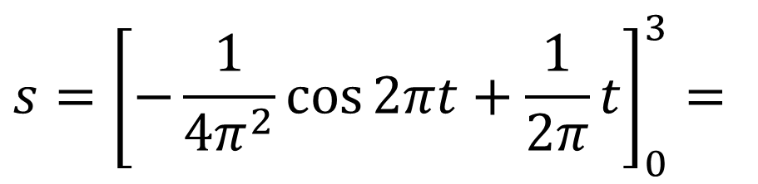
A particle is moving in a straight line with acceleration at time $t$ seconds given by
$$a=\cos{2πt ms^{−2}, t≥0}$$
The velocity of the particle at time $t=0$ is $\frac{1}{2π}$ ms⁻¹. Find:
a) an expression for the velocity at time $t$ seconds
b) the maximum speed
c) the distance travelled in the first 3 seconds.
c
Finding area under velocity-time graph.
$$s=\int_{0}^{3}{\frac{1}{2π}\sin{2πt}+\frac{1}{2π} dt}$$
$$s={\left[−\frac{1}{4π^{2}}\cos{2πt}+\frac{1}{2π}t\right]}_{0}^{3}=$$
$$0.477 m (3sf)$$

