Slide 1
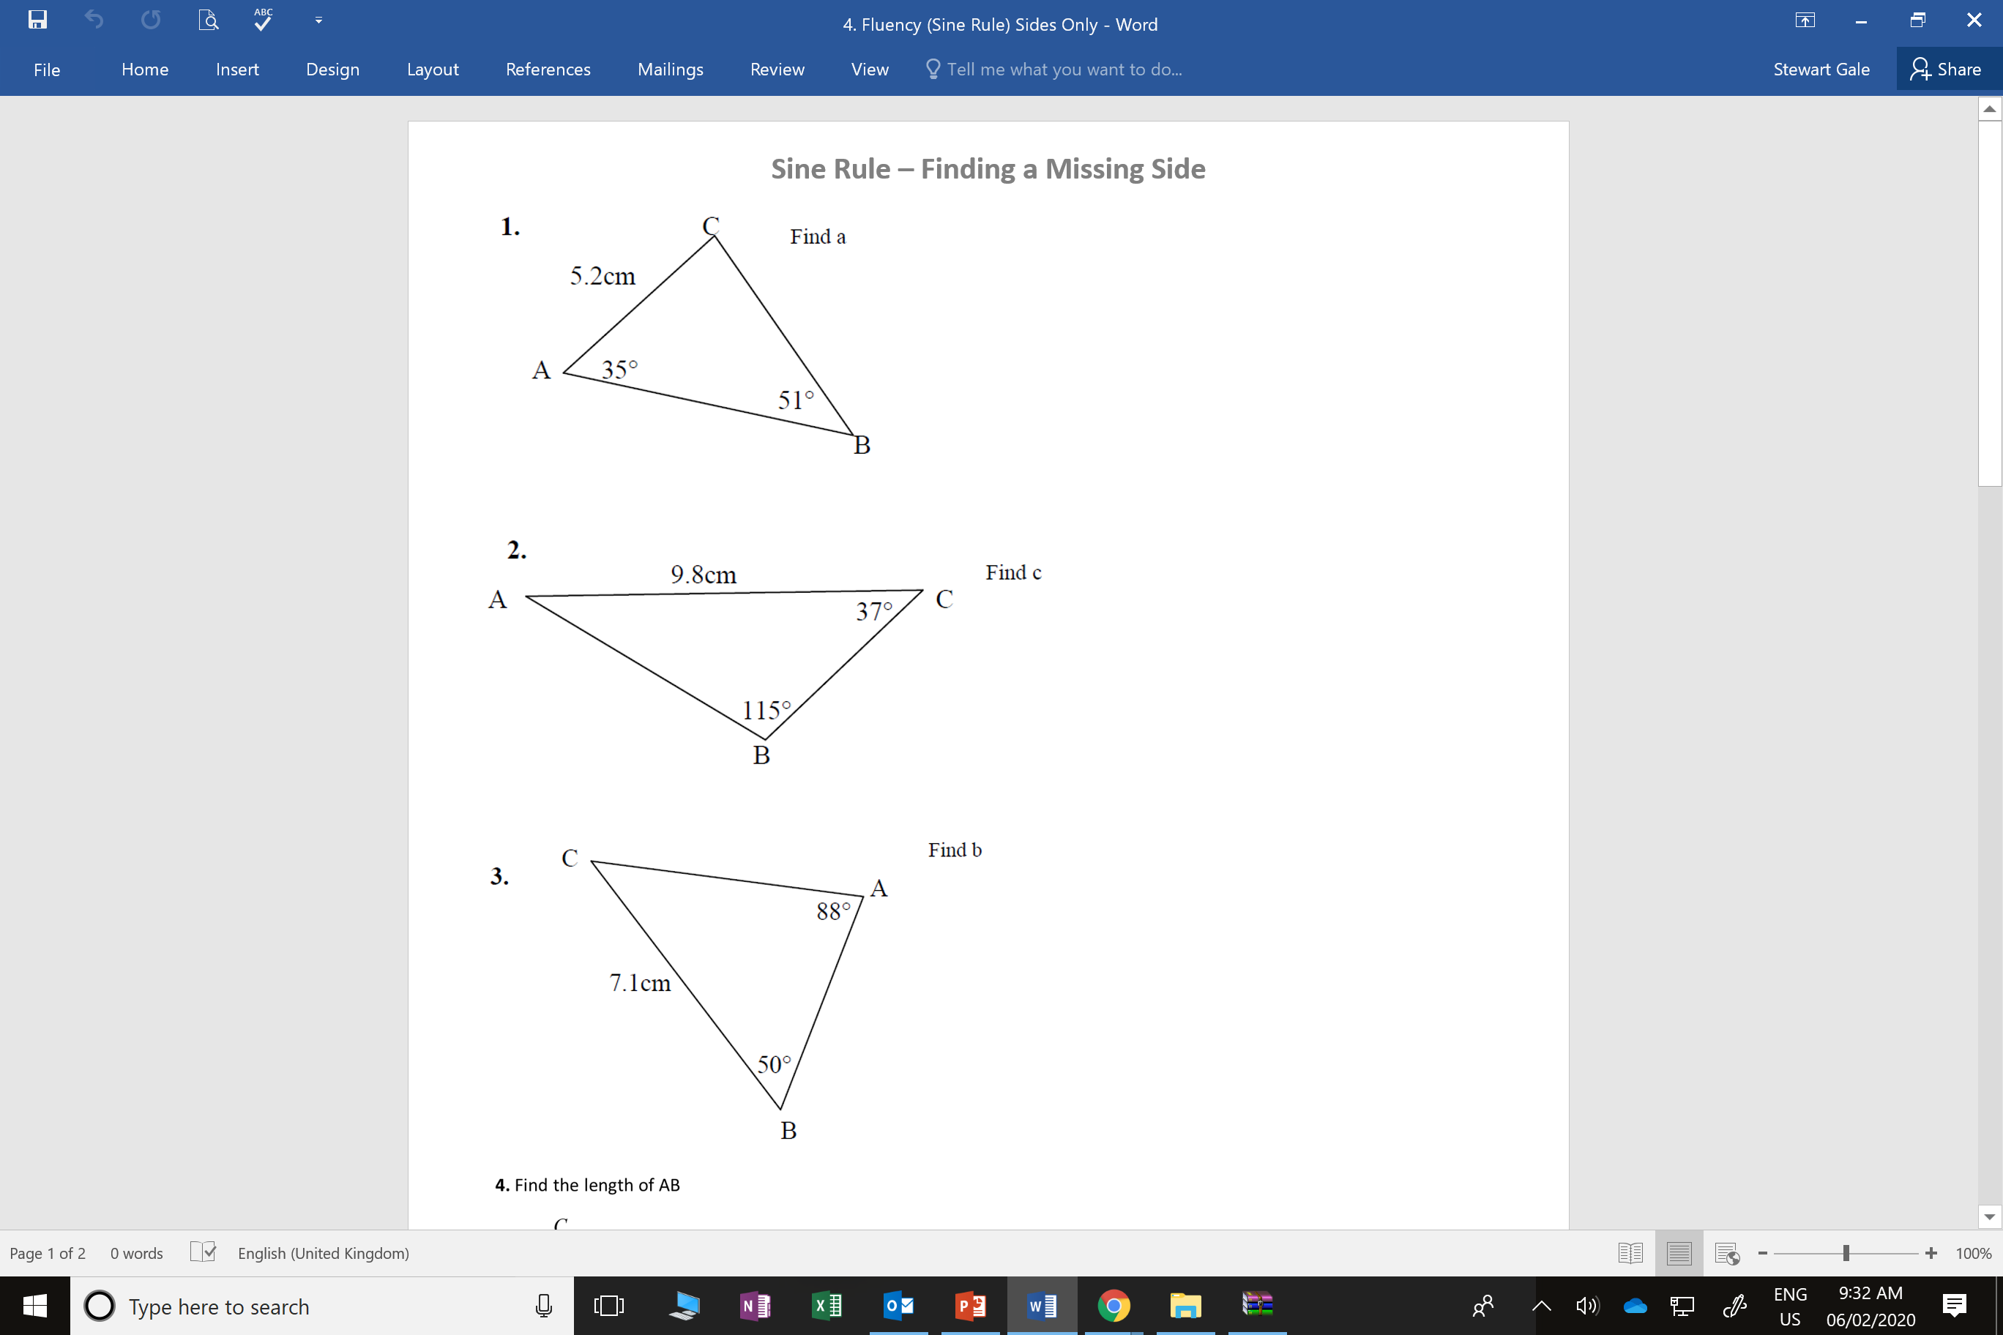
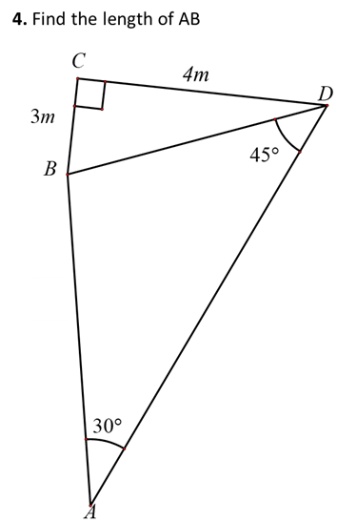
Give your answers to 1 decimal place.

Slide 2
ANSWERS

Slide 3
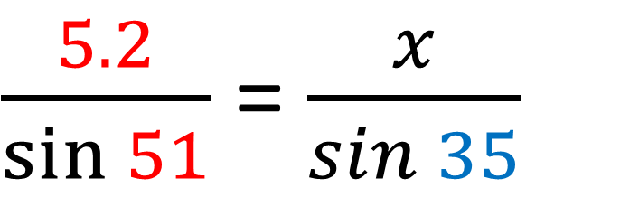
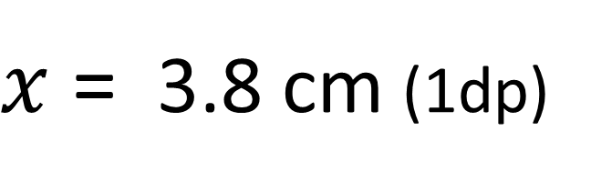
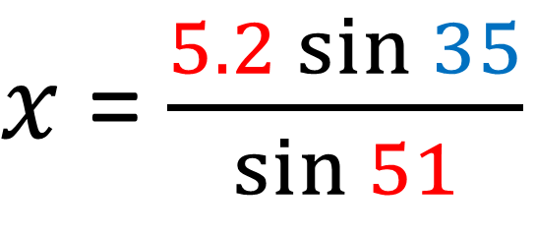
$\frac{5.2}{\sin{51}}$ = $\frac{x}{\sin{35}}$
$x$ = $\frac{5.2\sin{35}}{\sin{51}}$
$x$ = 3.8 cm (1dp)

Slide 4
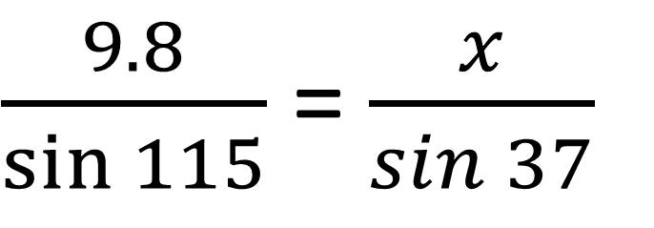
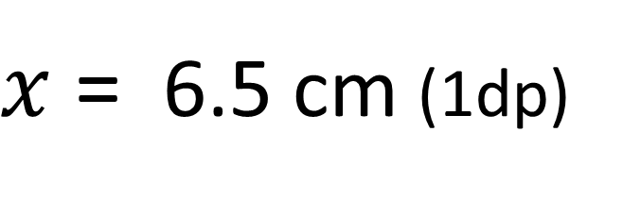
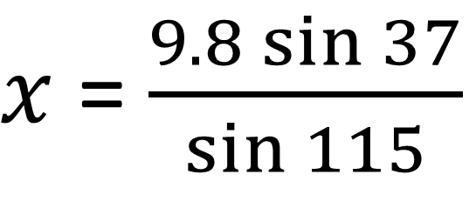
$\frac{9.8}{\sin{115}}$ = $\frac{x}{\sin{37}}$
$x$ = $\frac{9.8\sin{37}}{\sin{115}}$
$x$ = 6.5 cm (1dp)

Slide 5
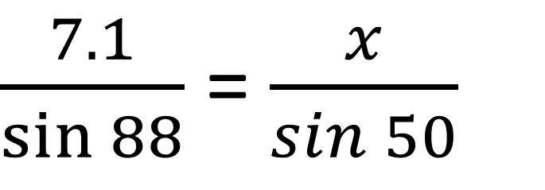
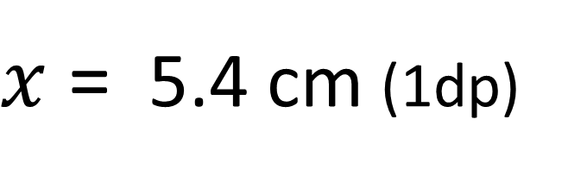
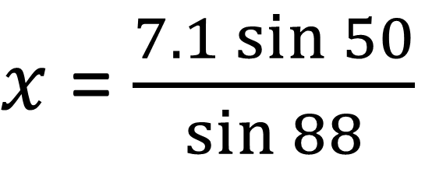
$\frac{7.1}{\sin{88}}$ = $\frac{x}{\sin{50}}$
$x$ = $\frac{7.1\sin{50}}{\sin{88}}$
$x$ = 5.4 cm (1dp)

Slide 6
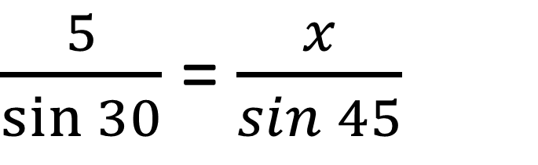
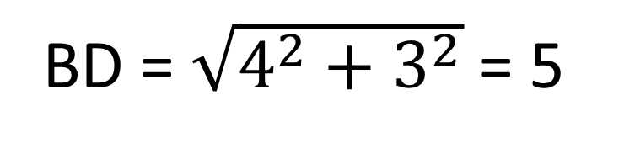
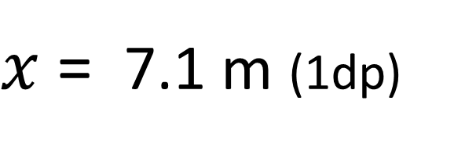
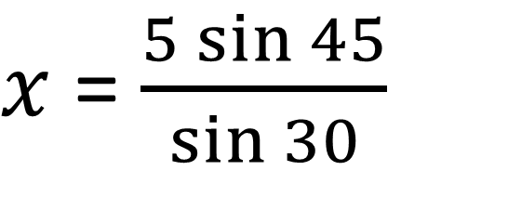
BD = $\sqrt{4^{2}+3^{2}}$ = 5
$\frac{5}{\sin{30}}$ = $\frac{x}{\sin{45}}$
$x$ = $\frac{5\sin{45}}{\sin{30}}$
$x$ = 7.1 m (1dp)

