Slide 1
FM: Modelling

Slide 2
Modelling using differentiation can be
good for finding
maximum and minimum values to a given problem.

Slide 3
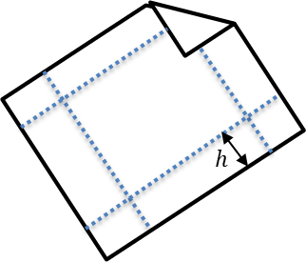
We have a sheet of A4 paper,
which we want to fold into a cuboid.
What height should we choose for the cuboid in order to maximise the volume?

Slide 4


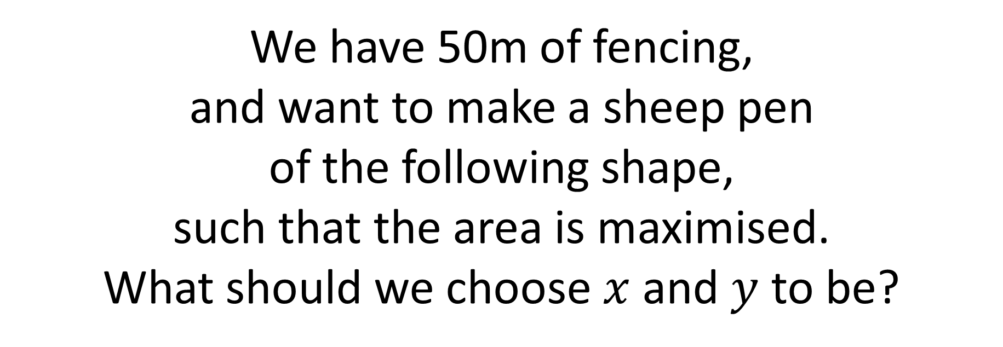
We have 50m of fencing,
and want to make a sheep pen
of the following shape,
such that the area is maximised.
What should we choose $x$ and $y$ to be?
$$x$$
$$y$$

Slide 5
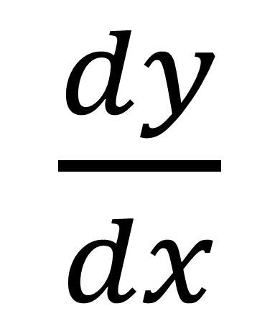
$\frac{dy}{dx}$
the change of y
with respect to
the change of x

Slide 6
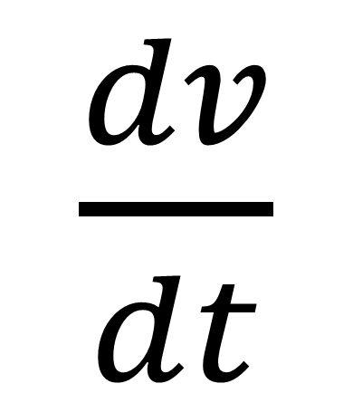
$\frac{dv}{dt}$
the change of volume
with respect to
the change of time

Slide 7
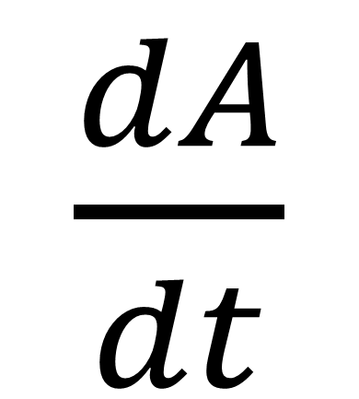
$\frac{dA}{dt}$
the change of Area
with respect to
the change of time

Slide 8

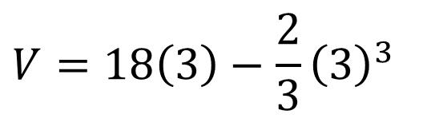

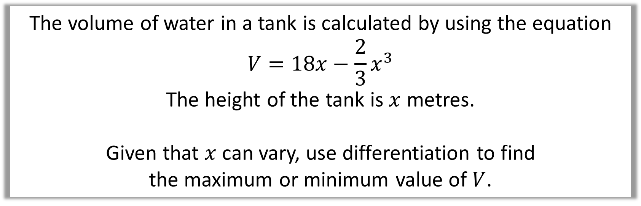

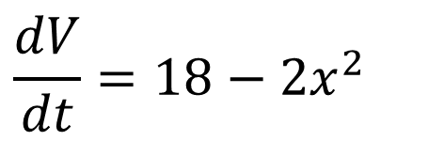
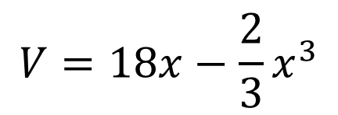
The volume of water in a tank is calculated by using the equation
$$V=18x−\frac{2}{3}x^{3}$$
The height of the tank is $x$ metres.
Given that $x$ can vary, use differentiation to find
the maximum or minimum value of $V$.
$$V=18x−\frac{2}{3}x^{3}$$
$$x=3$$
$$V=18\left(3\right)−\frac{2}{3}{\left(3\right)}^{3}$$
$$\frac{dV}{dt}=18−2x^{2}$$
$$0=18−2x^{2}$$
$$V=36$$

