Slide 1
Regression Correlation and Hypothesis Testing
Measuring Correlation
Chapter 1
(Part 2 of 3)

Slide 2
Measuring Correlation
You have used qualitative terms such as
“strong positive correlation”,
“ weak negative correlation”
and “no correlation”
to describe the type and strength of correlation.
It is much better if we can put qualitive value
for the type and strength of correlation.

Slide 3
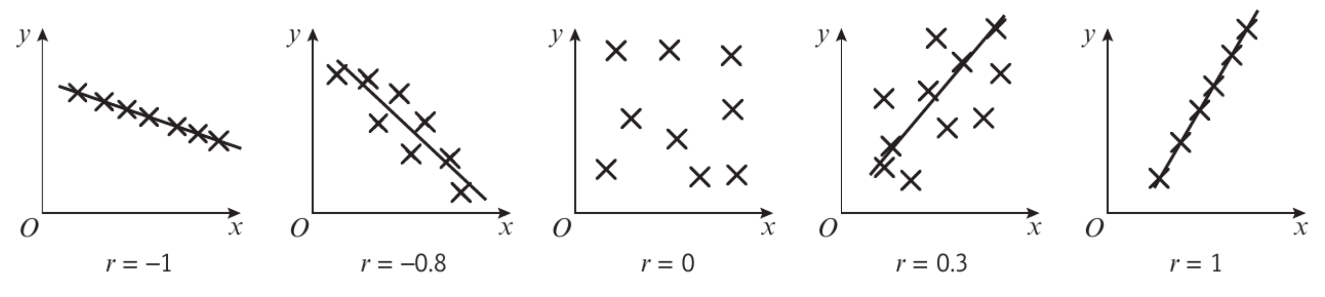
The Product Moment Correlation Coefficient
The Product Moment Correlation Coefficient
is one way to quantify this.

Slide 4
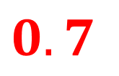
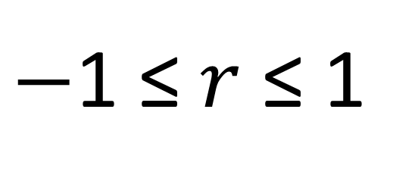
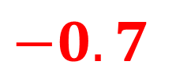
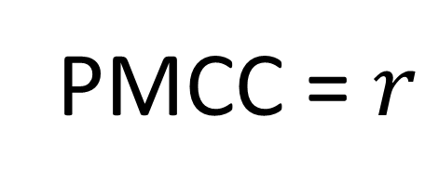
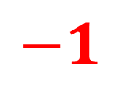


The Product Moment Correlation Coefficient
PMCC = $r$
$−$1 ≤ $r$ ≤ 1
$$−1$$
$−0.7$
$$0$$
$0.7$
$$1$$
Perfect
Negative
Correlation
Strong
Negative
No
Correlation
Strong
Positive
Perfect
Positive
Correlation
(Note: PMCC is only applicable for a linear correlation)

Slide 5


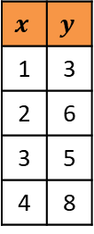

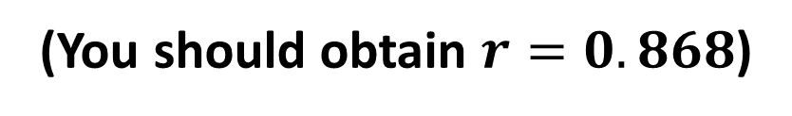



Measuring Correlation - Calculating $r$
Instructions for Casio ClassWiz:
6: Statistics
Press MODE then select ‘Statistics’.
$$y=a+bx$$
We want to measure linear correlation,
so select $y=a+bx$
$$x$$ | $$y$$
1 | 3
2 | 6
3 | 5
4 | 8
Data Entry
PMCC
Press OPTN then choose “Regression Calc”
to obtain $r$.
(You should obtain $r=0.868$)
You should obtain $r=0.868$

Slide 6
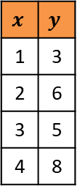
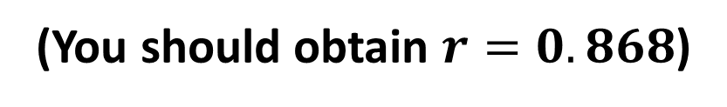
Instructions for Casio Graphical Calculator:
2: Statistics
Press MODE then select ‘Statistics’.
$$x$$ | $$y$$
1 | 3
2 | 6
3 | 5
4 | 8
Data Entry
Calc
REG
Press REG. Can be found on the bottom of the screen.
X
Press X. Can be found on the bottom of the screen.
ax + b
Press ax + b. Can be found on the bottom of the screen.
(You should obtain $r=0.868$)

Slide 7
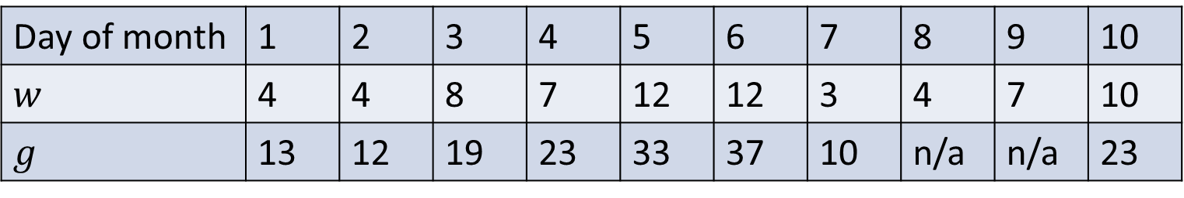
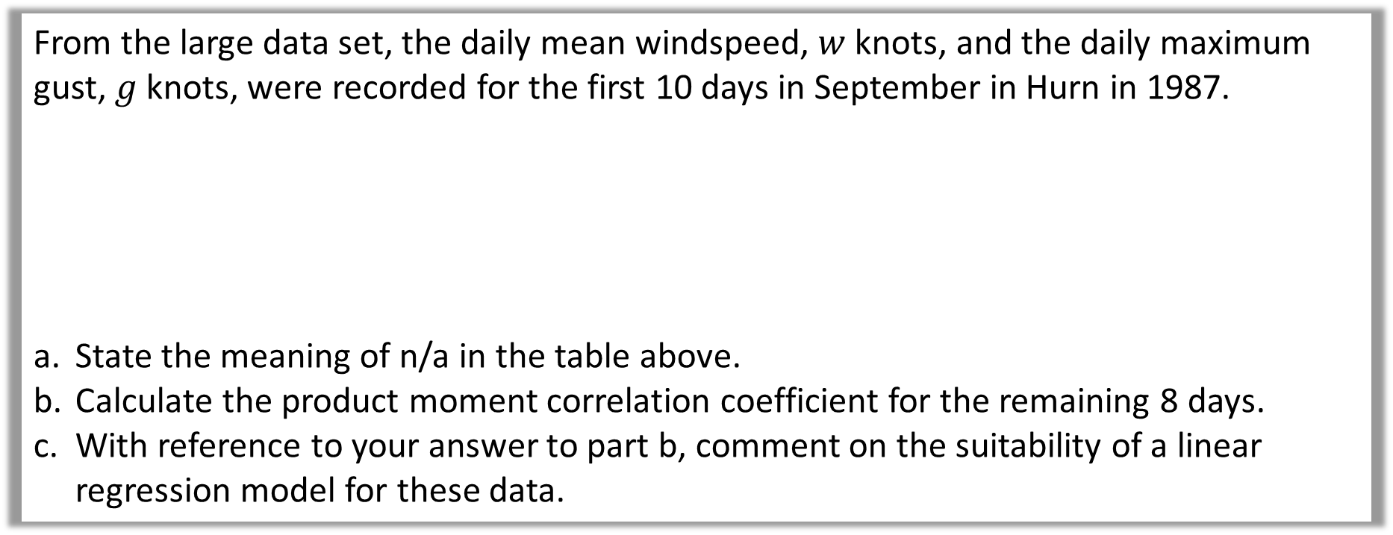
From the large data set, the daily mean windspeed, $w$ knots, and the daily maximum gust, $g$ knots, were recorded for the first 10 days in September in Hurn in 1987.
State the meaning of n/a in the table above.
Calculate the product moment correlation coefficient for the remaining 8 days.
With reference to your answer to part b, comment on the suitability of a linear regression model for these data.
Day of month | 1 | 2 | 3 | 4 | 5 | 6 | 7 | 8 | 9 | 10
$$w$$ | 4 | 4 | 8 | 7 | 12 | 12 | 3 | 4 | 7 | 10
$$g$$ | 13 | 12 | 19 | 23 | 33 | 37 | 10 | n/a | n/a | 23
Data on daily maximum gust is not available for these days.
a

Slide 8
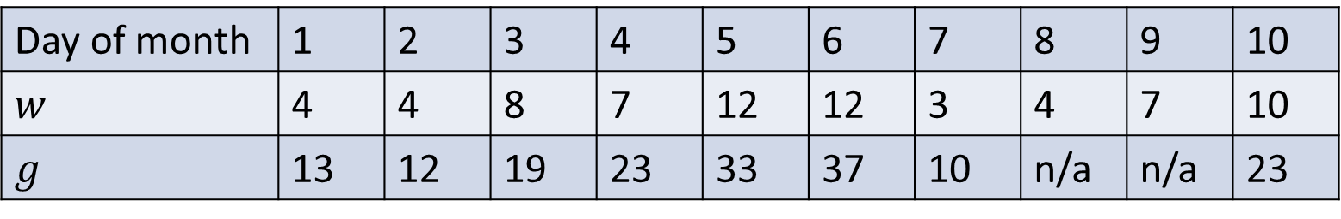
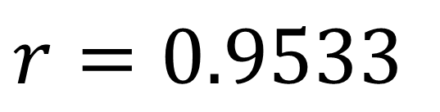
From the large data set, the daily mean windspeed, $w$ knots, and the daily maximum gust, $g$ knots, were recorded for the first 10 days in September in Hurn in 1987.
State the meaning of n/a in the table above.
Calculate the product moment correlation coefficient for the remaining 8 days.
With reference to your answer to part b, comment on the suitability of a linear regression model for these data.
Day of month | 1 | 2 | 3 | 4 | 5 | 6 | 7 | 8 | 9 | 10
$$w$$ | 4 | 4 | 8 | 7 | 12 | 12 | 3 | 4 | 7 | 10
$$g$$ | 13 | 12 | 19 | 23 | 33 | 37 | 10 | n/a | n/a | 23
$$r=0.9533$$
b

Slide 9

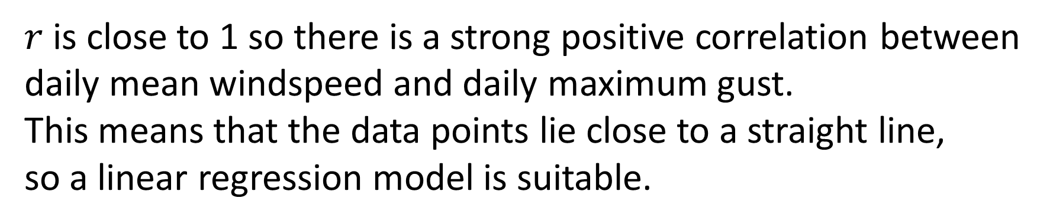
From the large data set, the daily mean windspeed, $w$ knots, and the daily maximum gust, $g$ knots, were recorded for the first 10 days in September in Hurn in 1987.
State the meaning of n/a in the table above.
Calculate the product moment correlation coefficient for the remaining 8 days.
With reference to your answer to part b, comment on the suitability of a linear regression model for these data.
Day of month | 1 | 2 | 3 | 4 | 5 | 6 | 7 | 8 | 9 | 10
$$w$$ | 4 | 4 | 8 | 7 | 12 | 12 | 3 | 4 | 7 | 10
$$g$$ | 13 | 12 | 19 | 23 | 33 | 37 | 10 | n/a | n/a | 23
$r$ is close to 1 so there is a strong positive correlation between daily mean windspeed and daily maximum gust.
This means that the data points lie close to a straight line,
so a linear regression model is suitable.
c

