Slide 1
LO: Functions

Slide 2
A function is when you
take an input,
perform a calculation
and get an output.

Slide 3
Input
Output
Function
Input
Output
x 3
Input
Output
x 3
+ 5

Slide 4
Notation
There are different types
of notation
to watch out for.

Slide 5
x
3x + 5
x 3
+ 5
x → 3x + 5

Slide 6
x
3x + 5
x 3
+ 5
x → 3x + 5
f (x) =3x + 5

Slide 7
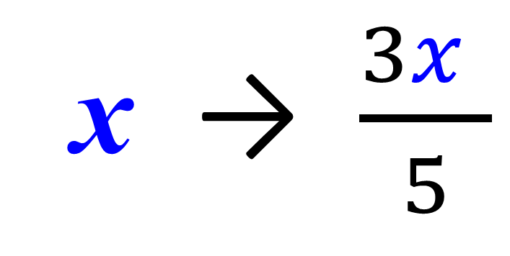
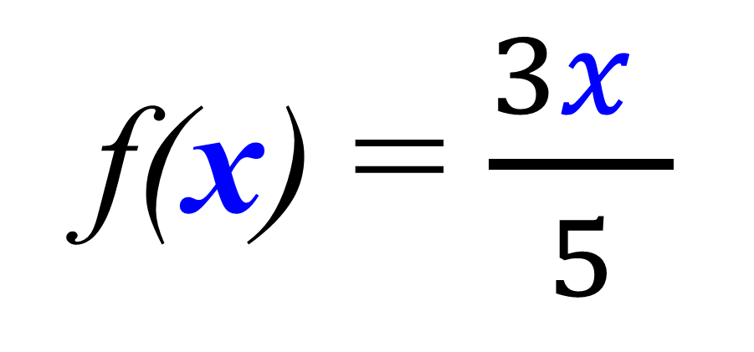
x
Output
x 3
÷ 5
f(x) = $\frac{3x }{5}$
x → $\frac{3x }{5}$

Slide 8
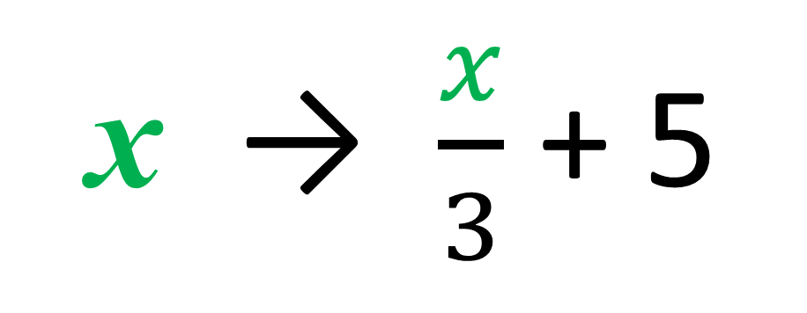
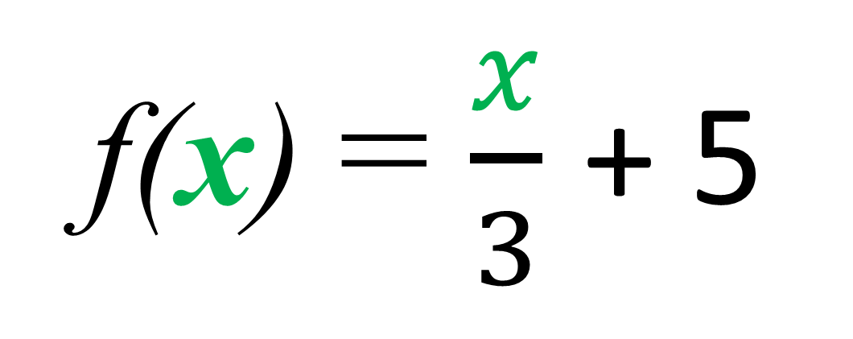
x
Output
÷ 3
+ 5
f(x) = $\frac{x}{3}$ + 5
x → $\frac{x}{3}$ + 5

Slide 9
Find the value of a Function
f (x) = 3x + 5
f (3) =
3(3) + 5
f (3) = 14

Slide 10
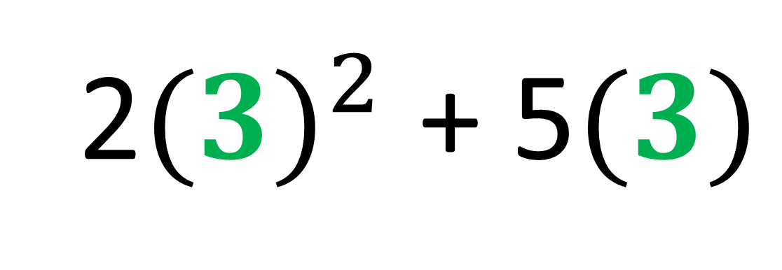
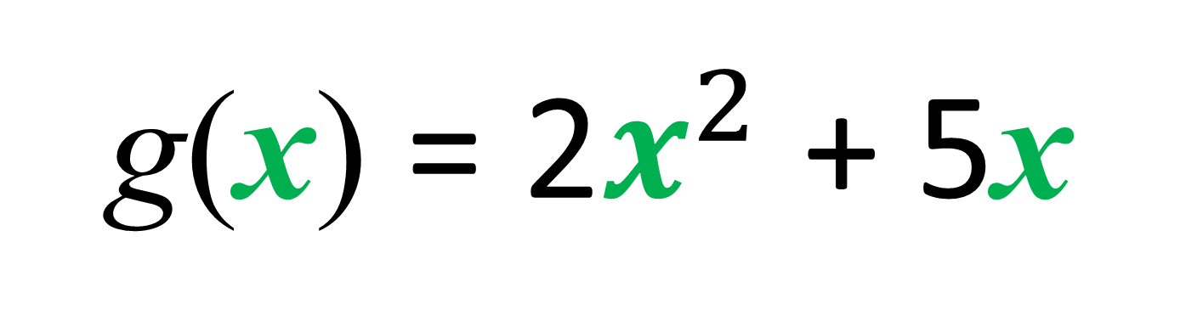
g(x) = 2$x^{2}$ + 5x
g(3) =
2${(3)}^{2}$ + 5$(3)$
g(3) = 33

Slide 11
f (x) = 2x
g(x) = x² + 4
Work out f (3) + g(3)
f (3) + g(3) =
6 + 13 = 19

Slide 12
f (x) = x + x²
Work out 5f (3)
f (3) =
12
5f (3) =
5 x 12 = 60

Slide 13
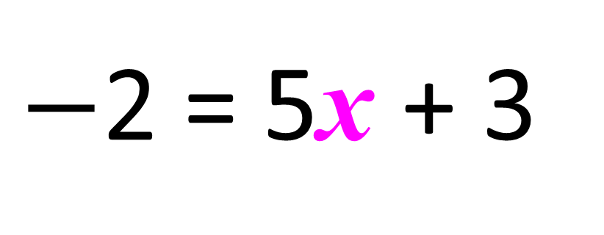
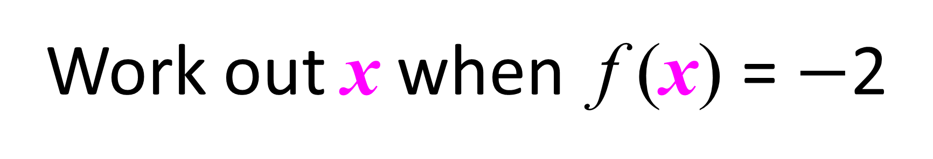
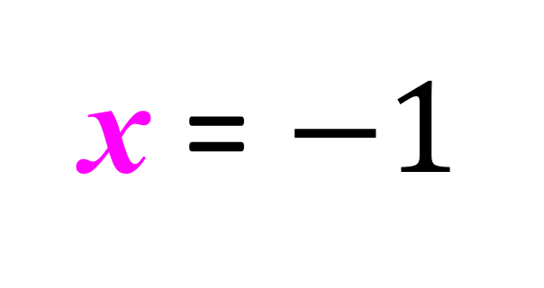
Solving a Function
f (x) = 5x + 3
Work out x when f (x) = $−$2
$−$2 = 5x + 3
x = $−1$

Slide 14
f (x) = 4x – 3
Work out x when f (x) = 0
0 = 4x – 3
x = 0.75

