Slide 1
LO: Writing and Solving
Equations
(I think of a number)

Slide 2
y
g
y
b
b
b
y
r
r
r
g
b – g = y
True or false?
True

Slide 3
y
g
y
b
b
b
y
r
r
r
g
g + r – y = b
True or false?
True

Slide 4
y
g
y
b
b
b
y
r
r
r
g
g + 2y = 3r
True or false?
False

Slide 5
y
g
y
b
b
b
y
r
r
r
g
3r + g – 2b = y
True or false?
True

Slide 6
y
g
y
b
b
b
y
r
r
r
g
3r + g – 2b = b - g
True or false?
True

Slide 7

With the power of maths you all
have the ability to read minds!
Think of a number.
times it by 5
then add 6.
What number do you have?

Slide 8
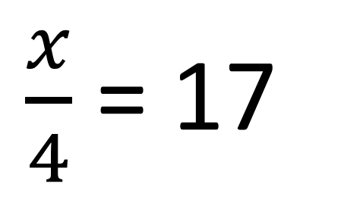

I think of a number. | x
I divide it by 4.
This gives an answer of 17.
$$\frac{x}{4}$$
$\frac{x}{4}$ = 17

Slide 9

I think of a number… | x
... and I times it by 3…
…I then add 5
This gives an answer of 17
$$3x$$
3x + 5
3x + 5 = 17

Slide 10

I think of a number | x
I add 3 to it
I then multiply by 7
This gives an answer of 28
$$x+3$$
7(x + 3)
7(x + 3) = 28

Slide 11

I think of a number | x
I subtract it by 5.
I then multiply by 4.
This gives an answer of 20
$$x−5$$
4(x – 5)
4(x – 5) = 20

