Slide 1
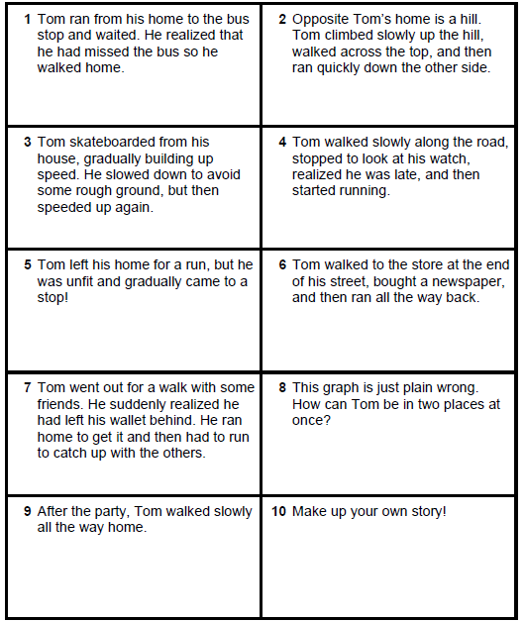
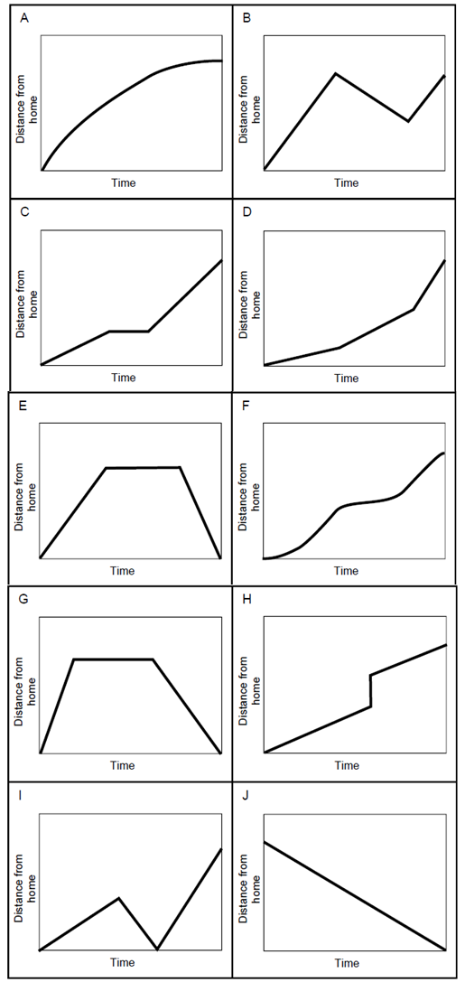

Slide 2
ANSWERS

Slide 3
graph | description
A
B
C
D
E
F
G
H
I
J
5
10
4
2
6
3
1
8
G
7
9

