Slide 1
Differentiation
Parametric Equations
Chapter 9
(Part 7 of 10)

Slide 2
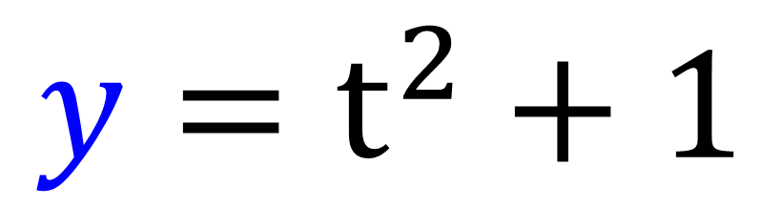
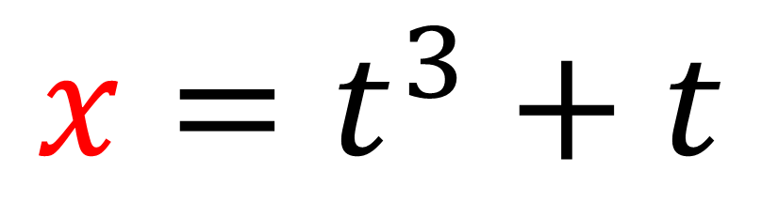
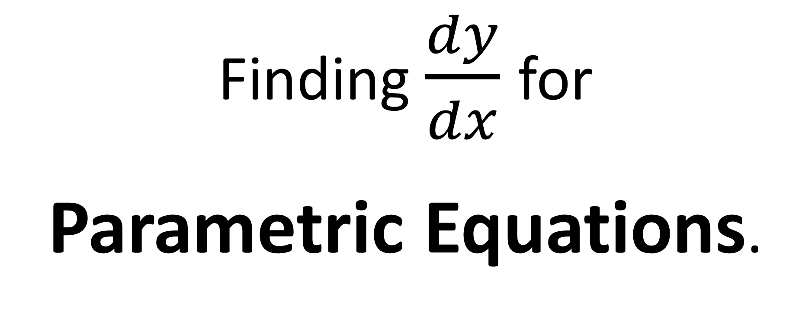
Finding $\frac{dy}{dx}$ for
Parametric Equations.
$$x=t^{3}+t$$
$$y=t^{2}+1$$

Slide 3
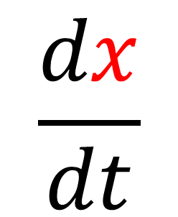
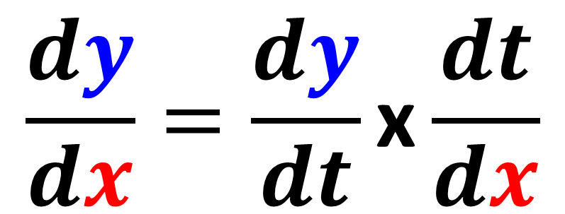
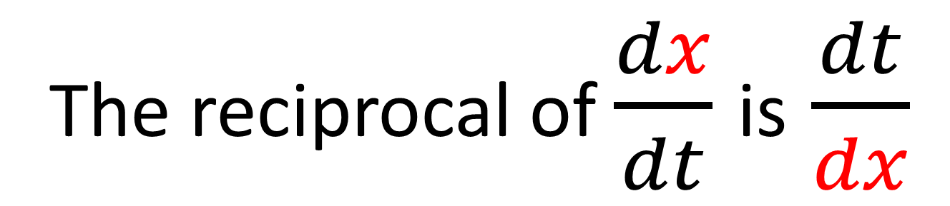
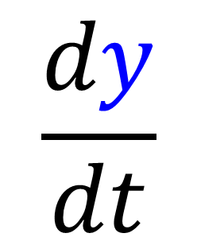
$$\frac{dx}{dt}$$
$$\frac{dy}{dt}$$
The reciprocal of $\frac{dx}{dt}$ is $\frac{dt}{dx}$
$$\frac{dy}{dx}=\frac{dy}{dt}\text{x}\frac{dt}{dx}$$

Slide 4
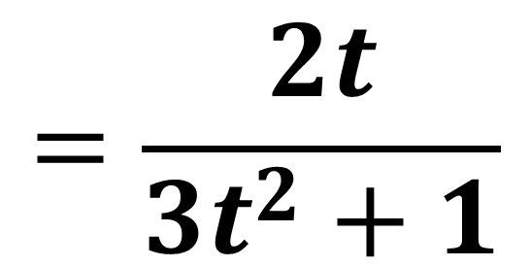
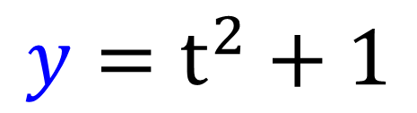
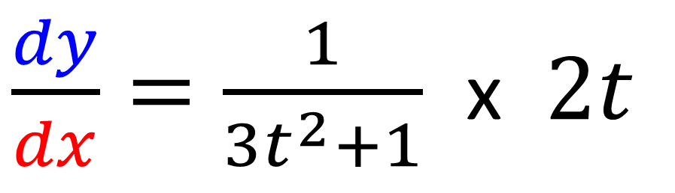
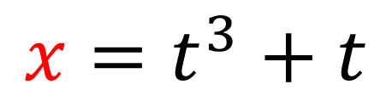
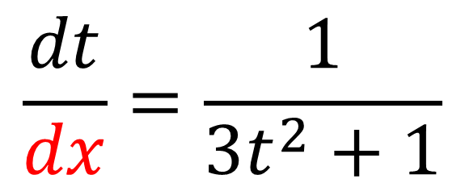
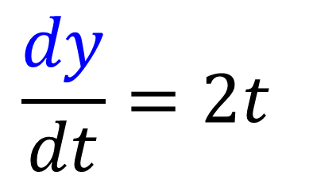
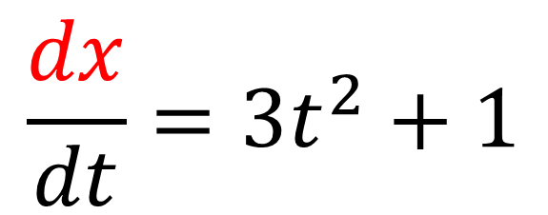
$$x=t^{3}+t$$
$$y=t^{2}+1$$
$$\frac{dx}{dt}=3t^{2}+1$$
$$\frac{dy}{dt}=2t$$
$$\frac{dt}{dx}=\frac{1}{3t^{2}+1}$$
$\frac{dy}{dx}=\frac{1}{3t^{2}+1}$ x $2t$
$$=\frac{2t}{3t^{2}+1}$$

Slide 5
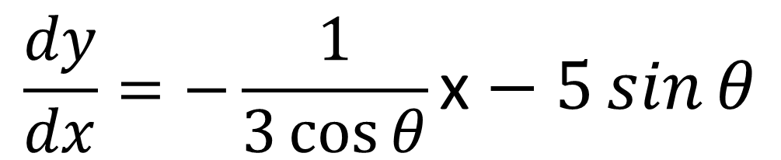
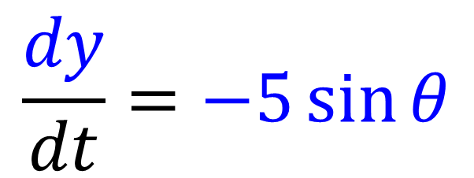
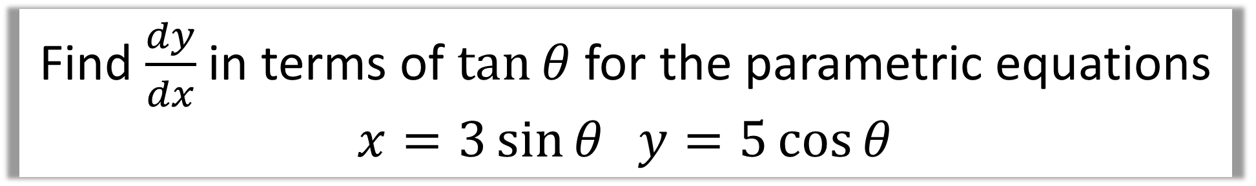
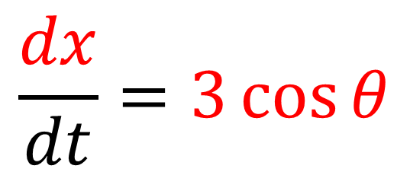
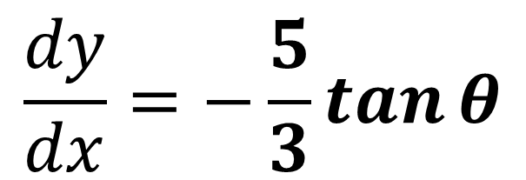
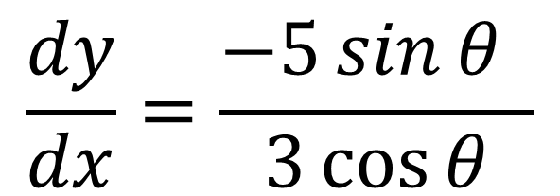
Find $\frac{dy}{dx}$ in terms of $\tan{θ}$ for the parametric equations
$$x=3\sin{θ} y=5\cos{θ}$$
$$\frac{dx}{dt}=3\cos{θ}$$
$$\frac{dy}{dx}=−\frac{1}{3\cos{θ}}\text{x}−5\sin{θ}$$
$$\frac{dy}{dx}=\frac{−5\sin{θ} }{3\cos{θ}}$$
$$\frac{dy}{dt}=−5\sin{θ}$$
$$\frac{dy}{dx}=−\frac{5}{3}\tan{θ}$$

Slide 6
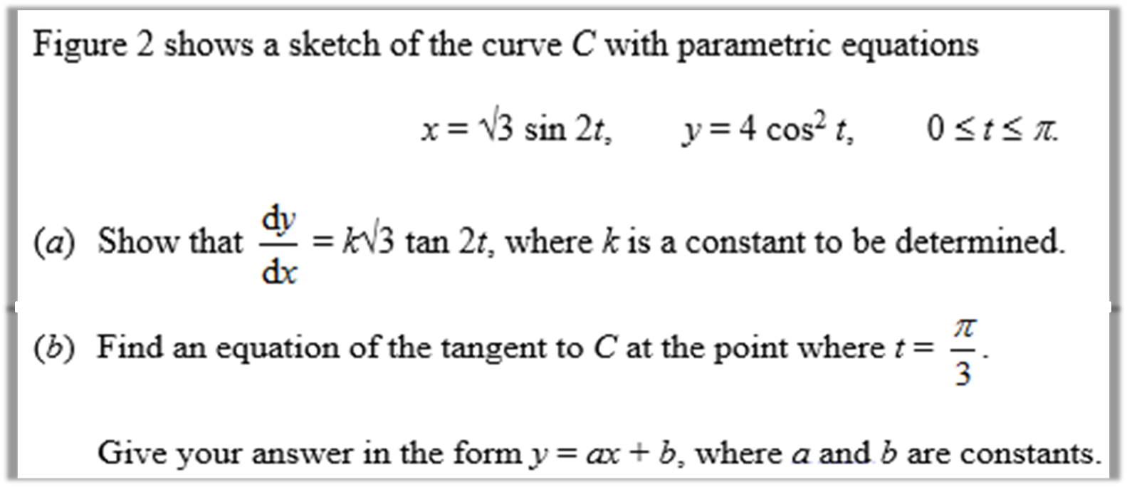
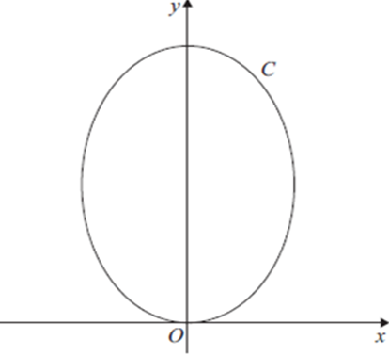

Slide 7
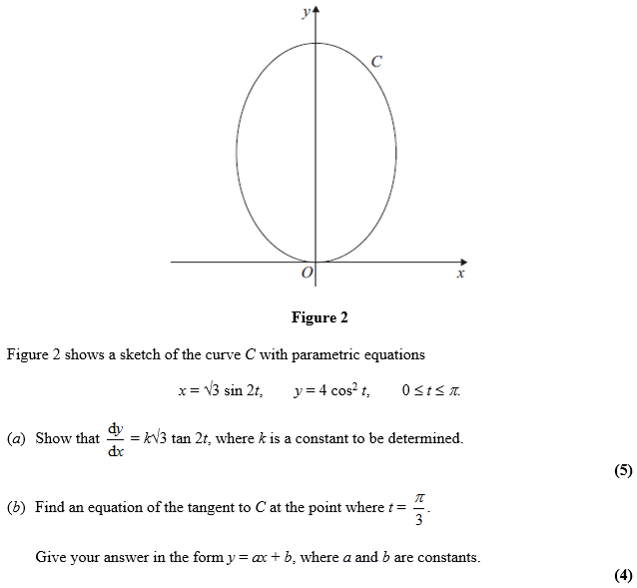
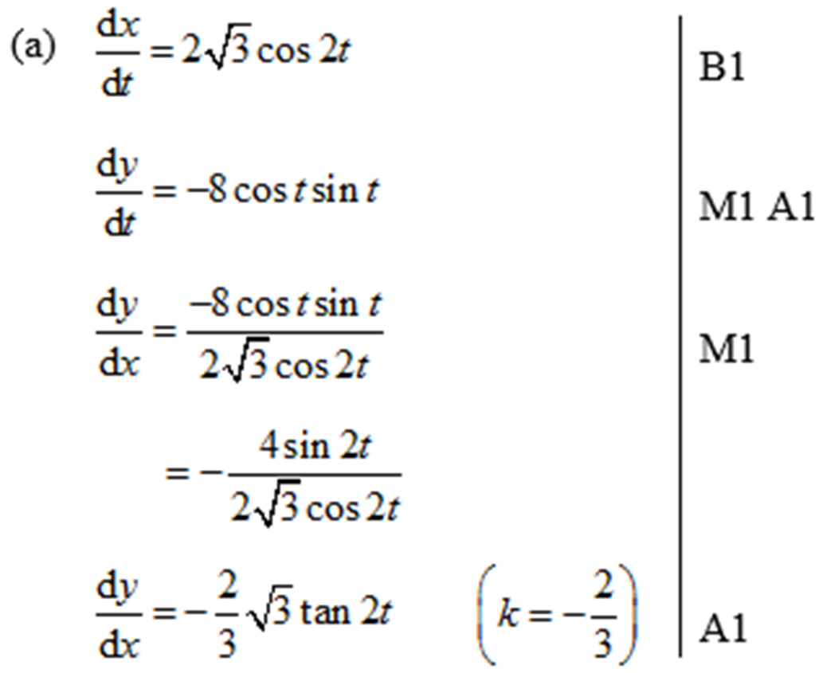

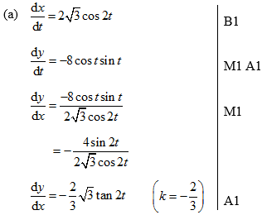

Slide 8
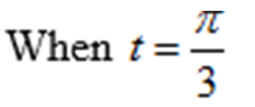

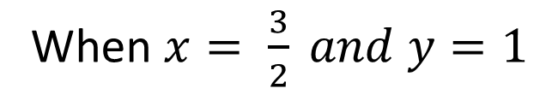

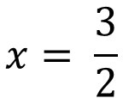
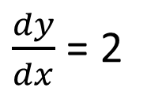

$\frac{dy}{dx}$ = 2
$$x= \frac{3}{2}$$
$$y=1$$
When $x= \frac{3}{2} and y=1$
$y=2x+c$
$y=2x−2$

