Slide 1
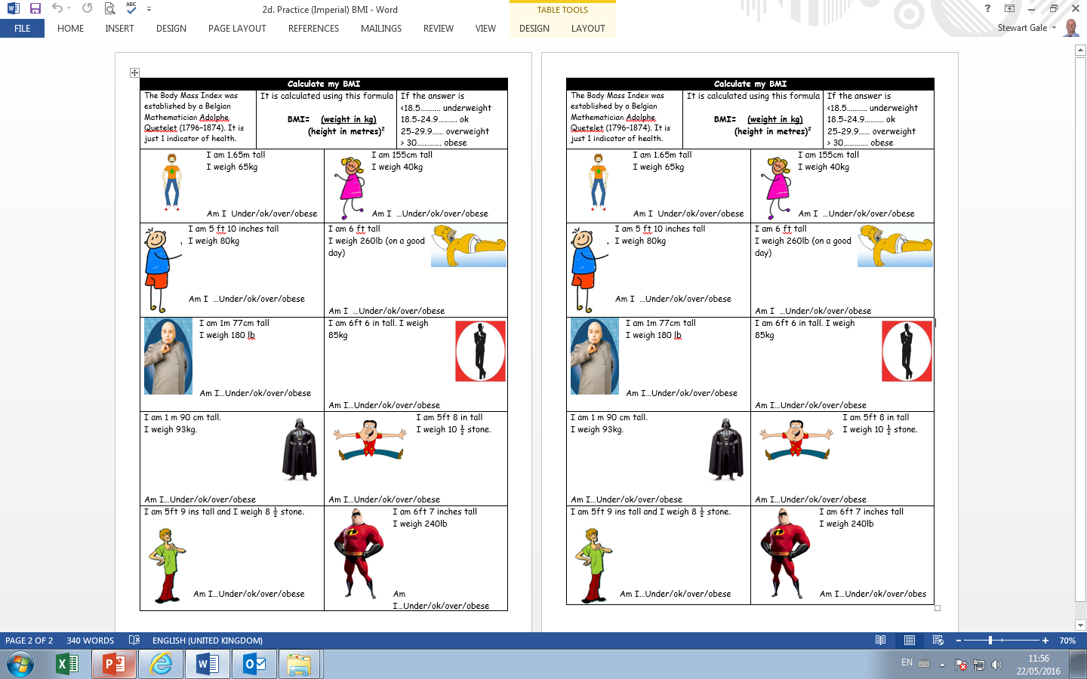

Slide 2
ANSWERS

Slide 3
Answers (will vary slightly dep on conversion factors used)
65/(1.65)² = 23.875 OK | 40/(1.55)² = 16.64 UNDER
80/(1.75)² = 26.1 OVER | 118/(1.8)² =36.4 OBESE
81.8/(1.77)² = 26.1 OVER | 85/(1.95)² =22.35 OK
93/(1.9)² = 25.76 OVER | 66.8/(1.7)² = 23.1 OK
54.1/(1.725)² =18.2 UNDER | 109/(1.975)² =27.94 OVER

