Slide 1
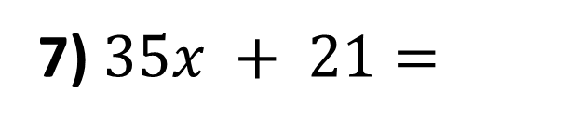
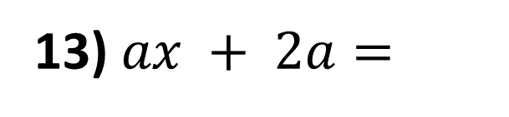
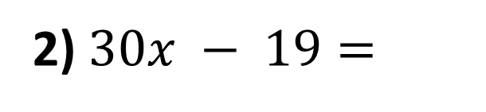
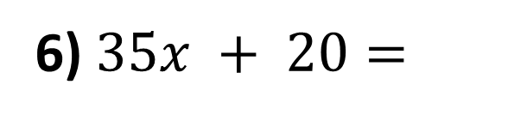
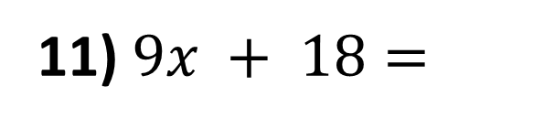
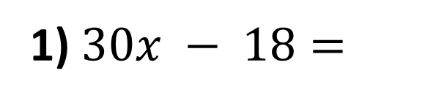
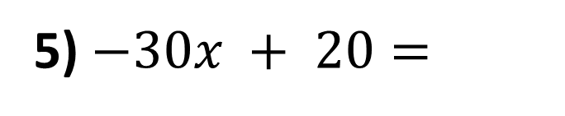
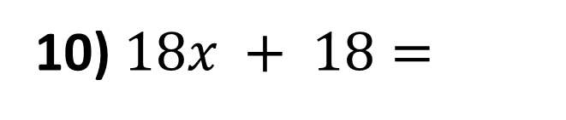
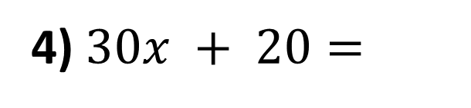
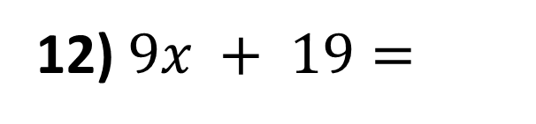
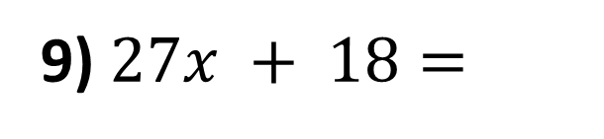
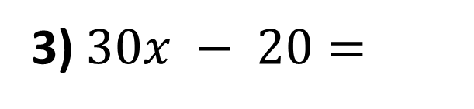
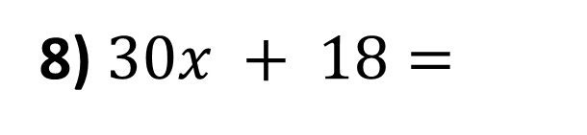
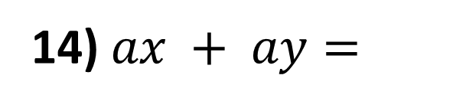
Factorise the following expressions.
1) $30x − 18=$
8) $30x + 18=$
2) $30x − 19=$
9) $27x + 18=$
3) $30x − 20=$
10) $18x + 18=$
4) $30x + 20=$
11) $9x + 18=$
5) $−30x + 20=$
12) $9x + 19=$
6) $35x + 20=$
13) $ax + 2a=$
7) $35x + 21=$
14) $ax + ay=$

Slide 2
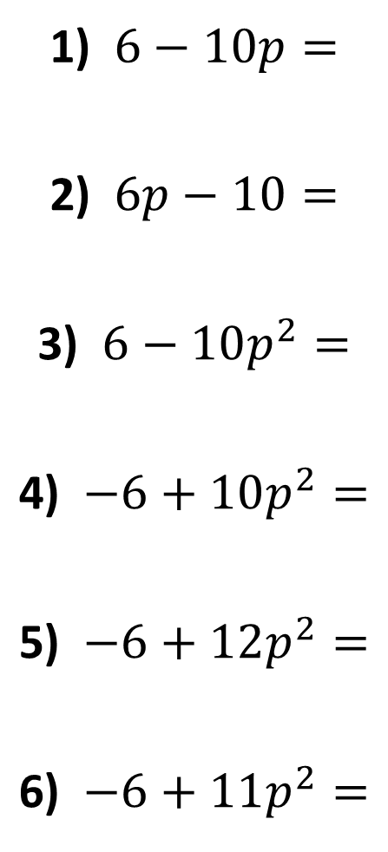
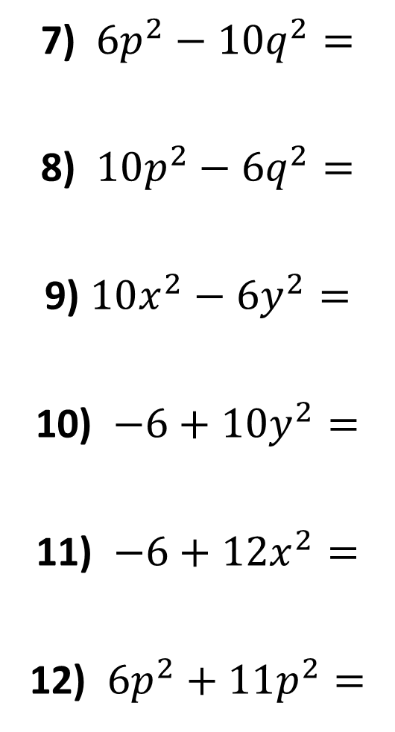
Factorise the following expressions.
1) $6−10p=$
2) $6p−10=$
3) $6−10p^{2}=$
4) $−6+10p^{2}=$
5) $−6+12p^{2}=$
6) $−6+11p^{2}=$
7) ${6p}^{2}−10q^{2}=$
8) $10p^{2}−6q^{2}=$
9) $10x^{2}−6y^{2}=$
10) $−6+10y^{2}=$
11) $−6+12x^{2}=$
12) $6p^{2}+11p^{2}=$

Slide 3
ANSWERS

Slide 4

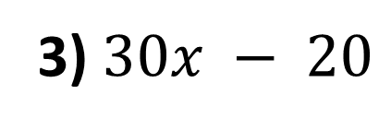


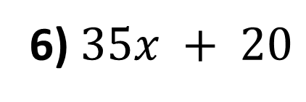
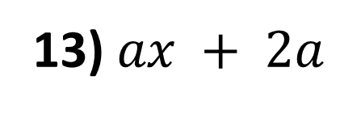

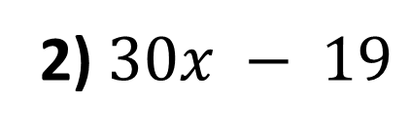

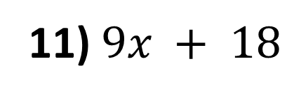

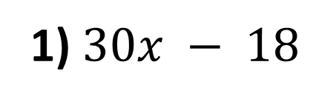
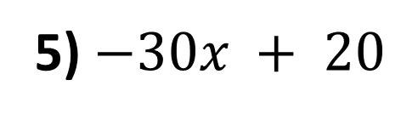



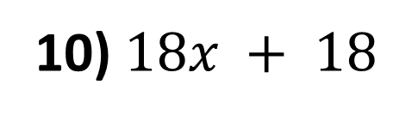



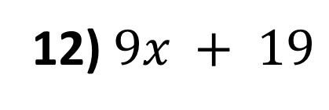
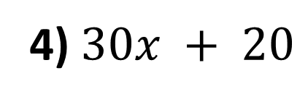
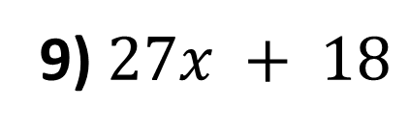

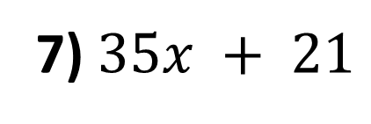

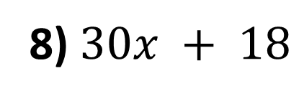
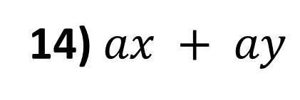
Factorise the following expressions.
1) $30x − 18$
$$=6(5x – 3)$$
8) $30x + 18$
$$=6(5x + 3)$$
2) $30x − 19$
$$=30x – 19$$
9) $27x + 18$
$$=9(3x + 2)$$
3) $30x − 20$
$$=10(3x – 2)$$
10) $18x + 18$
$$=18(x + 1)$$
4) $30x + 20$
$$=10(3x + 2)$$
11) $9x + 18$
$$=9(x + 2)$$
5) $−30x + 20$
$$=10(−3x + 2)$$
12) $9x + 19$
$$=9x + 19$$
6) $35x + 20$
$$=5(7x + 4)$$
13) $ax + 2a$
$$=a(x + 2)$$
7) $35x + 21$
$$=7(5x + 3)$$
14) $ax + ay$
$$=a(x + y)$$

Slide 5
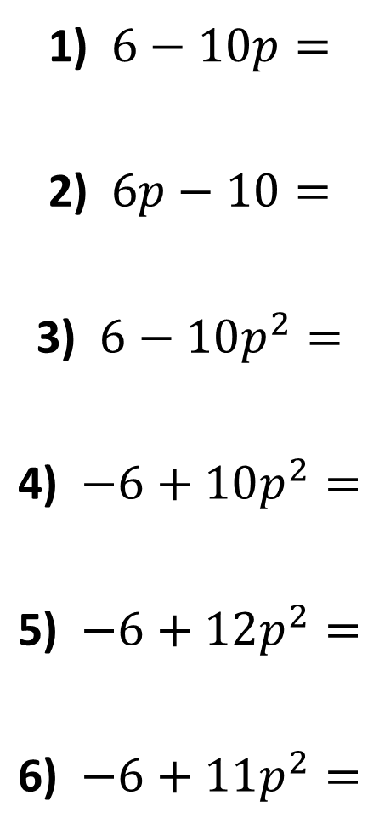








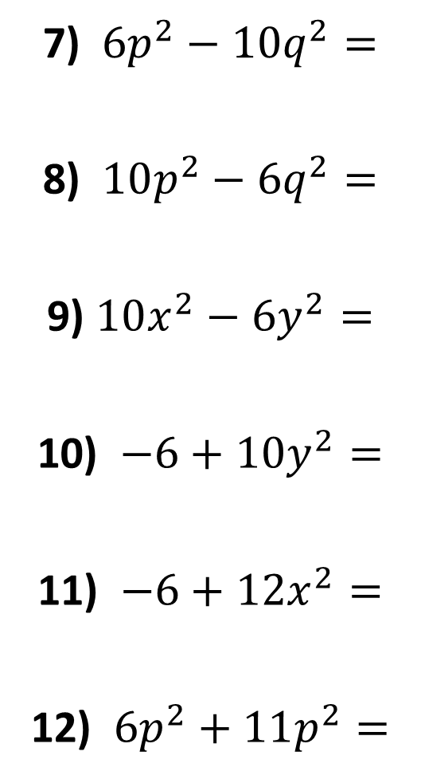




Factorise the following expressions.
1) $6−10p=$
2) $6p−10=$
3) $6−10p^{2}=$
4) $−6+10p^{2}=$
5) $−6+12p^{2}=$
6) $−6+11p^{2}=$
$$2(3−5p)$$
7) ${6p}^{2}−10q^{2}=$
8) $10p^{2}−6q^{2}=$
9) $10x^{2}−6y^{2}=$
10) $−6+10y^{2}=$
11) $−6+12x^{2}=$
12) $6p^{2}+11p^{2}=$
$$2(3p^{2}−5q^{2})$$
$$2(3p−5)$$
$$2(5p^{2}−3q^{2})$$
$$2(3−5p^{2})$$
$$2(5x^{2}−3y^{2})$$
$$2(−3+5p^{2})$$
$$2(−3+5y^{2})$$
$$6(−1+2p^{2})$$
$$6(−1+2x^{2})$$
$$Does not factorise$$
$$17p^{2}$$

