Slide 1
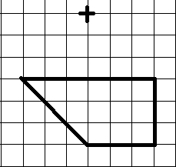
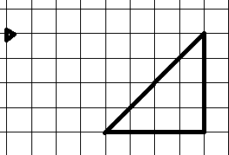
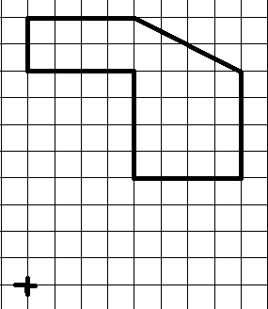
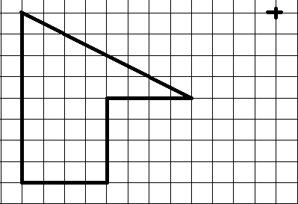
Scale factor ½ Scale factor ⅓
Scale factor ¼ Scale factor ¾

Slide 2
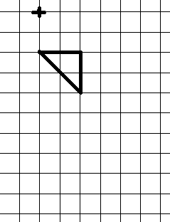
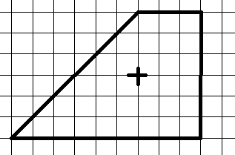
Scale factor 2½ Scale factor ⅔

Slide 3
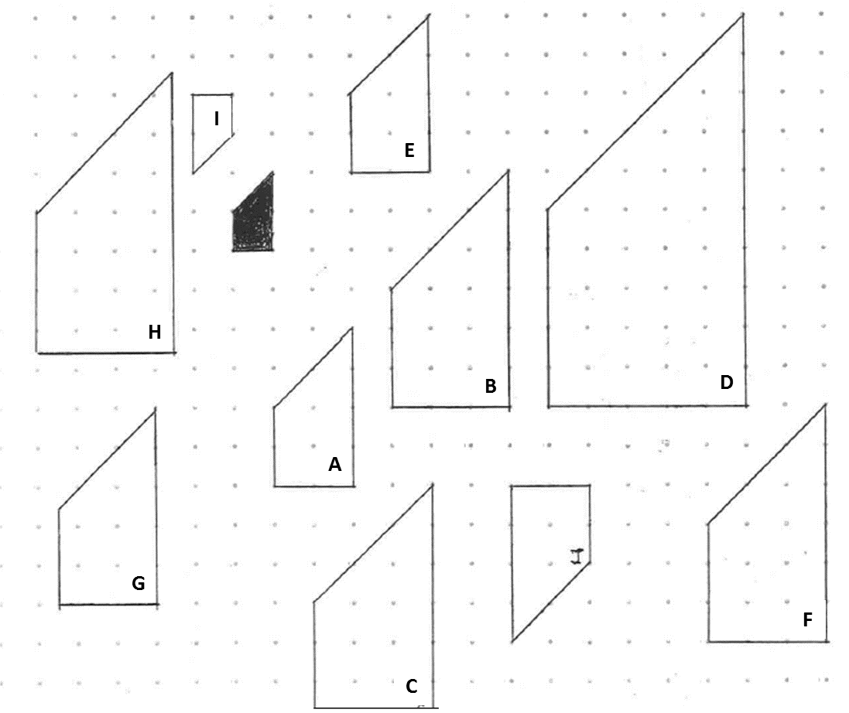
What are the scale factors for each of the following enlargements:
Original Shape to A
Original Shape to B
Original Shape to C
Original Shape to D
Original Shape to E
Original Shape to F
Original Shape to G
Original Shape to H
Original Shape to I

Slide 4
ANSWERS

Slide 5
Scale factor ½ Scale factor ⅓
Scale factor ¼ Scale factor ¾

Slide 6
Scale factor 2½ Scale factor ⅔

Slide 7








What are the scale factors for each of the following enlargements:
A to Shaded Shape:
$$\frac{1}{2}$$
B to Shaded Shape:
$$\frac{1}{3}$$
C to Shaded Shape:
$$\frac{1}{3}$$
D to Shaded Shape:
$$\frac{1}{4}$$
E to Shaded Shape:
$$\frac{1}{2}$$
F to Shaded Shape:
$$\frac{1}{3}$$
G to Shaded Shape:
$$\frac{2}{5}$$
H to Shaded Shape:
$$\frac{2}{7}$$
I to Shaded Shape:
-1

