Slide 1
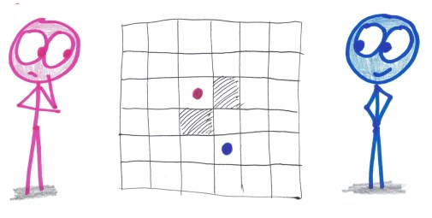
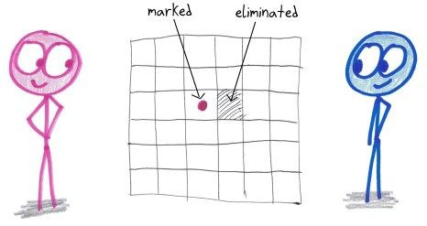
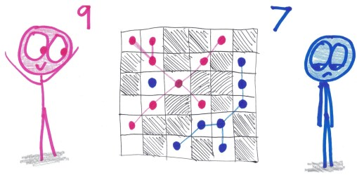
Collector
Eliminating a diagonal neighbor is allowed.
Begin with a 6 by 6 grid. On each turn, you mark any box you like, but you must also eliminate an empty neighboring box.
The winner is whoever creates the largest group of connected marks. (Diagonal connections count.)

