Slide 1
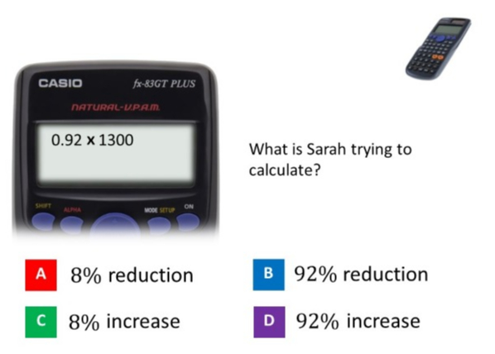
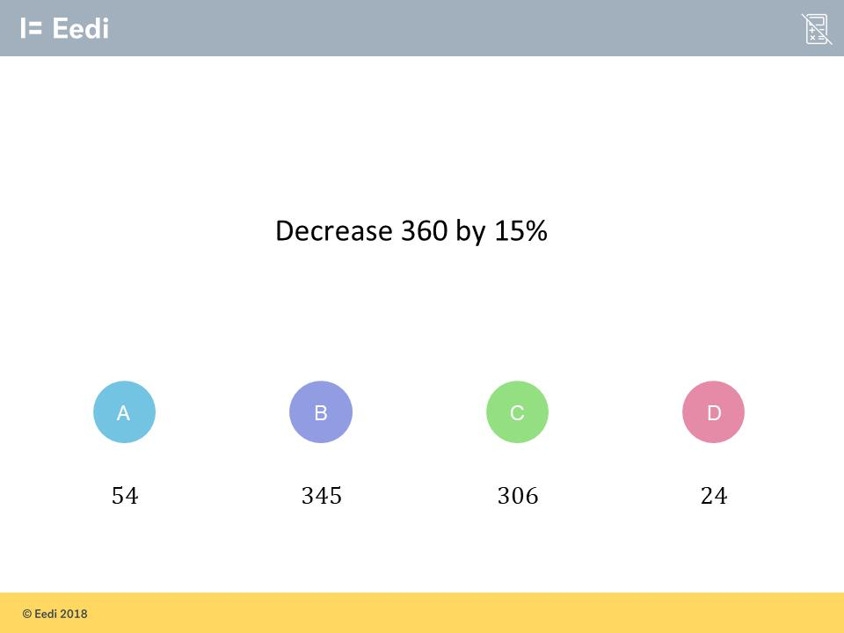
Worst answered question?
Most common wrong answer?

Slide 2
ANSWERS

Slide 3
Worst answered question?

Slide 4
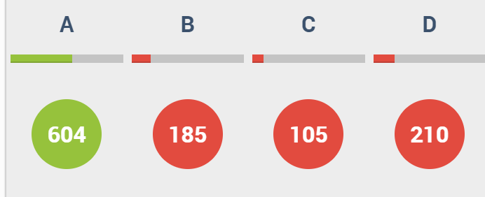
D
They did not realise it is the difference between
92% and 100%.

Slide 5
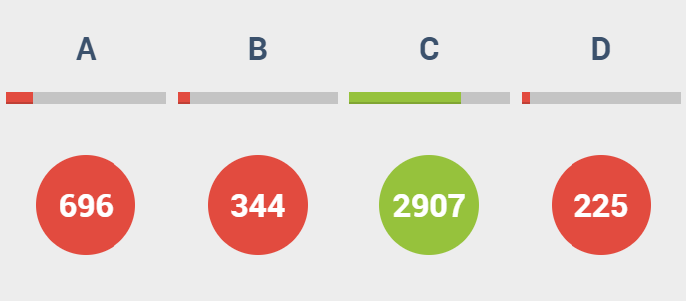
A
They calculated 9%.

