Slide 1
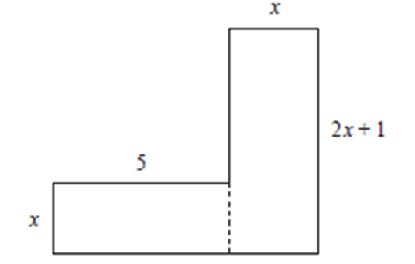
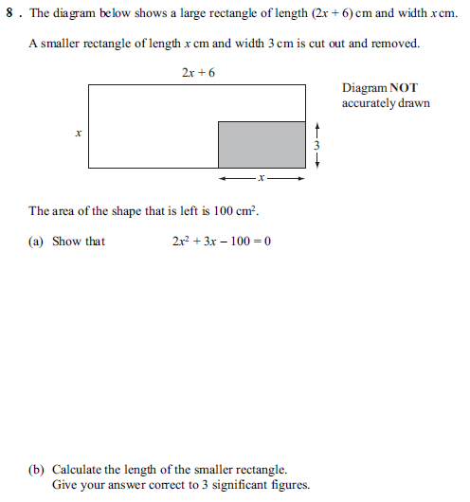
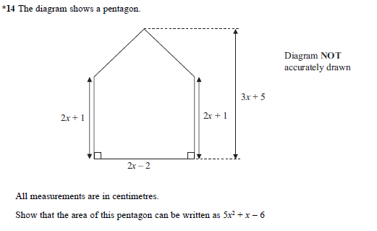
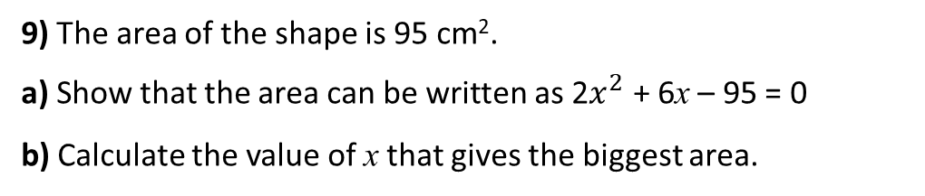
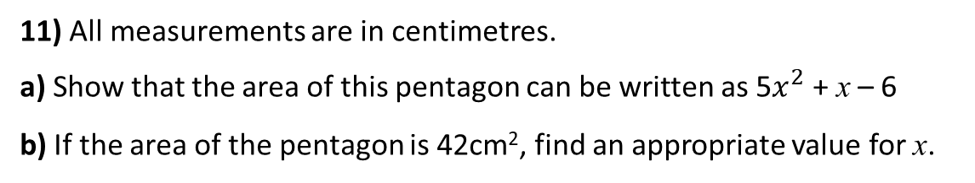
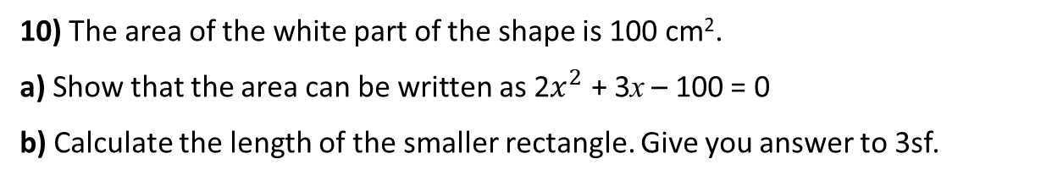
1) 2x² = 9x – 2
9) The area of the shape is 95 cm².
a) Show that the area can be written as 2$x^{2}$ + 6x – 95 = 0
b) Calculate the value of x that gives the biggest area.
2) 9x – 2 = 2x²
3) 2 – 9x = 2x²
10) The area of the white part of the shape is 100 cm².
a) Show that the area can be written as 2$x^{2}$ + 3x – 100 = 0
b) Calculate the length of the smaller rectangle. Give you answer to 3sf.
4) 2 – x = 2x²
5) – 2 + x = – 2x²
11) All measurements are in centimetres.
a) Show that the area of this pentagon can be written as 5$x^{2}$ + x – 6
b) If the area of the pentagon is 42cm², find an appropriate value for x.
6) –2 + x = –2x² + 10
7) –2 + x = –2x² + 10 + 4x
8) –2 + x + 5x² = –2x² + 10 + 4x

Slide 2
ANSWERS

Slide 3
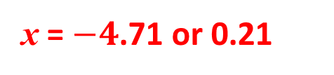
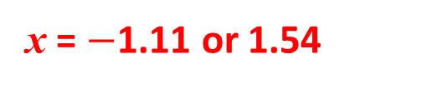
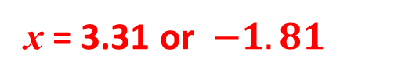
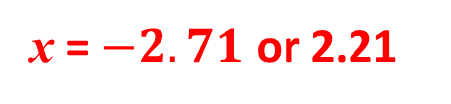
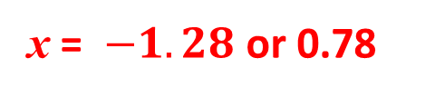
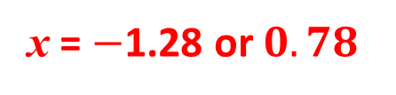
1) 2x² = 9x – 2
9) The area of the shape is 95 cm².
a) Show that the area can be written as 2$x^{2}$ + 6x – 95 = 0
b) Calculate the value of x that gives the biggest area.
x = 4.27 or 0.23
2) 9x – 2 = 2x²
x = 4.27 or 0.23
3) 2 – 9x = 2x²
10) The area of the white part of the shape is 100 cm².
a) Show that the area can be written as 2$x^{2}$ + 3x – 100 = 0
b) Calculate the length of the smaller rectangle. Give you answer to 3sf.
x = $−4$.71 or 0.21
4) 2 – x = 2x²
x = $−$1.28 or $0.78$
5) – 2 + x = – 2x²
x = $−1.28$ or 0.78
11) All measurements are in centimetres.
a) Show that the area of this pentagon can be written as 5$x^{2}$ + x – 6
b) If the area of the pentagon is 42cm², find an appropriate value for x.
6) –2 + x = –2x² + 10
x = $−2.71$ or 2.21
7) –2 + x = –2x² + 10 + 4x
x = 3.31 or $−1.81$
8) –2 + x + 5x² = –2x² + 10 + 4x
x = $−$1.11 or 1.54

Slide 4
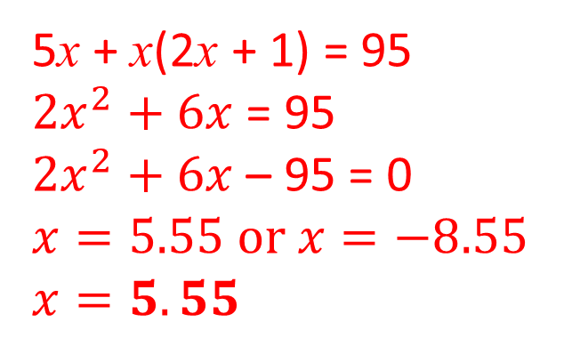
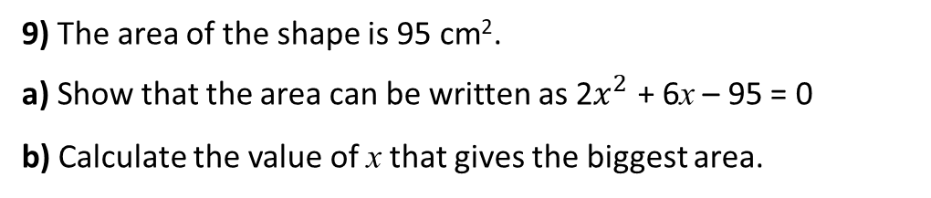
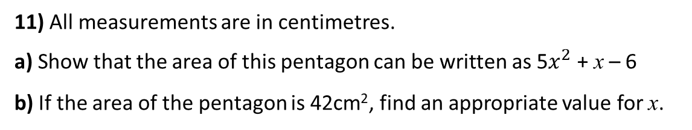
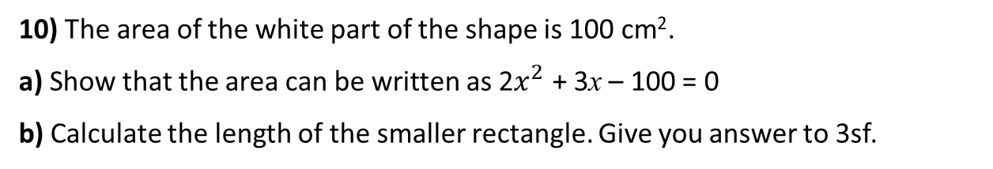
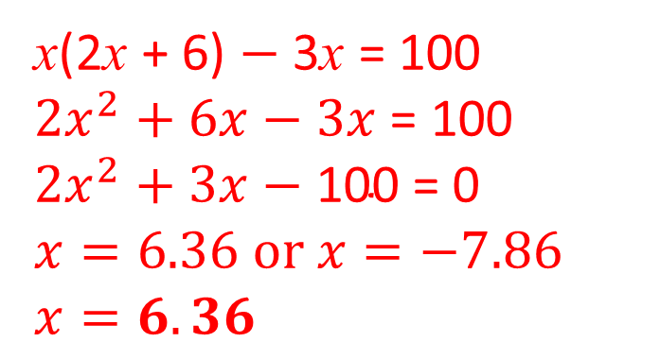
9) The area of the shape is 95 cm².
a) Show that the area can be written as 2$x^{2}$ + 6x – 95 = 0
b) Calculate the value of x that gives the biggest area.
5x + x(2x + 1) = 95
${2x}^{2}+6x$ = 95
${2x}^{2}+6x$ – 95 = 0
$$x=5.55 or x=−8.55$$
$$x=5.55$$
10) The area of the white part of the shape is 100 cm².
a) Show that the area can be written as 2$x^{2}$ + 3x – 100 = 0
b) Calculate the length of the smaller rectangle. Give you answer to 3sf.
x(2x + 6) $−$ 3x = 100
${2x}^{2}+6x−3x$ = 100
$${2x}^{2}+3x−\text{100 }\text{= 0}$$
$$x=6.36 or x=−7.86$$
$$x=6.36$$
11) All measurements are in centimetres.
a) Show that the area of this pentagon can be written as 5$x^{2}$ + x – 6
b) If the area of the pentagon is 42cm², find an appropriate value for x.

Slide 5
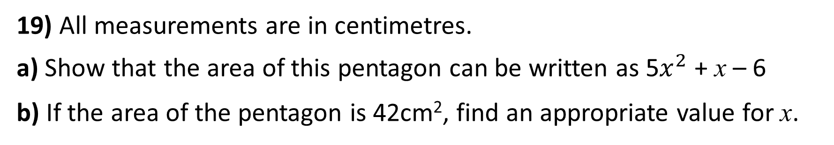
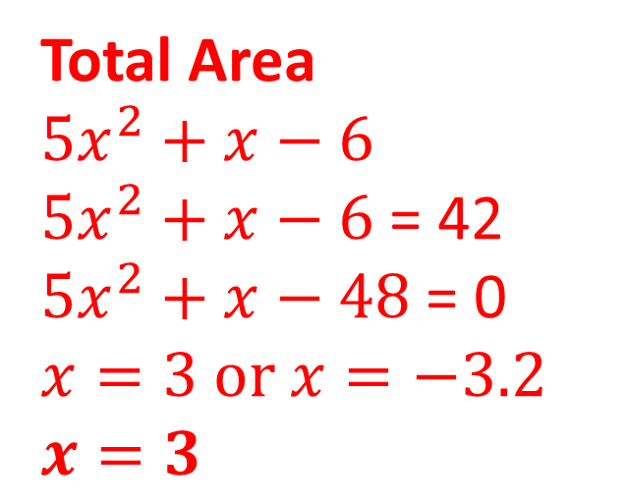
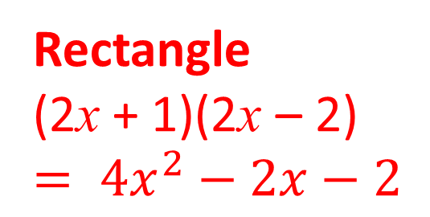
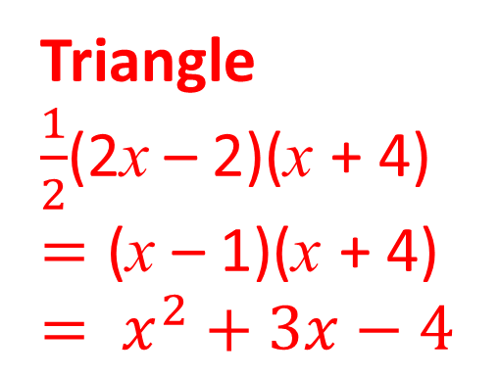
19) All measurements are in centimetres.
a) Show that the area of this pentagon can be written as 5$x^{2}$ + x – 6
b) If the area of the pentagon is 42cm², find an appropriate value for x.
Rectangle
(2x + 1)(2x – 2)
$$= {4x}^{2}−2x−2$$
Total Area
$${5x}^{2}+x−6$$
${5x}^{2}+x−6$ = 42
${5x}^{2}+x−48$ = 0
$$x=3 or x=−3.2$$
$$x=3$$
Triangle
$\frac{1}{2}$(2x – 2)(x + 4)
$$=\text{(}\text{x} \text{–}\text{ 1}\text{)(}\text{x} \text{+ 4)}$$
$$= x^{2}+3x−4$$

