Slide 1

Junior Challenge 4
GOLD

Slide 2
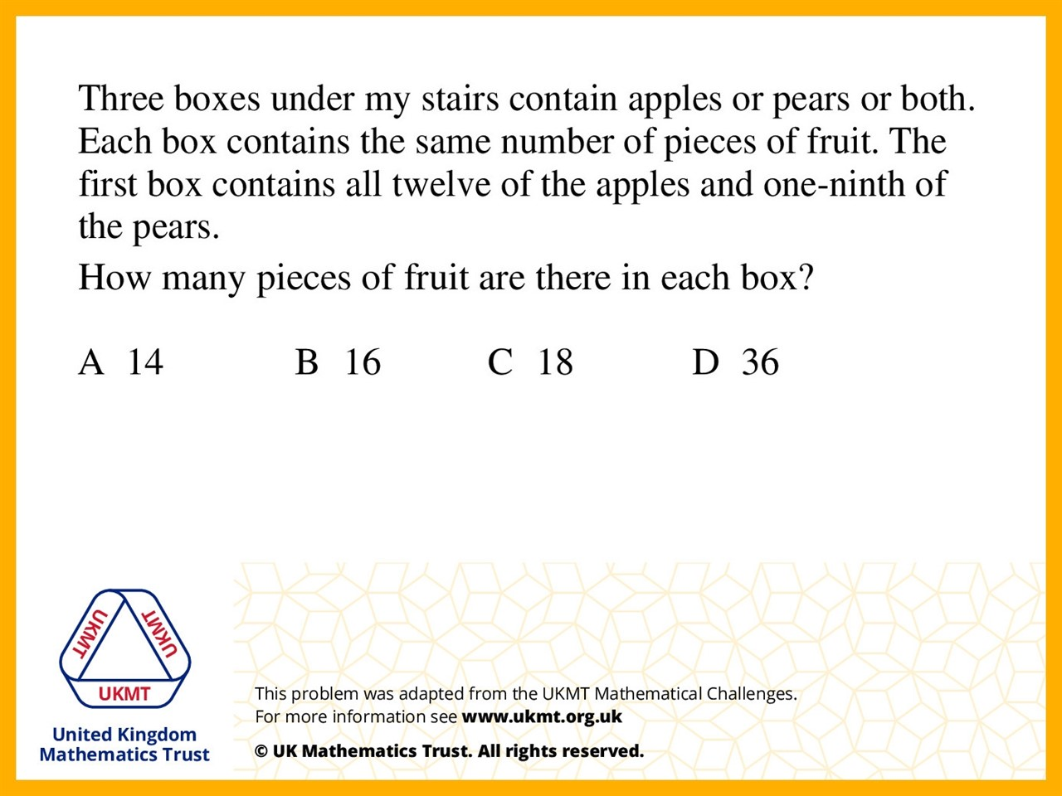
Q1.
There are 12 apples and 4 pears in the first box. Because 4 pears is one ninth of all the pears, there are eight ninths of all the pears left which is 32, which is divided evenly between the other two boxes to make 16 in each box.

Slide 3
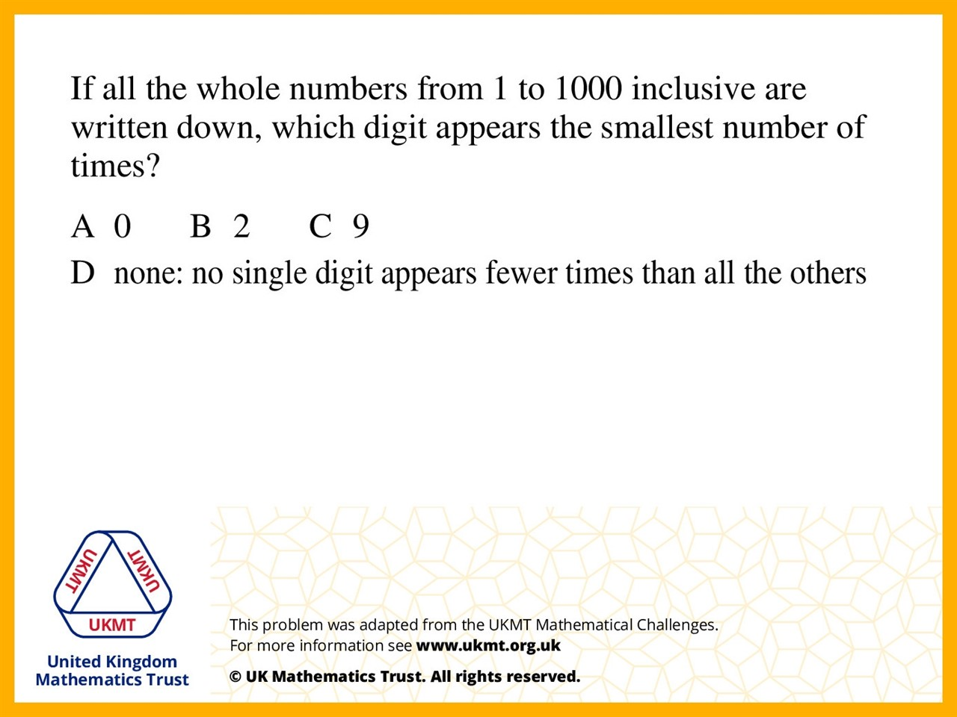
Q2.
All digits except 0 have their own tens column in the first 100 numbers. From 100 on they are all equal, but between 1 and 100 there are less 0's.

Slide 4
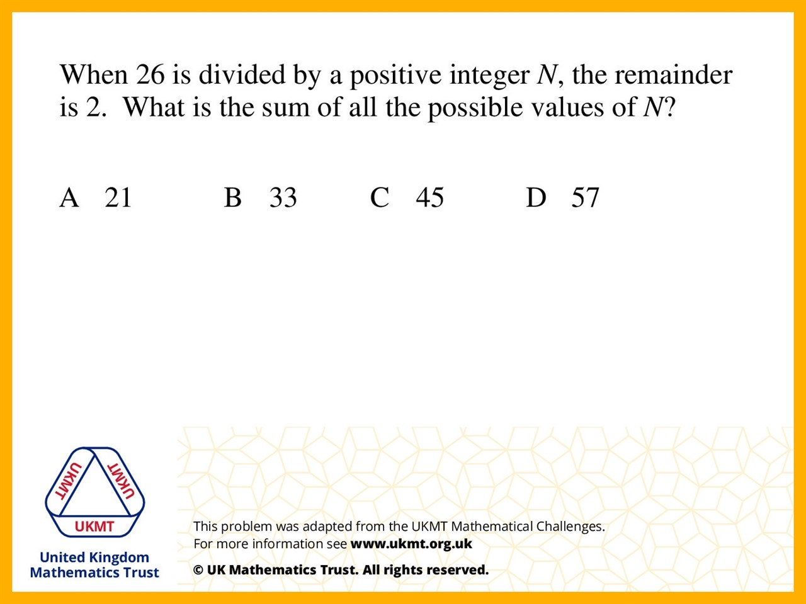
Q3.
Because if there isa remainder of 2 then
the N's must be factors of 24.
The numbers 24, 12, 3, 8, 4, 6 could be N.
These added together is 57.

Slide 5
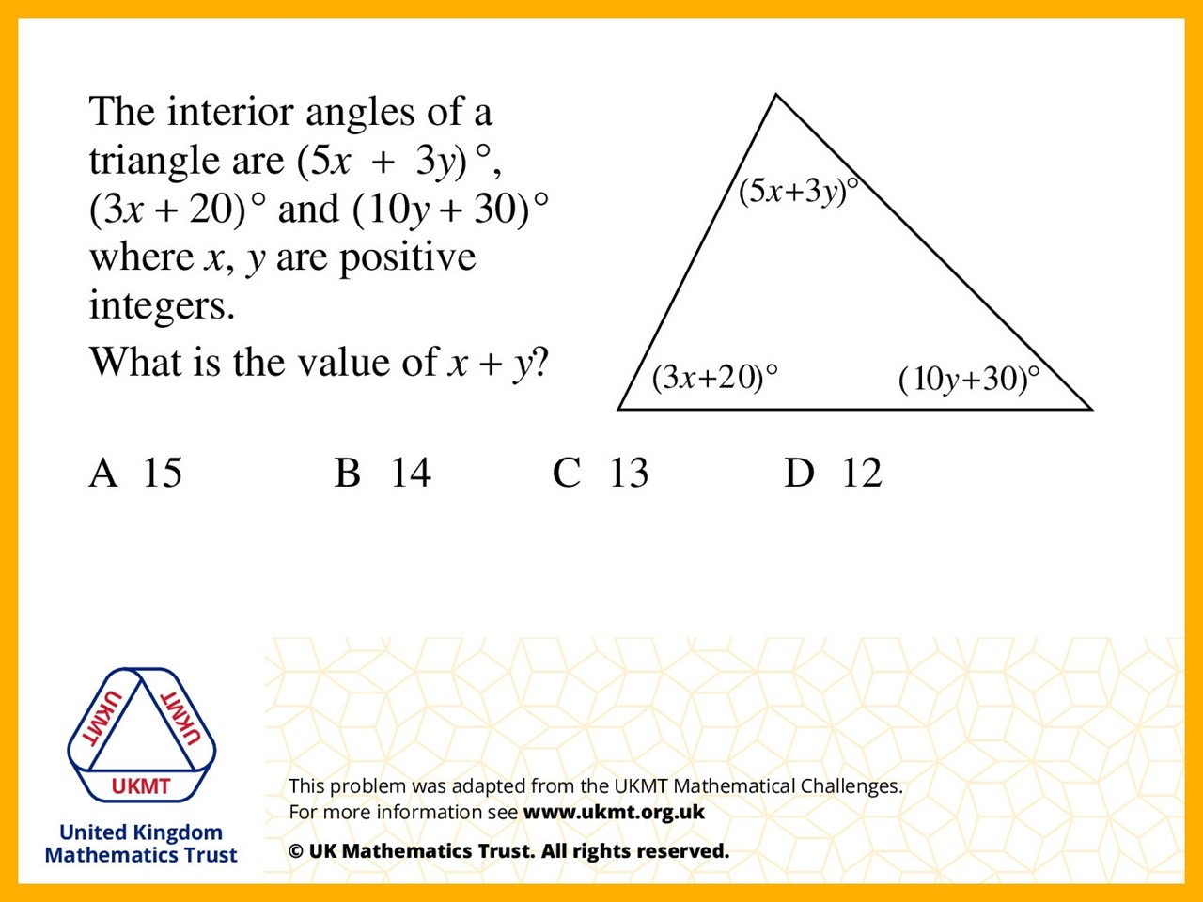
Q4.
5x + 3y + 3x + 20 + 10y + 30 = 180
8x + 13y + 50 = 180
13y + 8x = 130
X = 13 and y = 2
13 + 2 = 15

Slide 6
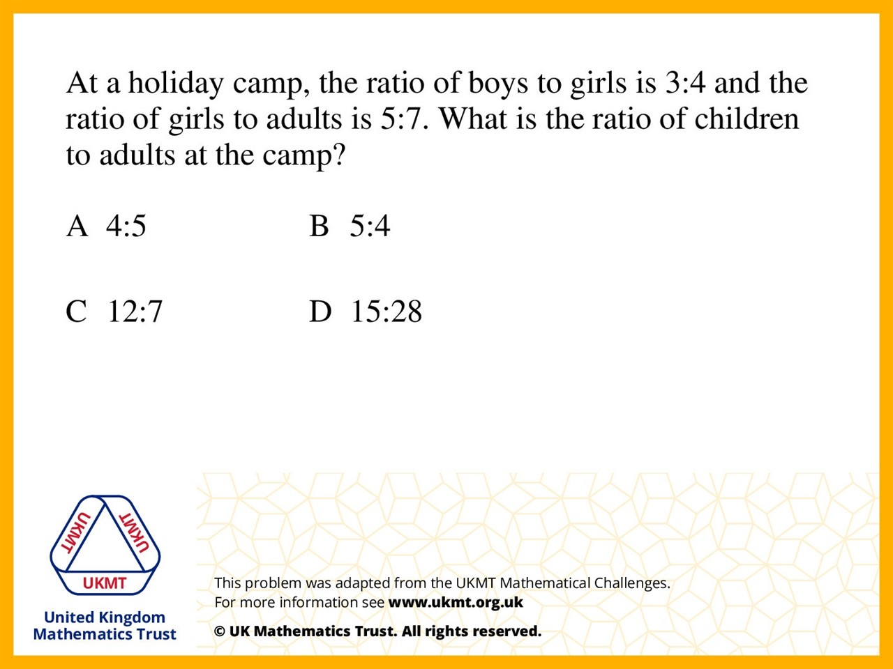
Q5.
3:4 = 15:20, 5:7 = 20:28, so if there are 28 adults there are 20 girls and 15 boys, giving a ratio of 35:28 which simplifies to 5:4.

