Slide 1
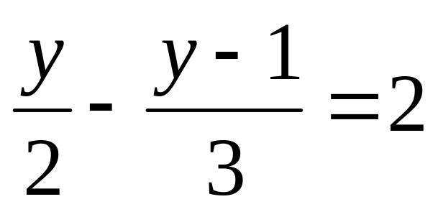
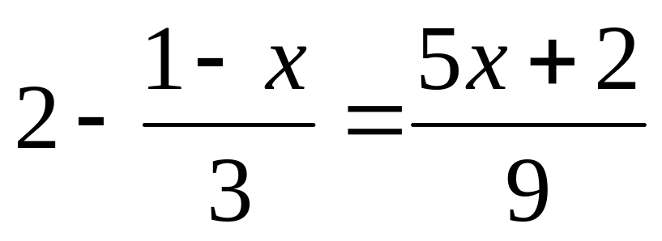
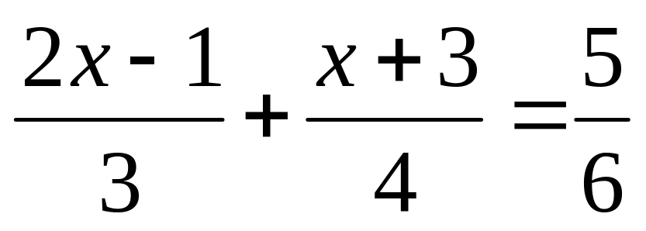
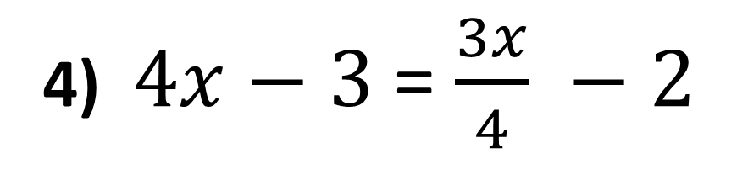
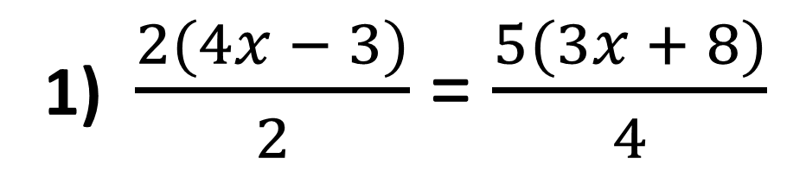
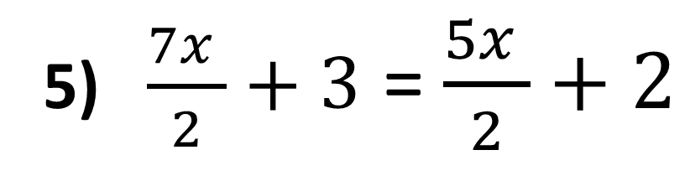
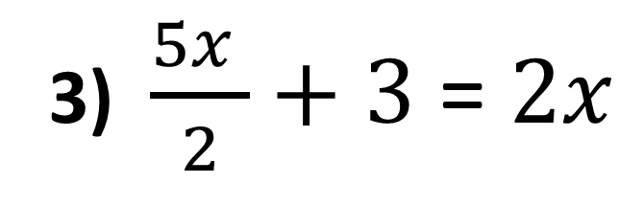
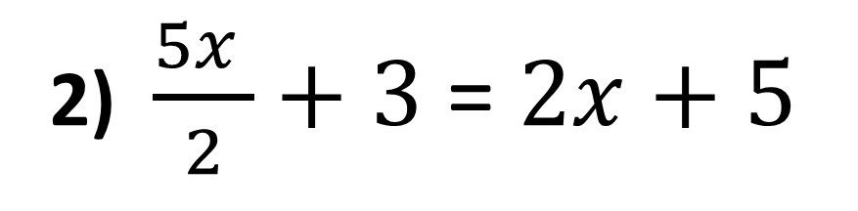
Extension
5) $\frac{7x }{2}+3$ = $\frac{5x }{2}+2$
1) $\frac{2(4x − 3)}{2}$ = $\frac{5(3x + 8)}{4}$
2) $\frac{5x }{2}+3$ = $2x+5$
6)
3) $\frac{5x }{2}+3$ = $2x$
7)
4) $4x−3$ = $\frac{3x}{4} −2$
8)

Slide 2
ANSWERS

Slide 3
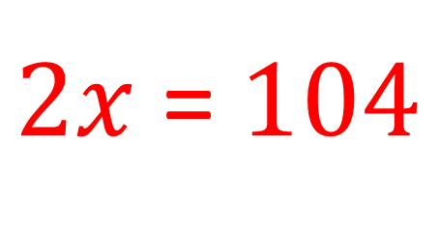
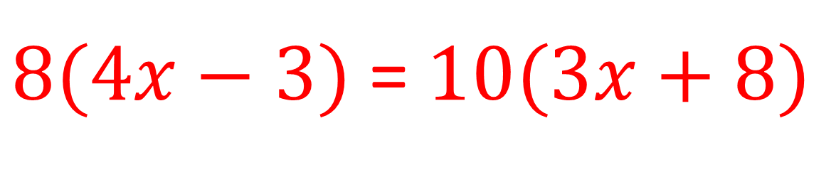
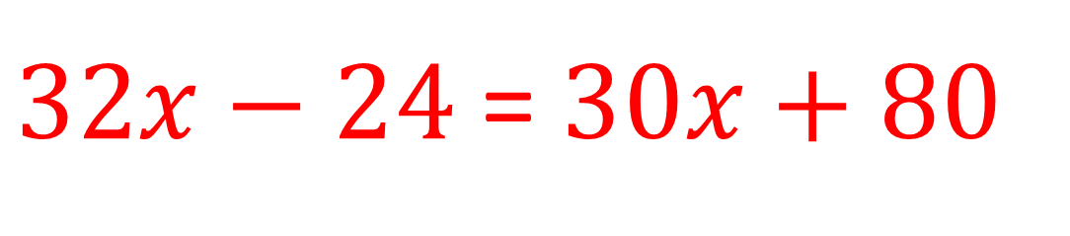
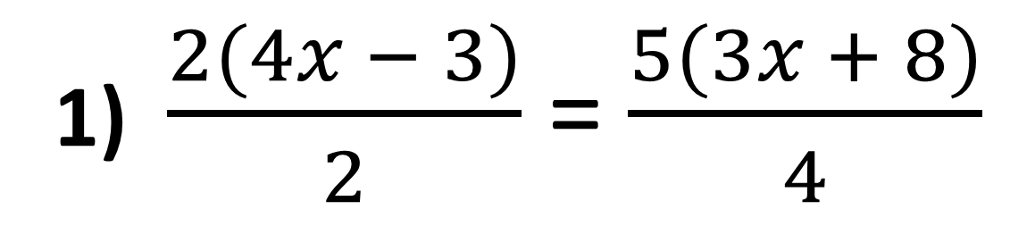
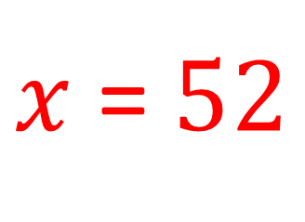
1) $\frac{2(4x − 3)}{2}$ = $\frac{5(3x + 8)}{4}$
$8(4x−3)$ = $10(3x+8)$
$32x−24$ = $30x+80$
$2x$ = $104$
$x$ = $52$

Slide 4
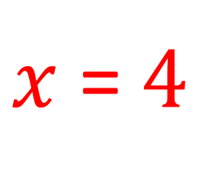
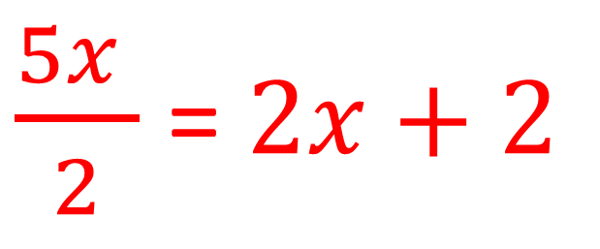
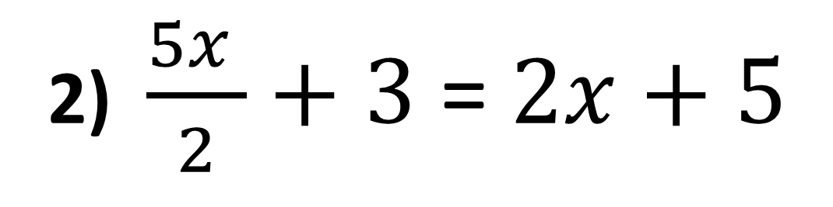
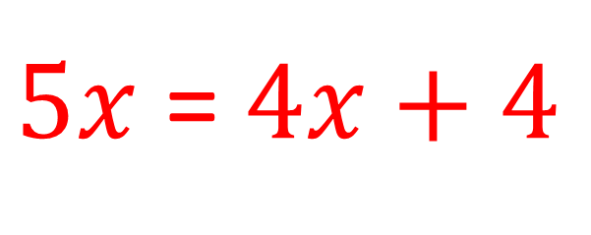
2) $\frac{5x }{2}+3$ = $2x+5$
$\frac{5x }{2}$ = $2x+2$
$5x$ = $4x+4$
$x$ = $4$

Slide 5
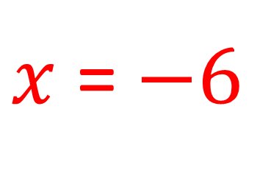
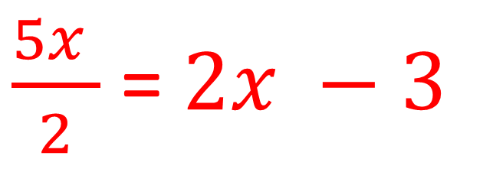
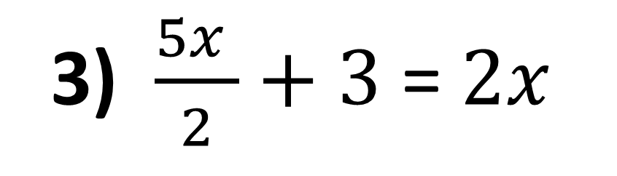
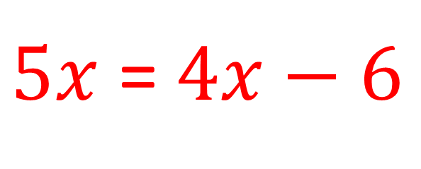
3) $\frac{5x }{2}+3$ = $2x$
$\frac{5x }{2}$ = $2x −3$
$5x$ = $4x−6$
$x$ = $−6$

Slide 6
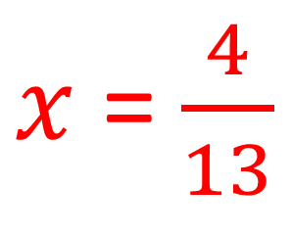
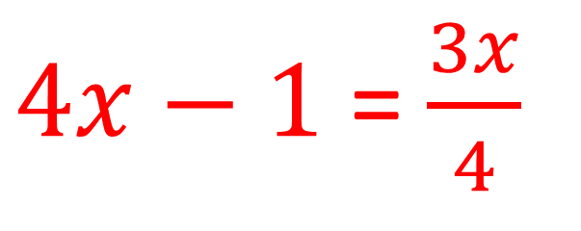
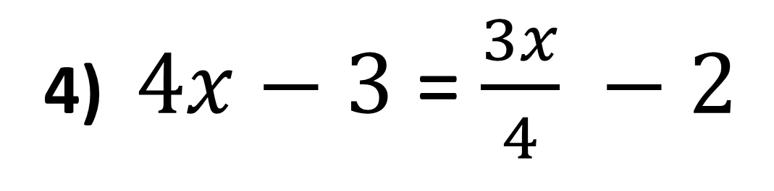
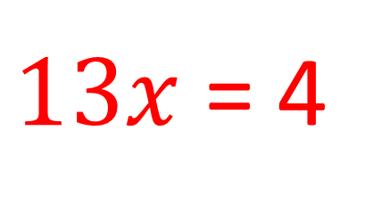
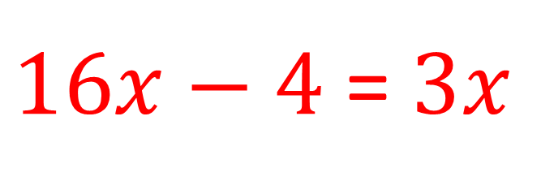
4) $4x−3$ = $\frac{3x}{4} −2$
$4x−1$ = $\frac{3x}{4}$
$16x−4$ = $3x$
$13x$ = 4
$x$ = $\frac{4}{13}$

Slide 7
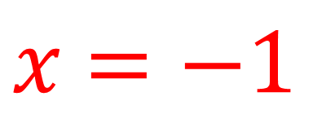
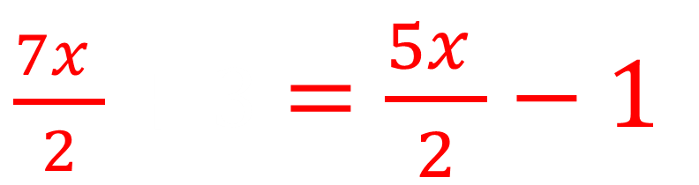
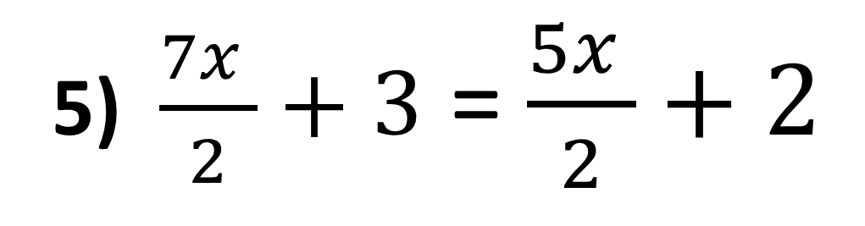
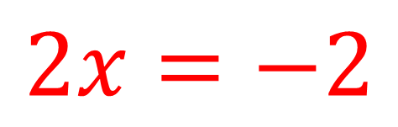
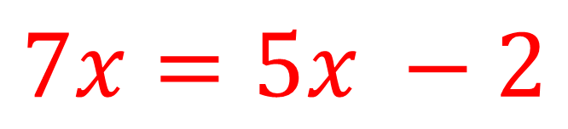
5) $\frac{7x }{2}+3$ = $\frac{5x }{2}+2$
$\frac{7x }{2}+3$ $=\frac{5x }{2}−1$
$$7x=5x −2$$
$$2x=−2$$
$x$ $=−1$

Slide 8
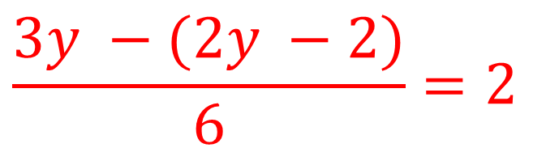
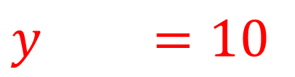
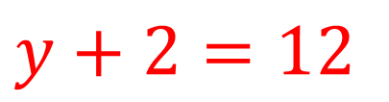
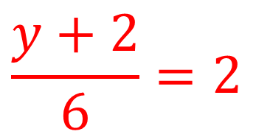
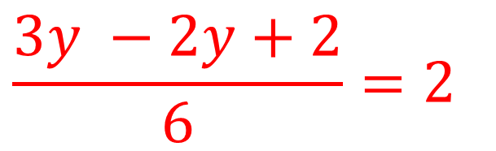
6)
$$y+2=12$$
$$y+2=10$$
$$\frac{3y −(2y −2)}{6}=2$$
$$\frac{3y −2y+2}{6}=2$$
$$\frac{y+2}{6}=2$$

Slide 9
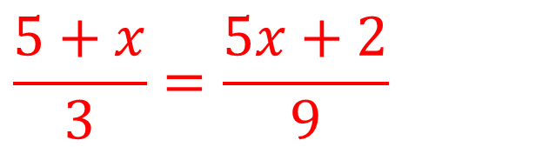
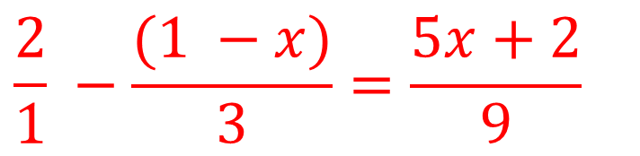
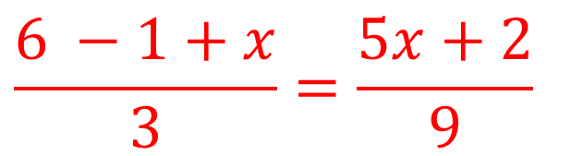
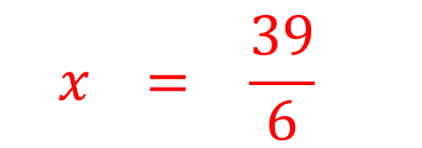
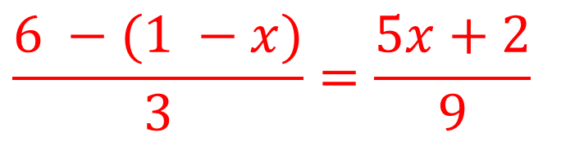


7)
$$\frac{5+x}{3}=\frac{5x+2}{9}$$
$$\frac{2}{1} −\frac{(1 −x)}{3}=\frac{5x+2}{9}$$
$$45+9x=15x+6$$
$$\frac{6 −(1 −x)}{3}=\frac{5x+2}{9}$$
$$39+9x=16x+6$$
$$−x =5\frac{39}{6}$$
$$\frac{6 −1+x}{3}=\frac{5x+2}{9}$$

Slide 10
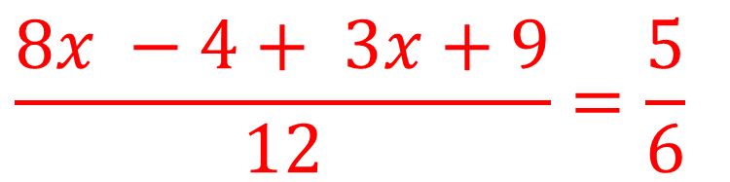
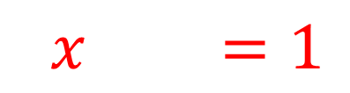
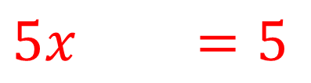
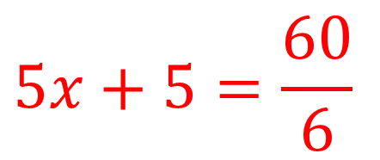
8)
$$\frac{8x −4+ 3x+9}{12}=\frac{5}{6}$$
$$5x+5=\frac{60}{6}$$
$$5x+5=5$$
$$5x+5=1$$

