Slide 1
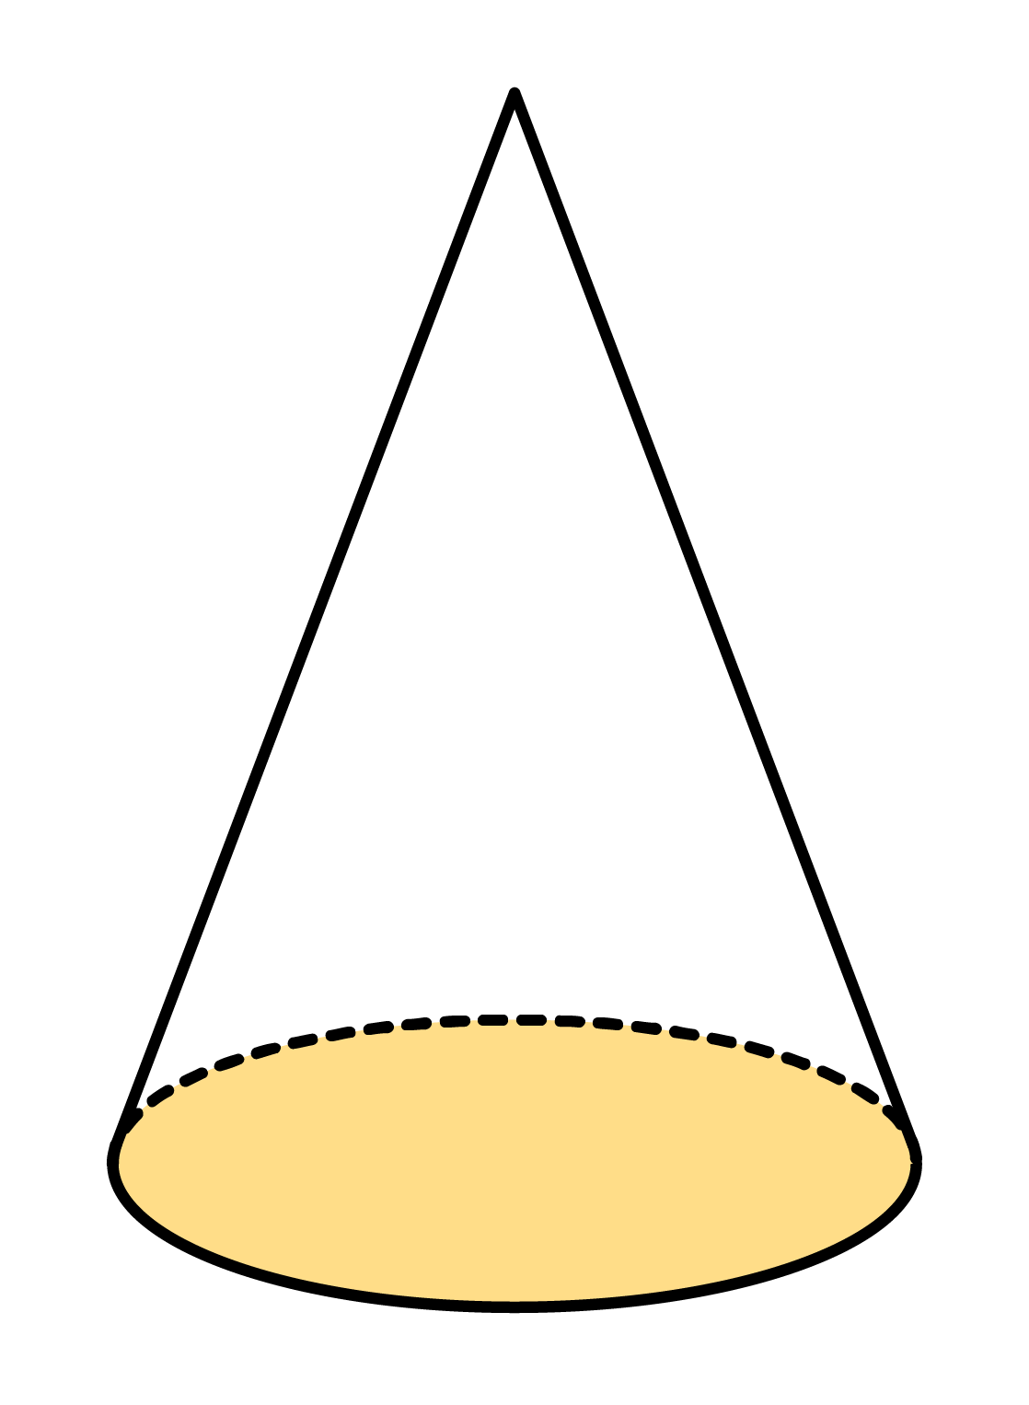
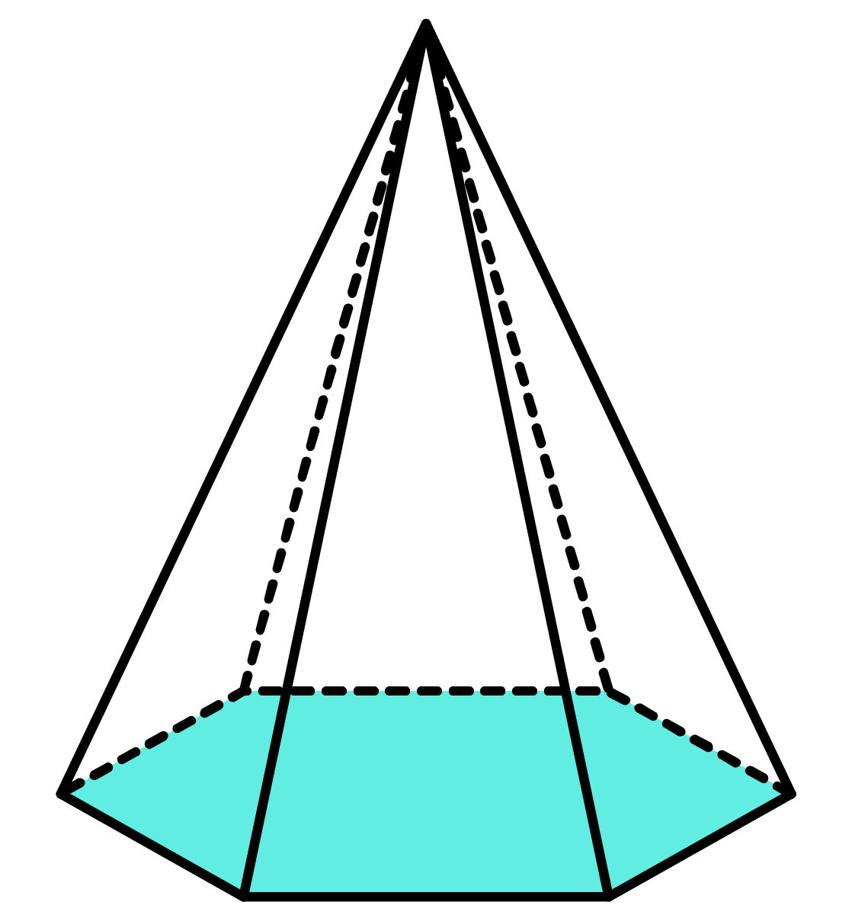
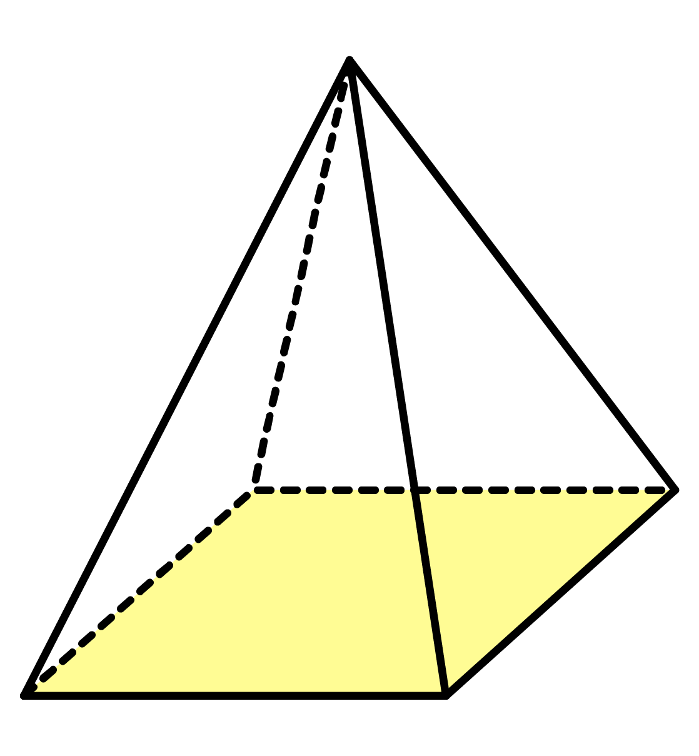
Q1. Work out the volume of each of the following pyramids.
a)
b)
c)
11m
12ft
8yd
Area
Area
Area
12m²
13.5yd²
22ft²

Slide 2
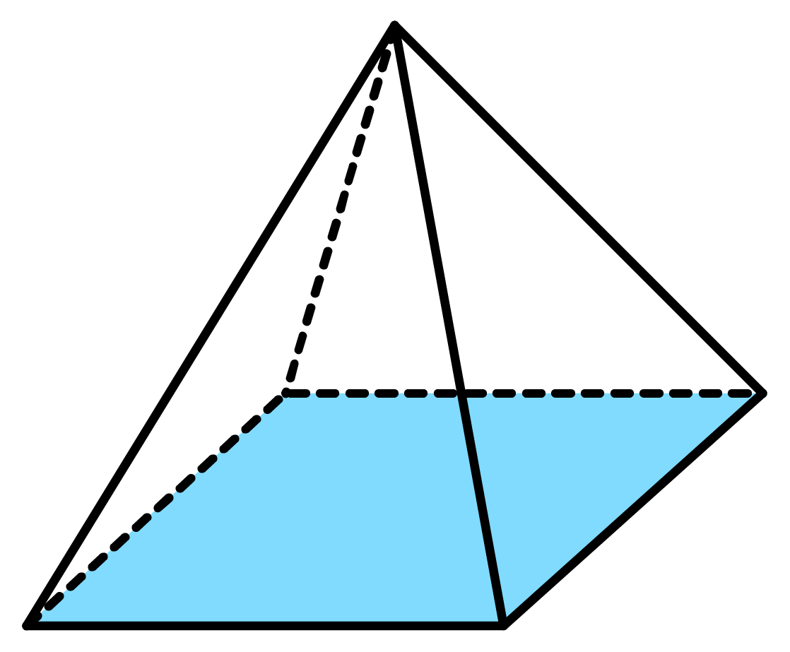
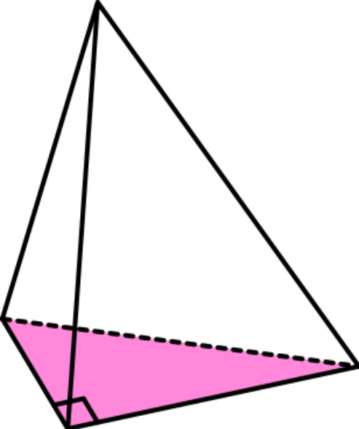
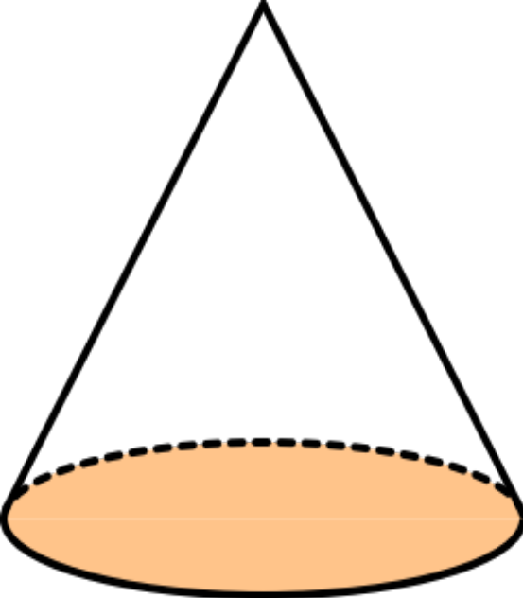
Q2. Work out the volume of each of the following pyramids.
a)
b)
c)
9cm
9cm
5mm
7cm
4cm
7cm
7cm
6mm

Slide 3
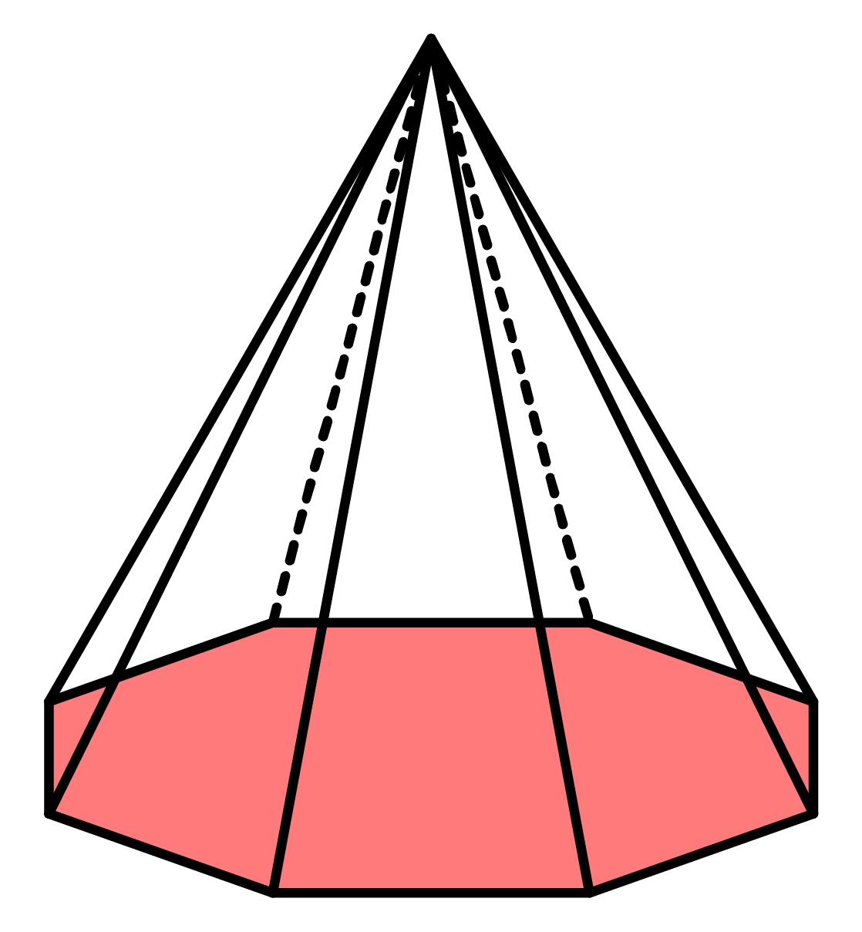
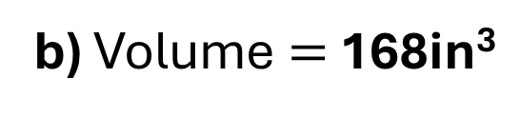
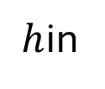
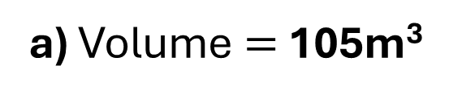
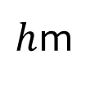
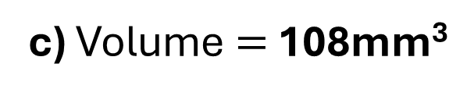
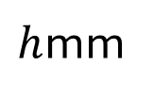
Q3. Work out the height of each of the following pyramids given their volume.
a) Volume $=$ 105m³
b) Volume $=$ 168in³
c) Volume $=$ 108mm³
$h$in
$h$mm
$h$m
Area
Area
Area
15m²
63in²
27mm

Slide 4
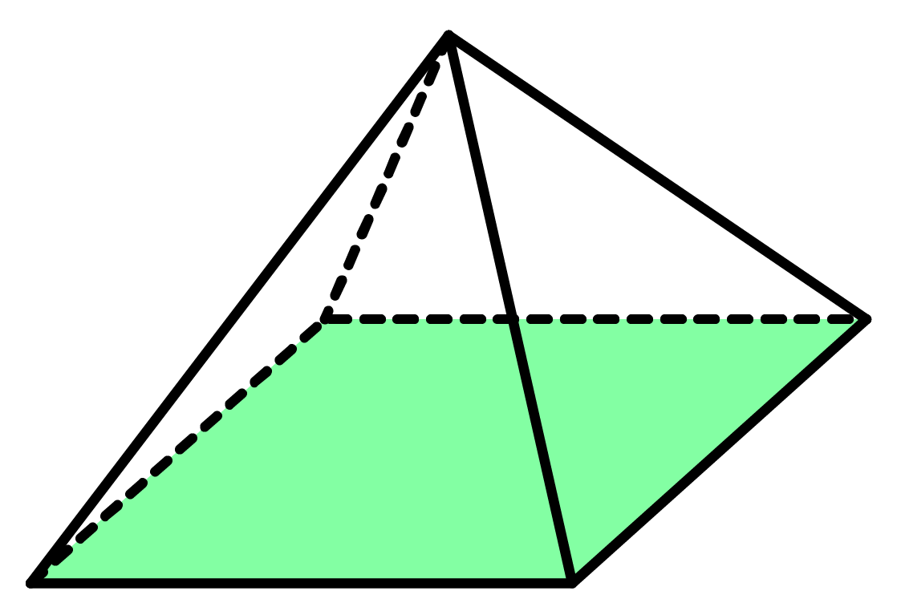

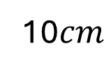
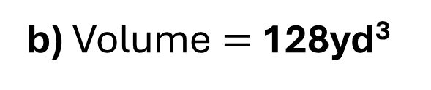
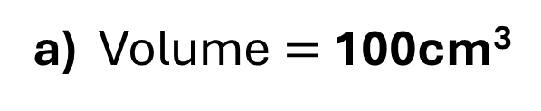

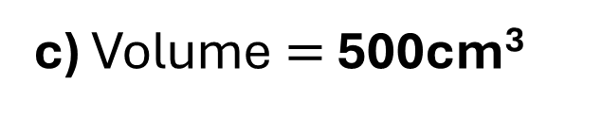

Q4. Work out the missing length of each of the following pyramids given their volume.
a) Volume $=$ 100cm³
b) Volume $=$ 128yd³
c) Volume $=$ 500cm³
12cm
6yd
¹⁰$cm$
$$r$$
$$l$$
$$l$$
Give you answer to the nearest cm.

Slide 5
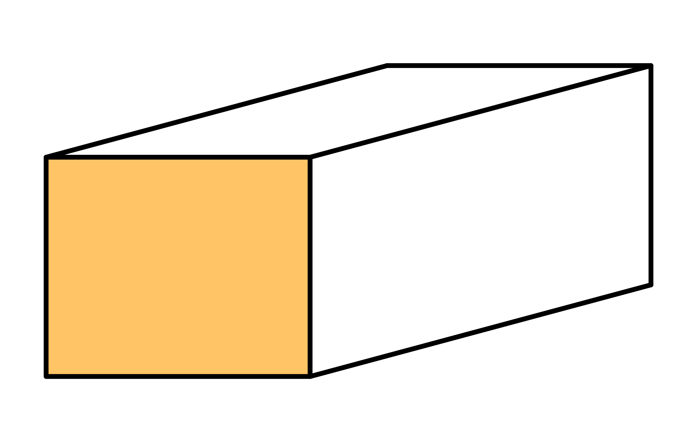
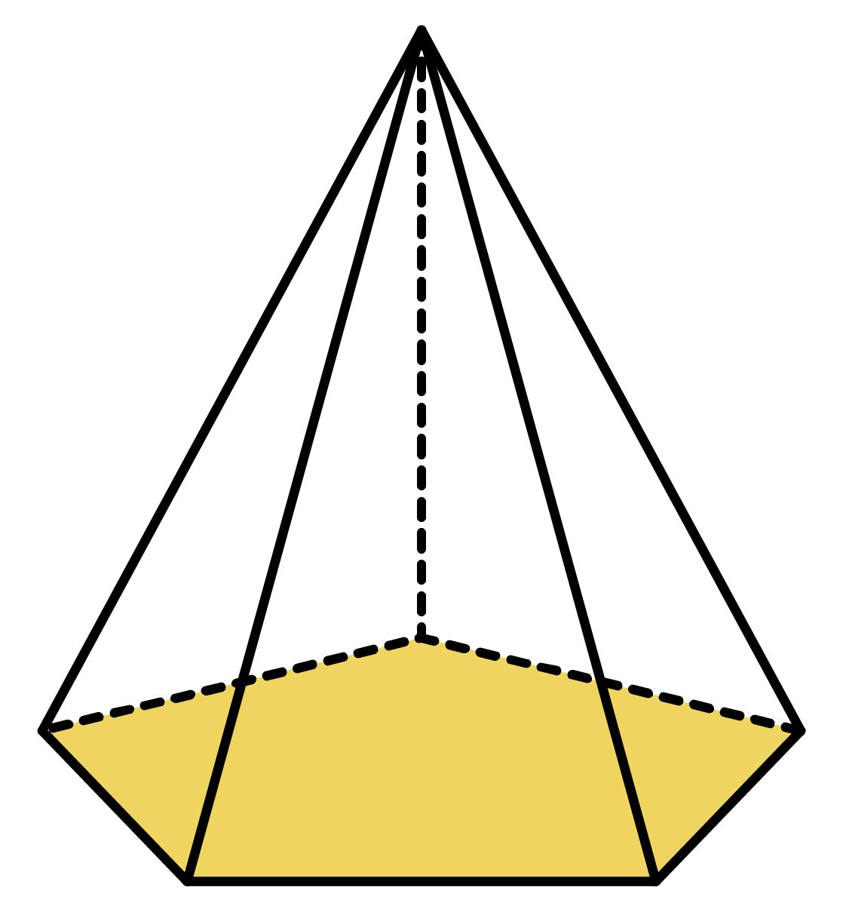
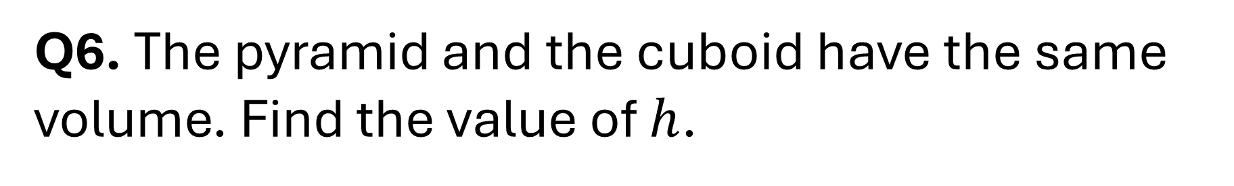
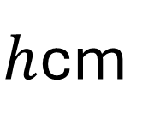
Q6. The pyramid and the cuboid have the same volume. Find the value of $h$.
5cm
$h$cm
6cm
7cm
Area
42cm²

Slide 6
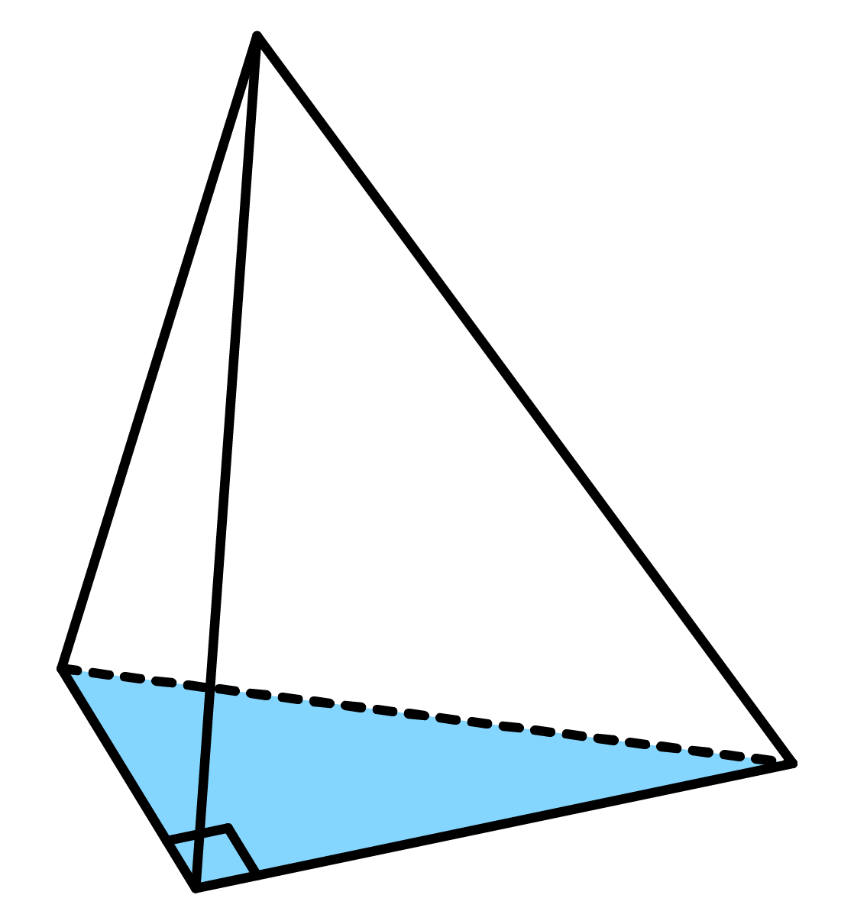
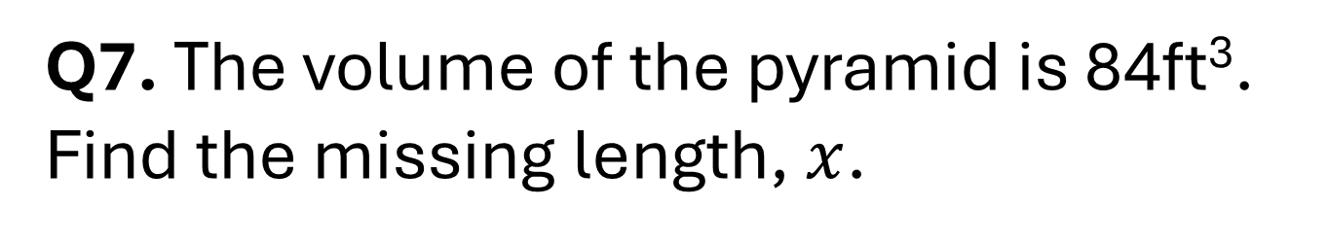
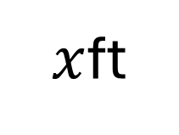
Q7. The volume of the pyramid is 84ft³.
Find the missing length, $x$.
21ft
$x$ft
8ft

Slide 7
ANSWERS

Slide 8
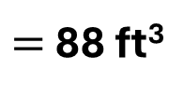
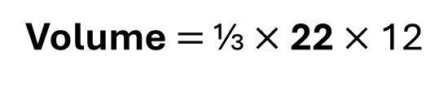
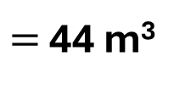
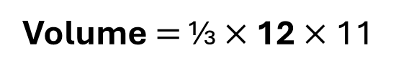
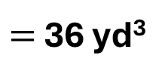
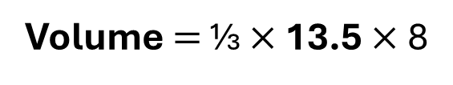
Q1. Work out the volume of each of the following pyramids.
a)
b)
c)
11m
12ft
8yd
Area
Area
Area
12m²
13.5yd²
22ft²
Volume $=$ ⅓ $×$ 12 $×$ 11
Volume $=$ ⅓ $×$ 22 $×$ 12
Volume $=$ ⅓ $×$ 13.5 $×$ 8
$=$ 44 m³
$=$ 88 ft³
$=$ 36 yd³

Slide 9
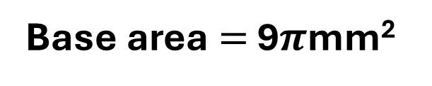
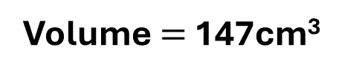
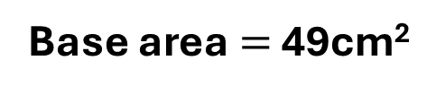
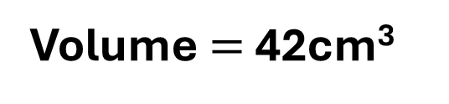
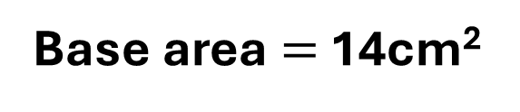
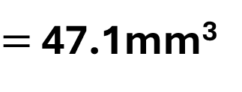

Q2. Work out the volume of each of the following pyramids.
a)
b)
c)
9cm
9cm
5mm
7cm
4cm
7cm
7cm
6mm
Base area $=$ 49cm²
Base area $=$ 14cm²
Base area $=$ 9$π$mm²
Volume $=$ 147cm³
Volume $=$ 42cm³
Volume $=$ 15$π$mm³
$=$ 47.1mm³

Slide 10
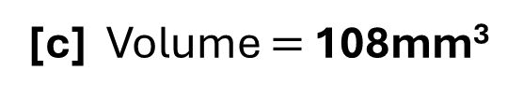

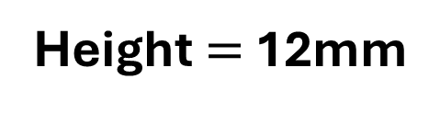
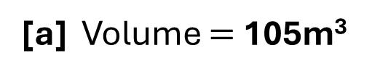
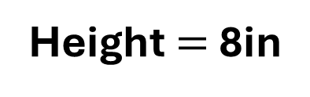
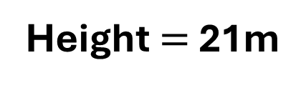
Q3. Work out the height of each of the following pyramids given their volume.
[a] Volume $=$ 105m³
[b] Volume $=$ 168in³
[c] Volume $=$ 108mm³
$h$in
$h$mm
$h$m
Area
Area
Area
15m²
63in²
27mm
Height $=$ 21m
Height $=$ 8in
Height $=$ 12mm

Slide 11
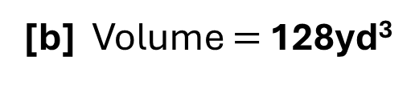
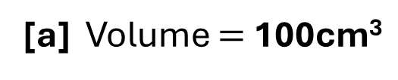
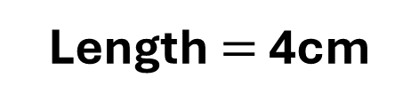
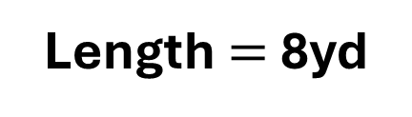
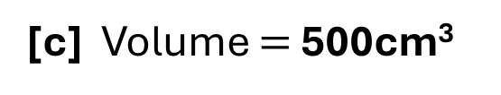


Q4. Work out the missing length of each of the following pyramids given their volume.
[a] Volume $=$ 100cm³
[b] Volume $=$ 128yd³
[c] Volume $=$ 500cm³
12cm
6yd
¹⁰$cm$
$$r$$
$$l$$
$$l$$
Give you answer to the nearest cm.
Length $=$ 5cm
Length $=$ 8yd
Length $=$ 4cm

Slide 12
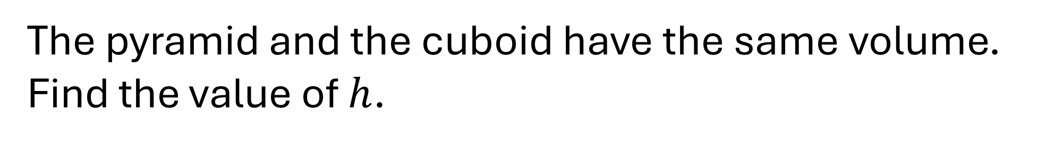
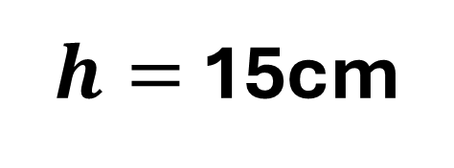
The pyramid and the cuboid have the same volume. Find the value of $h$.
5cm
$h$cm
6cm
7cm
Area
42cm²
$h=$ 15cm

Slide 13

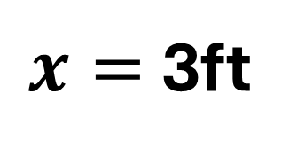
Given that the volume of the pyramid is 84ft³, find the missing length, $x$.
21ft
$x$ft
$x=$ 3ft
8ft

