Slide 1
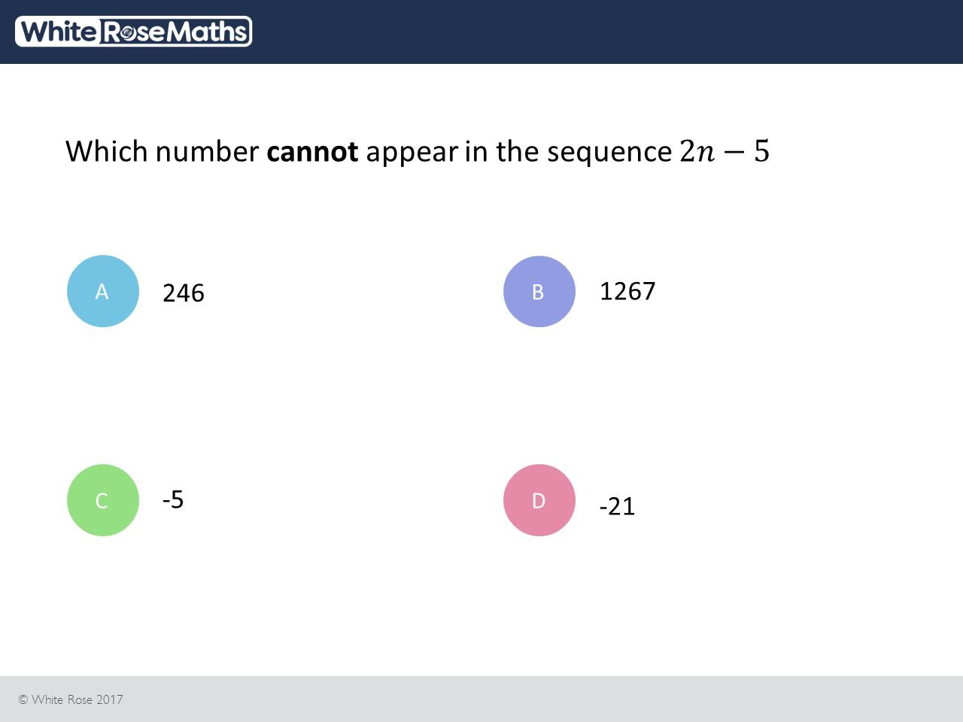
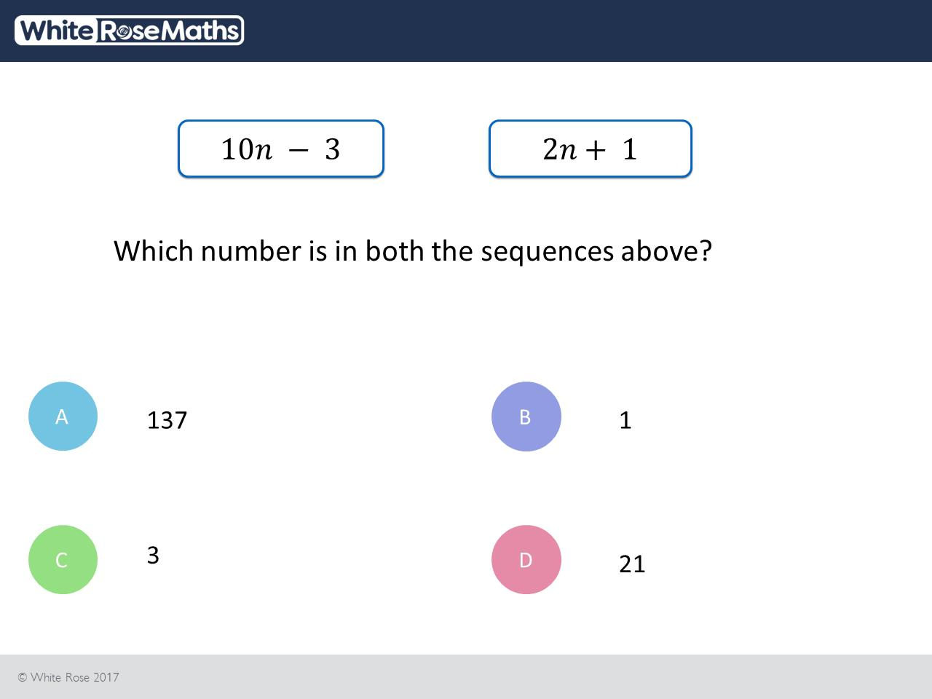
Worst answered question?
Most common wrong answer?

Slide 2
ANSWERS

Slide 3
Worst answered question?

Slide 4
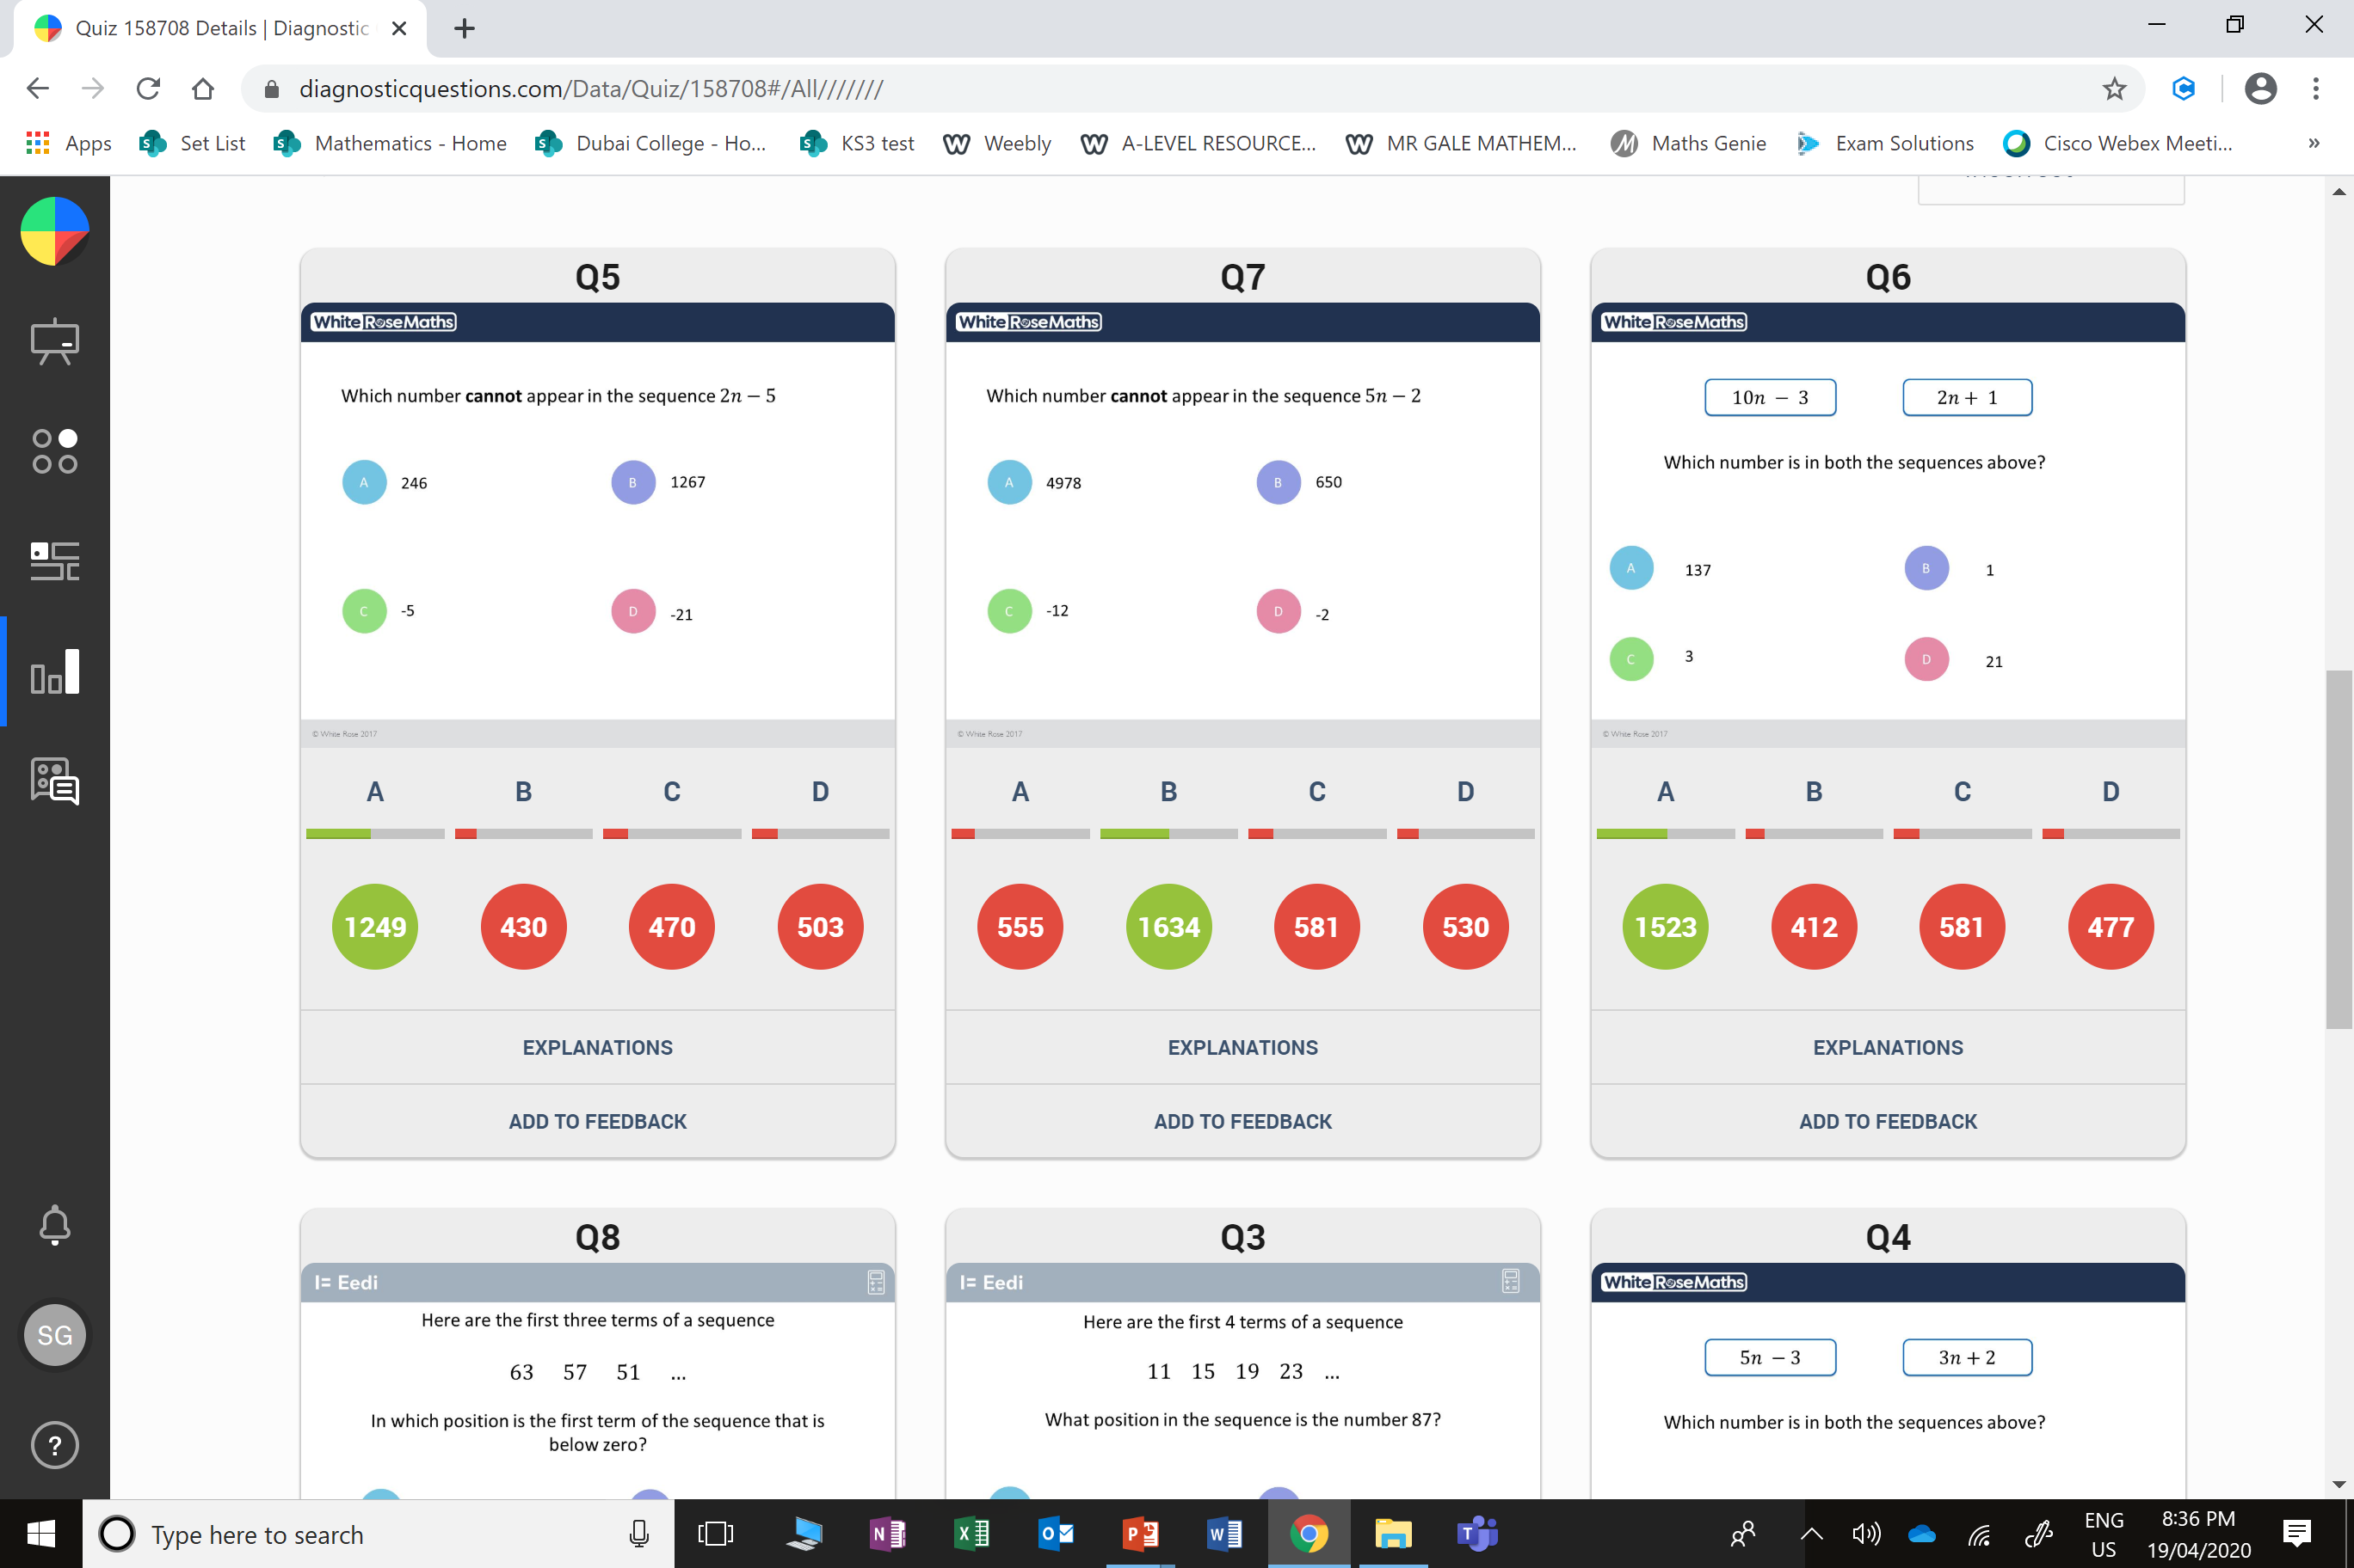
D
The student has picked a number that can appear in the sequence. Any odd number can appear in the sequence.

Slide 5
C
The student may have made an error when substituting in n = 0 into the first sequence.

