Slide 1
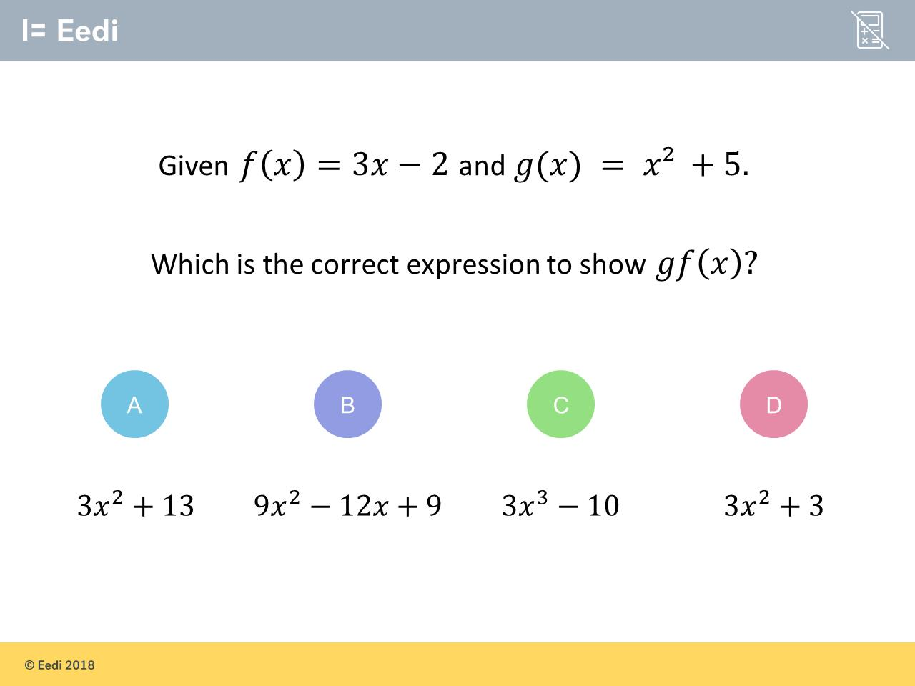
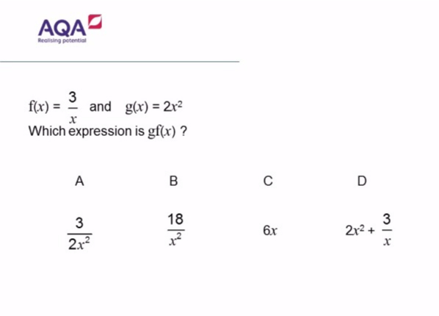
Worst answered question?
Most common wrong answer?

Slide 2
ANSWERS

Slide 3
Worst answered question?

Slide 4
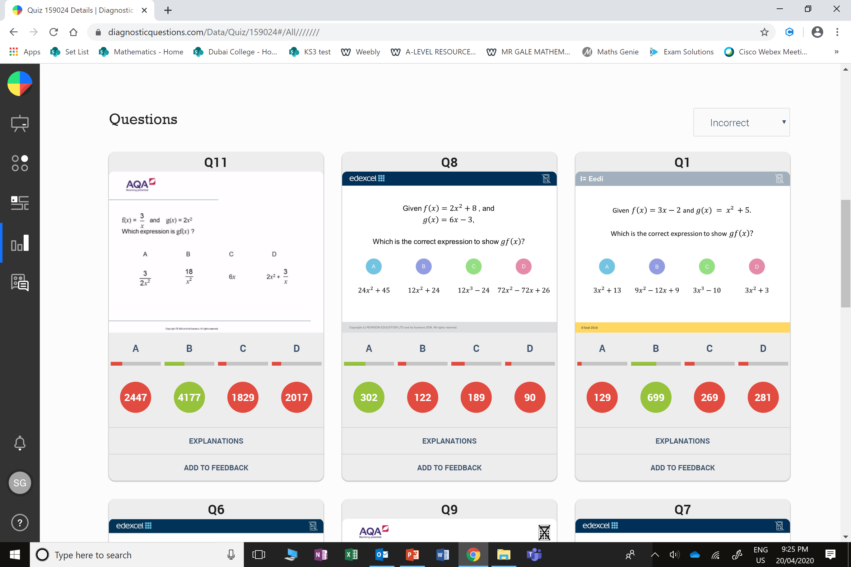
A
The student has found fg(x)

Slide 5
C
The student has found g(x) f(x)

