Slide 1
LO: Graphs of Functions with more than
one domain

Slide 2
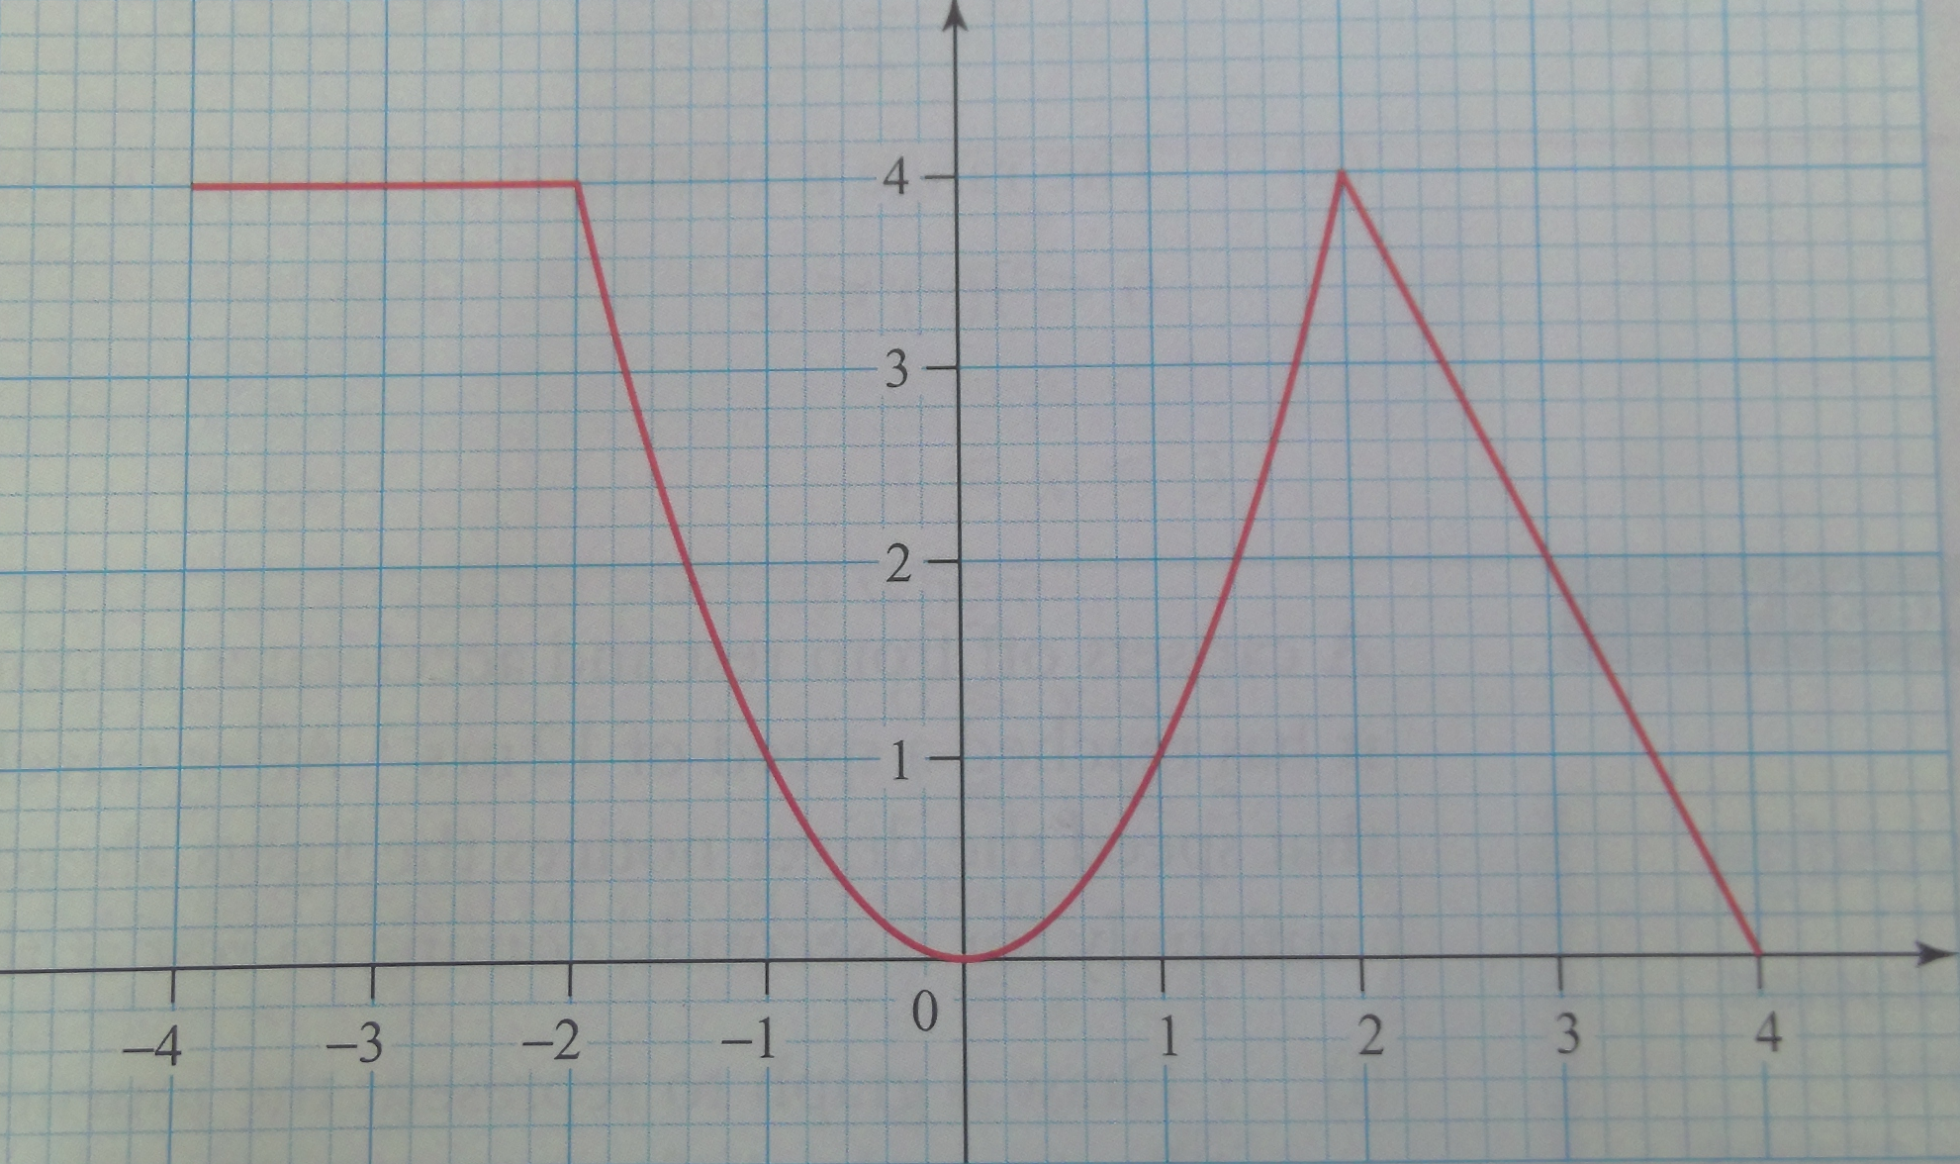
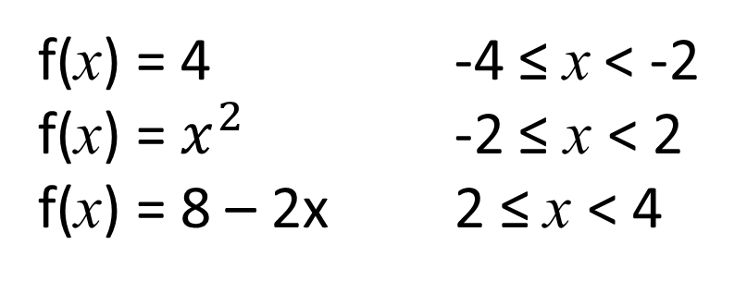
Draw the graph of y = f(x) where
f(x) = 4 -4 ≤ x < -2
f(x) = $x^{2}$ -2 ≤ x < 2
f(x) = 8 – 2x 2 ≤ x < 4

Slide 3
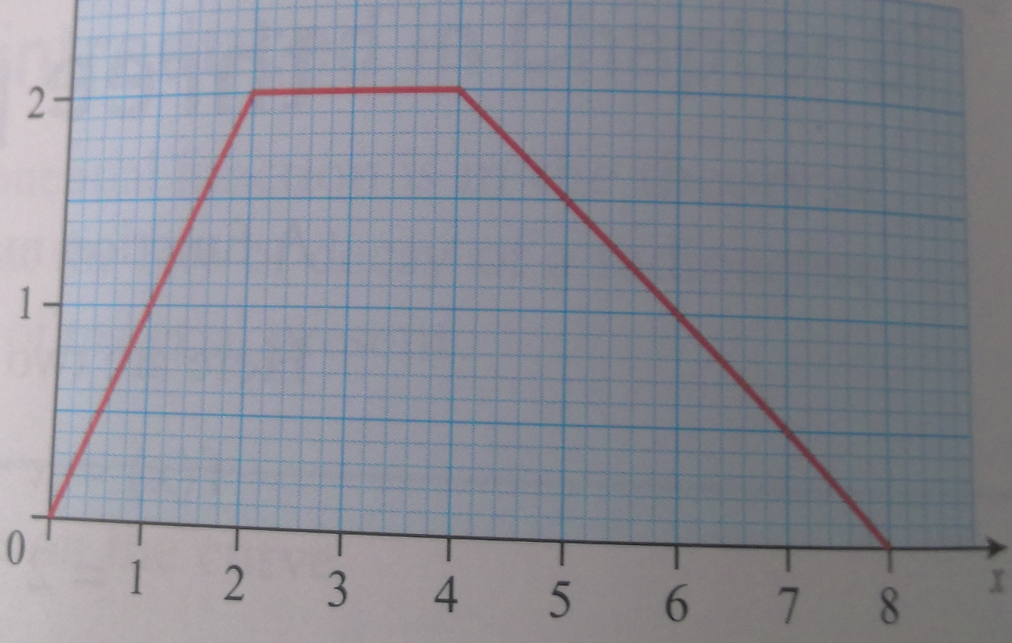
Here is the graph of y = f(x)
(i) Define f(x) stating clearly the domain for each part
(ii) State the range of f(x)

Slide 4
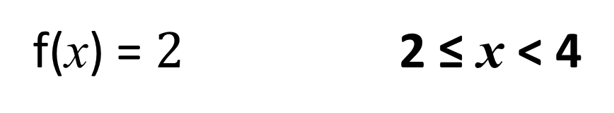
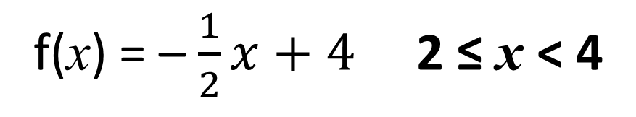
Here is the graph of y = f(x)
(i) Define f(x) stating clearly the domain for each part
f(x) = x 0 ≤ x < 2
f(x) = $2$ 2 ≤ x < 4
f(x) = – $\frac{1}{2}x+4$ 2 ≤ x < 4

Slide 5
Here is the graph of y = f(x)
(ii) State the range of f(x)
0 ≤ f(x) ≤ 2

Slide 6
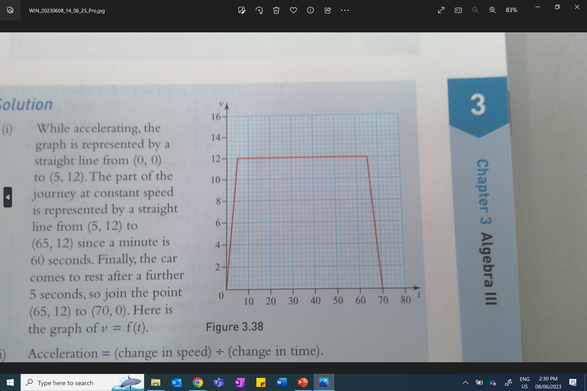
A car sets off from rest and accelerates uniformly for 5 seconds. After which it has reached a speed of 12ms-1. After traveling for a further minute at that speed the drive notices the lights ahead change to red so decelerates uniformly for 5 seconds, coming to rest at the lights.
(i) Work out the acceleration for each of the three stages of the journey.
2.4m⁻², 0, -2.4m⁻²
(ii) Work out the total distance travelled.
780m

