Slide 1
Sequences and Series
Sum of Arithmetic Series
Chapter 3
(Part 2 of 8)

Slide 2
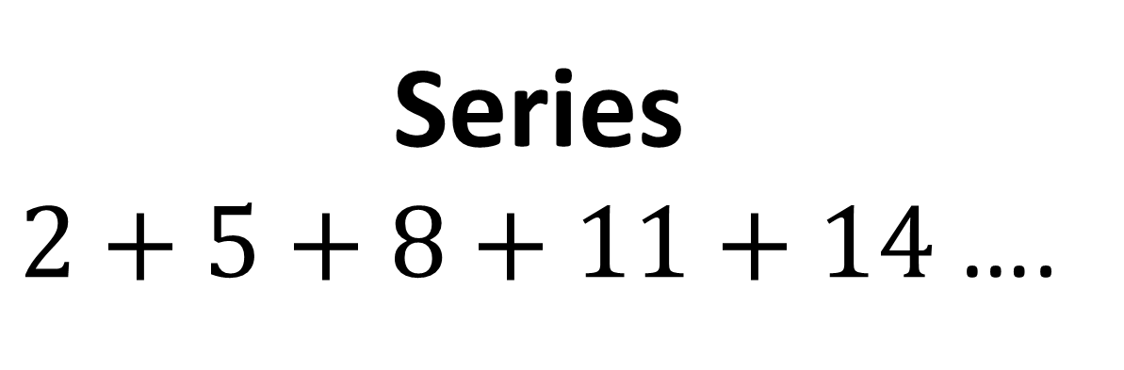
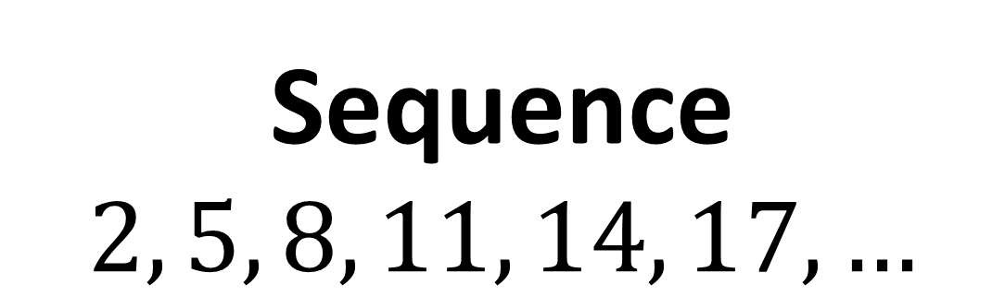
A series is a sum of terms in a sequence.
Sequence
$$2, 5, 8, 11, 14, 17, …$$
Series
$2+5+8+11+14$ ….

Slide 3

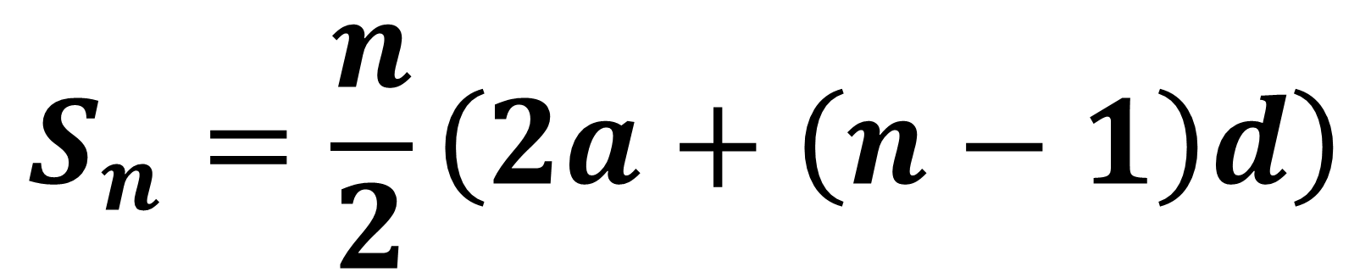
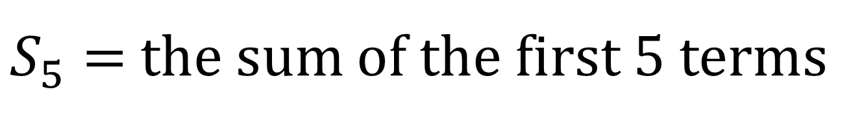
Sum of first $n$ terms
$$S_{n}=\frac{n}{2}\left(2a+\left(n−1\right)d\right)$$
$S_{5}=$ the sum of the first 5 terms

Slide 4
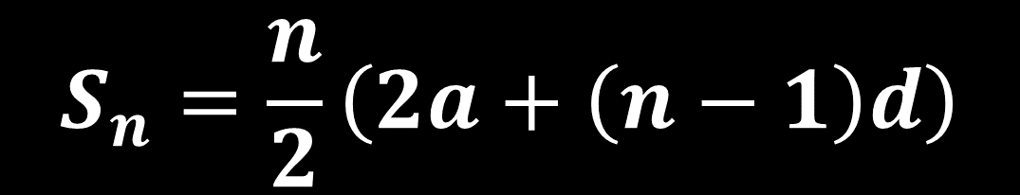
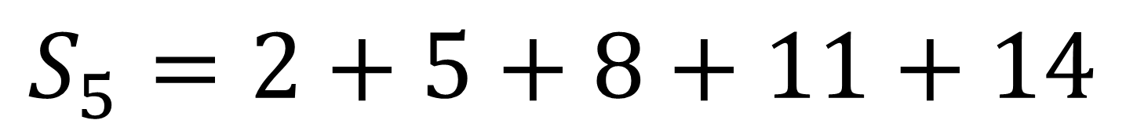
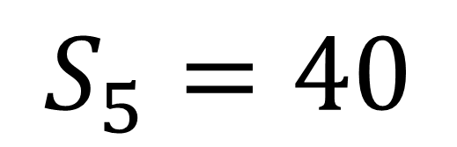
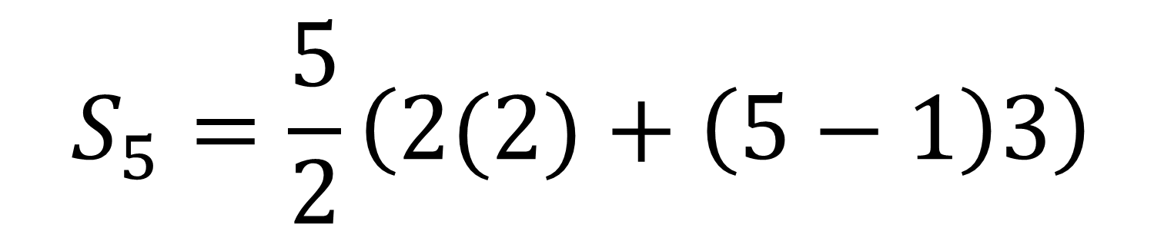
$$S_{5}=2+5+8+11+14$$
$$S_{n}=\frac{n}{2}\left(2a+\left(n−1\right)d\right)$$
$$S_{5}=\frac{5}{2}\left(2(2)+\left(5−1\right)3\right)$$
$$S_{5}=40$$

Slide 5
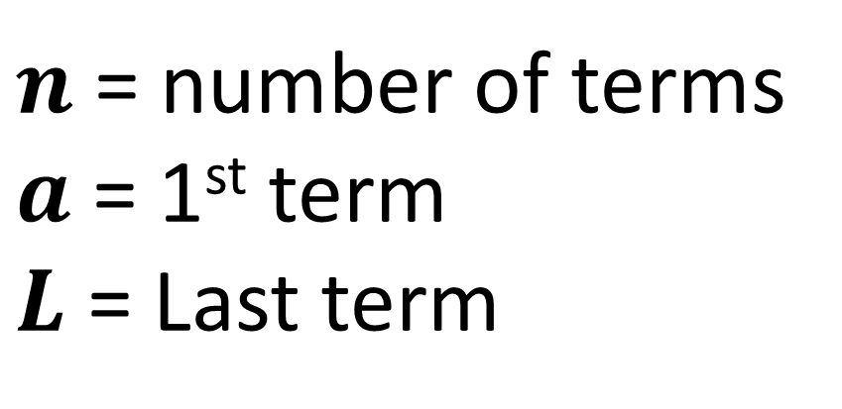
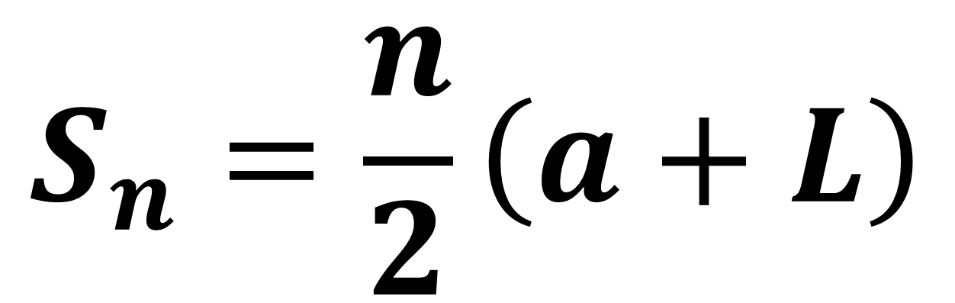
Arithmetic Series - Alternative Formula
$$S_{n}=\frac{n}{2}\left(a+L\right)$$
$n$ = number of terms
$a$ = 1st term
$L$ = Last term

Slide 6
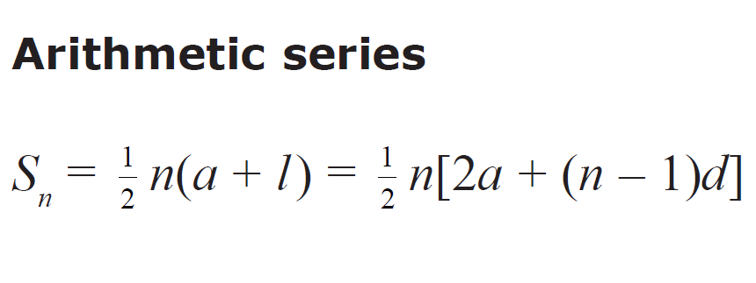
The Series formula can be found in the formula booklet.

Slide 7
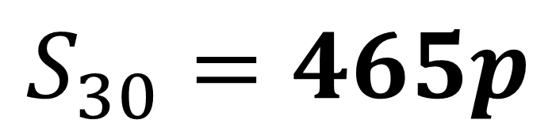

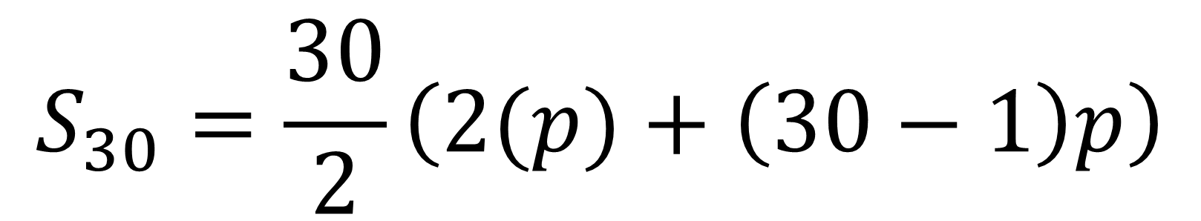
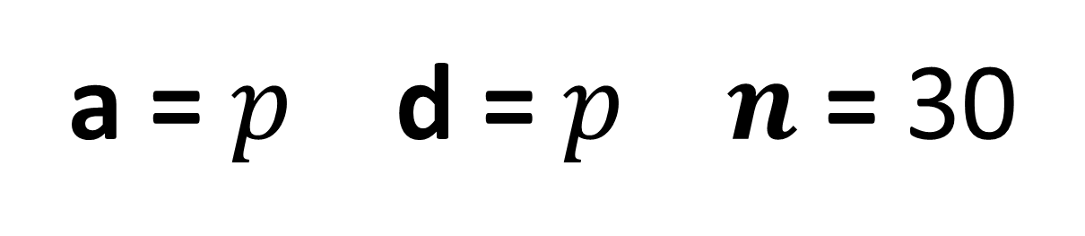
Find the sum of the first 30 terms of the following arithmetic sequence
$$p+2p+3p+…$$
a = $p$ d = $p n$ = 30
$$S_{30}=\frac{30}{2}\left(2(p)+\left(30−1\right)p\right)$$
$$S_{30}=465p$$

Slide 8
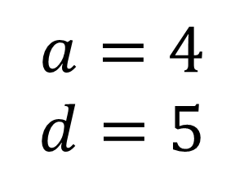

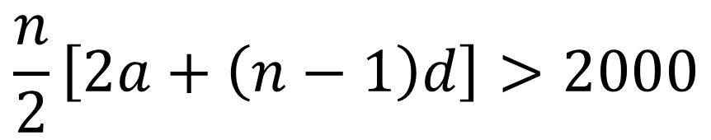
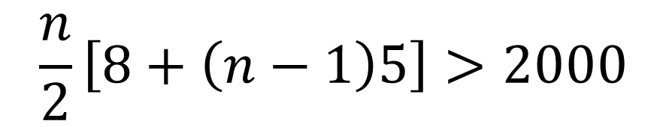
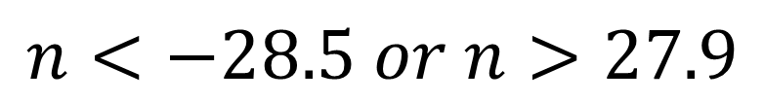
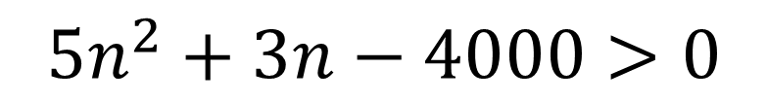

Find the greatest number of terms for the sum of $4+9+14+…$ to exceed 2000.
$$S_{n}>2000$$
$$\frac{n}{2}\left[8+\left(n−1\right)5\right]>2000$$
$$a=4$$
$$d=5$$
$$5n^{2}+3n−4000>0$$
$$n<−28.5 or n>27.9$$
$$\frac{n}{2}\left[2a+\left(n−1\right)d\right]>2000$$
So 28 terms needed

Slide 9
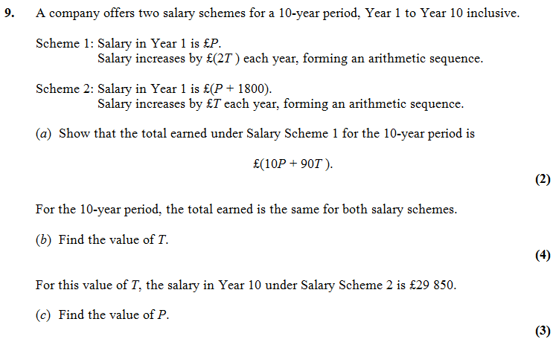

Slide 10
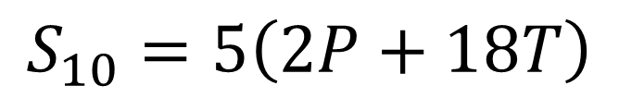
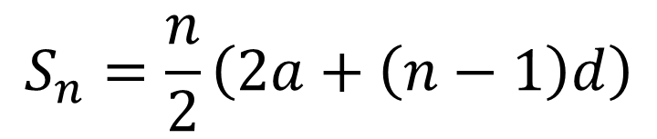
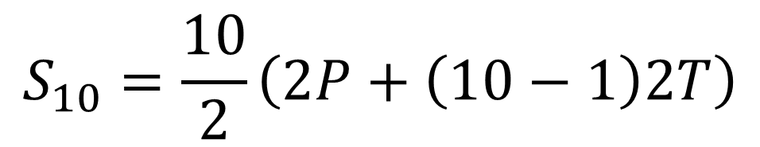



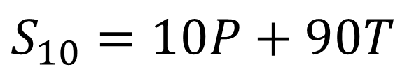
$$a=P$$
$$S_{10}=\frac{10}{2}\left(2P+\left(10−1\right)2T\right)$$
$$d=2T$$
$$n=10$$
$$S_{10}=5\left(2P+18T\right)$$
$$S_{n}=\frac{n}{2}\left(2a+\left(n−1\right)d\right)$$
$$S_{10}=10P+90T$$

Slide 11
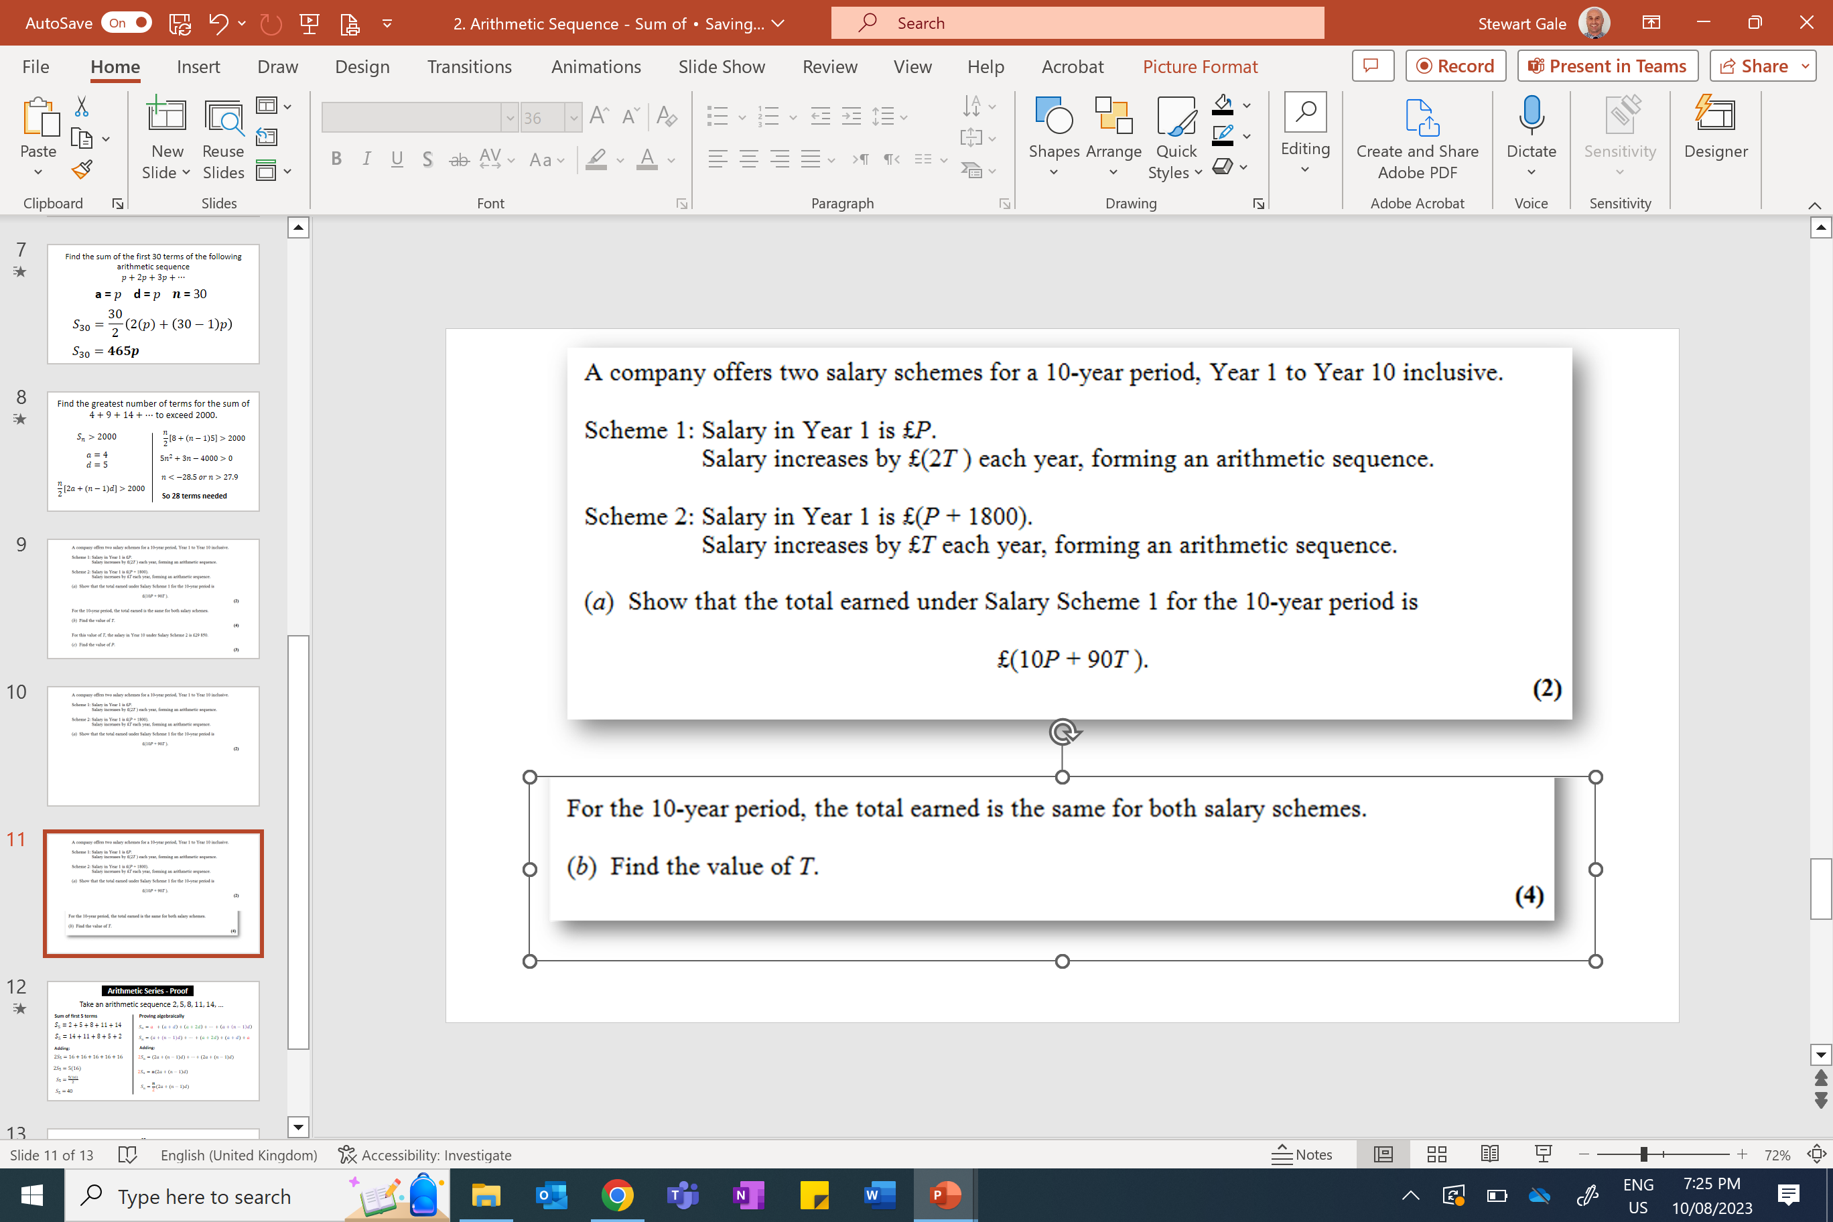
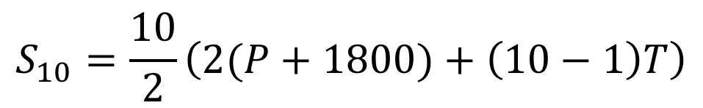




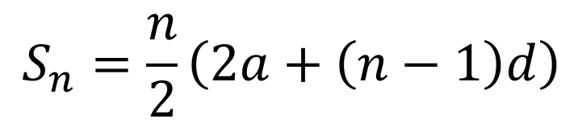

$$a=P+1800$$
$$S_{10}=\frac{10}{2}\left(2(P+1800)+\left(10−1\right)T\right)$$
$$d=T$$
$$n=10$$
$$S_{10}=5\left(2P+3600+9T\right)$$
$$S_{n}=\frac{n}{2}\left(2a+\left(n−1\right)d\right)$$
$$S_{10}=10P+18000+45T$$

Slide 12
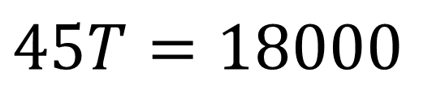
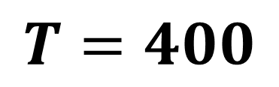
$$10P+90T=10P+18000+45T$$
$$45T=18000$$
$$T=400$$

Slide 13
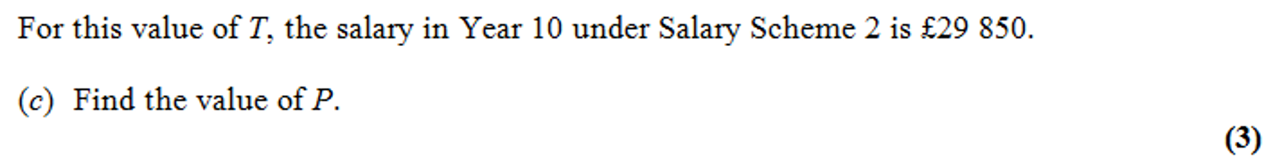
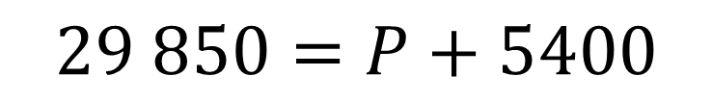

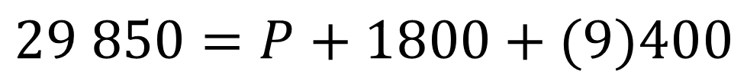
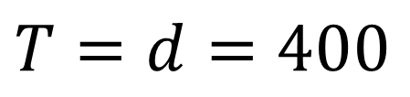
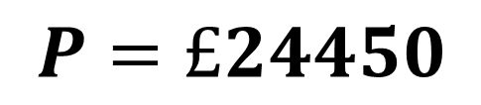
$$29 850=P+1800+(9)400$$
$$T=d=400$$
$$29 850=P+5400$$
$$u_{n}=a+\left(n−1\right)d$$
$$P=£24450$$

Slide 14
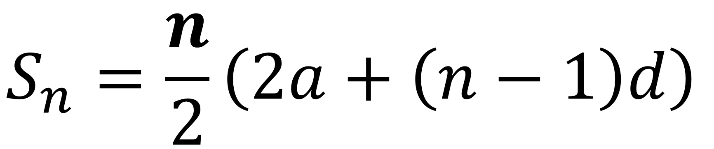
Arithmetic Series
Proof of
$$S_{n}=\frac{n}{2}\left(2a+\left(n−1\right)d\right)$$

Slide 15
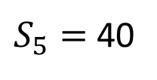







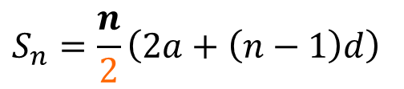
Arithmetic Series - Proof
Take an arithmetic sequence $2, 5, 8, 11, 14,$…
Sum of first 5 terms
Proving algebraically
$$S_{5}=2+5+8+11+14$$
$$S_{n}=a +\left(a+d\right)+\left(a+2d\right)+… +\left(a+\left(n−1\right)d\right)$$
$$S_{5}=14+11+8+5+2$$
$$S_{n}=\left(a+\left(n−1\right)d\right)+… +\left(a+2d\right)+\left(a+d\right)+a$$
Adding:
Adding:
$${2S}_{5}=16+16+16+16+16$$
$$2S_{n}=\left(2a+\left(n−1\right)d\right)+…+\left(2a+\left(n−1\right)d\right)$$
$${2S}_{5}=5(16)$$
$$2S_{n}=n\left(2a+\left(n−1\right)d\right)$$
$$S_{5}=\frac{5(16)}{2}$$
$$S_{n}=\frac{n}{2}\left(2a+\left(n−1\right)d\right)$$
$S_{5}=$40

Slide 16
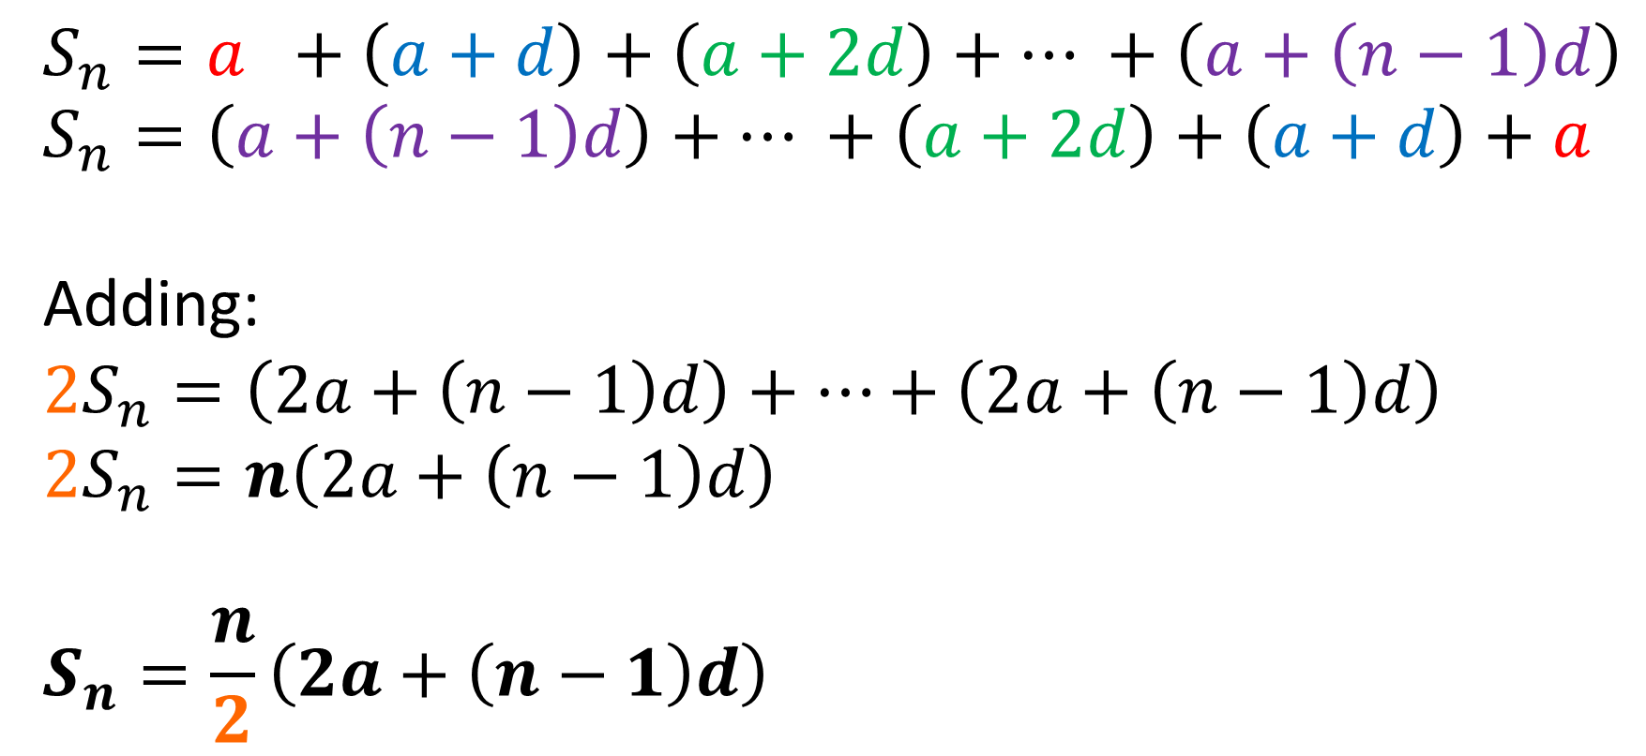

Prove $S_{n}=\frac{n}{2}\left(2a+\left(n−1\right)d\right)$
$$S_{n}=a +\left(a+d\right)+\left(a+2d\right)+… +\left(a+\left(n−1\right)d\right) \\ S_{n}=\left(a+\left(n−1\right)d\right)+… +\left(a+2d\right)+\left(a+d\right)+a$$
Adding:
$$2S_{n}=\left(2a+\left(n−1\right)d\right)+…+\left(2a+\left(n−1\right)d\right)$$
$$2S_{n}=n\left(2a+\left(n−1\right)d\right)$$
$$S_{n}=\frac{n}{2}\left(2a+\left(n−1\right)d\right)$$

