Slide 1
Constant Acceleration
Velocity-Time Graphs
Chapter 9
(Part 2 of 4)

Slide 2
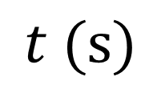
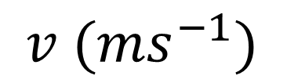
Is this velocity-time graph possible?
$v ({ms}^{−1})$
0
$$t (s)$$
Yes

Slide 3
Velocity-Time Graphs
Velocity is speed with direction.

Slide 4
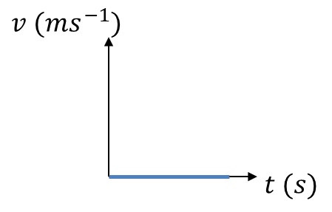
Describe the motion of each object
Object is stationary.

Slide 5
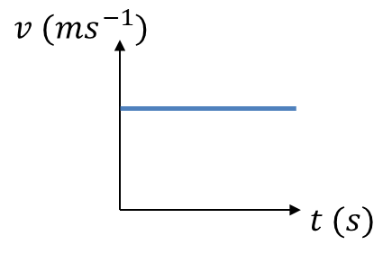
Describe the motion of each object
Object is moving with constant velocity.

Slide 6
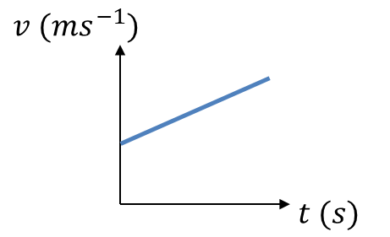
Describe the motion of each object
Object has constant/uniform acceleration.

Slide 7
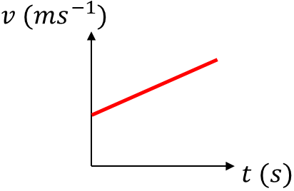
What do you learn from the gradient of the graph?
Acceleration is the gradient of the line.

Slide 8
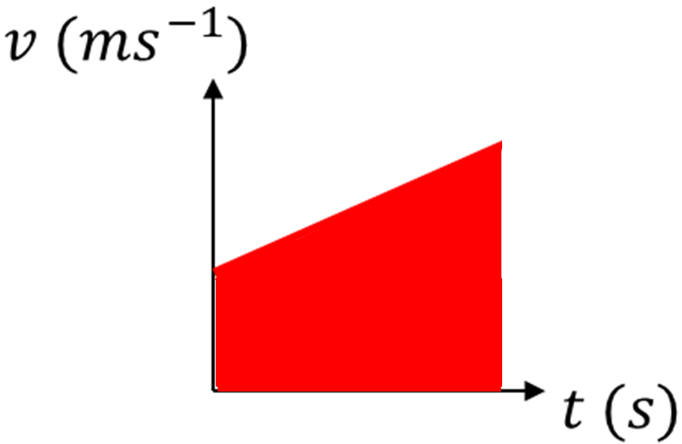
What do you learn from the area under the graph?
Distance travelled is the area under the graph.

Slide 9
Velocity-Time Graphs One Vehicle
This is the most common style of exam question.

Slide 10
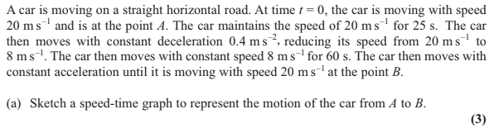
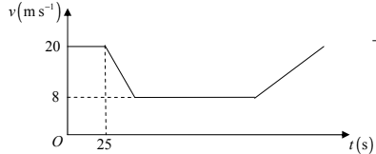

Slide 11


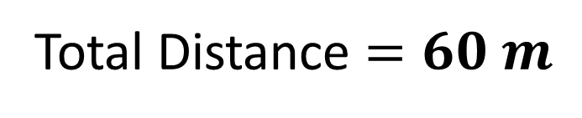
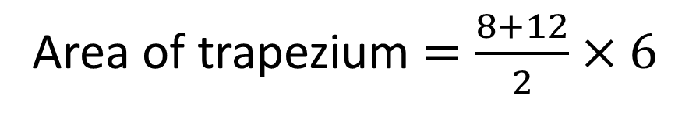
The figure shows a velocity-time graph illustrating the motion of a cyclist moving along a straight road for a period of 12 seconds. For the first 8 seconds, she moves at a constant speed of 6 m s⁻¹. She then decelerates at a constant rate, stopping after a further 4 seconds.
Find the displacement from the starting point of the cyclist after this 12 second period.
Work out the rate at which the cyclist decelerates.
$$v (ms^{−1})$$
Area of trapezium $=\frac{8+12}{2}×6$
a)
6
Total Distance $=60 m$
$$t (s)$$
8
12

Slide 12


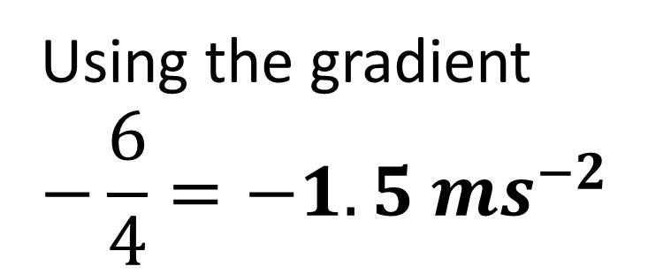
The figure shows a velocity-time graph illustrating the motion of a cyclist moving along a straight road for a period of 12 seconds. For the first 8 seconds, she moves at a constant speed of 6 m s⁻¹. She then decelerates at a constant rate, stopping after a further 4 seconds.
Find the displacement from the starting point of the cyclist after this 12 second period.
Work out the rate at which the cyclist decelerates.
$$v (ms^{−1})$$
Using the gradient
$$−\frac{6}{4}=−1.5 ms^{−2}$$
b)
6
$$t (s)$$
8
12

Slide 13



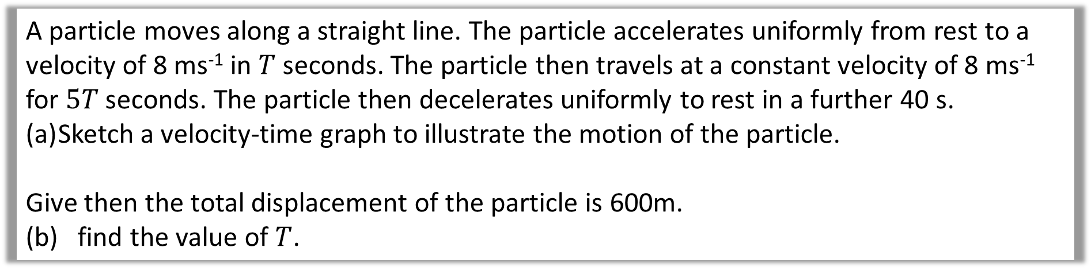



A particle moves along a straight line. The particle accelerates uniformly from rest to a velocity of 8 ms⁻¹ in $T$ seconds. The particle then travels at a constant velocity of 8 ms⁻¹ for $5T$ seconds. The particle then decelerates uniformly to rest in a further 40 s.
Sketch a velocity-time graph to illustrate the motion of the particle.
Give then the total displacement of the particle is 600m.
(b) find the value of $T$.
a)
$$v (ms^{−1})$$
8
$$t (s)$$
$$O$$
Sometimes it’s easier to indicate the period of time that has passed rather than the time at the end of the interval.
$$T$$
$$5T$$
$$40$$

Slide 14
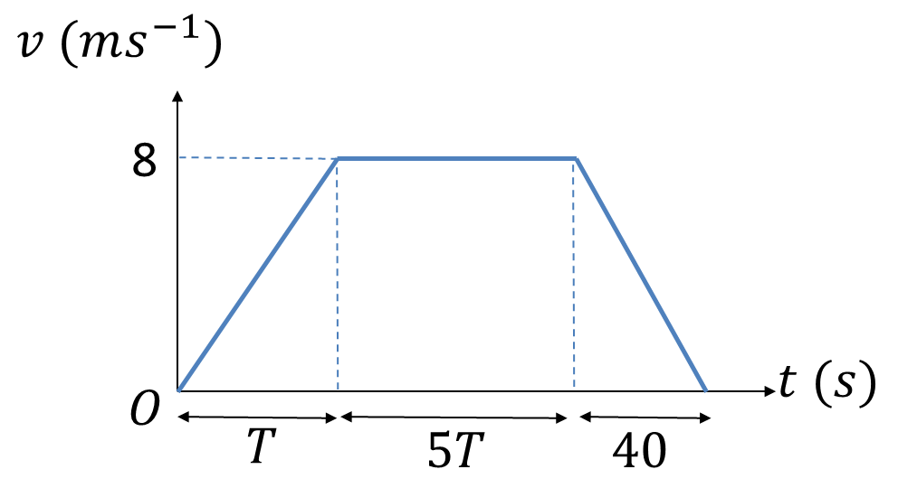
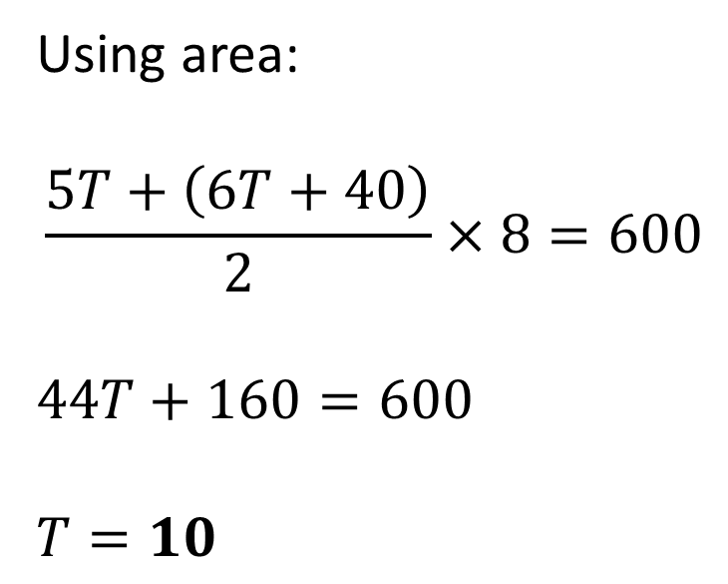
A particle moves along a straight line. The particle accelerates uniformly from rest to a velocity of 8 ms⁻¹ in $T$ seconds. The particle then travels at a constant velocity of 8 ms⁻¹ for $5T$ seconds. The particle then decelerates uniformly to rest in a further 40 s.
Sketch a velocity-time graph to illustrate the motion of the particle.
Give then the total displacement of the particle is 600m.
(b) find the value of $T$.
b)
Using area:
$$\frac{5T+\left(6T+40\right)}{2}×8=600$$
$$44T+160=600$$
$$T=10$$

Slide 15
Velocity-Time Graphs Two Vehicle
This is a much harder question.

Slide 16
Two trains M and N are moving in the same direction along parallel straight horizontal tracks.
At time t = 0, M overtakes N whilst they are travelling with speeds 40 m s^{–1} and 30 m s^{–1} respectively.
Train M overtakes train N as they pass a point X at the side of the tracks.
After overtaking N, train M maintains its speed of 40 m s^{–1} for T seconds and then decelerates uniformly, coming to rest next to a point Y at the side of the tracks.
After being overtaken, train N maintains its speed of 30 m s^{–1} for 25 s and then decelerates uniformly, also coming to rest next to the point Y.
The times taken by the trains to travel between X and Y are the same.
(a) Sketch, on the same diagram, the speed-time graphs for the motions of the two trains between X and Y.
(4)
Given that XY = 975 m,
(b) find the value of T.
(8)

Slide 17
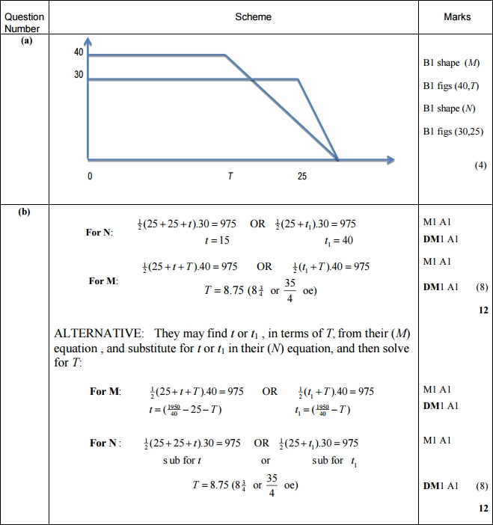
Two trains M and N are moving in the same direction along parallel straight horizontal tracks. At time t = 0, M overtakes N whilst they are travelling with speeds 40 m s^{–1} and 30 m s^{–1} respectively. Train M overtakes train N as they pass a point X at the side of the tracks. After overtaking N, train M maintains its speed of 40 m s^{–1} for T seconds and then decelerates uniformly, coming to rest next to a point Y at the side of the tracks. After being overtaken, train N maintains its speed of 30 m s^{–1} for 25 s and then decelerates uniformly, also coming to rest next to the point Y.
The times taken by the trains to travel between X and Y are the same.
(a) Sketch, on the same diagram, the speed-time graphs for the motions of the two trains between X and Y.
a)

Slide 18
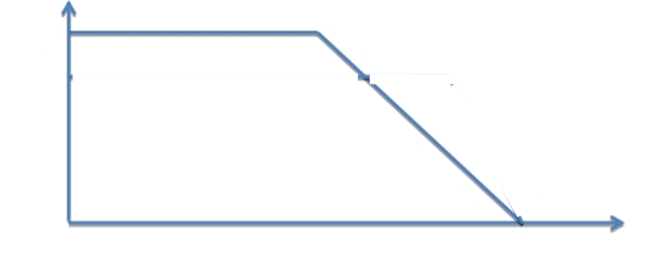
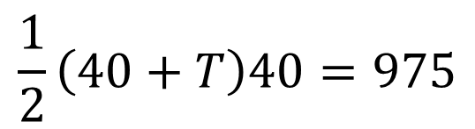

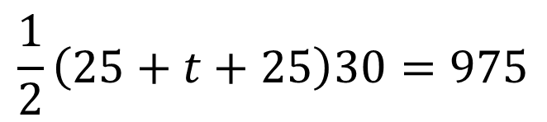

Two trains M and N are moving in the same direction along parallel straight horizontal tracks. At time t = 0, M overtakes N whilst they are travelling with speeds 40 m s^{–1} and 30 m s^{–1} respectively. Train M overtakes train N as they pass a point X at the side of the tracks. After overtaking N, train M maintains its speed of 40 m s^{–1} for T seconds and then decelerates uniformly, coming to rest next to a point Y at the side of the tracks. After being overtaken, train N maintains its speed of 30 m s^{–1} for 25 s and then decelerates uniformly, also coming to rest next to the point Y.
The times taken by the trains to travel between X and Y are the same.
(b) Given that XY = 975 m, find the value of T. (8)
T
25
40
30
M
N
25 + t
$$\frac{1}{2}\left(25+t+25\right)30=975$$
40
$$\frac{1}{2}\left(40+T\right)40=975$$
$$t=15$$
$$T=8.75$$

Slide 19
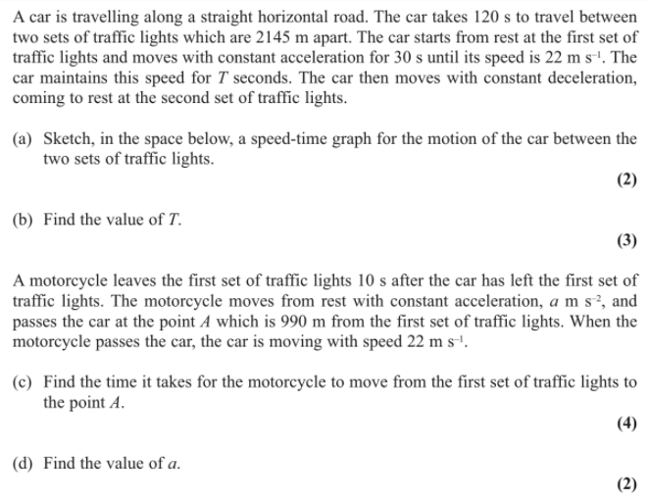

Slide 20






a)
$$v (ms^{−1})$$
22
$$t (s)$$
$$O$$
$$30$$
$$30+T$$
$$120$$

Slide 21
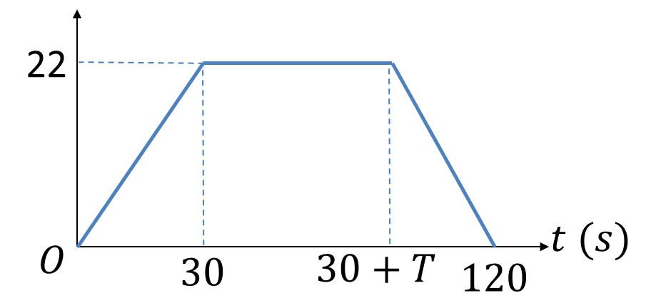
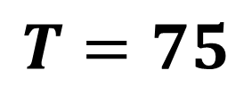
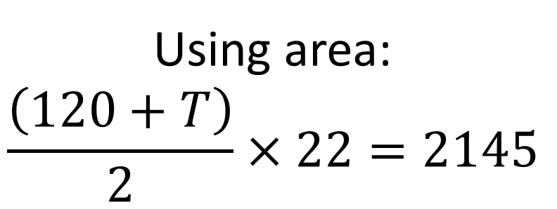
b)
Using area:
$$\frac{\left(120+T\right)}{2}×22=2145$$
$$T=75$$

Slide 22

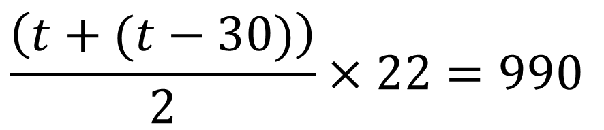



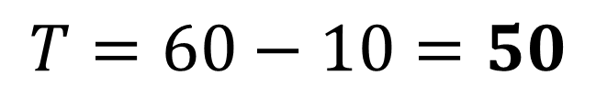

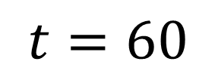

Using area:
c)
$$v (ms^{−1})$$
$$\frac{\left(t+(t−30)\right)}{2}×22=990$$
$$t −30$$
22
$$t=60$$
$$T=60−10=50$$
$$t (s)$$
$$O$$
$$30$$
$$t$$

