Slide 1

Diagnostic Assessment .Delta 1
Unit 4
Converting Fractions, Decimals and Percentages
Adding and Subtracting Fractions
Multiplying and Dividing Fractions

Slide 2
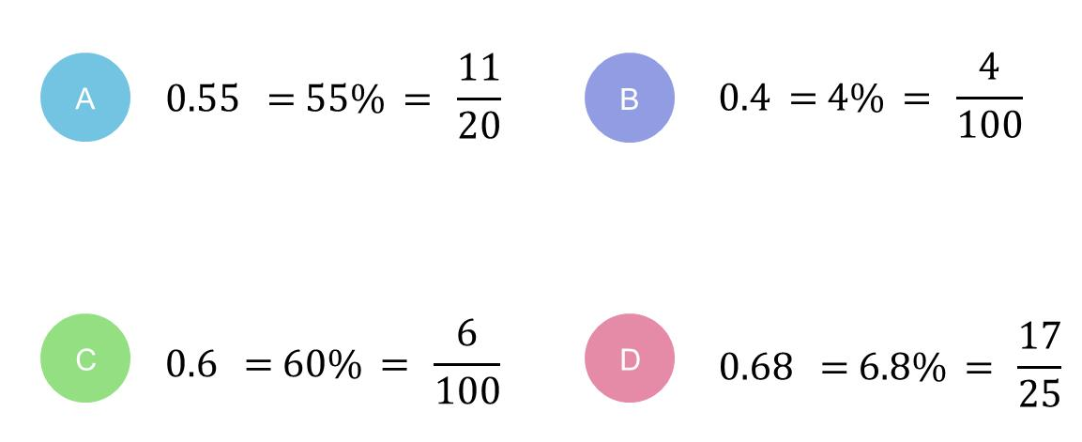
Question 1 – Converting Fractions, Decimals and Percentages
Which of the following is correct?

Slide 3
Answers 1 – Converting Fractions, Decimals and Percentages
Which of the following is correct?
CORRECT ANSWER | CORRECT EXPLANATION
A | We have 0.55 is equal to 55%, which is equal to 55/100. This is equivalent to 11/20.
COMMON MISTAKES | WHAT MIGHT BE YOUR MISTAKE
B | It looks like you've assumed that 0.4 = 4% but actually, 0.4 = 4/10 = 40/100 = 40%.
C | It looks like you've assumed that 0.6 = 6% but actually, 0.6 = 6/10 = 60/100 = 60%.
D | Not quite! It looks like you've assumed that 0.68 = 6.8%. But actually 0.68 = 68/100 = 68%. Pay close attention to place value!

Slide 4
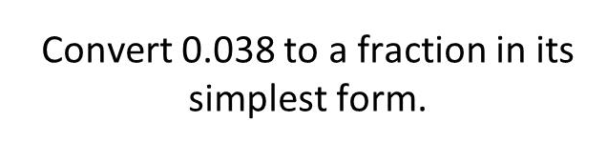
Question 2 – Converting Fractions, Decimals and Percentages

Slide 5
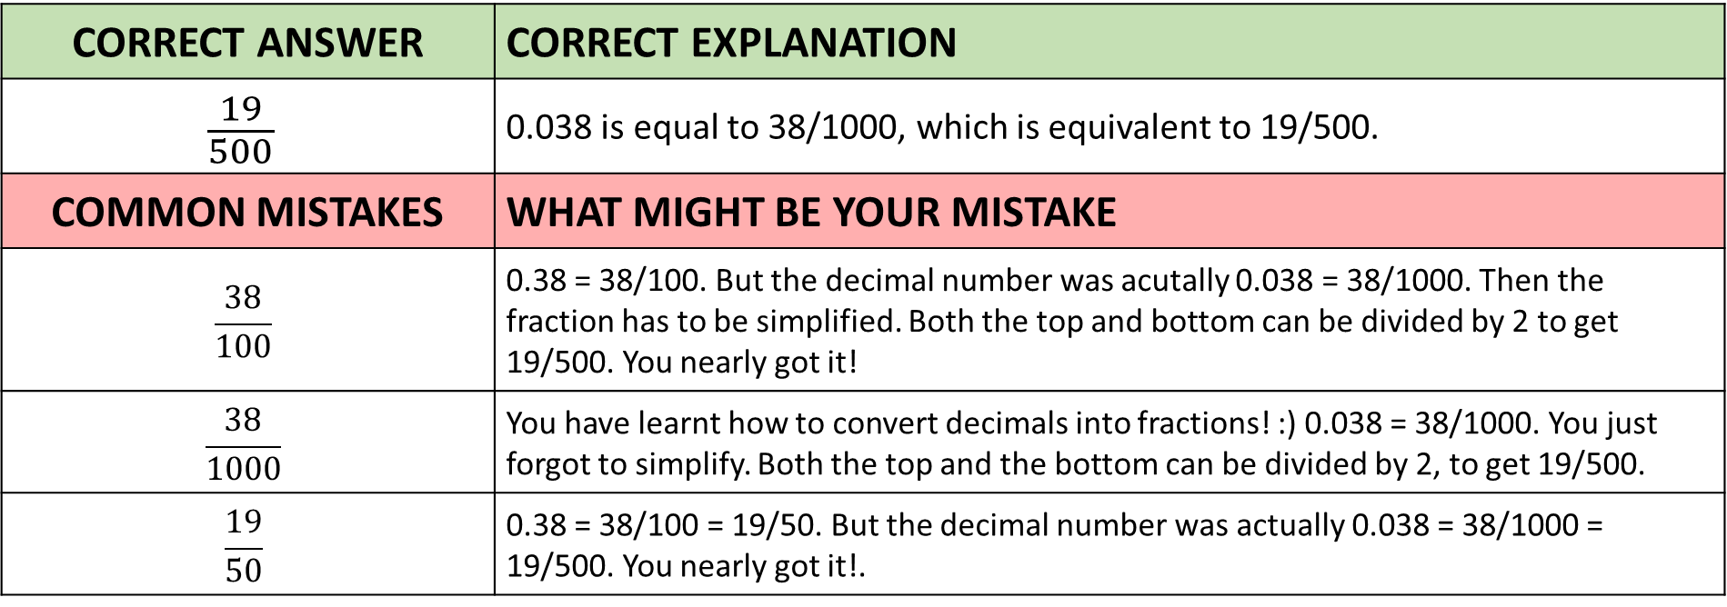
Answers 2 – Converting Fractions, Decimals and Percentages
CORRECT ANSWER | CORRECT EXPLANATION
$$\frac{19}{500}$$ | 0.038 is equal to 38/1000, which is equivalent to 19/500.
COMMON MISTAKES | WHAT MIGHT BE YOUR MISTAKE
$$\frac{38}{100}$$ | 0.38 = 38/100. But the decimal number was acutally 0.038 = 38/1000. Then the fraction has to be simplified. Both the top and bottom can be divided by 2 to get 19/500. You nearly got it!
$$\frac{38}{1000}$$ | You have learnt how to convert decimals into fractions! :) 0.038 = 38/1000. You just forgot to simplify. Both the top and the bottom can be divided by 2, to get 19/500.
$$\frac{19}{50}$$ | 0.38 = 38/100 = 19/50. But the decimal number was actually 0.038 = 38/1000 = 19/500. You nearly got it!.

Slide 6
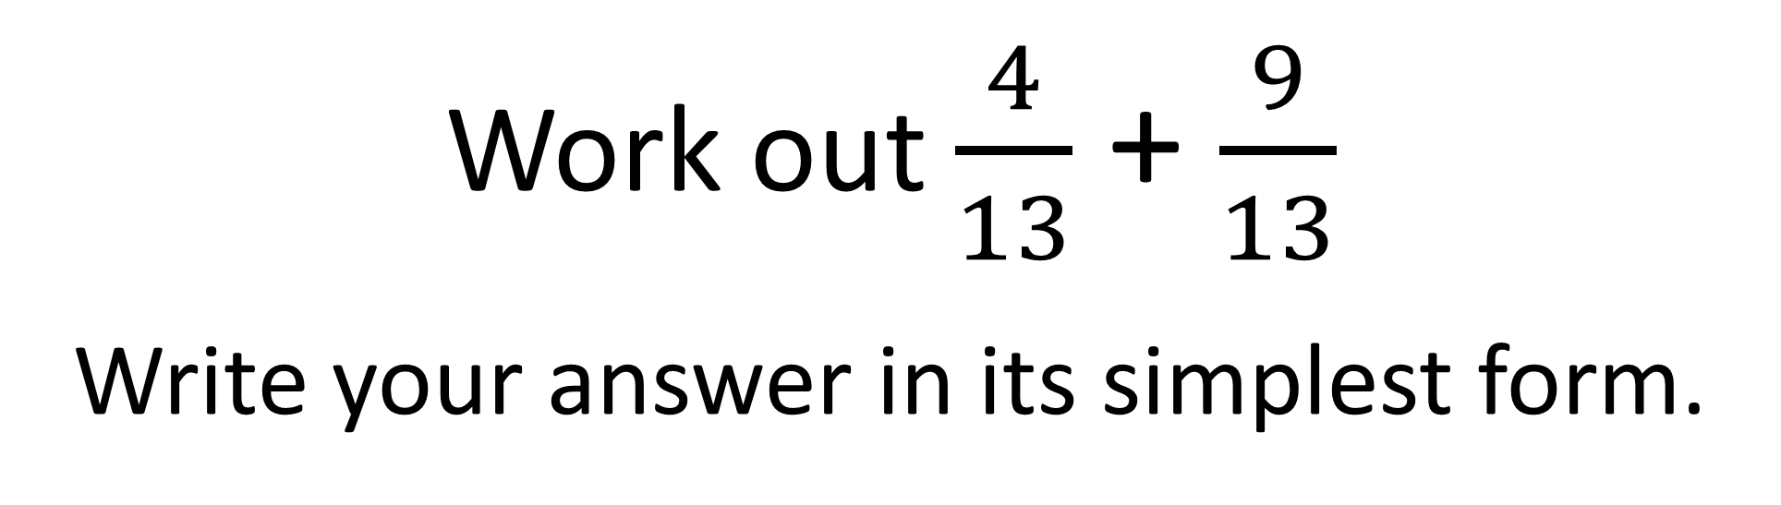
Question 3 – Adding Fractions
Work out $\frac{4}{13}$ + $\frac{9}{13}$
Write your answer in its simplest form.

Slide 7

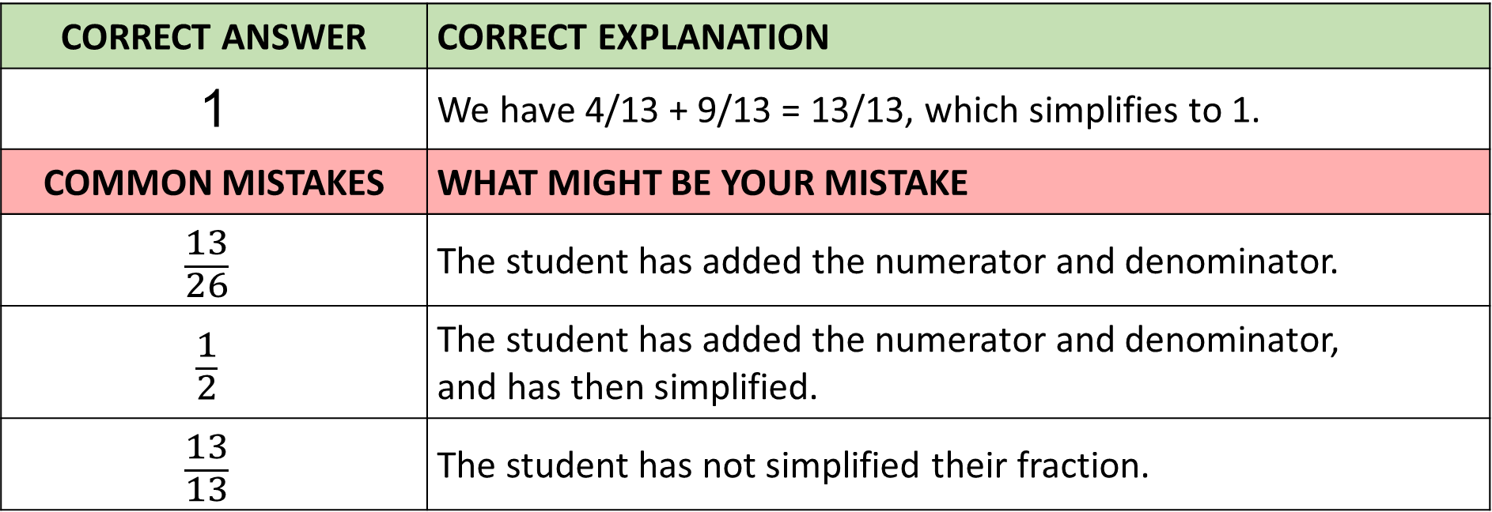
Answer 3 – Adding Fractions
Work out $\frac{4}{13}$ + $\frac{9}{13}$
Write your answer in its simplest form.
CORRECT ANSWER | CORRECT EXPLANATION
1 | We have 4/13 + 9/13 = 13/13, which simplifies to 1.
COMMON MISTAKES | WHAT MIGHT BE YOUR MISTAKE
$$\frac{13}{26}$$ | The student has added the numerator and denominator.
$$\frac{1}{2}$$ | The student has added the numerator and denominator, and has then simplified.
$$\frac{13}{13}$$ | The student has not simplified their fraction.

Slide 8
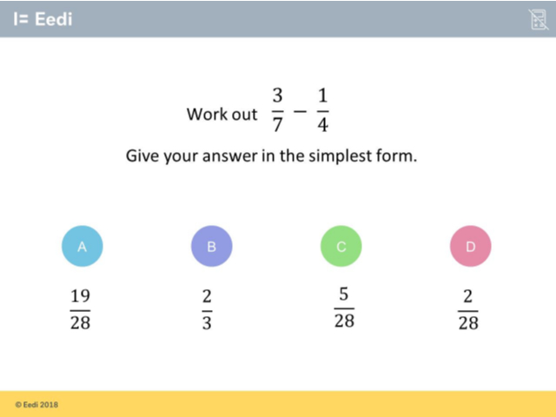
Question 4 – Subtracting Fractions

Slide 9
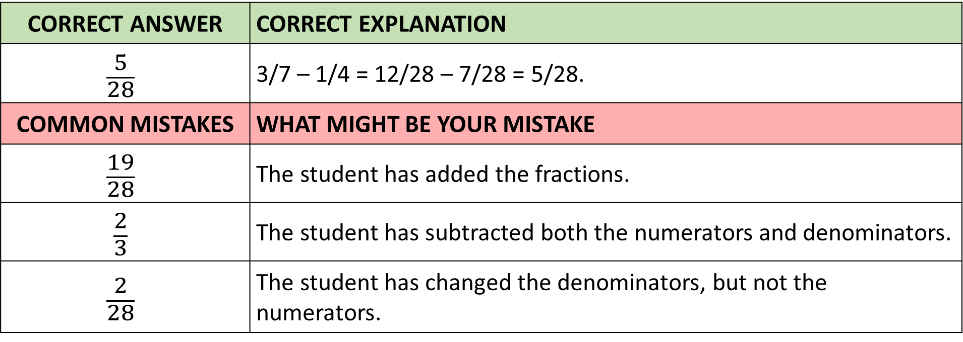
Answer 4 – Subtracting Fractions
CORRECT ANSWER | CORRECT EXPLANATION
$$\frac{5}{28}$$ | 3/7 – 1/4 = 12/28 – 7/28 = 5/28.
COMMON MISTAKES | WHAT MIGHT BE YOUR MISTAKE
$$\frac{19}{28}$$ | The student has added the fractions.
$$\frac{2}{3}$$ | The student has subtracted both the numerators and denominators.
$$\frac{2}{28}$$ | The student has changed the denominators, but not the numerators.

Slide 10
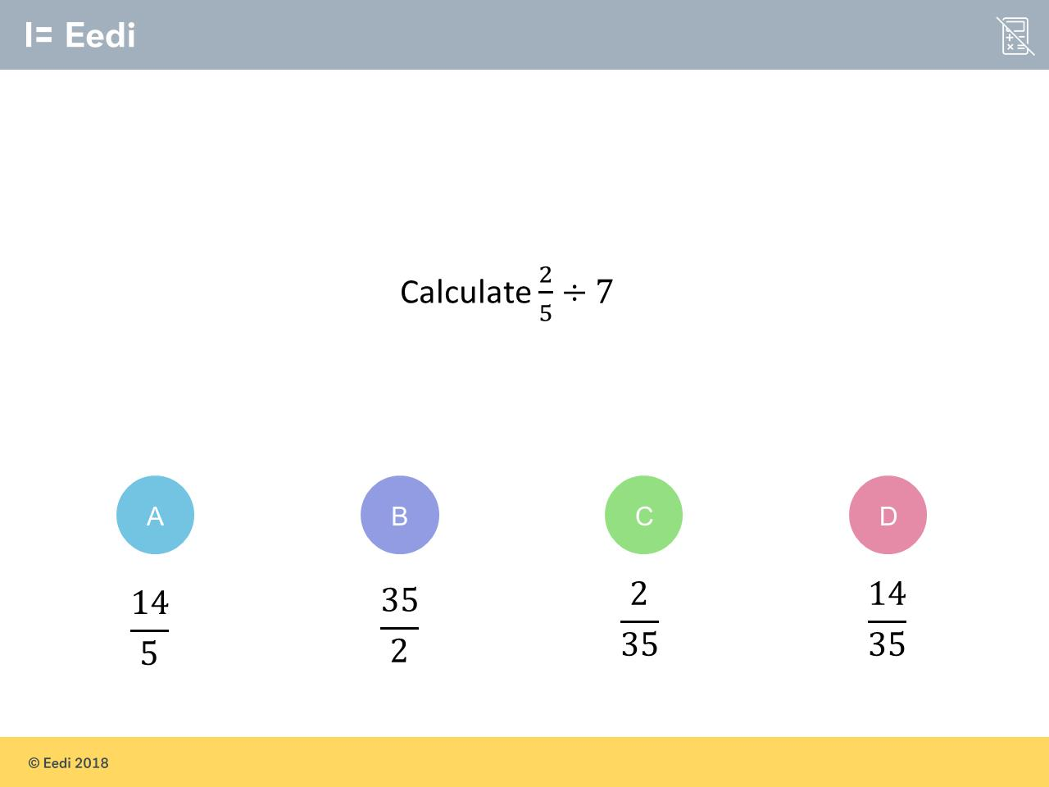
Question 5 – Dividing Fractions

Slide 11
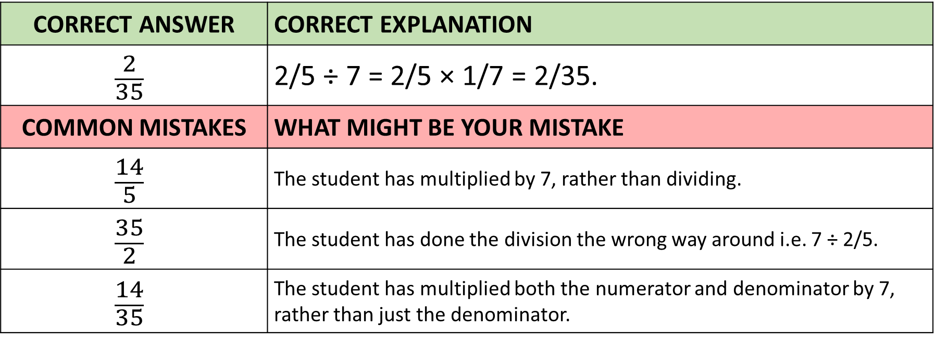
Answer 5 – Dividing Fractions
CORRECT ANSWER | CORRECT EXPLANATION
$$\frac{2}{35}$$ | 2/5 ÷ 7 = 2/5 × 1/7 = 2/35.
COMMON MISTAKES | WHAT MIGHT BE YOUR MISTAKE
$$\frac{14}{5}$$ | The student has multiplied by 7, rather than dividing.
$$\frac{35}{2}$$ | The student has done the division the wrong way around i.e. 7 ÷ 2/5.
$$\frac{14}{35}$$ | The student has multiplied both the numerator and denominator by 7, rather than just the denominator.

Slide 12
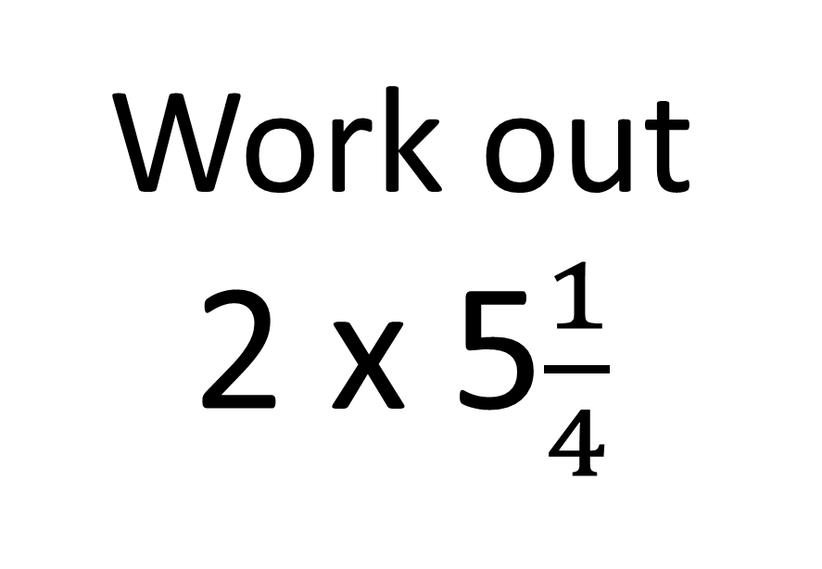
Question 6 – Multiplying Fractions
Work out
2 x 5$\frac{1}{4}$

Slide 13
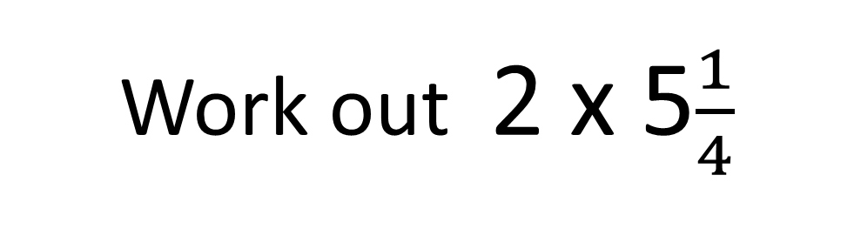
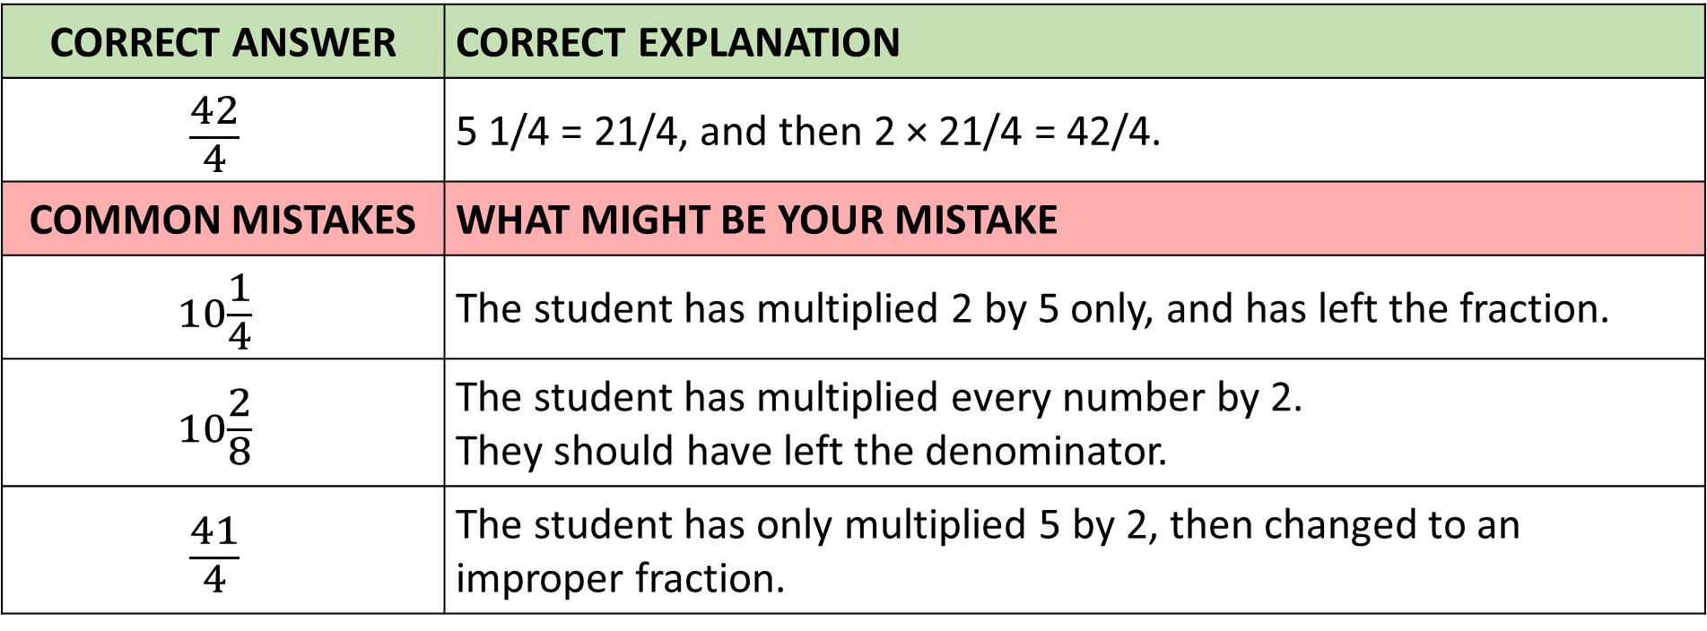
Answer 6 – Multiplying Fractions
Work out 2 x 5$\frac{1}{4}$
CORRECT ANSWER | CORRECT EXPLANATION
$$\frac{42}{4}$$ | 5 1/4 = 21/4, and then 2 × 21/4 = 42/4.
COMMON MISTAKES | WHAT MIGHT BE YOUR MISTAKE
$$10\frac{1}{4}$$ | The student has multiplied 2 by 5 only, and has left the fraction.
$$10\frac{2}{8}$$ | The student has multiplied every number by 2. They should have left the denominator.
$$\frac{41}{4}$$ | The student has only multiplied 5 by 2, then changed to an improper fraction.

Slide 14
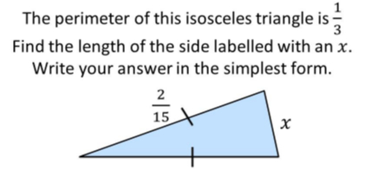
Question 7 – Adding and Subtracting Fractions

Slide 15
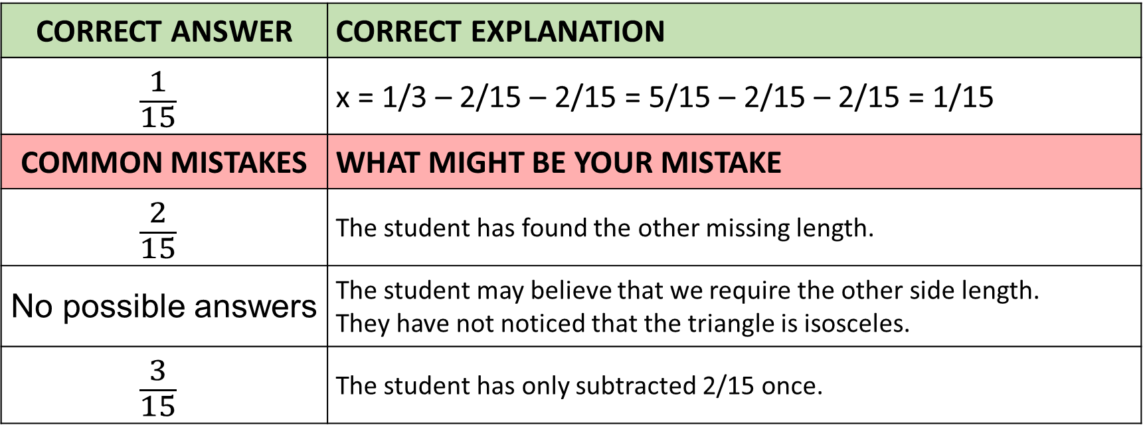
Answer 7 – Adding and Subtracting Fractions
CORRECT ANSWER | CORRECT EXPLANATION
$$\frac{1}{15}$$ | x = 1/3 – 2/15 – 2/15 = 5/15 – 2/15 – 2/15 = 1/15
COMMON MISTAKES | WHAT MIGHT BE YOUR MISTAKE
$$\frac{2}{15}$$ | The student has found the other missing length.
No possible answers | The student may believe that we require the other side length. They have not noticed that the triangle is isosceles.
$$\frac{3}{15}$$ | The student has only subtracted 2/15 once.

Slide 16
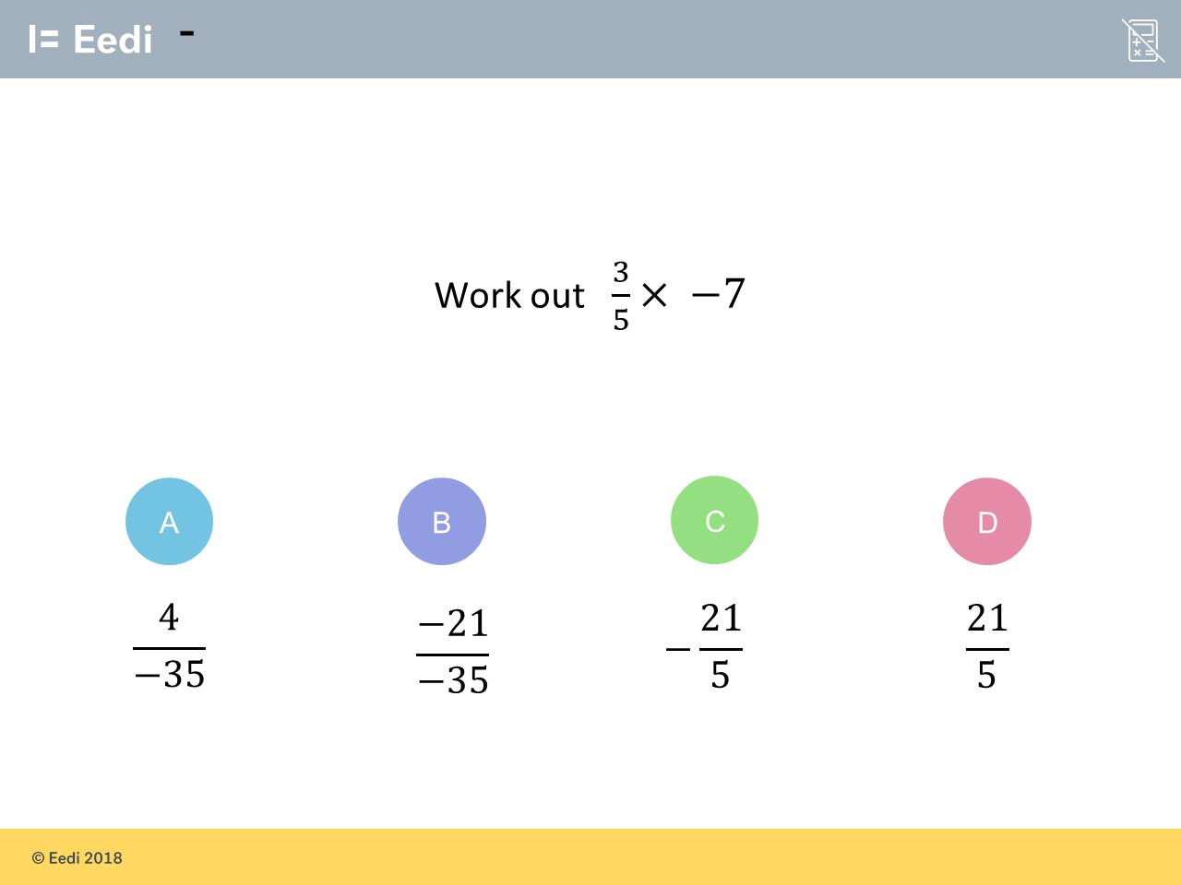
Question 8 – Multiplying Fractions

Slide 17
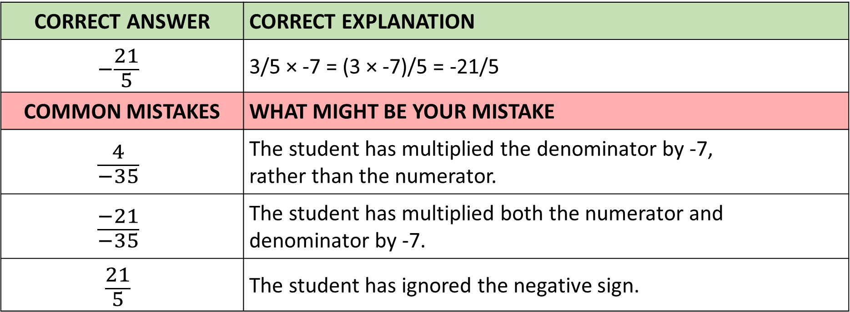
Answer 8 – Two Way Tables
CORRECT ANSWER | CORRECT EXPLANATION
$$−\frac{21}{5}$$ | 3/5 × -7 = (3 × -7)/5 = -21/5
COMMON MISTAKES | WHAT MIGHT BE YOUR MISTAKE
$$\frac{4}{−35}$$ | The student has multiplied the denominator by -7, rather than the numerator.
$$\frac{−21}{−35}$$ | The student has multiplied both the numerator and denominator by -7.
$$\frac{21}{5}$$ | The student has ignored the negative sign.

Slide 18
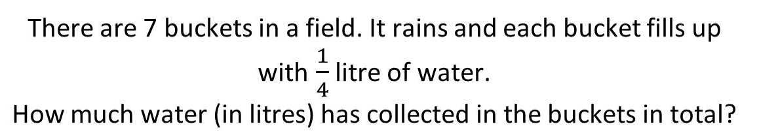
Question 9 – Dividing Fractions

Slide 19
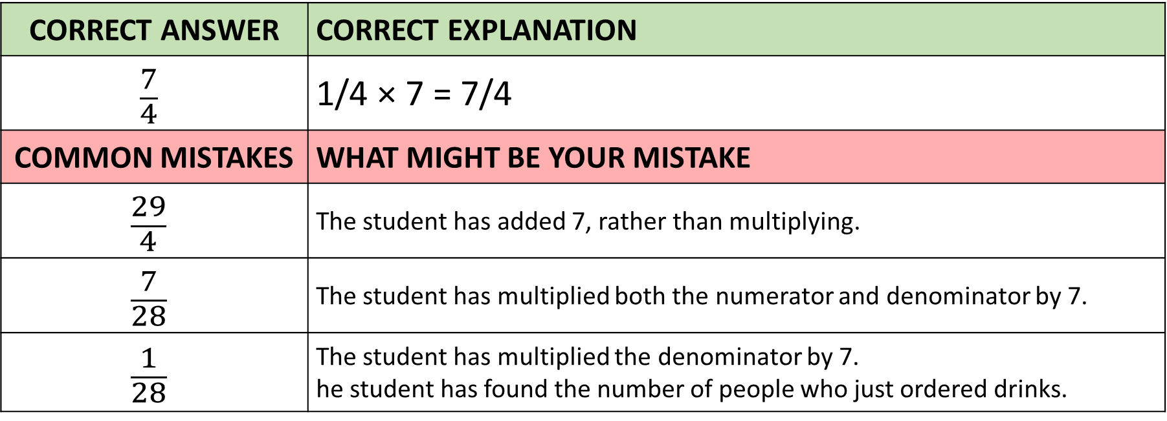
Answer 9 – Dividing Fractions
CORRECT ANSWER | CORRECT EXPLANATION
$$\frac{7}{4}$$ | 1/4 × 7 = 7/4
COMMON MISTAKES | WHAT MIGHT BE YOUR MISTAKE
$$\frac{29}{4}$$ | The student has added 7, rather than multiplying.
$$\frac{7}{28}$$ | The student has multiplied both the numerator and denominator by 7.
$$\frac{1}{28}$$ | The student has multiplied the denominator by 7. he student has found the number of people who just ordered drinks.

Slide 20
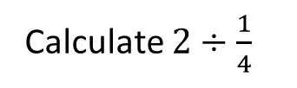
Question 10 – Dividing Fractions

Slide 21
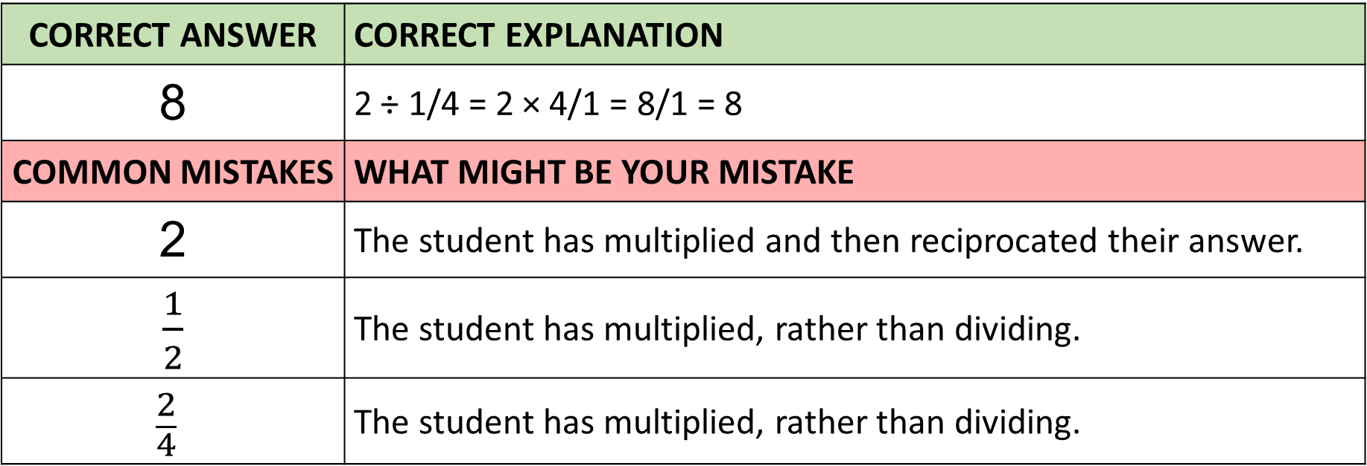
Answer 10 – Two Way Tables
CORRECT ANSWER | CORRECT EXPLANATION
8 | 2 ÷ 1/4 = 2 × 4/1 = 8/1 = 8
COMMON MISTAKES | WHAT MIGHT BE YOUR MISTAKE
2 | The student has multiplied and then reciprocated their answer.
$\frac{1}{2}$ | The student has multiplied, rather than dividing.
$$\frac{2}{4}$$ | The student has multiplied, rather than dividing.

