Slide 1
LO: Characteristic
of Linear Graphs

Slide 2
y = mx + c
m = gradient
c = y intercept

Slide 3
Which line has the steeper gradient?
A
B

Slide 4
Which line has the steeper gradient?
A
B

Slide 5
Which line has the steeper gradient?
A
B
Same Gradient
Parallel

Slide 6
Which line has the steeper gradient?
B
A

Slide 7
Which equation produces
the steeper gradient?
A
B
y = 3x
y = 5x

Slide 8
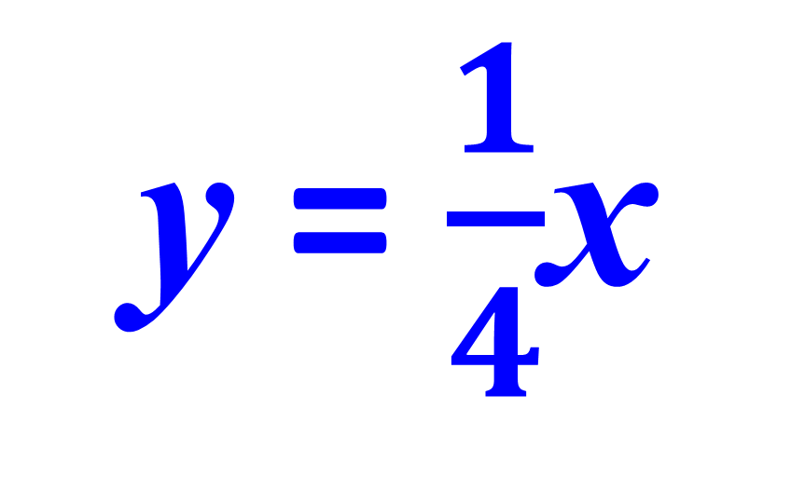
Which equation produces
the steeper gradient?
A
B
y = $\frac{1}{4}$x
y = 0.5x

Slide 9
Which equation produces
the steeper gradient?
A
B
y = -4x
y = 2x

Slide 10
Which equation produces
the steeper gradient?
A
B
y = 3x + 7
y = 5x + 1

Slide 11
Which equation produces
the steeper gradient?
A
B
y = x + 7
y = 7 – 2x

Slide 12
Which equation goes with which line?
y = 4x
y = 6x
x
y = x

Slide 13
Which equation goes with which line?
y = –4x
y = 0.1x
x
y = –2x

Slide 14
Which co-ordinate is at the y intercept?
(0, 4)
(0, -3)

Slide 15
Which co-ordinate is at the y intercept?
(0, 2)
(0, 5)

Slide 16
Which equation goes with which line?
y = 2x + 3
y = 2x – 3
x
y = 2x + 1

Slide 17
Which equation goes with which line?
y = x + 1
y = x + 3
x
y = x

Slide 18
Which equation goes with which line?
y = – x + 2
y = x + 1
x
y = x – 2

Slide 19
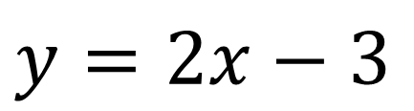
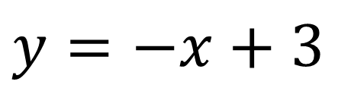
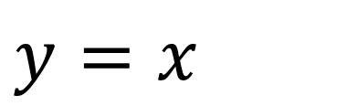
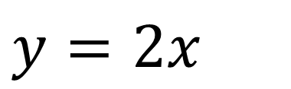
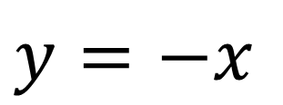
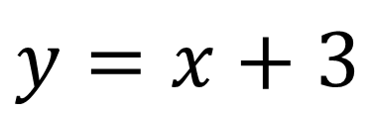
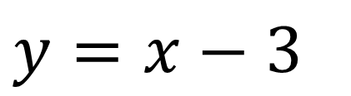
Which colour goes with
which equation?
$$y=−x+3$$
Green
A
$$y=x+3$$
Black
B
$$y=−x$$
Blue
C
$$y=2x$$
Orange
D
$$y=x$$
Red
E
$$y=2x−3$$
Yellow
F
$$y=x−3$$
Purple
G

Slide 20
y = 6x + 4
What is the gradient and the
co-ordinate of the y intercept?
6 and (0, 4)

Slide 21
y = 5 – 3x
What is the gradient and the
co-ordinate of the y intercept?
–3 and (0, 5)

Slide 22
y = x – 3
What is the gradient and the
co-ordinate of the y intercept?
1 and (0, –3)

Slide 23
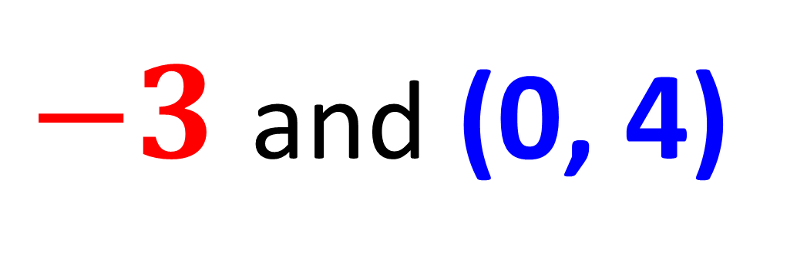
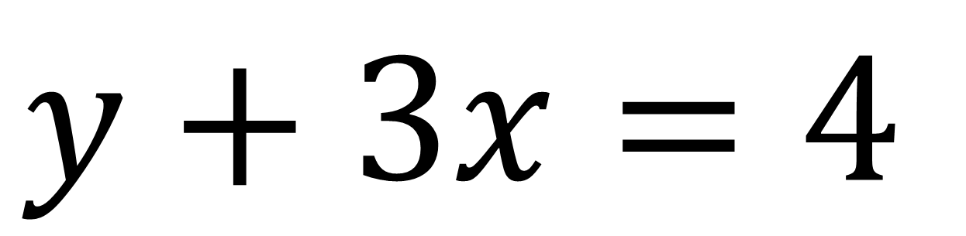
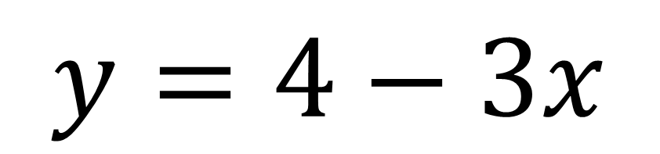
$$y+3x=4$$
What is the gradient and the
co-ordinate of the y intercept?
$y=4−3x$
$−3$ and (0, 4)

Slide 24
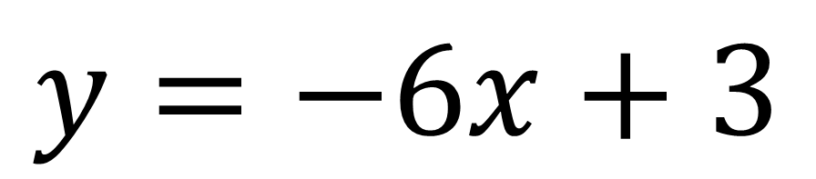
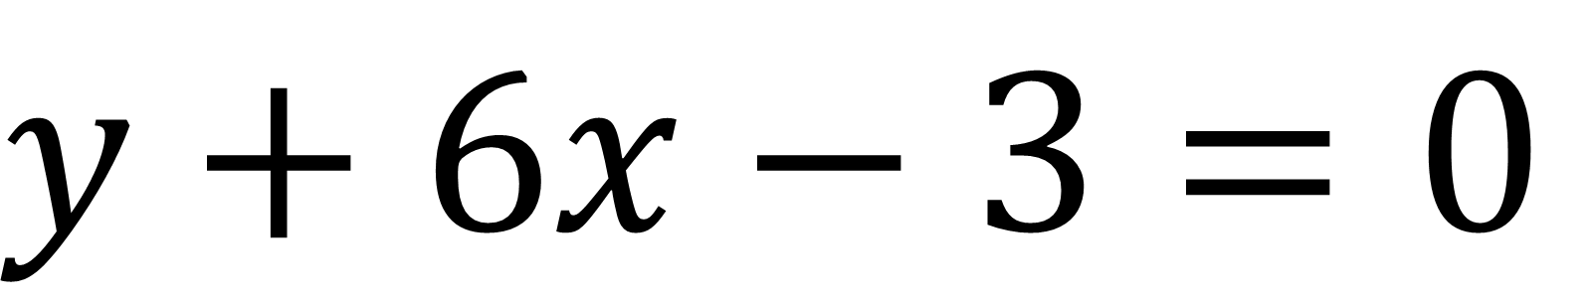
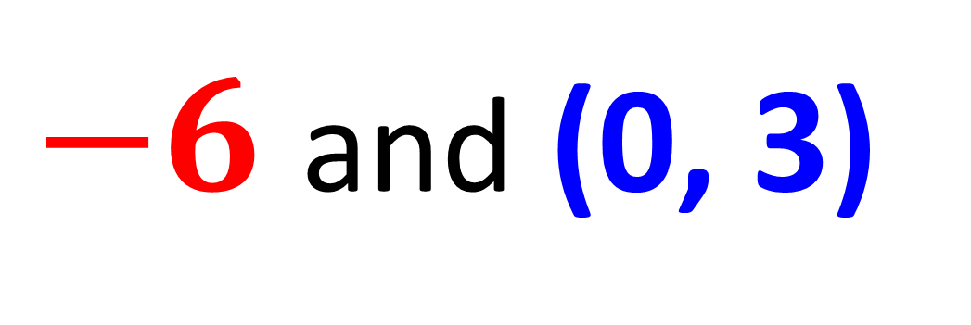
$$y+6x−3=0$$
What is the gradient and the
co-ordinate of the y intercept?
$−6$ and (0, 3)
$y=−6x+3$

Slide 25
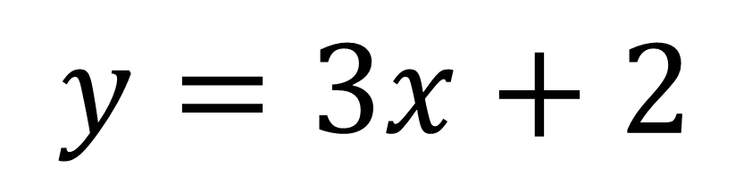
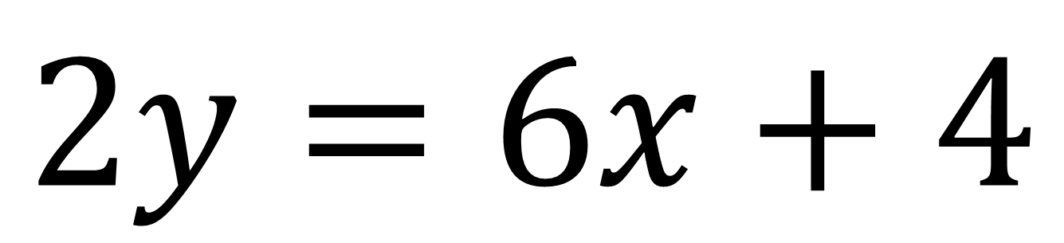
$2y=6x+4$
What is the gradient and the
co-ordinate of the y intercept?
3 and (0, 2)
$y=3x+2$

Slide 26
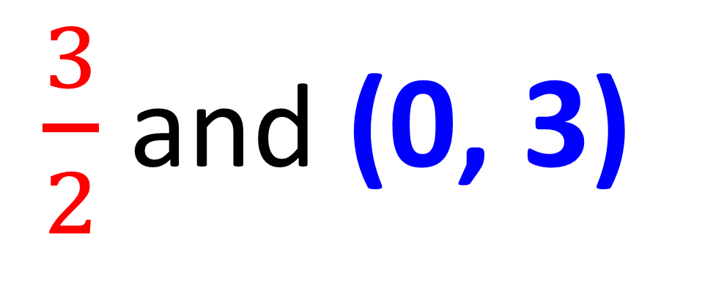
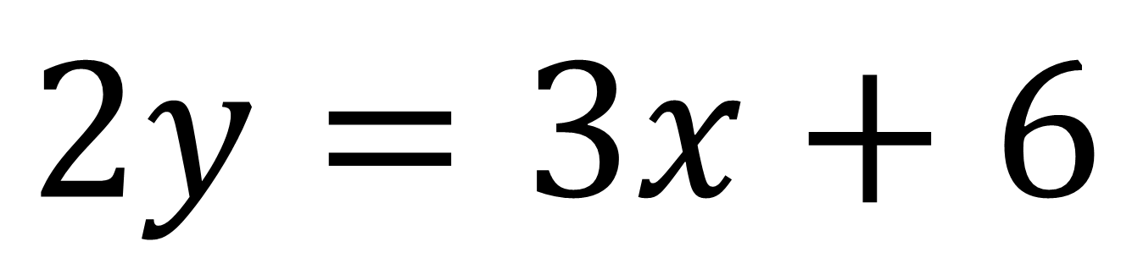
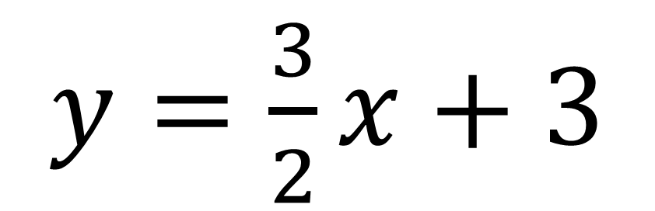
$2y=3x+6$
What is the gradient and the
co-ordinate of the y intercept?
$y=\frac{3}{2}x+3$
$\frac{3}{2}$ and (0, 3)

Slide 27
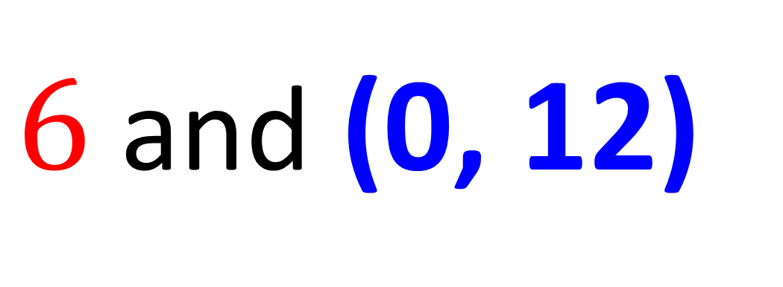
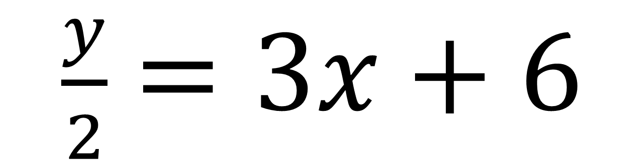
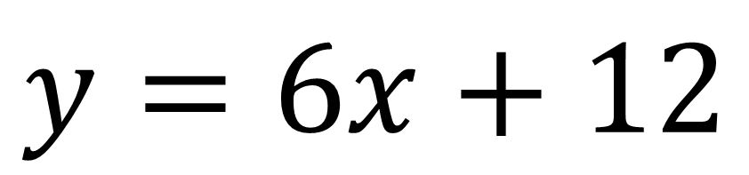
$\frac{y}{2}=3x+6$
What is the gradient and the
co-ordinate of the y intercept?
$6$ and (0, 12)
$y=6x+12$

Slide 28
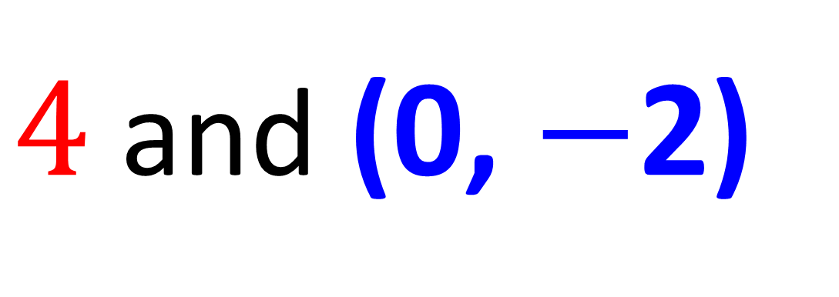
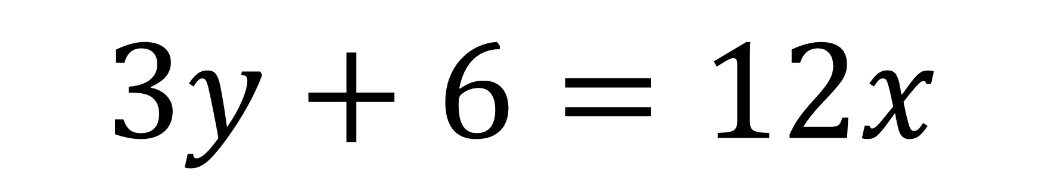
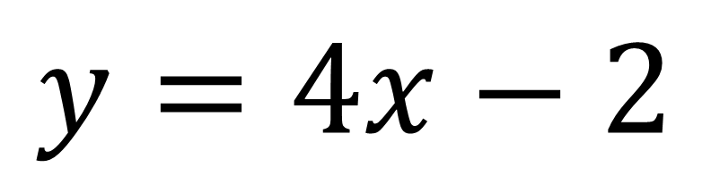
$3y+6=12x$
What is the gradient and the
co-ordinate of the y intercept?
$y=4x−2$
$4$ and (0, $−$2)

