Slide 1
Exponentials and Logs
Quadratics Equations
Chapter 14
(Part 4 of 9)

Slide 2
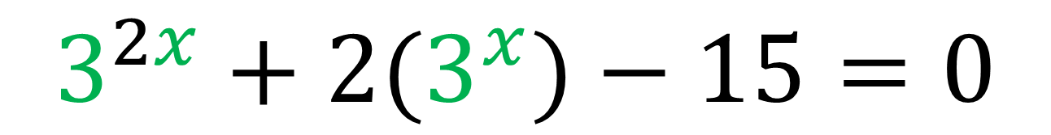
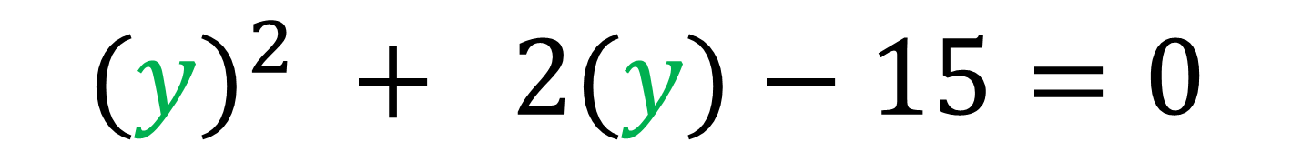
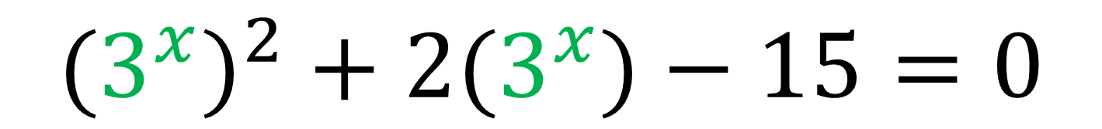
Solving Exponentials - Quadratic Equations
Look out for exponent equations that look a bit like a quadratic equation.
$$3^{2x}+2(3^{x})−15=0$$
$${{(3}^{x})}^{2}+2(3^{x})−15=0$$
$${(y)}^{2} + 2(y)−15=0$$

Slide 3
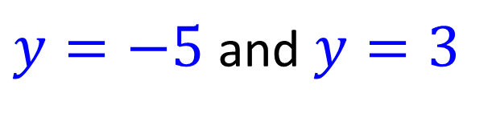
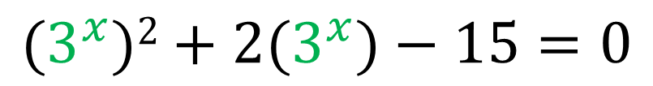
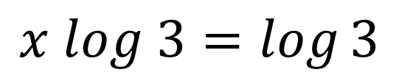
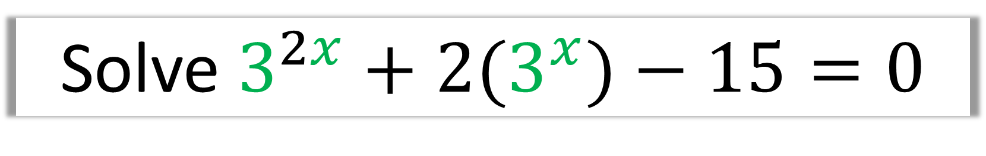
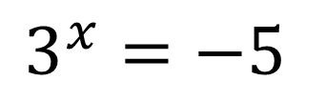
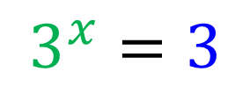
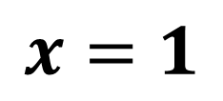
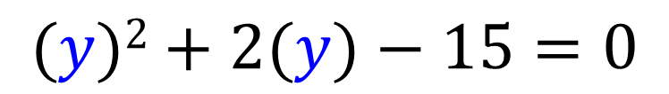
Solve $3^{2x}+2(3^{x})−15=0$
$${(3}^{x})2+2{(3}^{x})−15=0$$
$$3^{x}=3$$
$$x log 3=\log{3}$$
$$(y)2+2(y)−15=0$$
$$x=1$$
$y=−5$and $y=3$
$$3^{x}=−5$$
No solution
(You can’t log a negative)

Slide 4
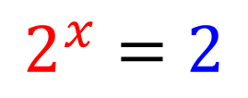
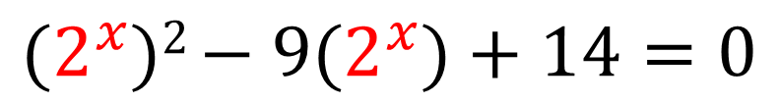
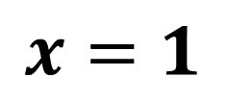
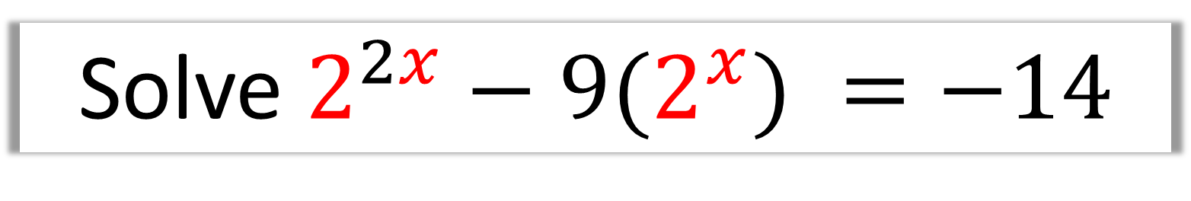
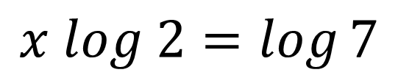
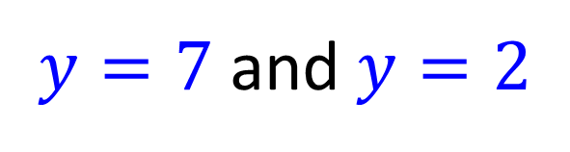
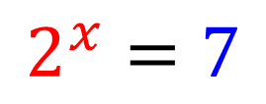
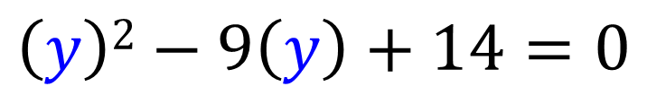
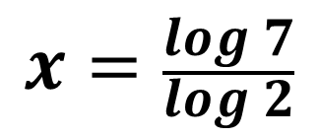
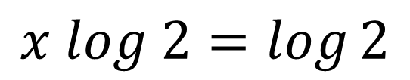
Solve $2^{2x}−9(2^{x}) =−14$
$$2^{x}=7$$
$${(2}^{x})2 {− 9(2}^{x})+14=0$$
$$x log 2=\log{7}$$
$$\left(y\right)2−9\left(y\right)+14=0$$
$$x=\frac{\log{7}}{\log{2}}$$
$y=7$ and $y=2$
$$2^{x}=2$$
$$x log 2=\log{2}$$
$$x=1$$

Slide 5
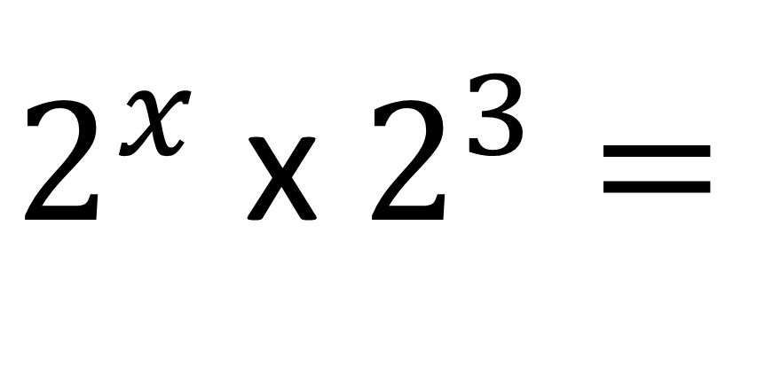
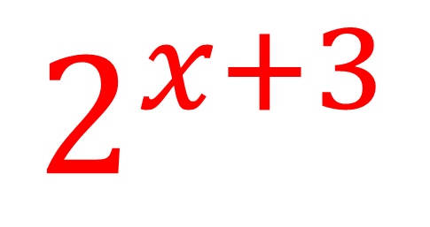
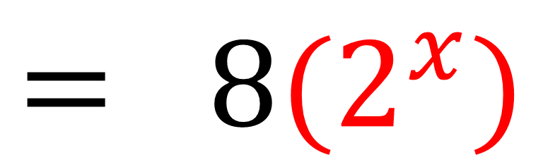
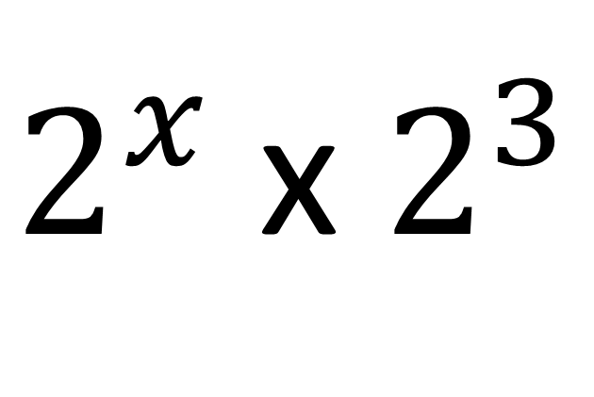
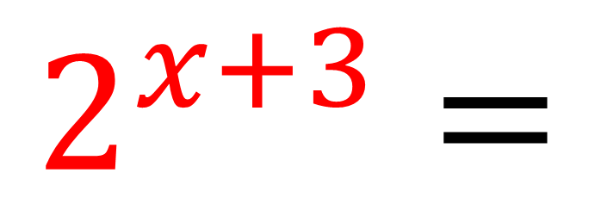
$2^{x}$ x $2^{3}=$
$$2^{x+3}$$
$$2^{x+3}=$$
$2^{x}$ x $2^{3}$
$$= 8{(2}^{x})$$

Slide 6
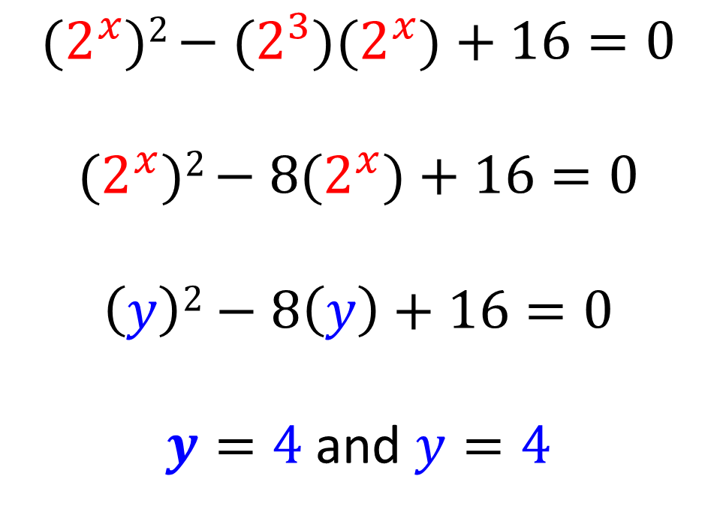
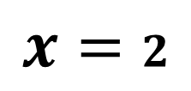
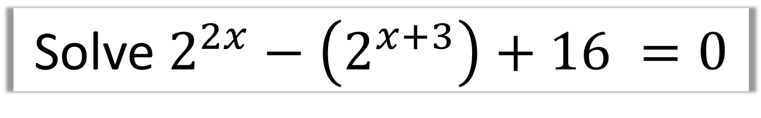
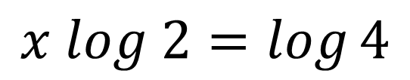
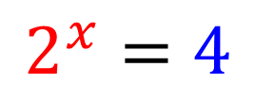
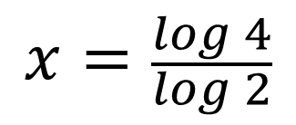
Solve $2^{2x}−\left(2^{x+3}\right)+16 =0$
$${(2}^{x})2 {− (2^{3})(2}^{x})+16=0$$
$${(2}^{x})2 {− 8(2}^{x})+16=0$$
$$\left(y\right)2−8\left(y\right)+16=0$$
$y=4$and $y=4$
$$2^{x}=4$$
$$x log 2=\log{4}$$
$$x=\frac{\log{4}}{\log{2}}$$
$$x=2$$

