Slide 1
Murder Mystery 2

Slide 2
At 9am, when the maid knocked on the door of Lady Bilkington’s room in the Rits Hotel, there was no reply.

Slide 3
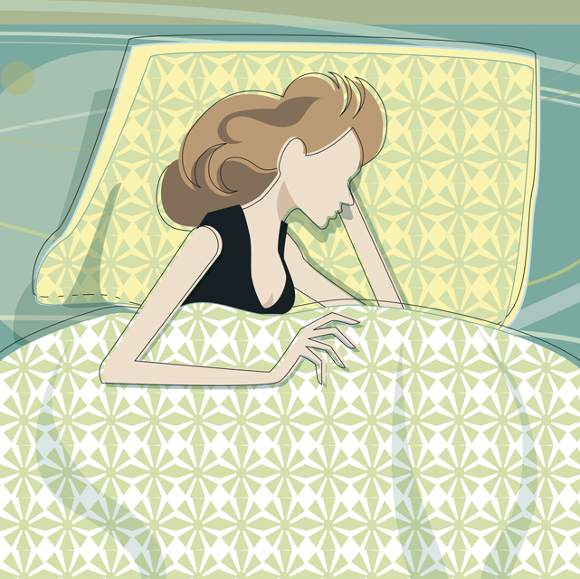

She had asked for breakfast in bed and a few minutes later, the manager opened the door. Lady Bilkington was lying dead in her bed.

Slide 4

Beside her was a half drunk cup of cocoa which smelt rather odd. Later tests revealed that this had been laced with poison.

Slide 5
Her jewellery case containing the Bilkington diamonds was empty.

Slide 6

The waitress who had served the evening cocoa was nowhere to be seen. Her body was found in her room – she had been shot.

Slide 7
The police were now looking for the mastermind behind this and the diamonds theft.

Slide 8
The waitress, not entirely trusting the mastermind, had left hidden in her room 6 clues in code. The first five give helpful facts about the murderer and the 6th clue reveals where the diamonds are.

Slide 9
There are 32 suspects. Each clue eliminates half of the suspects.
Can you find the murderer and the place where the diamonds are hidden?

Slide 10
In clues 1,3 & 4: A=1, B=2 etc
For help with certain clues, click on the selected arrow.
Clue 2
Clue 3
Clue 5
Answers

Slide 11
Clue 2
Here is the first line done. Mark off the lines of symmetry for each letter then working from left to right look for the numbers.
back to clues page
121110
0 | 1 | 0 | 0 | 2 | 0 | 0 | 1 | 0 | 0 | 1 | 0 | 1 | 1 | 1 | 0
z | t | s | r | h | p | q | e | f | j | m | n | u | w | x | r

Slide 12
Clue 3
Most of these sequences are straight forward apart from:
7) square numbers
8) prime numbers
10) Fibonacci
13) prime numbers
14) doubling
17) doubling
back to clues page

Slide 13
Clue 5
Try the 3 x 12 grids.
back to clues page

Slide 14

Stop! Answers coming up.

Slide 15
m + 10 = 30 20=t
3m = 24 8=h
m + 14 = 19 5=e
m – 4 = 12 16=p
m + 10 = 25 15=o
4m = 36 9=i
m – 11 = 8 19=s
m + 6 = 21 15=o
m ÷ 2 =7 14=n
8m = 40 5=e
m ÷ 3 = 6 18=r
2m + 4 = 20 8=h
10m = 10 1=a
m + 6 = 25 19=s
2m + 2 = 30 14=n
m ÷ 5 = 3 15=o
3m – 3 = 15 6=f
m ÷ 2 = 9 18=r
20m = 100 5=e
9m – 2 = 25 3=c
3m + 7 = 40 11=k
3m = 36 12=l
m – 5 = 0 5=e
m + 9 = 28 19=s
Clue 1
The poisoner has no freckles

Slide 16
Clue 2
Birds and mammals are warm blooded – all others are cold blooded.
0 | 1 | 0 | 0 | 2 | 0 | 0 | 1 | 0 | 0 | 1 | 0 | 1 | 1 | 1 | 0
z | t | s | r | h | p | q | e | f | j | m | n | u | w | x | r
2 | 0 | 1 | 0 | 1 | 1 | 1 | 0 | 0 | 0 | 1 | 1 | 1 | 0 | 1 | 2
I | J | D | S | E | Y | W | R | Q | P | E | C | A | R | T | I
1 | 0 | 1 | 0 | 1 | 8 | 2 | 1 | 0 | 8 | 0 | 1 | 1 | 2 | 1 | 0
E | S | C | G | A | O | I | e | L | O | L | D | B | I | E | l
1 | 8 | 1 | 8 | 0 | 0 | 1 | 1 | 0 | 1 | 0 | 1 | 1 | 2 | 0 | 0
E | O | A | O | F | R | D | E | P | D | L | W | D | I | K | j
0 | 1 | 1 | 0 | 0 | 2 | 1 | 0 | 0 | 2 | 0 | 1 | 0 | 0 | 1 | 1
Q | E | T | S | P | H | E | F | P | I | R | M | P | J | E | t

Slide 17
1) | 20 | 40 | 60 | 80 |  |  | t
2) | 2 | 4 | 6 | 8 |  |  | h
3) | 35 | 25 | 15 | 5 |  |  | e
4) | 19 | 17 | 15 | 13 |  |  | m
5) | 7 | 14 | 21 | 28 |  |  | u
6) | 12 | 13 | 15 | 18 |  |  | r
7) | 1 | 4 | 9 | 16 |  |  | d
8) | 2 | 3 | 5 | 7 | 11 |  | e
9) | -6 | 0 | 6 | 12 | 18 |  | r
10) | 0 | 1 | 1 | 2 | 3 | 5 | e
11) | 48 | 38 | 28 | 18 |  |  | r
12) | 6 | 9 | 12 | 15 | 18 |  | i
13) | 7 | 11 | 13 | 17 | 19 |  | s
14) | 3 | 6 | 12 | 24 | 48 |  | l
15) | -25 | -15 | -5 | 5 |  |  | e
16) | 1 | 6 | 11 | 16 |  |  | f
17) | 10 | 20 | 40 | 80 | 160 |  | t
18) | 68 | 48 | 28 | 8 |  |  | h
19) | 1 | 3 | 6 | 10 | 15 |  | a
20) | 112 | 56 | 28 | 14 |  |  | n
21) | 1 | 2 | 4 | 8 | 16 |  | d
22) | 0 | 5 | 10 | 15 | 20 |  | e
23) | 1 | 4 | 7 | 10 |  |  | d
Clue 3
The murderer is left handed

Slide 18
½ of 40=20 t
⅔ of 12=8 h
⅕ of 25=5 e
⅛ of 88=11 k
¾ of 12=9 i
⅔ of 18=12 l
¼ of 48=12 l
⅛ of 40=5 e
⅔ of 27=18 r
⅜ of 48=18 r
⅗ of 15=9 i
⅙ of 24=4 d
⅓ of 15=5 e
½ of 38=19 s
⅛ of 8=1 a
⅕ of 65=13 m
¾ of 20=15 o
⅝ of 32=20 t
⅓ of 45=15 o
⅗ of 30=18 r
⅛ of 16=2 b
⅜ of 24=9 i
¼ of 44=11 k
⅙ of 30=5 e
Clue 4
The killer rides a motorbike

Slide 19
Clue 5
The murderer educated at an all boys school
TDL/HUL/ECB/MAO/UTY/RES/DDS/EAC/RTH/EAO/RNO/EAL
T | H | E | M | U | R | D | E | R | E | R | E
D | U | C | A | T | E | D | A | T | A | N | A
L | L | B | O | Y | S | S | C | H | O | O | L

Slide 20
Clue 6
Diamonds in toilet cistern
click

Slide 21
Summary
Clue 1 – The poisoner has no freckles.
Clue 2 – The murderer is cold blooded like their pet.
Clue 3 – The murderer is left handed.
Clue 4 – The killer rides a motorbike.
Clue 5 – The murderer educated at an all boys school.
This should give the murderer as Simon Robinson.
Clue 6 – Diamonds in toilet cistern.

