Slide 1
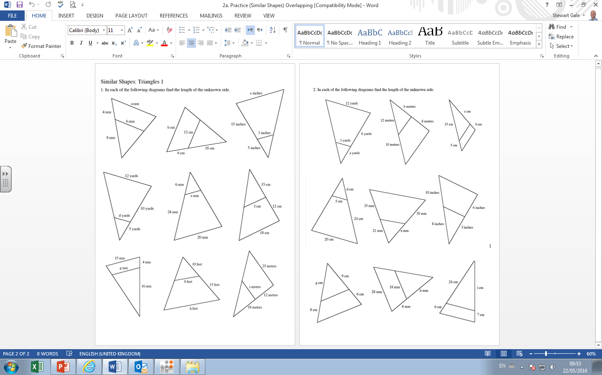

Slide 2
Answers

Slide 3
12
9.6
12
9
16
2
8
4
4
10
18
4.8
12
12
15
14.4
28
20

