Slide 1
LO: Solving Simultaneous
Equations Graphically
(Linear and Quadratic Graphs)

Slide 2
How many points of intersection
can you have with
a quadratic graph and
a linear graph?
0, 1 or 2

Slide 3
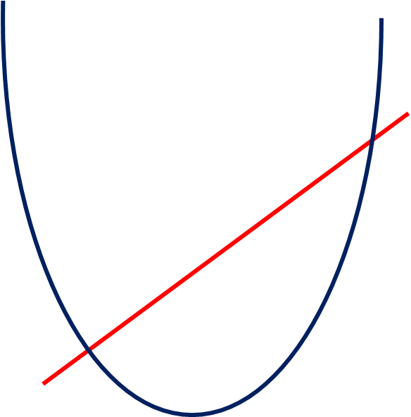
Two points of intersection

Slide 4
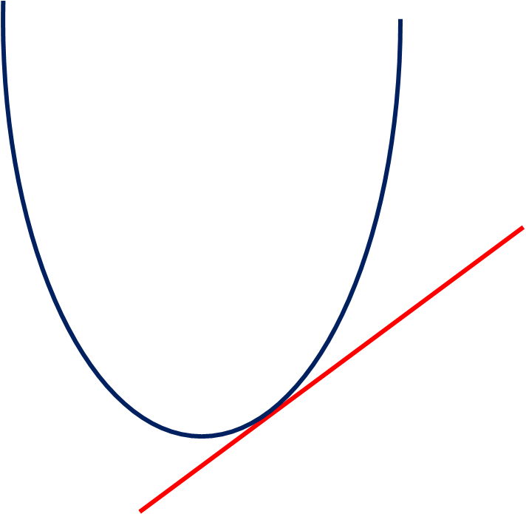
One point of intersection

Slide 5
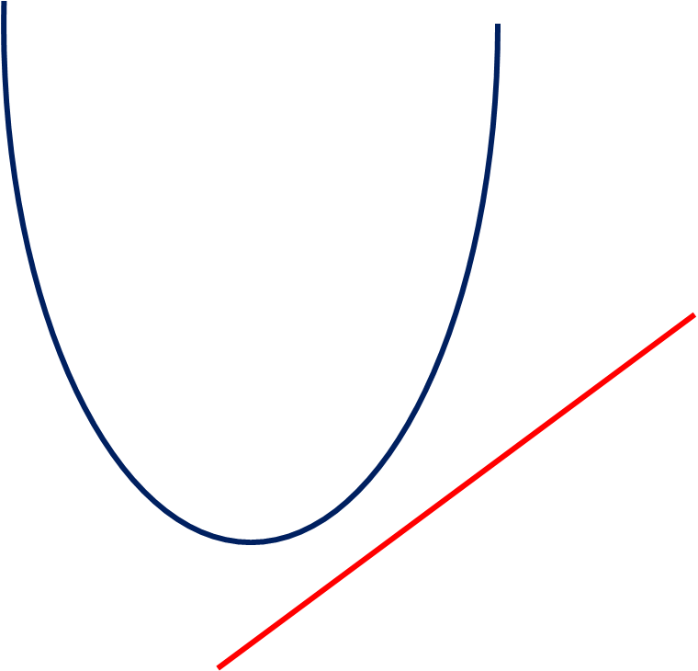
No points
of intersection

Slide 6
How many solutions?
2 Solutions (2 Roots)

Slide 7
How many solutions?
2 Solutions (2 Roots)

Slide 8
How many solutions?
1 Solution (1 Root)

Slide 9
How many solutions?
2 Solutions (2 Roots)

Slide 10
How many solutions?
0 Solution (0 Root)

Slide 11
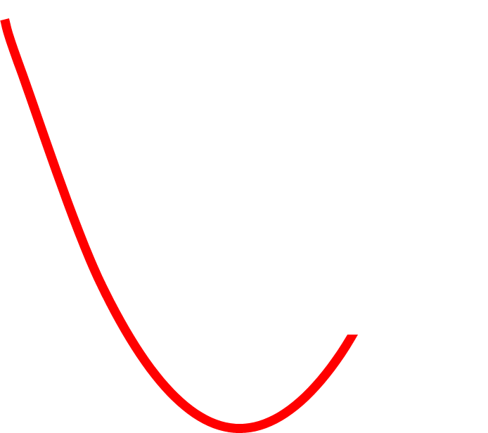
How many solutions?
2 Solutions (2 Roots)

Slide 12
If you read the solutions from
a graph, they will be approximate solutions.

Slide 13
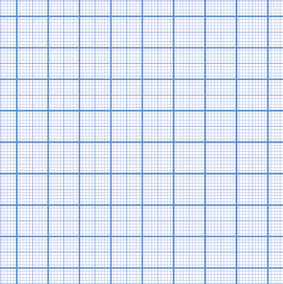
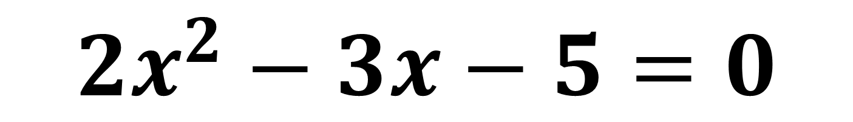
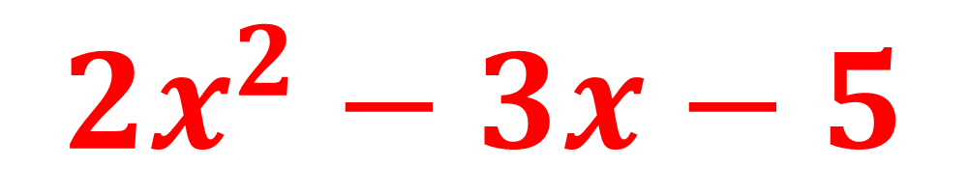

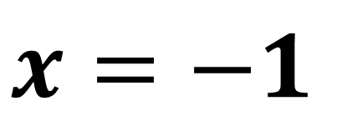
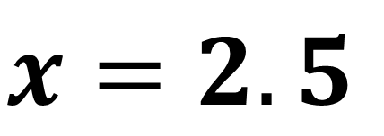
$${2x}^{2}−3x−5=0$$
$${2x}^{2}−3x−5$$
$$0$$
10
8
6
4
(–1,0)
2
(2.5, 0)
–4
–3
–2
–1
0
1
2
3
4
–2
$$x=−1$$
–4
–6
$$x=2.5$$

Slide 14

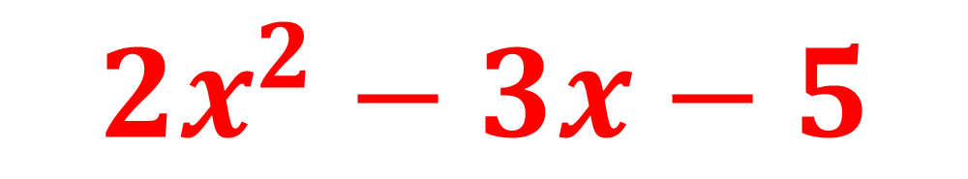
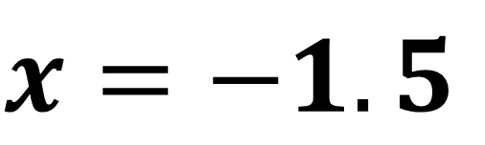
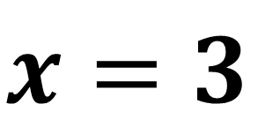
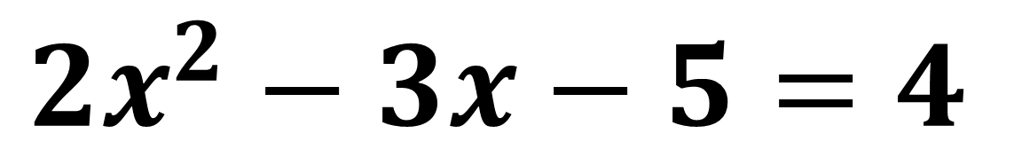
$${2x}^{2}−3x−5=4$$
$${2x}^{2}−3x−5$$
$$4$$
10
8
(-1.5,4)
6
(3, 4)
4
2
–4
–3
–2
–1
0
1
2
3
4
$$x=−1.5$$
–2
–4
$$x=3$$
–6

Slide 15

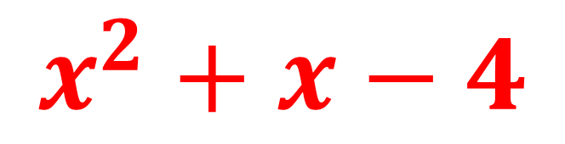
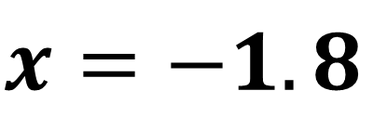
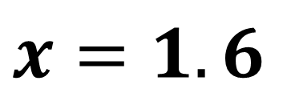
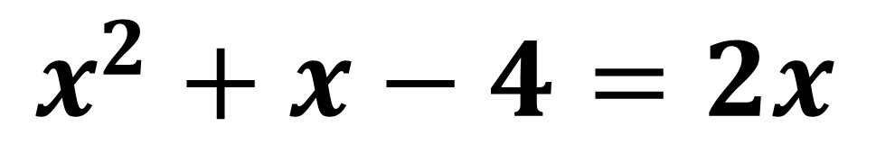
$$x^{2}+x−4$$
$$x^{2}+x−4=2x$$
$$2x$$
10
8
6
4
2
–4
–3
–2
–1
0
1
2
3
4
–2
$$x=−1.8$$
–4
$$x=1.6$$
–6

Slide 16
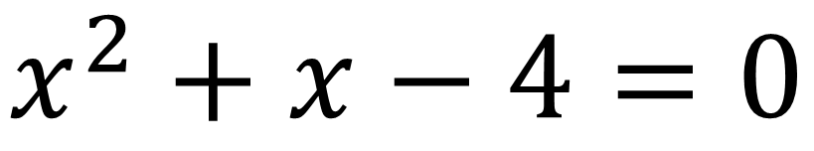
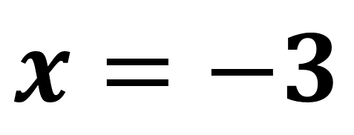
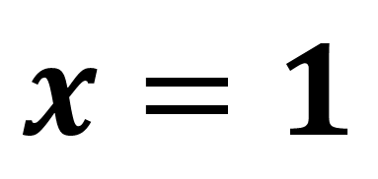
Use the graphs to find the approximate solutions to:
y = x² + x – 4
10
$$x^{2}+x−4=0$$
8
6
$$x=1$$
4
2
$$x=−3$$
–4
–3
–2
–1
0
1
2
3
4
–2
–4
–6

Slide 17
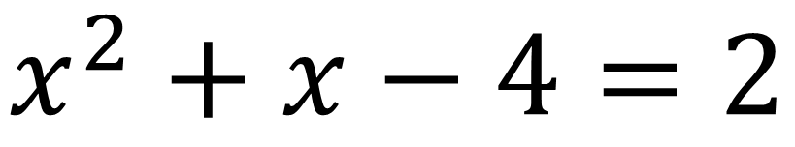
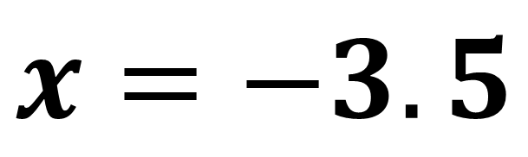
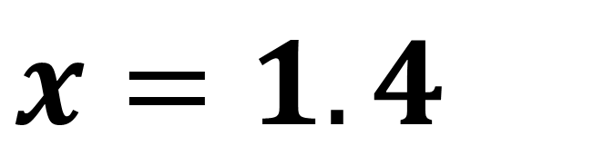
Use the graphs to find the approximate solutions to:
y = x² + x – 4
10
$$x^{2}+x−4=2$$
8
6
$$x=1.4$$
4
2
y = 2
$$x=−3.5$$
–4
–3
–2
–1
0
1
2
3
4
–2
–4
–6

Slide 18
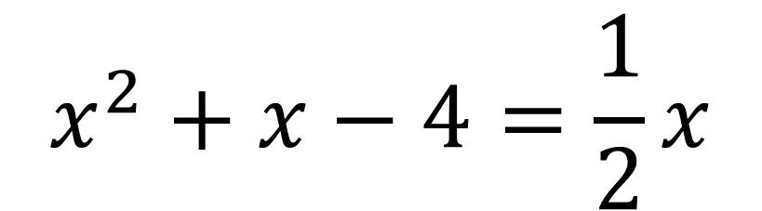
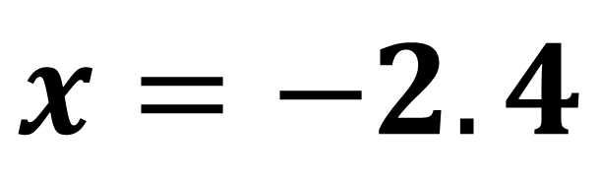
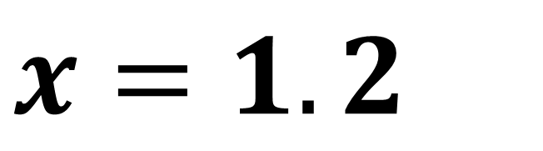
Use the graphs to find the approximate solutions to:
y = x² + x – 4
10
$$x^{2}+x−4=\frac{1}{2}x$$
8
6
y = ½x
4
$$x=1.2$$
2
–4
–3
–2
–1
0
1
2
3
4
$$x=−2.4$$
–2
–4
–6

Slide 19
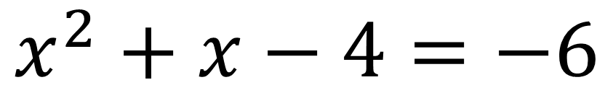
Use the graphs to find the approximate solutions to:
y = x² + x – 4
10
$$x^{2}+x−4=−6$$
8
6
4
No Solutions
2
–4
–3
–2
–1
0
1
2
3
4
–2
–4
y = –6
–6

Slide 20
Extension

Slide 21
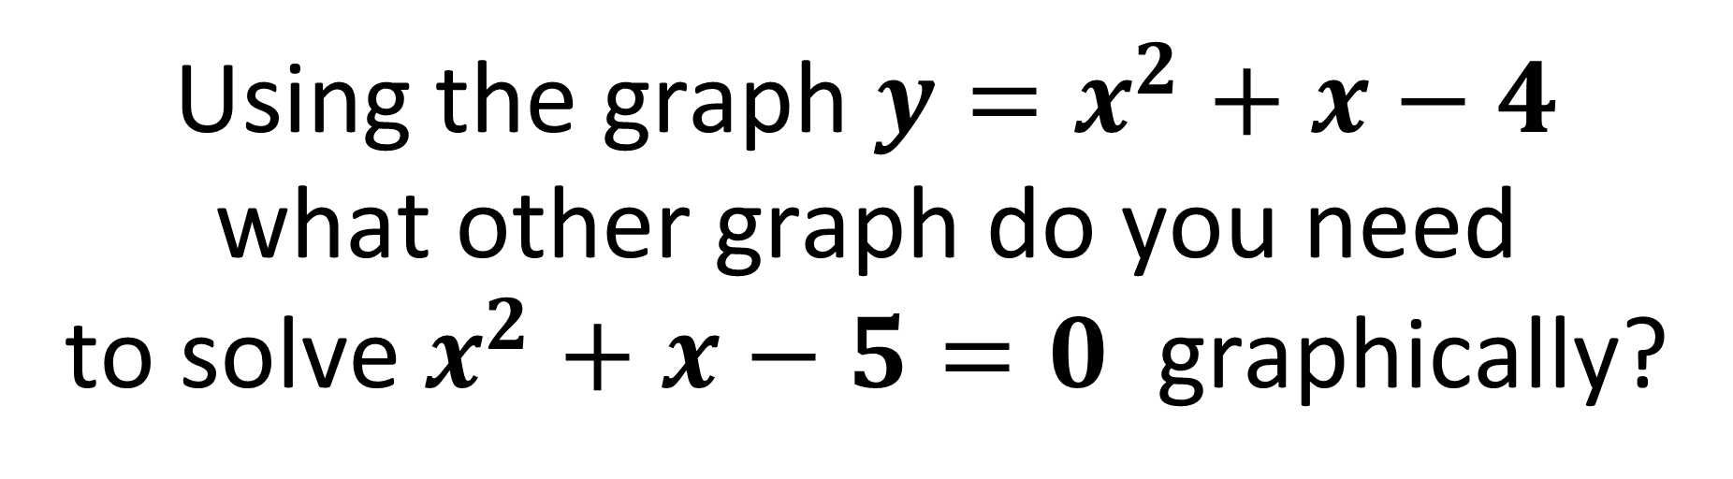

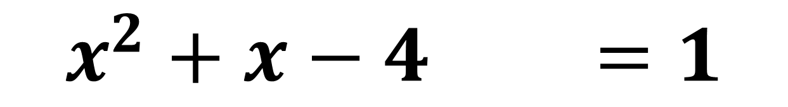
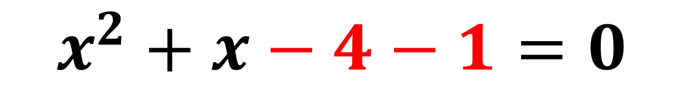

Using the graph ${y=x}^{2}+x−4$
what other graph do you need
to solve $x^{2}+x−5=0$ graphically?
$$− 5$$
$$x^{2}+x−4−1=0$$
$$x^{2}+x−4−1=1$$
You need to graph $y=1$

Slide 22

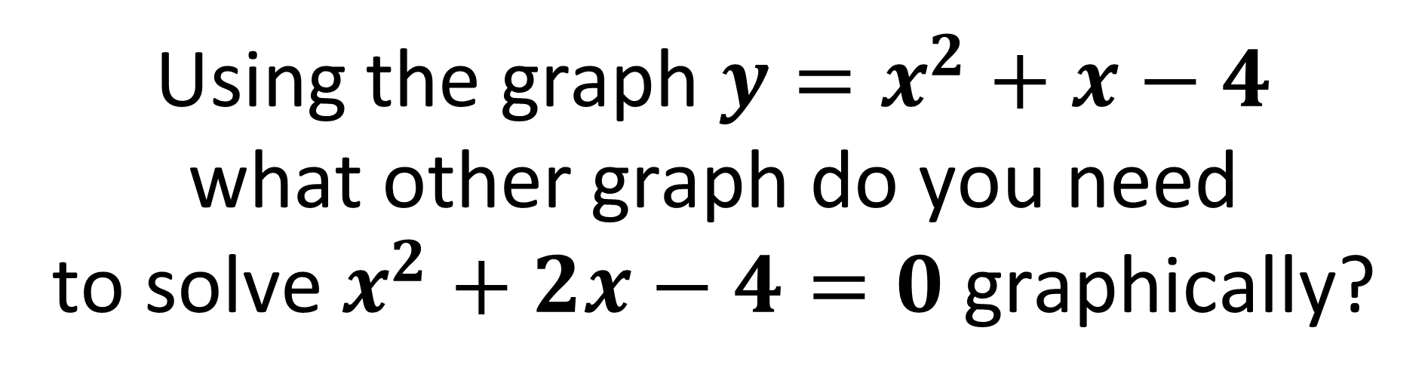
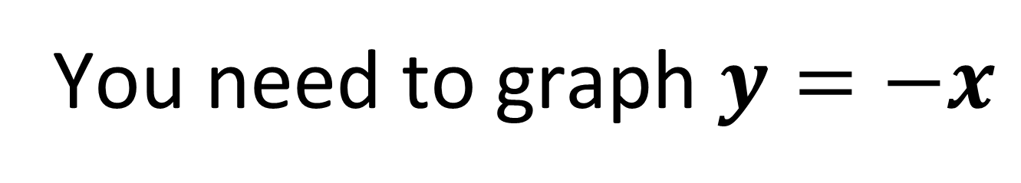
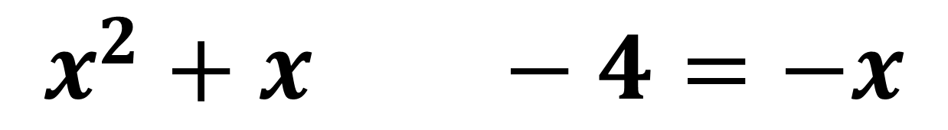
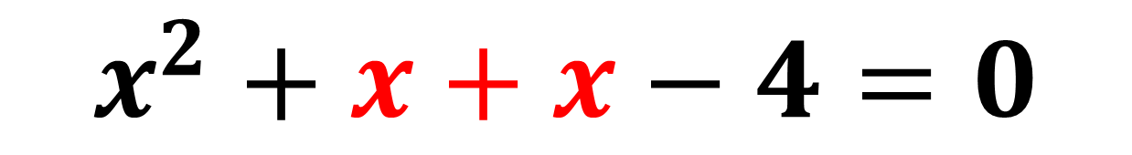
Using the graph ${y=x}^{2}+x−4$
what other graph do you need
to solve $x^{2}+2x−4=0$graphically?
$$2x$$
$$x^{2}+x+x−4=0$$
$$x^{2}+x+x−4=−x$$
You need to graph $y=−x$

Slide 23
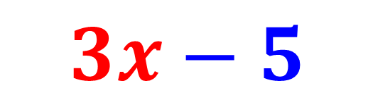
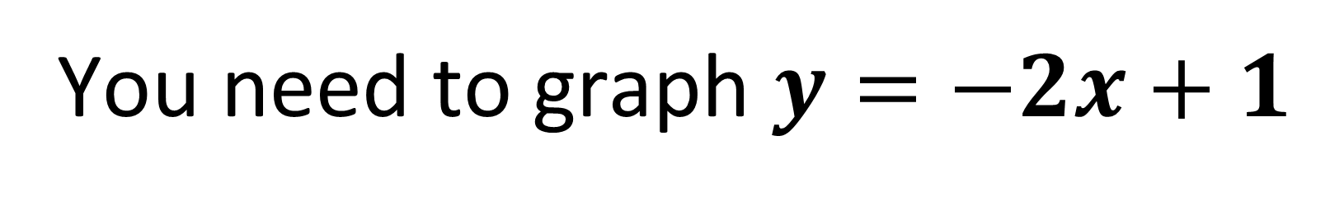
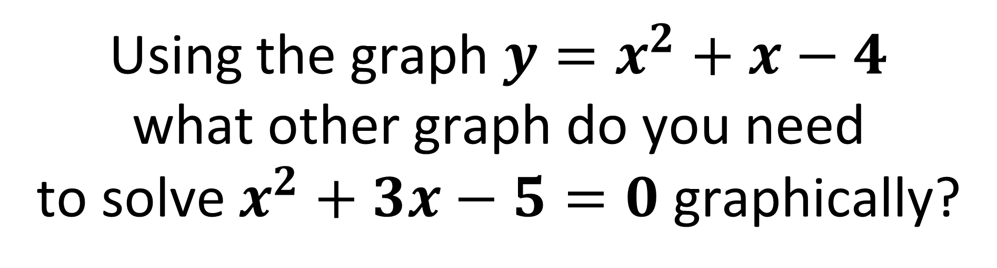
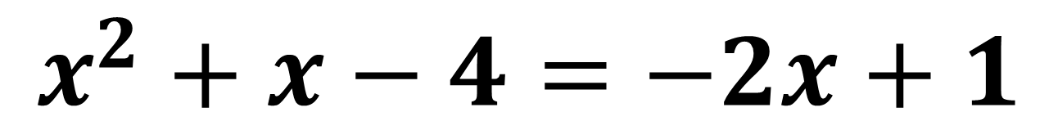
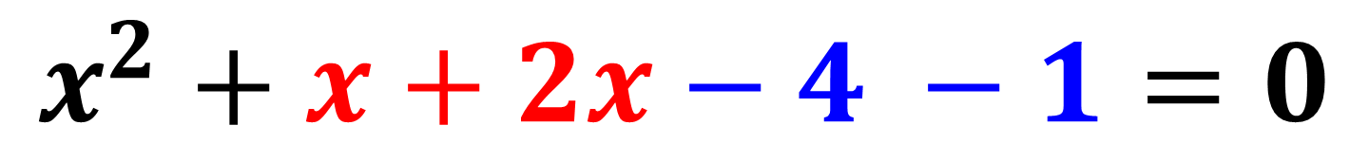
Using the graph ${y=x}^{2}+x−4$
what other graph do you need
to solve $x^{2}+3x−5=0$ graphically?
$$3x−5$$
$$x^{2}+x+2x−4 −1=0$$
$$x^{2}+x−4=−2x+1$$
You need to graph $y=−2x+1$

