Slide 1
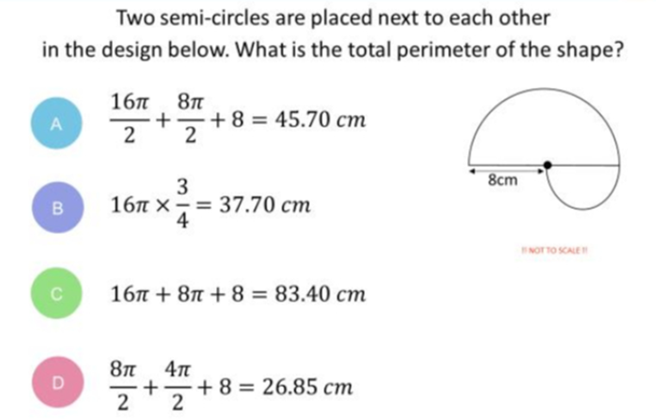
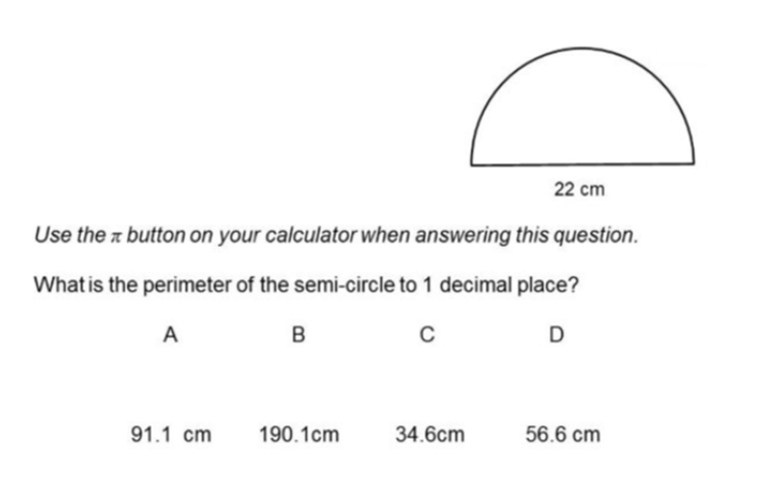
Which question had the lowest percentage of
correct answers?
For each question, what was the most common
wrong answer?

Slide 2
Which question had the lowest percentage of
correct answers?

Slide 3
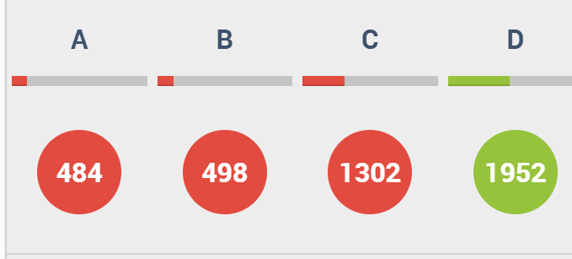
C
They forgot to add on 22cm (diameter) onto half the circumference.

Slide 4
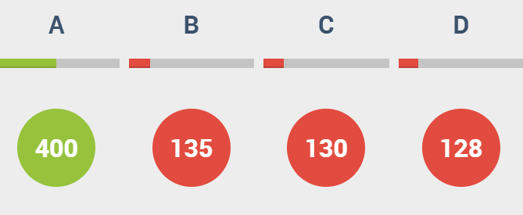
B
U appears on both sides.

