Slide 1
Integration
Trig Identities
Chapter 11
(Part 2 of 12)

Slide 2
When integrating
trigonometric functions
that look complicated
first see if they are in the formula booklet.

Slide 3
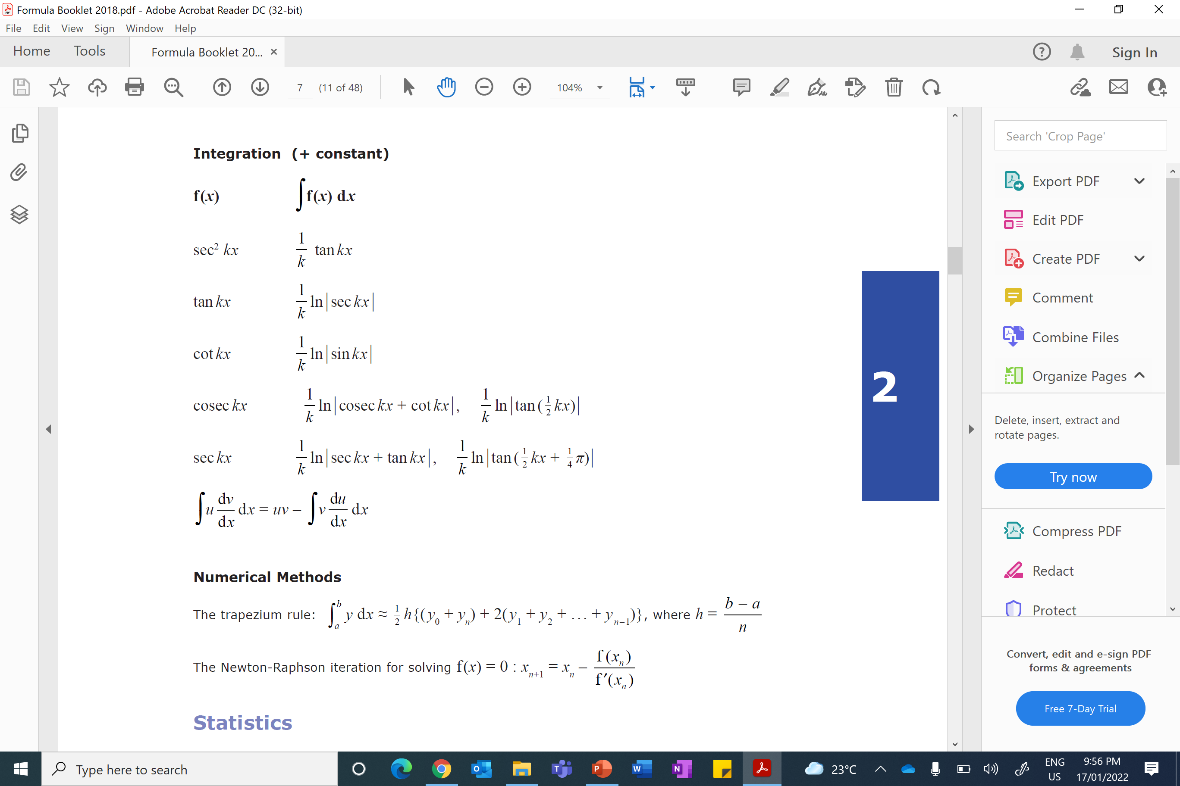

Slide 4
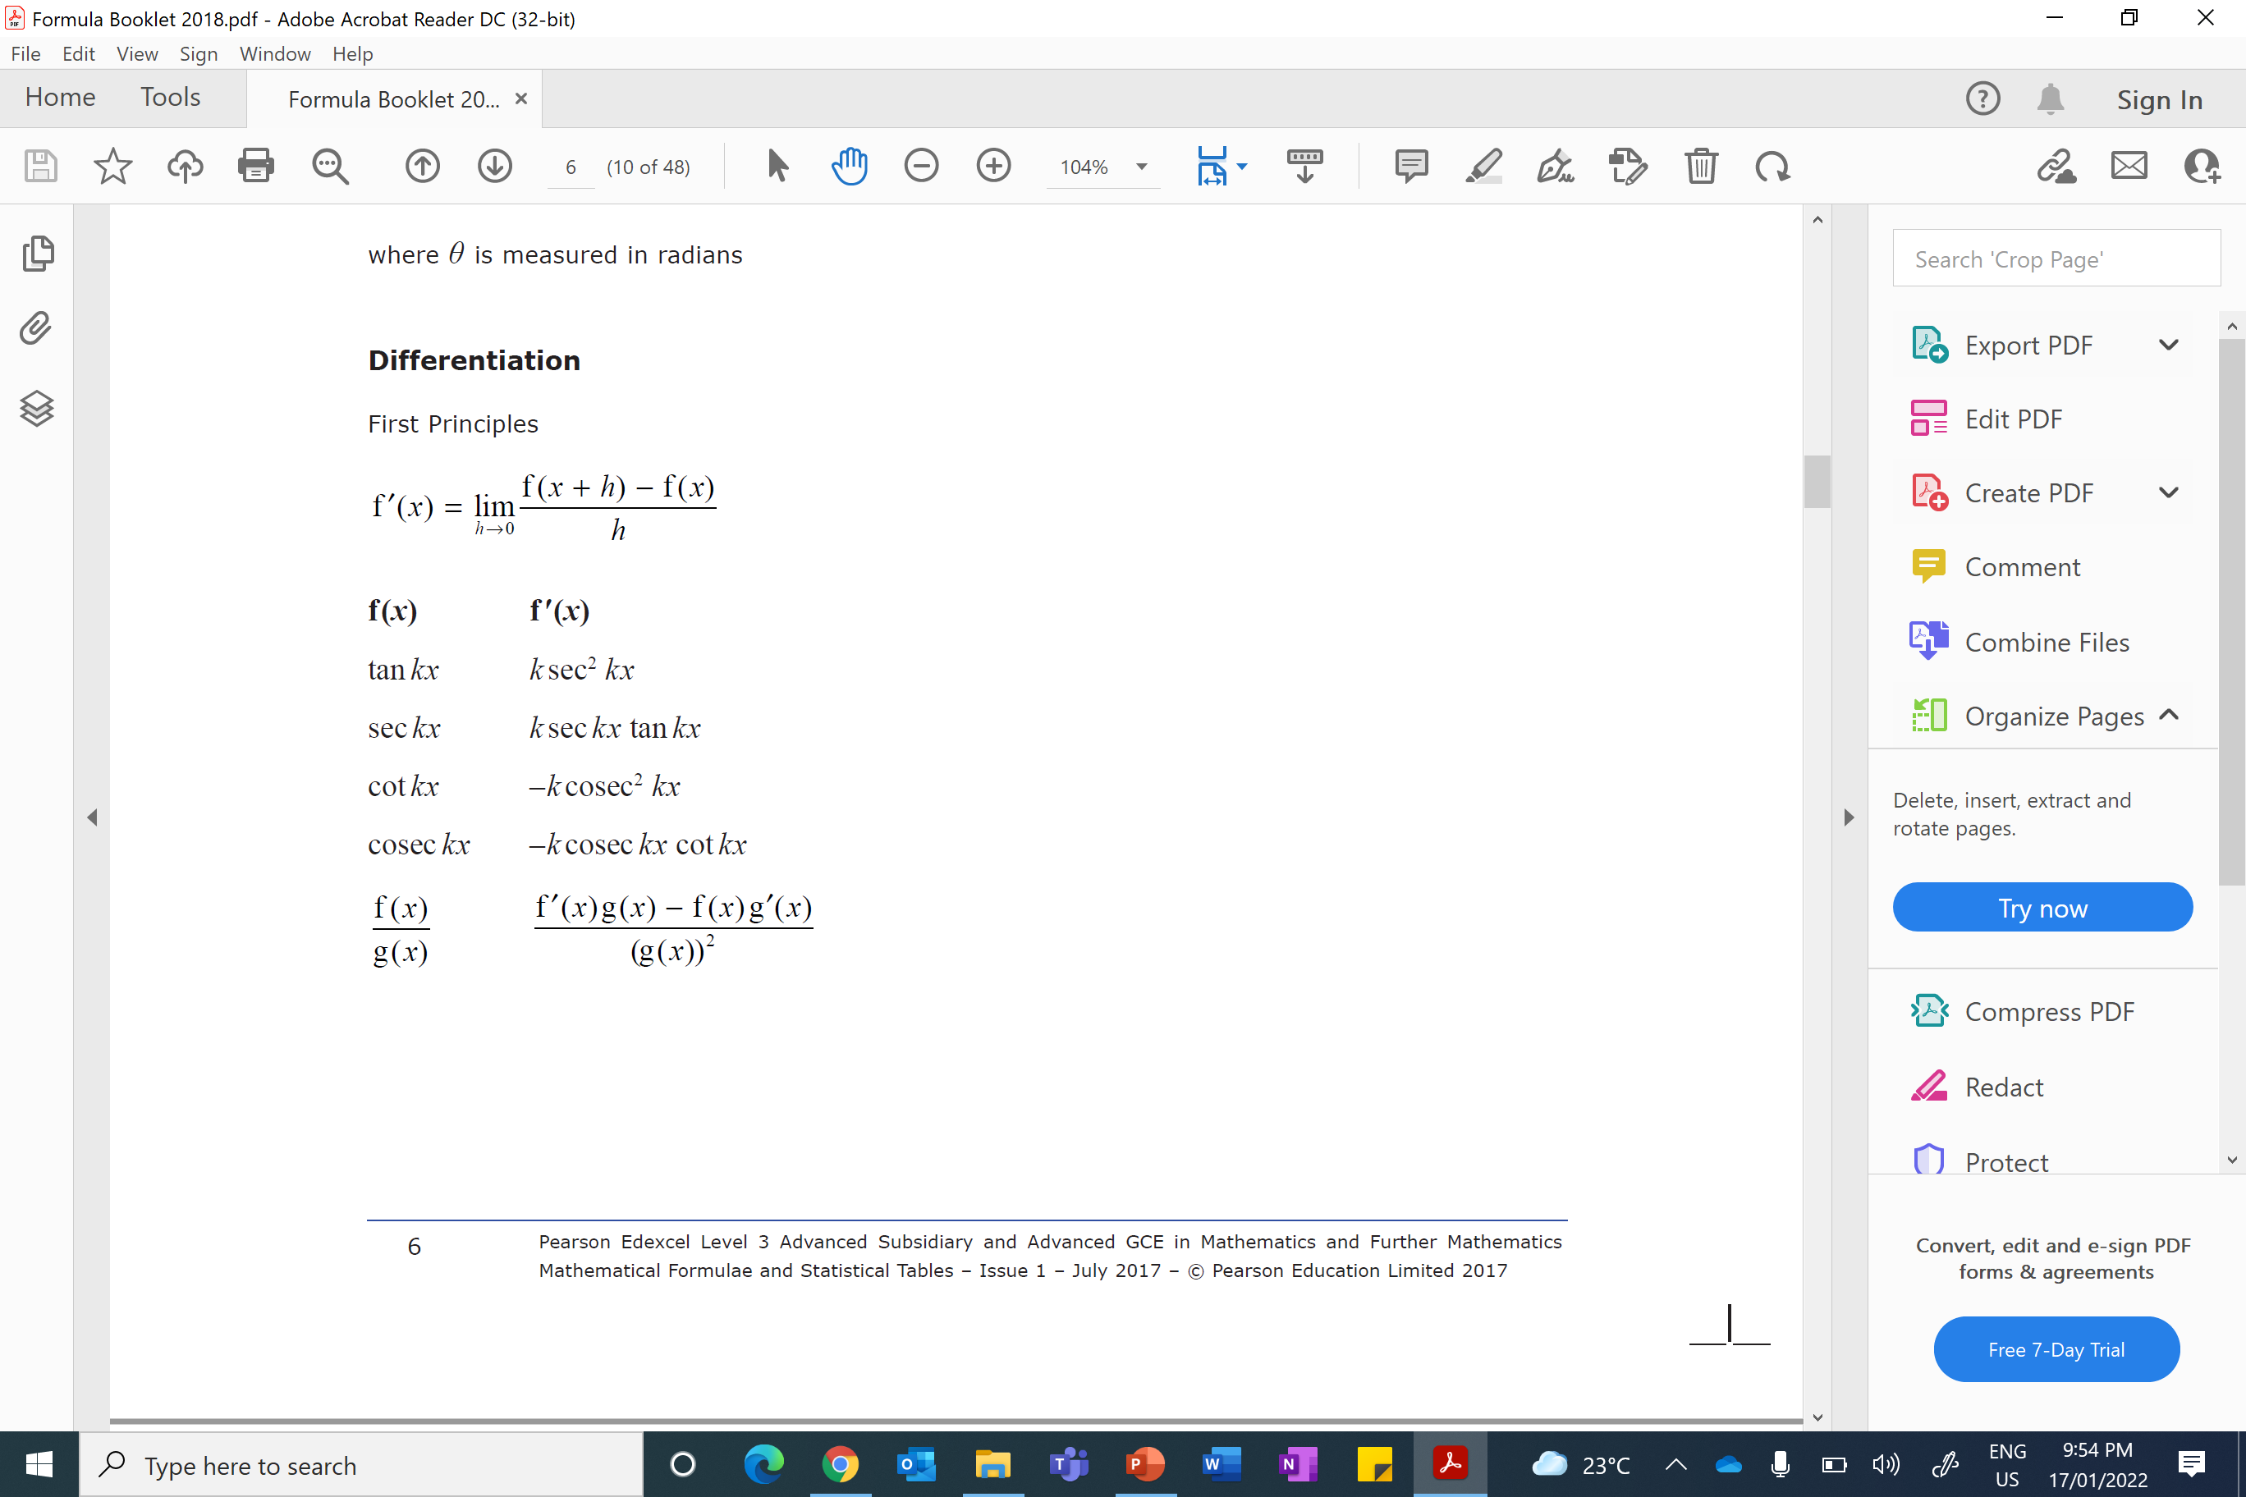
Integration
$$\frac{1}{k}$$
+ C
$$\frac{1}{k}$$
+ C
$$\frac{1}{k}$$
+ C
$$\frac{1}{k}$$
+ C

Slide 5
If it is not in the formula booklet, then you may need to
rewrite the question using
trig identities!!!

Slide 6
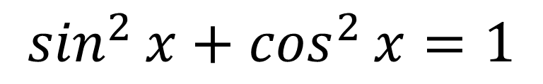
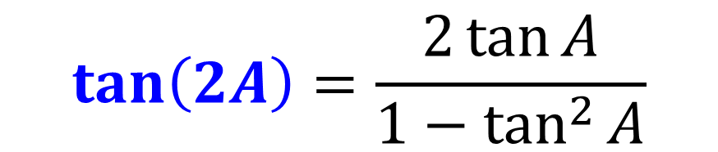
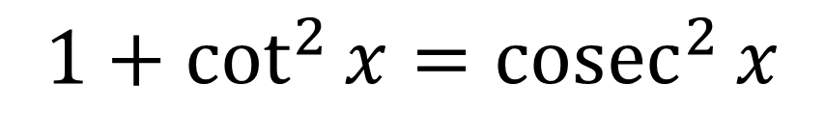
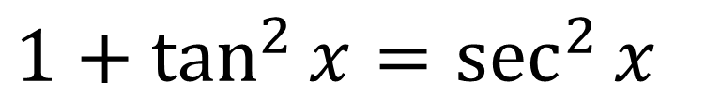
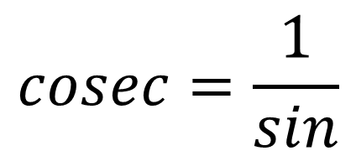
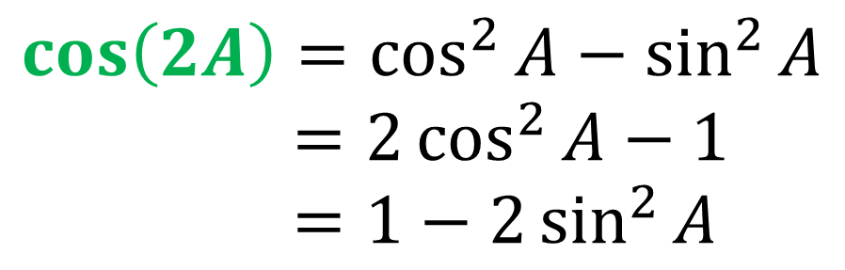
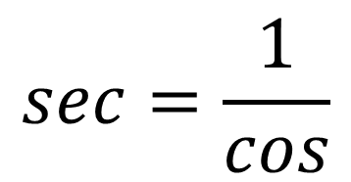

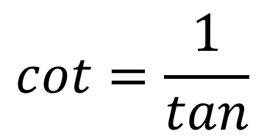
Double Angle
Trig Identities
$$\sin\left(2A\right)=2\sin{A}\cos{A}$$
$$\sin^{2}{x}+\cos^{2}{x}=1$$
$$1+\tan^{2}{x}=\sec^{2}{x}$$
$$\cos\left(2A\right)=\cos^{2}{A}−\sin^{2}{A}$$
$=2\cos^{2}{A}−1$
$=1−2\sin^{2}{A}$
$$1+\cot^{2}{x}={cosec}^{2}{x}$$
$$cosec=\frac{1}{sin}$$
$$sec=\frac{1}{cos}$$
$$\tan\left(2A\right)=\frac{2\tan{A}}{1−\tan^{2}{A}}$$
$$cot=\frac{1}{tan}$$

Slide 7
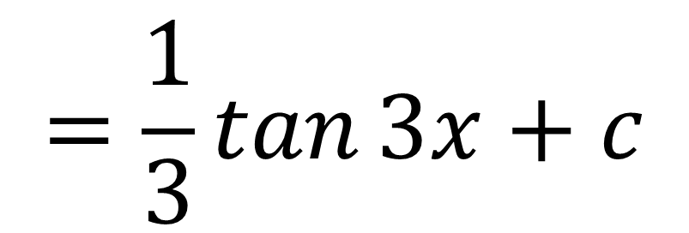
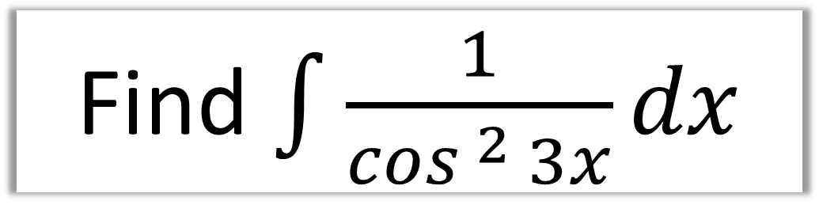
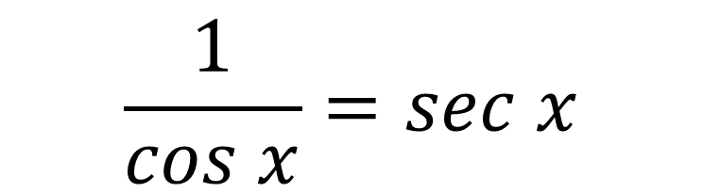
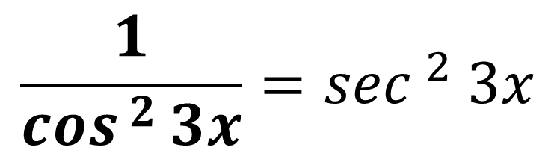
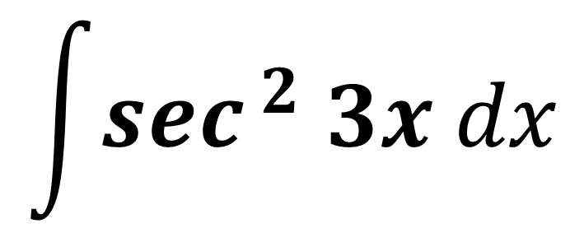
Find $\int{\frac{1}{\cos^{ 2 }3x}dx}$
Rewrite – Trig Identity
$$\int{\sec^{ 2} 3x dx}$$
$$\frac{1}{\cos^{ }x}=sec x$$
$$=\frac{1}{3}\tan{3x}+c$$
$$\frac{1}{\cos^{ 2 }3x}=\sec^{ 2} 3x$$

Slide 8
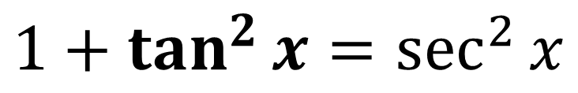
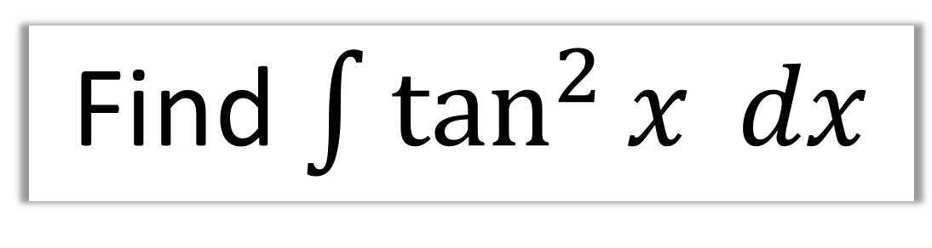
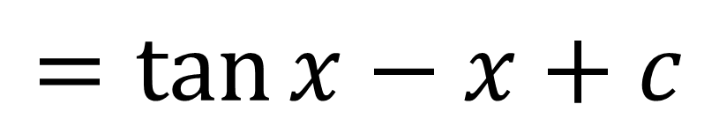
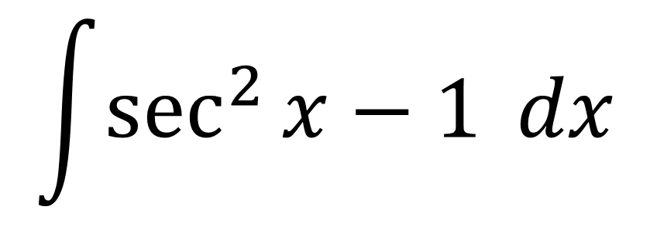
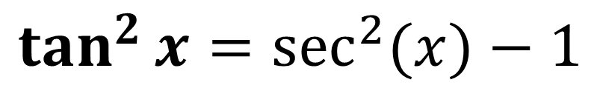
Find $\int{\tan^{2}{x} dx}$
Rewrite – Tri Identity
$$\int{\sec^{2}{x}−1} dx$$
$$1+\tan^{2}{x}=\sec^{2}{x}$$
$$=tan{x}−x+c$$
$$\tan^{2}{x}=\sec^{2}{(x)}−1$$

Slide 9
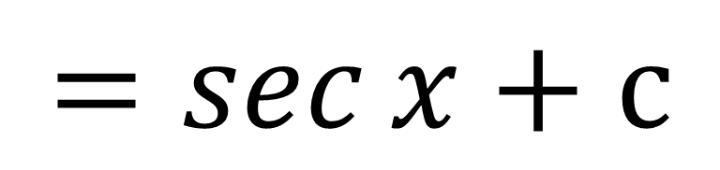

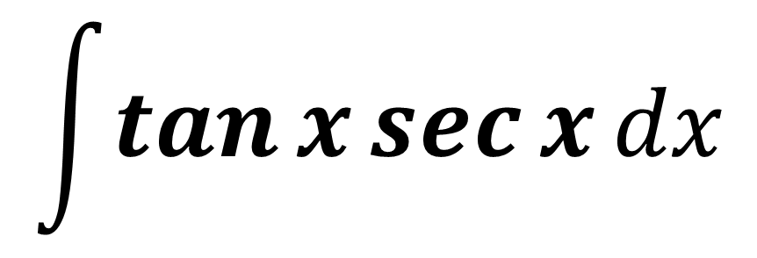
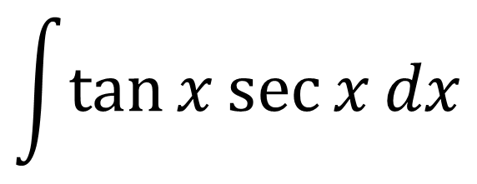
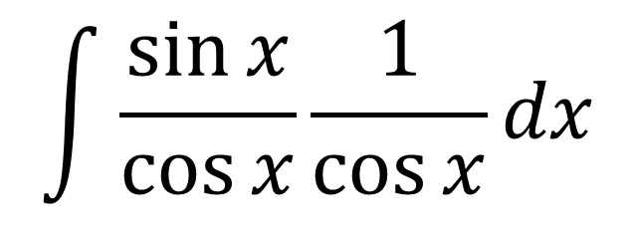
Find $\int{\frac{\sin{x}}{\cos^{2}x}dx}$
Split it up
$$\int{\tan{x}\sec{x}dx}$$
$$\int{\frac{\sin{x}}{\cos{x}}\frac{1}{\cos{x}}dx}$$
$$=sec{x}+c$$
Rewrite – Trig Identities
$$\int{\tan{x}\sec{x}dx}$$

Slide 10
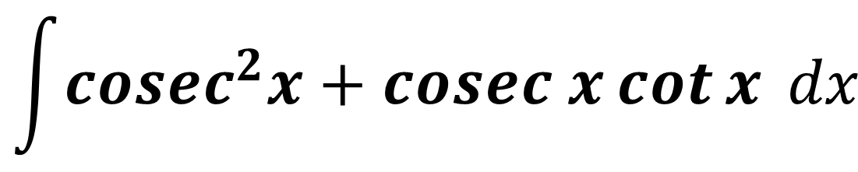
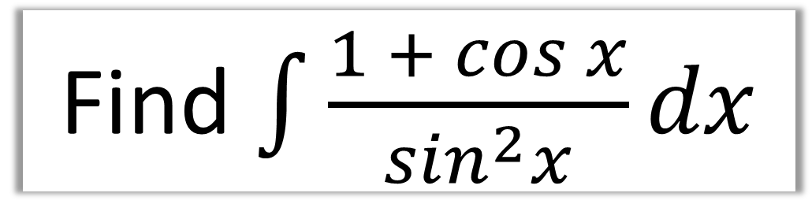
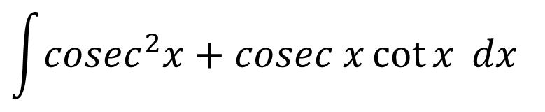
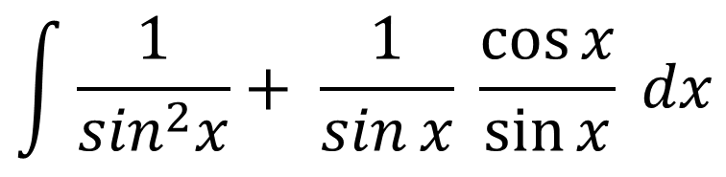
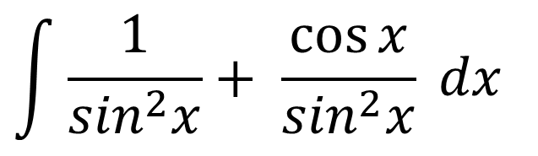
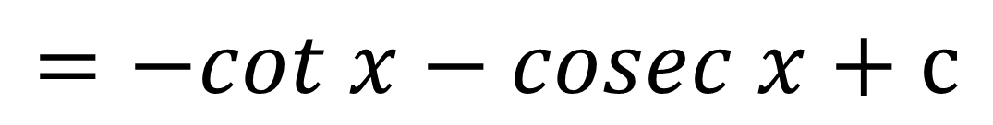
Find $\int{\frac{1 + cos{x}}{\sin^{2}x}dx}$
Split it up
$$\int{{cosec}^{2}x+cosec x\cot{x} dx}$$
$$\int{\frac{1}{\sin^{2}x}+ \frac{\cos{x}}{\sin^{2}x} dx}$$
$$\int{\frac{1}{\sin^{2}x}+ \frac{1}{\sin{x}} \frac{\cos{x}}{\sin{x}} dx}$$
$$=−cot x−cosec x+c$$
Rewrite – Trig Identities
$$\int{{cosec}^{2}x+cosec x\cot{x} dx}$$

Slide 11
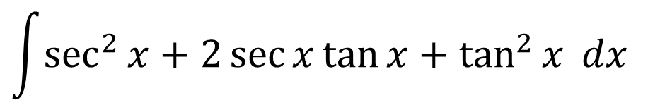
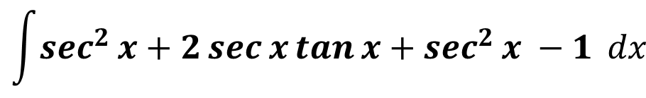
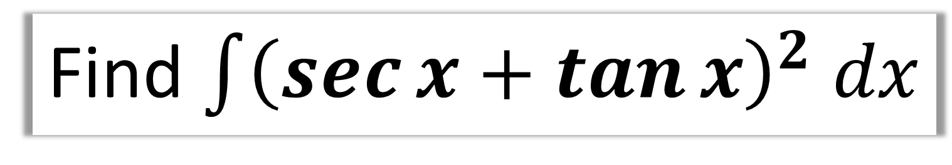
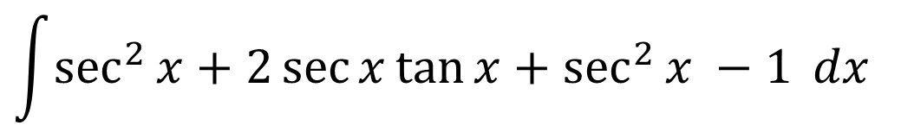

Find $\int{{\left(\sec{x}+\tan{x}\right)}^{2} dx}$
Expand
$$\int{\sec^{2}{x}+2\sec{x}\tan{x}+\sec^{2}{x −1} dx}$$
$$\int{\sec^{2}{x}+2\sec{x}\tan{x}+\tan^{2}{x} dx}$$
$$=\tan{x}+2\sec{x}+\tan{x}−x+c$$
Rewrite – Trig Identity
$$=2\tan{x}+2\sec{x}−x+c$$
$$\int{\sec^{2}{x}+2\sec{x}\tan{x}+\sec^{2}{x −1} dx}$$

Slide 12
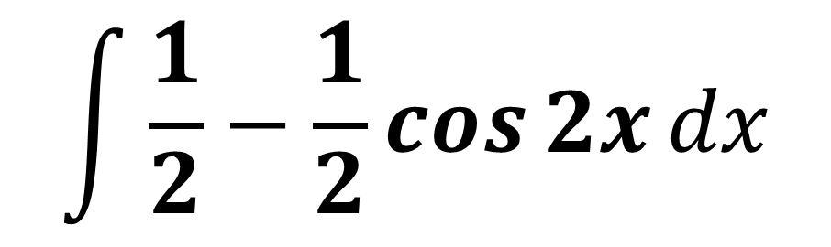
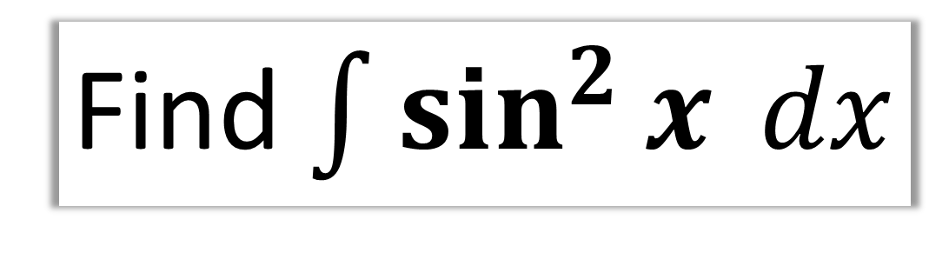
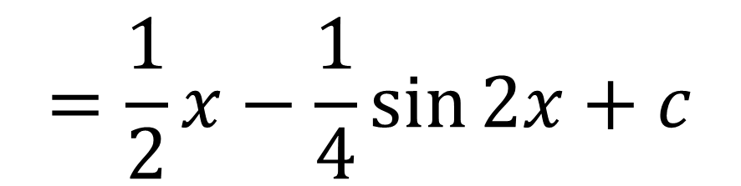
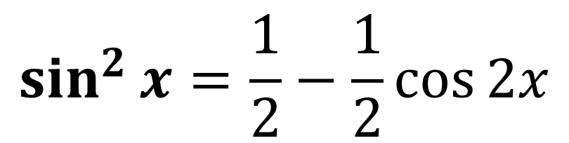
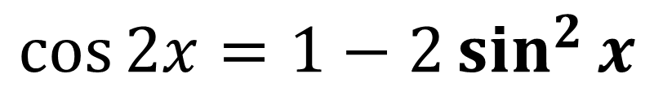
Find $\int{\sin^{2}{x} dx}$
Rewrite – Double Angle
$$\int{\frac{1}{2}−\frac{1}{2}\cos{2x}dx}$$
$$\cos{2x}=1−2\sin^{2}{x}$$
$$\sin^{2}{x}=\frac{1}{2}−\frac{1}{2}\cos{2x}$$
$$=\frac{1}{2}x−\frac{1}{4}\sin{2x}+c$$

Slide 13
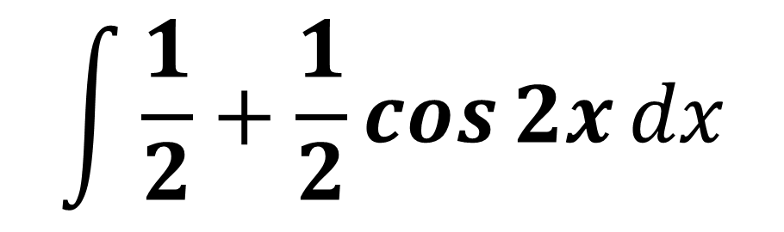
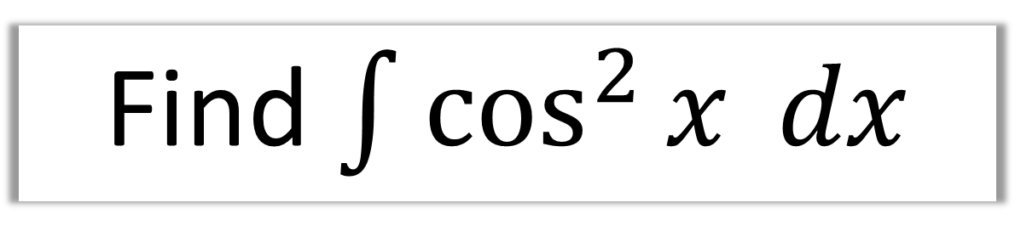
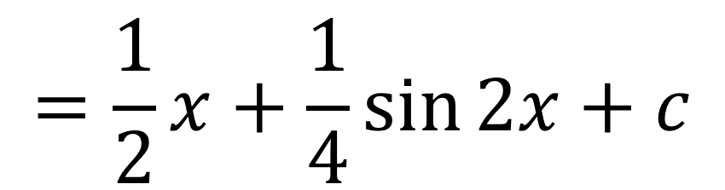
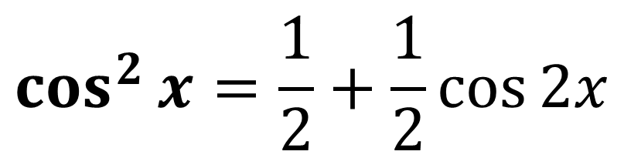
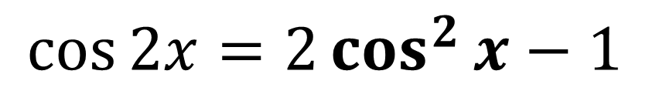
Find $\int{\cos^{2}{x} dx}$
Rewrite – Double Angle
$$\int{\frac{1}{2}+\frac{1}{2}\cos{2x}dx}$$
$$\cos{2x}=2\cos^{2}{x}−1$$
$$=\frac{1}{2}x+\frac{1}{4}\sin{2x}+c$$
$$\cos^{2}{x}=\frac{1}{2}+\frac{1}{2}\cos{2x}$$

Slide 14
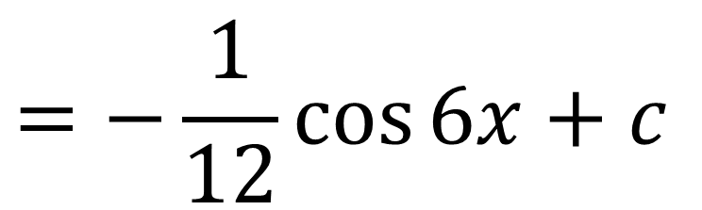
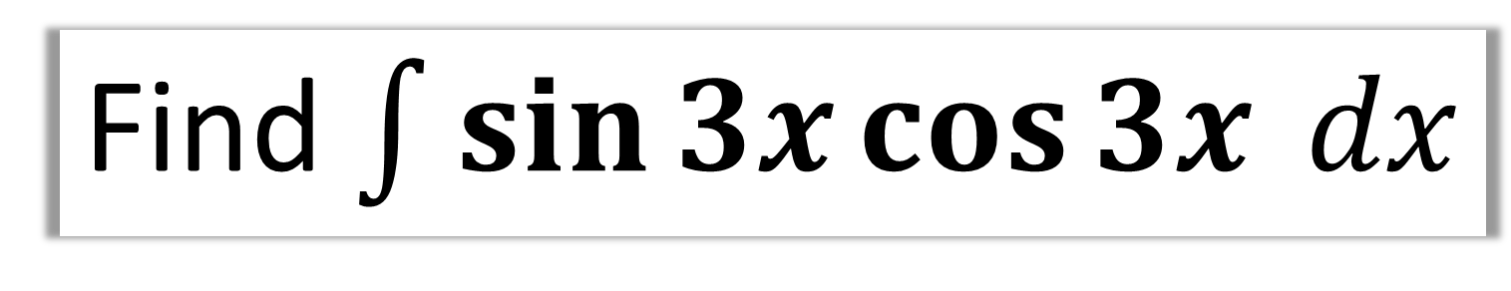
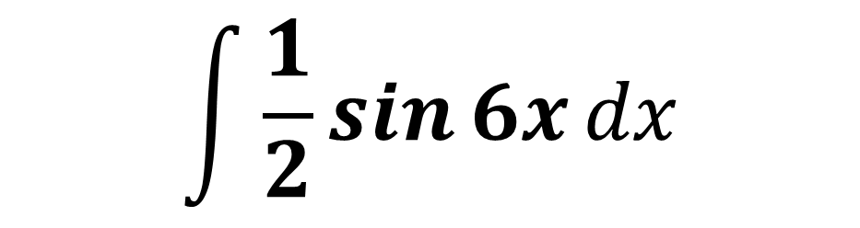
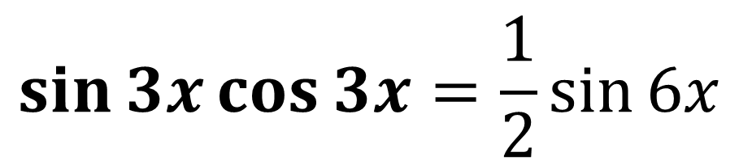
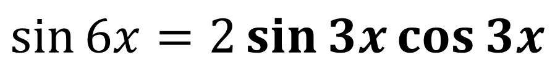
Find $\int{\sin{3x}\cos{3x} dx}$
$$\int{\frac{1}{2}\sin{6x}dx}$$
Rewrite – Double Angle
$$\sin{6x=2\sin{3x}\cos{3x}}$$
$$=−\frac{1}{12}\cos{6x}+c$$
$$\sin{3x}\cos{3x}=\frac{1}{2}\sin{6x}$$

Slide 15
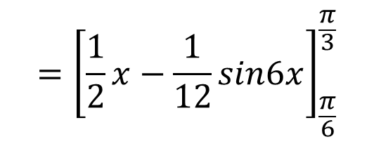







Find $\int_{\frac{π}{6}}^{\frac{π}{3}}{\sin^{2}{3x}} dx$
$$\int_{\frac{π}{6}}^{\frac{π}{3}}{ \frac{1}{2}−\frac{1}{2}cos6x} dx$$
Rewrite – Double Angle
$$\cos{2x}=1−2\sin^{2}{x}$$
$$={\left[\frac{1}{2}x−\frac{1}{12}sin6x\right]}_{\frac{π}{6}}^{\frac{π}{3}}$$
$$\cos{6x}=1−2\sin^{2}{3x}$$
$$=\left(\frac{π}{6}−\frac{1}{12}\sin{2π}\right)−\left(\frac{π}{12}−\sin{π}\right)$$
$$\sin^{2}{3x}=\frac{1}{2}−\frac{1}{2}\cos{6x}$$
$$=\frac{π}{12}$$

