Slide 1
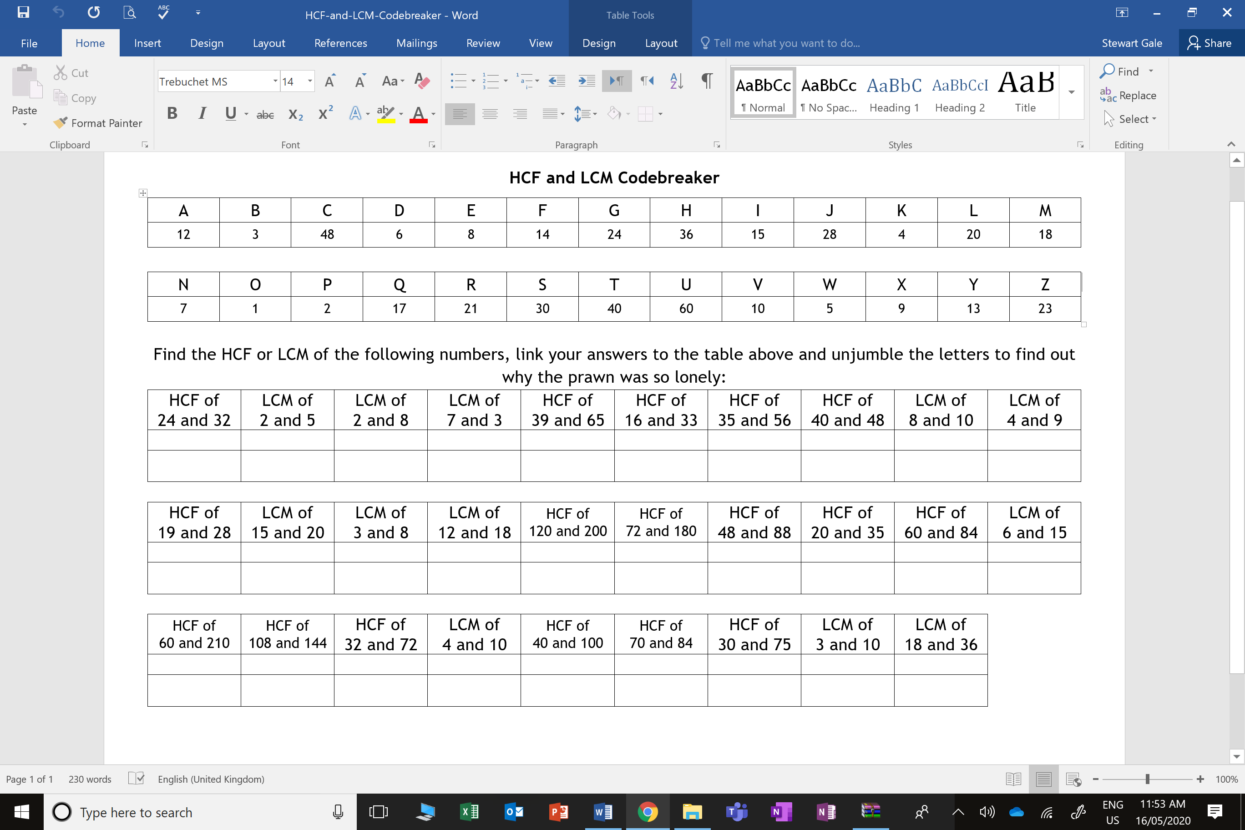
the crab had no friends
108
36

Slide 2
ANSWERS

Slide 3
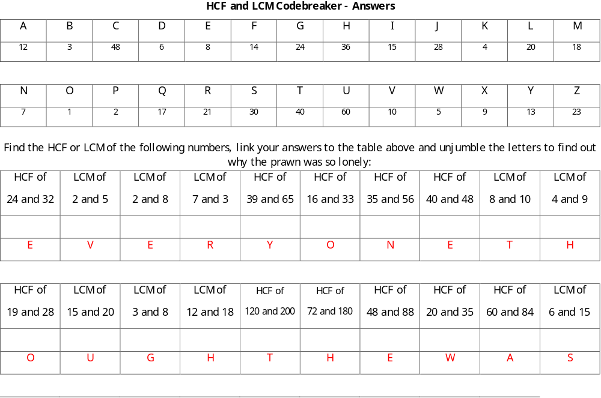
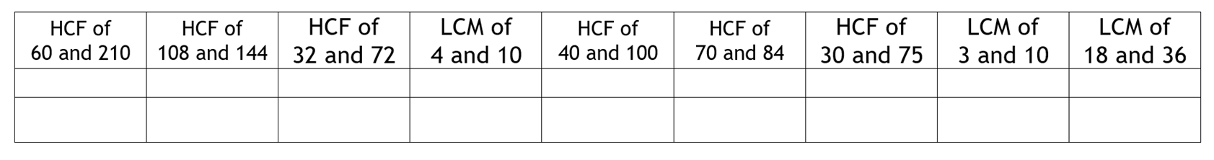
36
8
5
12
30
30
36
8
20
20
14
15
30
36
S
h
e
l
l
f
i
s
h

