Slide 1
Straight Line Graphs
Distance Between Two Points
and Enclosed Area
Chapter 5
(Part 4 of 4)

Slide 2
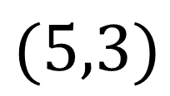
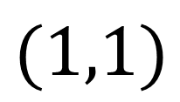
Distances between Points
How could you find the distance between these two points?
$$(5,3)$$
$$(1,1)$$

Slide 3
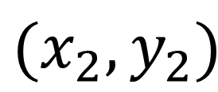
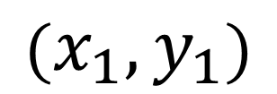
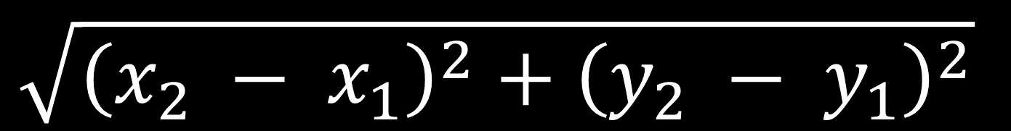
Distance between two points
$$(x_{2},y_{2})$$
$$(x_{1},y_{1})$$
$$\sqrt{{\left(x_{2} − x_{1}\right)}^{2}+{\left(y_{2} − y_{1}\right)}^{2}}$$

Slide 4
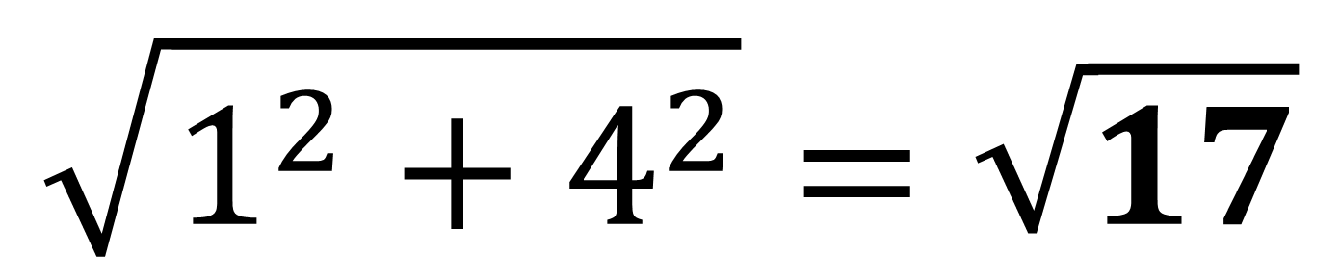
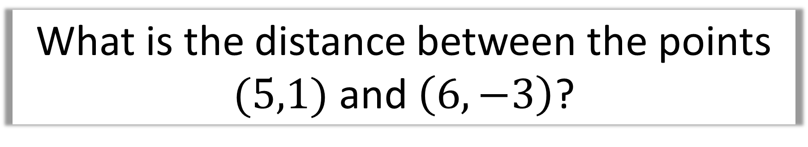
What is the distance between the points $(5,1)$ and $\left(6,−3\right)$?
$$\sqrt{1^{2}+4^{2}}=\sqrt{17}$$

Slide 5
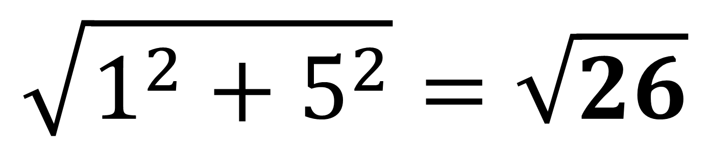
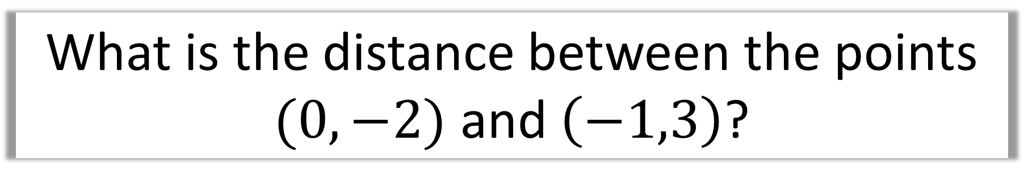
What is the distance between the points $(0,−2)$ and $\left(−1,3\right)$?
$$\sqrt{1^{2}+5^{2}}=\sqrt{26}$$

Slide 6


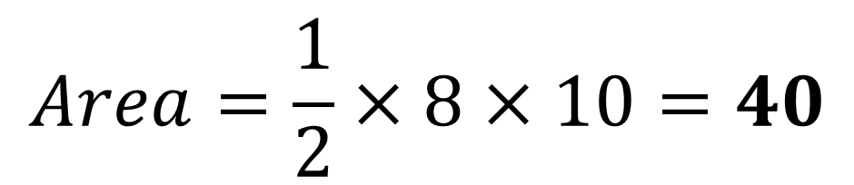


Area of Shapes
$$y$$
Height
8
Base
$$Area=\frac{1}{2}×8×10=40$$
$$x$$
$$O$$
$$10$$

Slide 7
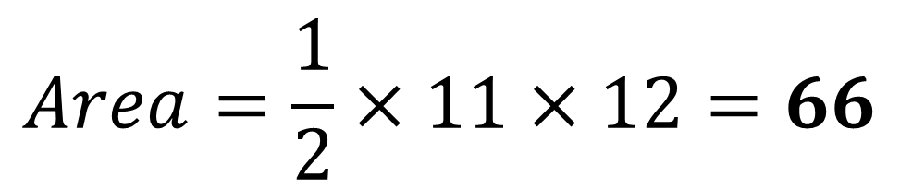






$$y$$
$$8$$
Height
Base
$$O$$
$$x$$
$$12$$
$$−3$$
$$Area=\frac{1}{2}×11×12=66$$

Slide 8

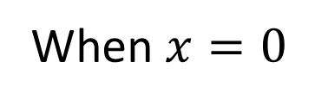




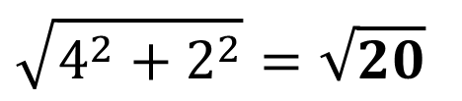

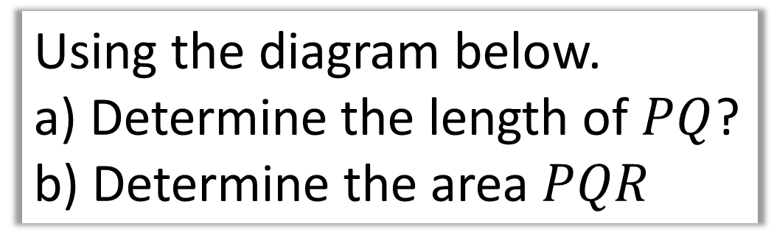












Using the diagram below.
a) Determine the length of $PQ$?
b) Determine the area $PQR$
a)
Point P
$$2y=8−y+4$$
$$3y=12$$
$$y=4$$
$$y$$
$$x=4$$
$$2y=x+4$$
Point Q
$$R$$
$$\left(4,4\right)$$
When $x=0$
$$P$$
$$2y=4$$
$$\left(0,2\right)$$
$$Q$$
$$x+y=8$$
$$y=2$$
$$x=8−y$$
Distance $PQ$
$$x$$
$$O$$
$$\sqrt{4^{2}+2^{2}}=\sqrt{20}$$

Slide 9






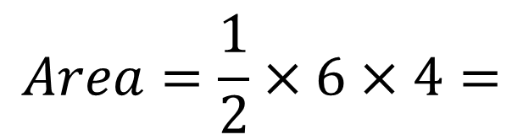

Using the diagram below.
a) Determine the length of $PQ$?
b) Determine the area $PQR$
b)
Point R
$$x+y=8$$
$$y$$
$$0+y=8$$
$$2y=x+4$$
$$R\left(0,8\right)$$
$$\left(0,8\right)$$
$$R$$
$$\left(4,4\right)$$
$$P$$
Use $RQ$ as the base:
$$\left(0,2\right)$$
$$Q$$
$$x+y=8$$
$$Area=\frac{1}{2}×6×4=$$
$$12$$
$$x$$
$$O$$

Slide 10
















Using the diagram below.
a) Determine the coordinate of 𝑃.
b) Determine the area of 𝑃𝑄𝑅.
c) Determine the length 𝑃𝑄.
Point P
a)
$$2\left(x−3\right)+x=12$$
$$2x−6+x=12$$
$$y$$
$$3x=18$$
$$2y+x=12$$
$$y=x−3$$
$$Q$$
$$x=6$$
$$P$$
$$y=x−3$$
$$y=6−3$$
$$y=3$$
$$O$$
$$x$$
$$P\left(6,3\right)$$
$$R$$

Slide 11










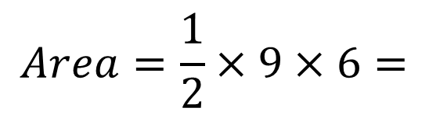


Using the diagram below.
a) Determine the coordinate of 𝑃.
b) Determine the area of 𝑃𝑄𝑅.
c) Determine the length 𝑃𝑄.
b)
Point Q
$$2y+x=12$$
$$2y+0=12$$
$$y=6$$
$$y$$
$$2y+x=12$$
$$y=x−3$$
$$Q\left(0,6\right)$$
$$\left(0,6\right)$$
$$Q$$
Point R
$$P$$
$$\left(6,3\right)$$
$$y=x−3$$
$$y=0−3$$
$$R\left(0,−3\right)$$
$$O$$
$$x$$
$$Area=\frac{1}{2}×9×6=$$
$$R$$
$$27$$
$$\left(0,−3\right)$$

Slide 12
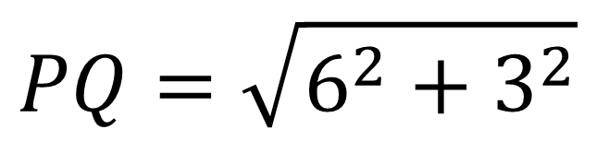
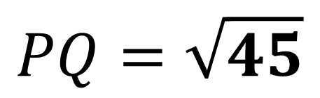
Using the diagram below.
a) Determine the coordinate of 𝑃.
b) Determine the area of 𝑃𝑄𝑅.
c) Determine the length 𝑃𝑄.
c)
$$PQ=\sqrt{6^{2}+3^{2}}$$
$$y$$
$$2y+x=12$$
$$y=x−3$$
$$Q$$
$$PQ=\sqrt{45}$$
$$\left(0,6\right)$$
$$P$$
$$\left(6,3\right)$$
$$O$$
$$x$$
$$R$$
$$\left(0,−3\right)$$

