Slide 1

Diagnostic Assessment .Delta 3
Unit 9
Trigonometry
3D Trigonometry
Trigonometric Waves

Slide 2
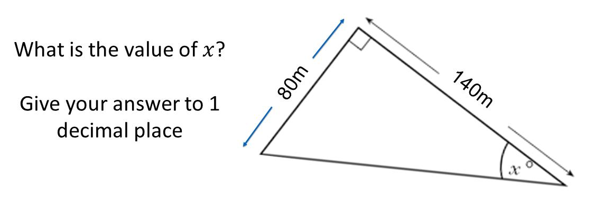
Question 1 – Trigonometry

Slide 3
Answer 1 – Trigonometry
CORRECT ANSWER | CORRECT EXPLANATION
29.7˚ | We have tan(x) = 80/140. We then have x = tan⁻¹(80/140) = 29.7°.
COMMON MISTAKES | WHAT MIGHT BE YOUR MISTAKE
55.2˚ | The student has used sin, rather than tan.
0.0˚ | The student may have used sin or cos, and written the fraction the wrong way around.
34.8˚ | The student has used cos, rather than tan.

Slide 4
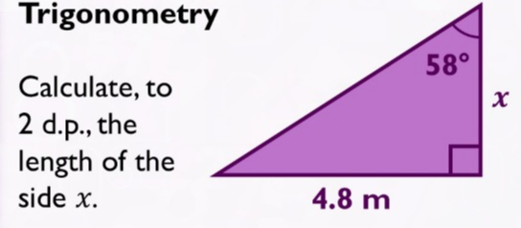
Question 2 – Trigonometry

Slide 5
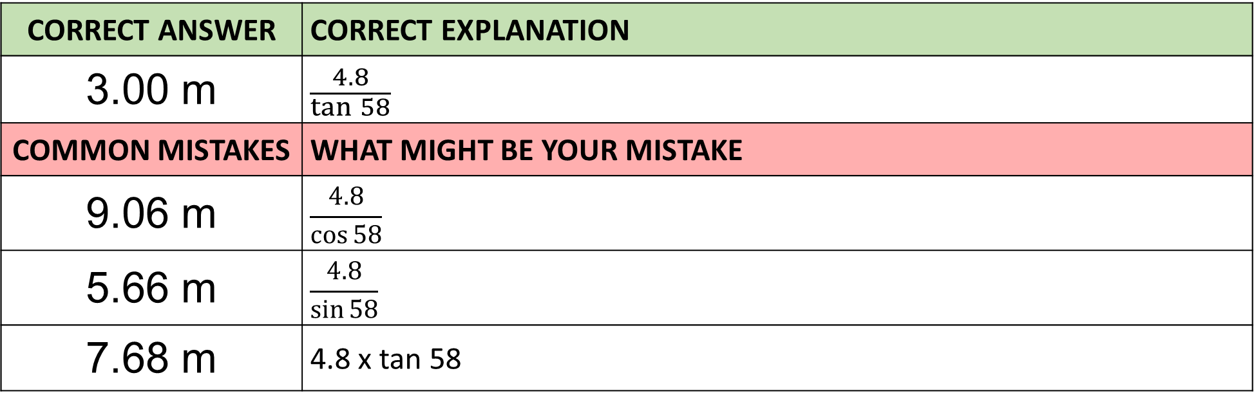
Answer 2 – Trigonometry
CORRECT ANSWER | CORRECT EXPLANATION
3.00 m | $$\frac{4.8}{\tan{58}}$$
COMMON MISTAKES | WHAT MIGHT BE YOUR MISTAKE
9.06 m | $$\frac{4.8}{\cos{58}}$$
5.66 m | $$\frac{4.8}{\sin{58}}$$
7.68 m | 4.8 x tan 58

Slide 6
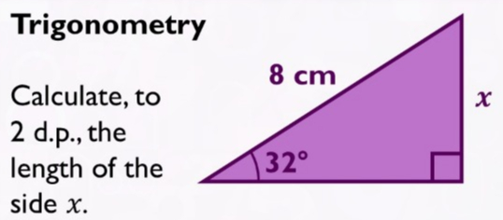
Question 3 – Trigonometry

Slide 7
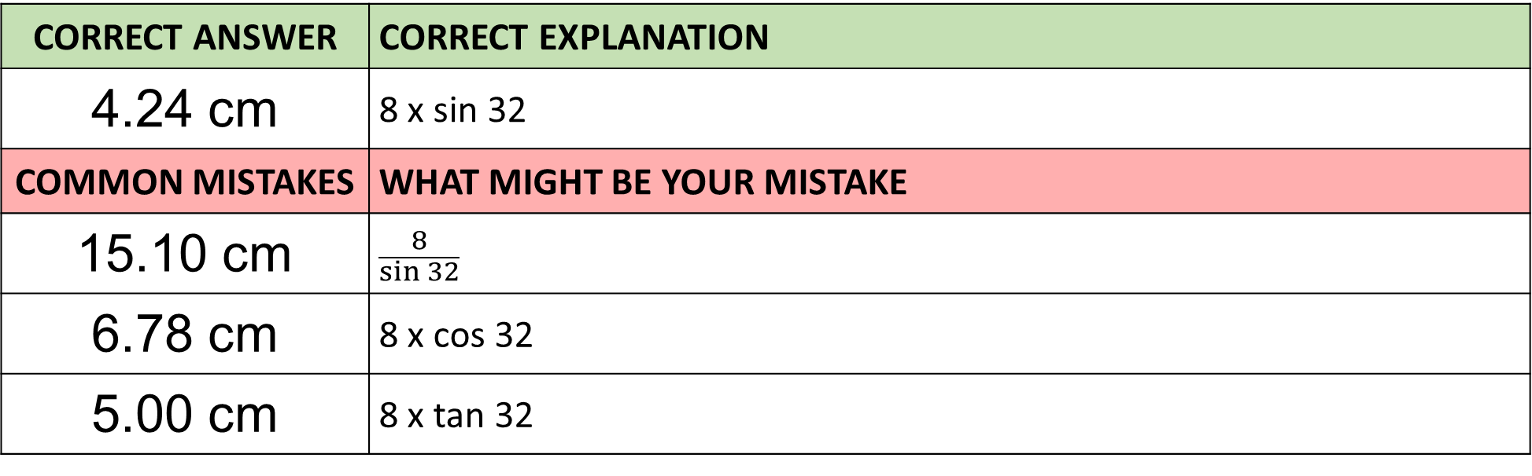
Answer 3 – Trigonometry
CORRECT ANSWER | CORRECT EXPLANATION
4.24 cm | 8 x sin 32
COMMON MISTAKES | WHAT MIGHT BE YOUR MISTAKE
15.10 cm | $$\frac{8}{\sin{32}}$$
6.78 cm | 8 x cos 32
5.00 cm | 8 x tan 32

Slide 8
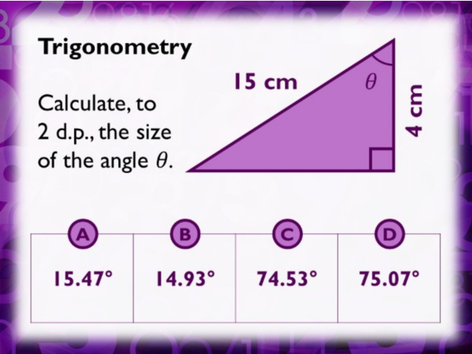
Question 4 – Trigonometry

Slide 9

Answer 4 – Trigonometry
CORRECT ANSWER | CORRECT EXPLANATION
74.53˚ | $$\cos^{−1}({\frac{4}{15})}$$
COMMON MISTAKES | WHAT MIGHT BE YOUR MISTAKE
14.93˚ | $$\tan^{−1}({\frac{4}{15})}$$
15.47˚ | $$\sin^{−1}({\frac{4}{15})}$$
1.00˚ | $$cos ({\frac{4}{15})}$$

Slide 10
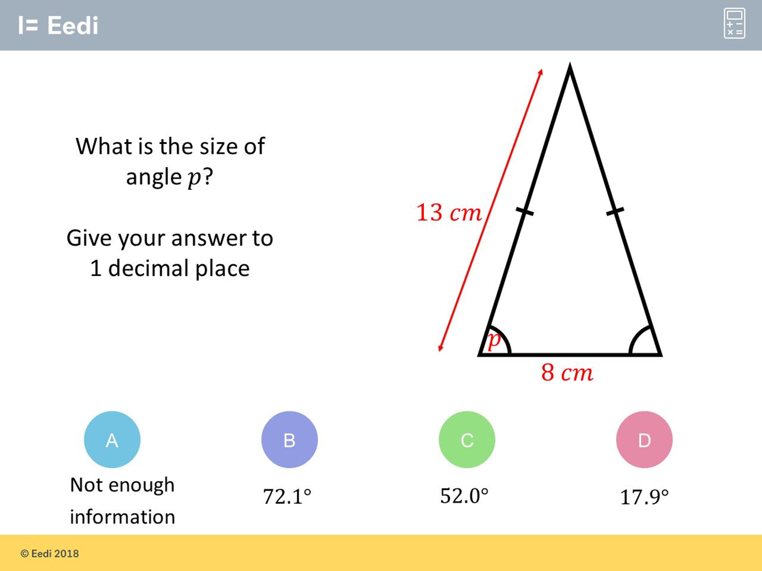
Question 5 – Trigonometry

Slide 11
Answer 5 – Trigonometry
CORRECT ANSWER | CORRECT EXPLANATION
72.1 | We can split this isosceles triangle into two right angled triangles with sides 13 cm and 8/2 = 4 cm. We then have cos(p) = 4/13. Finding the inverse cos of 4/13 gives 72.1°.
COMMON MISTAKES | WHAT MIGHT BE YOUR MISTAKE
Not enough information | The student may have not recognised this as an isosceles triangle and can be split into two right angles.
52.0 | The student has not divided the 8cm side by two.
17.9 | The student has used sin, rather than cos.

Slide 12
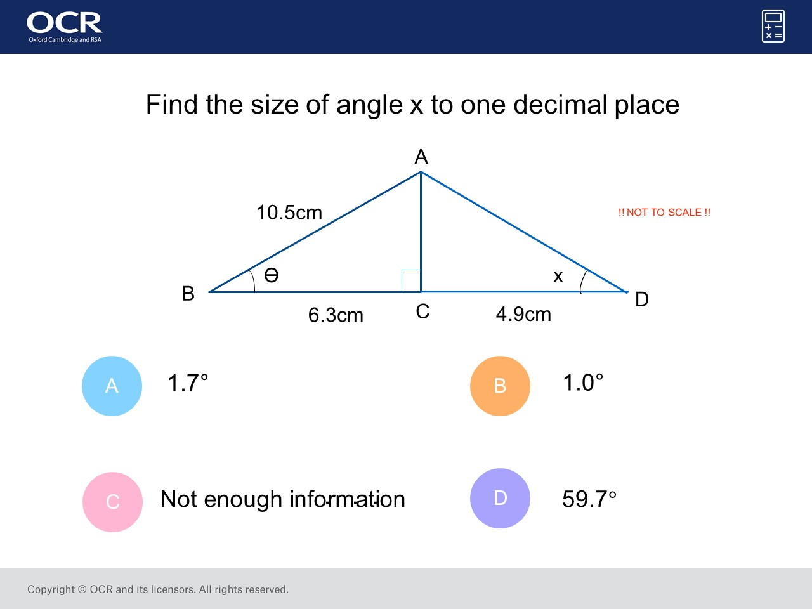
Question 6 – Trigonometry

Slide 13
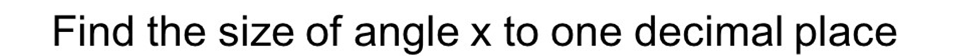
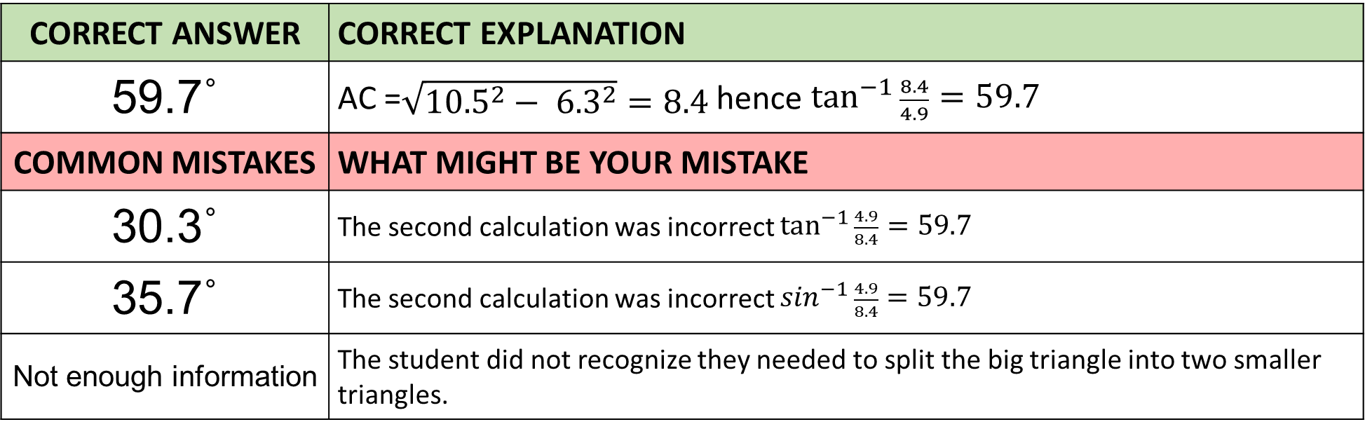
Answer 6 – Trigonometry
CORRECT ANSWER | CORRECT EXPLANATION
59.7˚ | AC =$\sqrt{{10.5}^{2}− {6.3}^{2}}=8.4$ hence $\tan^{−1}{\frac{8.4}{4.9}}=59.7$
COMMON MISTAKES | WHAT MIGHT BE YOUR MISTAKE
30.3˚ | The second calculation was incorrect $\tan^{−1}{\frac{4.9}{8.4}}=59.7$
35.7˚ | The second calculation was incorrect $\sin^{−1}{\frac{4.9}{8.4}}=59.7$
Not enough information | The student did not recognize they needed to split the big triangle into two smaller triangles.

Slide 14
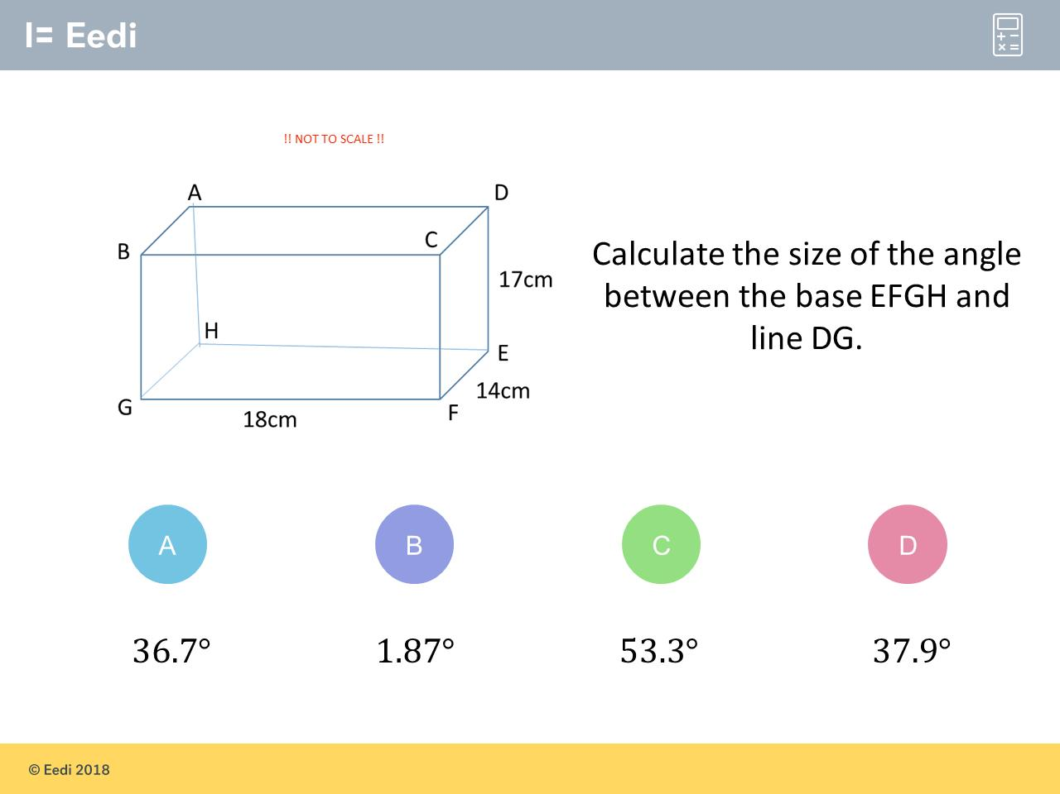
Question 7 – 3D Trigonometry

Slide 15
Answer 7 – 3D Trigonometry
CORRECT ANSWER | CORRECT EXPLANATION
36.7˚ | The length EG is √(18² + 14²) = √520. Then the angle DGE is tan x=17 ÷ √520 = 0.75, and so x = 36.7.
COMMON MISTAKES | WHAT MIGHT BE YOUR MISTAKE
1.87˚ | The student has forgotten to square root the length EG in the final step.
53.3˚ | The student has used the lengths 17 and EG the wrong way around.
37.9˚ | The student has found EGF, not DGE.

Slide 16
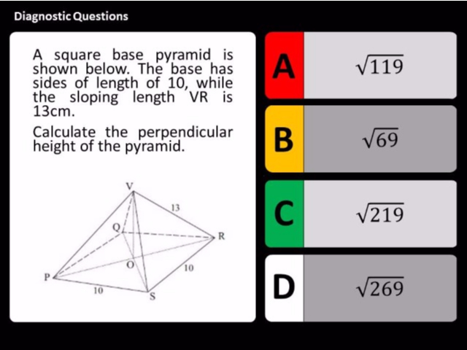
Question 8 – 3D Trigonometry

Slide 17
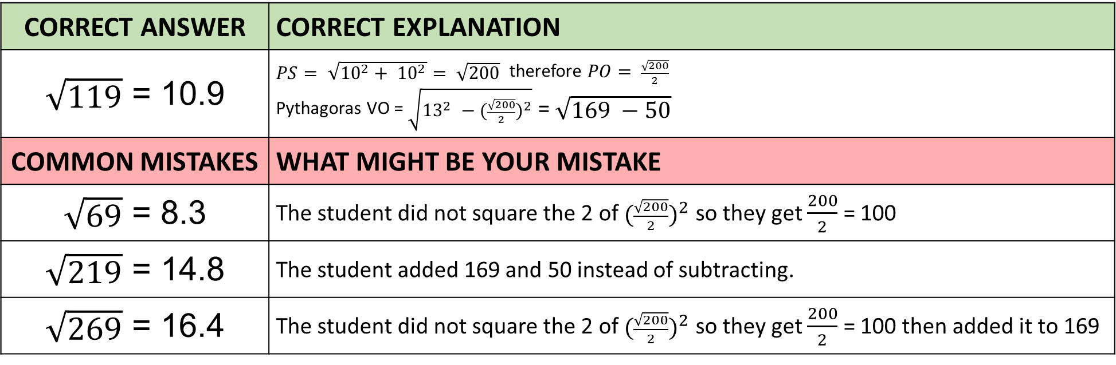
Answer 8 – 3D Trigonometry
CORRECT ANSWER | CORRECT EXPLANATION
$\sqrt{119}$ = 10.9 | $PS= \sqrt{{10}^{2}+ {10}^{2}}= \sqrt{200}$ therefore $PO= \frac{\sqrt{200}}{2}$ Pythagoras VO = $\sqrt{{13}^{2} −({\frac{\sqrt{200}}{2})}^{2}}$ = $\sqrt{169 −50}$
COMMON MISTAKES | WHAT MIGHT BE YOUR MISTAKE
$\sqrt{69}$ = 8.3 | The student did not square the 2 of $({\frac{\sqrt{200}}{2})}^{2}$ so they get $\frac{200}{2}$ = 100
$\sqrt{219}$ = 14.8 | The student added 169 and 50 instead of subtracting.
$\sqrt{269}$ = 16.4 | The student did not square the 2 of $({\frac{\sqrt{200}}{2})}^{2}$ so they get $\frac{200}{2}$ = 100 then added it to 169

Slide 18
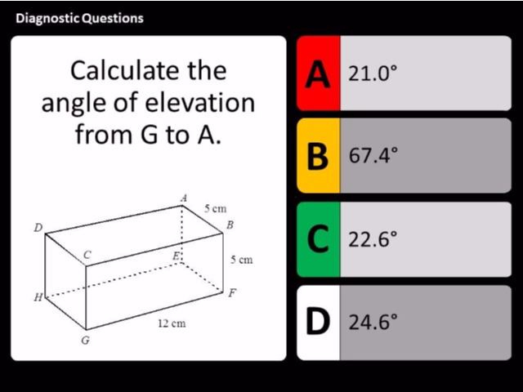
Question 9 – Trigonometric Waves

Slide 19
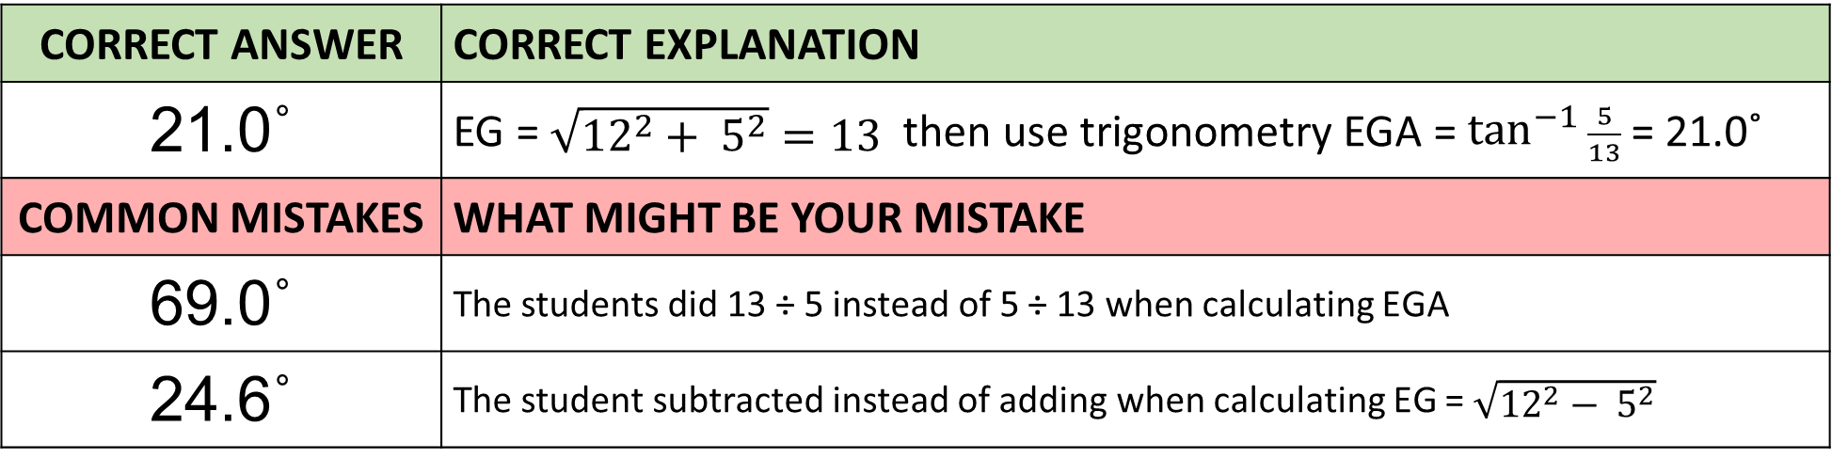
Answer 9 – Trigonometric Waves
CORRECT ANSWER | CORRECT EXPLANATION
21.0˚ | EG = $\sqrt{{12}^{2}+ 5^{2}}=13$ then use trigonometry EGA = $\tan^{−1}{\frac{5}{13}}$ = 21.0˚
COMMON MISTAKES | WHAT MIGHT BE YOUR MISTAKE
69.0˚ | The students did 13 ÷ 5 instead of 5 ÷ 13 when calculating EGA
24.6˚ | The student subtracted instead of adding when calculating EG = $\sqrt{{12}^{2}− 5^{2}}$

Slide 20
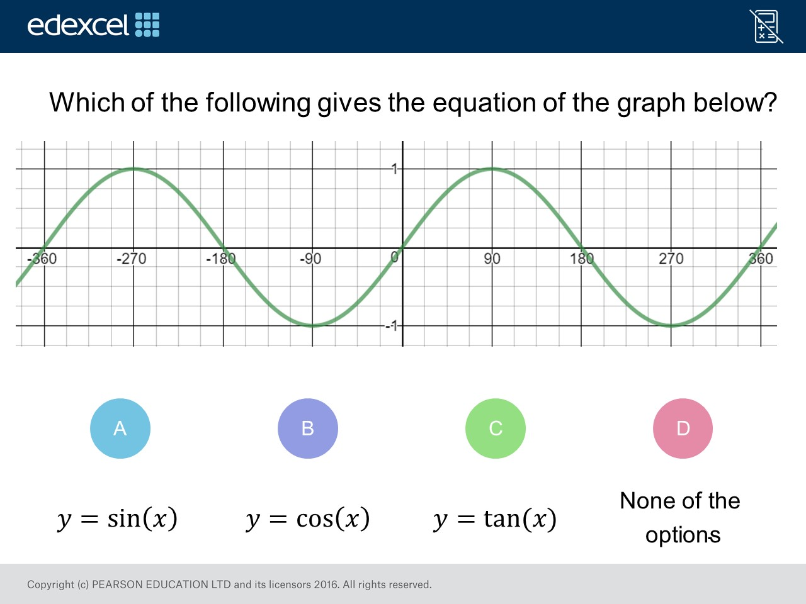
Question 10 – Trigonometric Waves

Slide 21
Answer 10 – Trigonometric Waves
CORRECT ANSWER | CORRECT EXPLANATION
A | The value of sin(0) = 0, and sin(90) = 1, sin(180) = 0 again, so this graph is of 𝑦 = sin(x) as it has these values.
COMMON MISTAKES | WHAT MIGHT BE YOUR MISTAKE
B | The student may be confused as to whether this graph passes through the origin or not.
C | The student Is not familiar with the shape of 𝑦 = tan(x).
D | The student is unfamiliar with plotting trigonometric functions

Slide 22
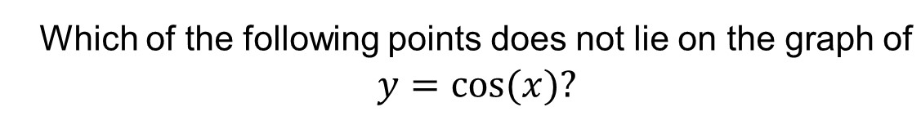
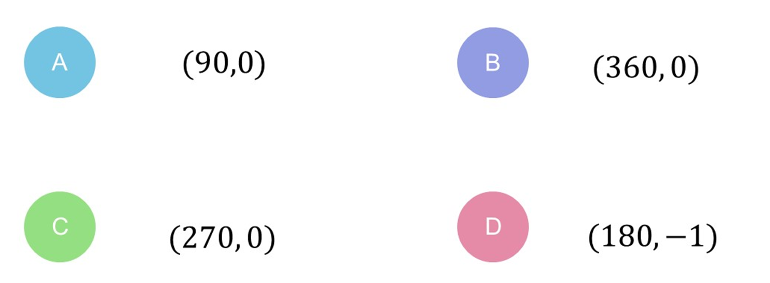
Question 11 – Trigonometric Waves

Slide 23
Answer 11 – Trigonometric Waves
CORRECT ANSWER | CORRECT EXPLANATION
B | Key points that y = cos x are (0,1) (90,0) (180,-1), (270, 0) (360, 1)
COMMON MISTAKES | WHAT MIGHT BE YOUR MISTAKE
A | The student is unfamiliar with plotting trigonometric functions
C | The student is unfamiliar with plotting trigonometric functions
D | The student is unfamiliar with plotting trigonometric functions

Slide 24
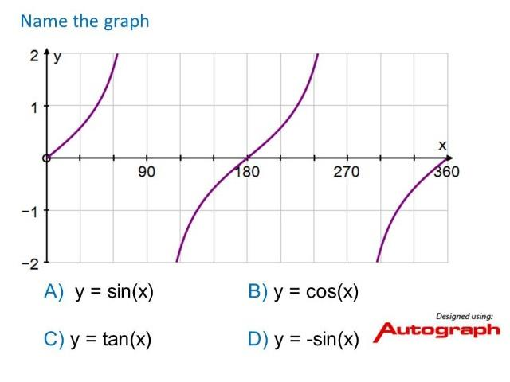
Question 12 – Trigonometric Waves

Slide 25
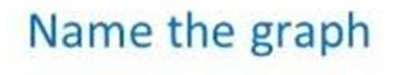
Answer 12 – Trigonometric Waves
CORRECT ANSWER | CORRECT EXPLANATION
y = tan x | The tan graph is very distinctive with separate sections.
COMMON MISTAKES | WHAT MIGHT BE YOUR MISTAKE
y = sin x | The student is unfamiliar with plotting trigonometric functions
y = cos x | The student is unfamiliar with plotting trigonometric functions

Slide 26
Question 13 – Trigonometric Waves
sin x = 0
What are all the solutions between 0 ≤ x ≤ 360?

Slide 27
Answer 13 – Trigonometric Waves
sin x = 0
What are all the solutions between 0 ≤ x ≤ 360?
CORRECT ANSWER | CORRECT EXPLANATION
0˚ 180˚ 360˚ | The sine wave starts at (0,0) then repeats every 180˚
COMMON MISTAKES | WHAT MIGHT BE YOUR MISTAKE
90˚ and 270˚ | The student was thinking about the cosine wave

Slide 28
Question 14 – Trigonometric Waves
cos x = 0.5
What are all the solutions between 0 ≤ x ≤ 360?

Slide 29
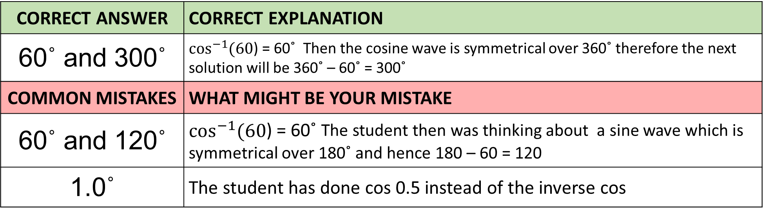
Answer 14 – Trigonometric Waves
cos x = 0.5
What are all the solutions between 0 ≤ x ≤ 360?
CORRECT ANSWER | CORRECT EXPLANATION
60˚ and 300˚ | $\cos^{−1}{(60}$) = 60˚ Then the cosine wave is symmetrical over 360˚ therefore the next solution will be 360˚ – 60˚ = 300˚
COMMON MISTAKES | WHAT MIGHT BE YOUR MISTAKE
60˚ and 120˚ | $\cos^{−1}{(60}$) = 60˚ The student then was thinking about a sine wave which is symmetrical over 180˚ and hence 180 – 60 = 120
1.0˚ | The student has done cos 0.5 instead of the inverse cos

