Slide 1
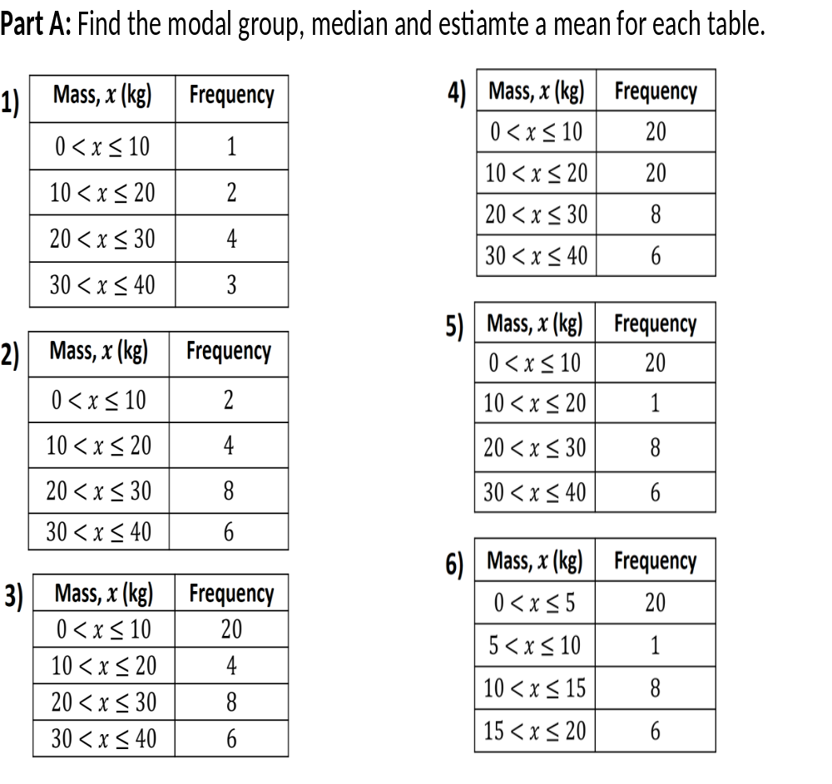
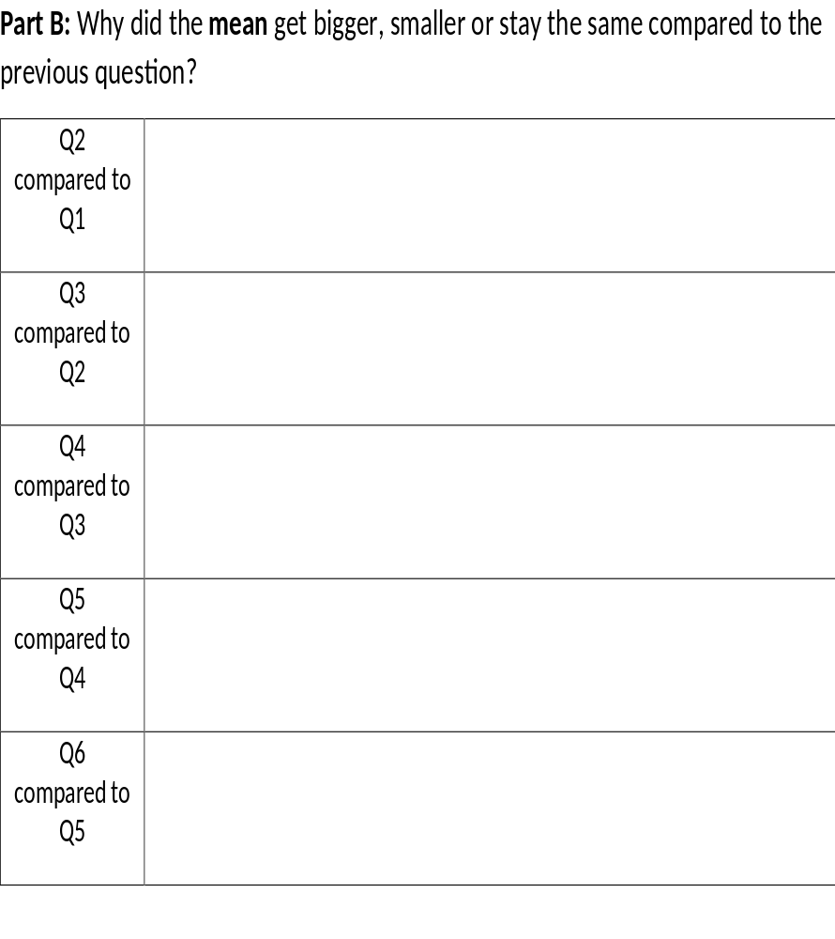

Slide 2
ANSWERS

Slide 3
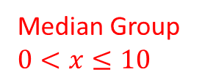
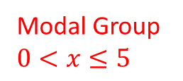
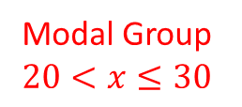
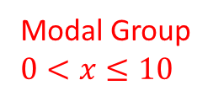
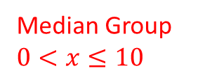
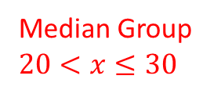
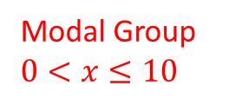
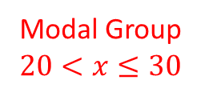
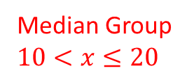
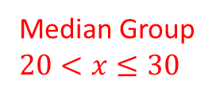
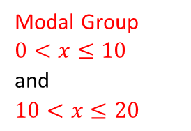
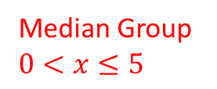
1) Mean = 24kg
4) Mean = 15kg
Modal Group
$$20<x≤30$$
Modal Group
$0<x≤10$
and
$$10<x≤20$$
Median Group
$$20<x≤30$$
Median Group
$$10<x≤20$$
2) Mean = 24kg
Modal Group
$$20<x≤30$$
5) Mean = 15kg
Modal Group
$$0<x≤10$$
Median Group
$$20<x≤30$$
Median Group
$$0<x≤10$$
3) Mean = 15kg
6) Mean = 7.5kg
Modal Group
$$0<x≤10$$
Modal Group
$$0<x≤5$$
Median Group
$$0<x≤10$$
Median Group
$$0<x≤5$$

Slide 4
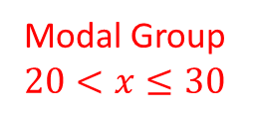

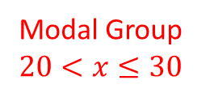

1) Mean = 24kg
Modal Group
$$20<x≤30$$
Median Group
$$20<x≤30$$
2) Mean = 24kg
Modal Group
$$20<x≤30$$
Median Group
$$20<x≤30$$
1 to 2) Stays the same because
the mass total doubles but so does the total frequency

Slide 5
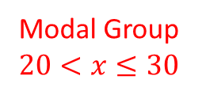

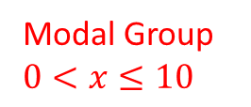
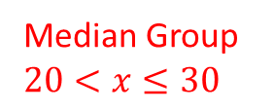
2) Mean = 24kg
Modal Group
$$20<x≤30$$
Median Group
$$20<x≤30$$
3) Mean = 15kg
Modal Group
$$0<x≤10$$
Median Group
$$0<x≤10$$
2 to 3) Decrease because
the group 0 to 10 increase which is below the previous mean

Slide 6
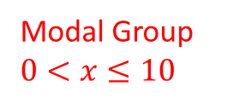
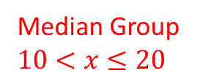
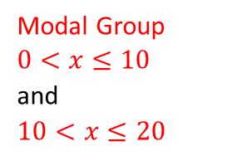

3) Mean = 15kg
Modal Group
$$0<x≤10$$
Median Group
$$0<x≤10$$
4) Mean = 15kg
Modal Group
$0<x≤10$
and
$$10<x≤20$$
Median Group
$$10<x≤20$$
3 to 4) It stays the same because
the only group that increase is the group with the previous mean

Slide 7
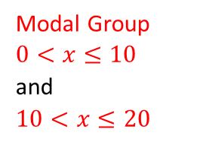

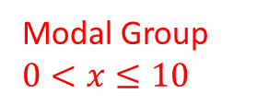

4) Mean = 15kg
Modal Group
$0<x≤10$
and
$$10<x≤20$$
Median Group
$$10<x≤20$$
5) Mean = 15kg
Modal Group
$$0<x≤10$$
Median Group
$$0<x≤10$$
4 to 5) It stays the same because
the only group that increase is the group with the previous mean

Slide 8

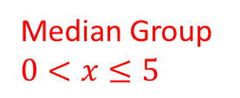


5) Mean = 15kg
Modal Group
$$0<x≤10$$
Median Group
$$0<x≤10$$
6) Mean = 7.5kg
Modal Group
$$0<x≤5$$
Median Group
$$0<x≤5$$
5 to 6) Decreased because
the total frequency stayed the same, but the mass have all been halved

