Slide 1
LO: Polygons
and Properties

Slide 2
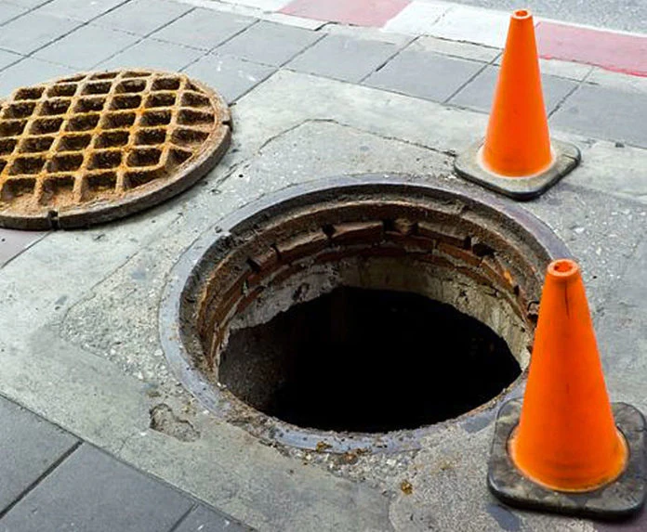
Why are manhole covers circular?
A round manhole cover cannot fall through its circular opening.
A square manhole cover could fall through diagonal.

Slide 3
What makes a shape
a polygon?
The shape only has
straight lines.

Slide 4

Polygon or Not?

Slide 5

Polygons or Not?

Slide 6
Polygon or Not?

Slide 7
Polygons or Not?

Slide 8
Polygons or Not?

Slide 9
Number of sides | Name of polygon
3
4
5
6
7
8
9
10
Triangles
Quadrilateral
Pentagon
Hexagon
Heptagon
Octagon
Nonagon
Decagon

Slide 10
What is meant by a
regular shape?
All sides are the same length.
All angles are the same size.

Slide 11
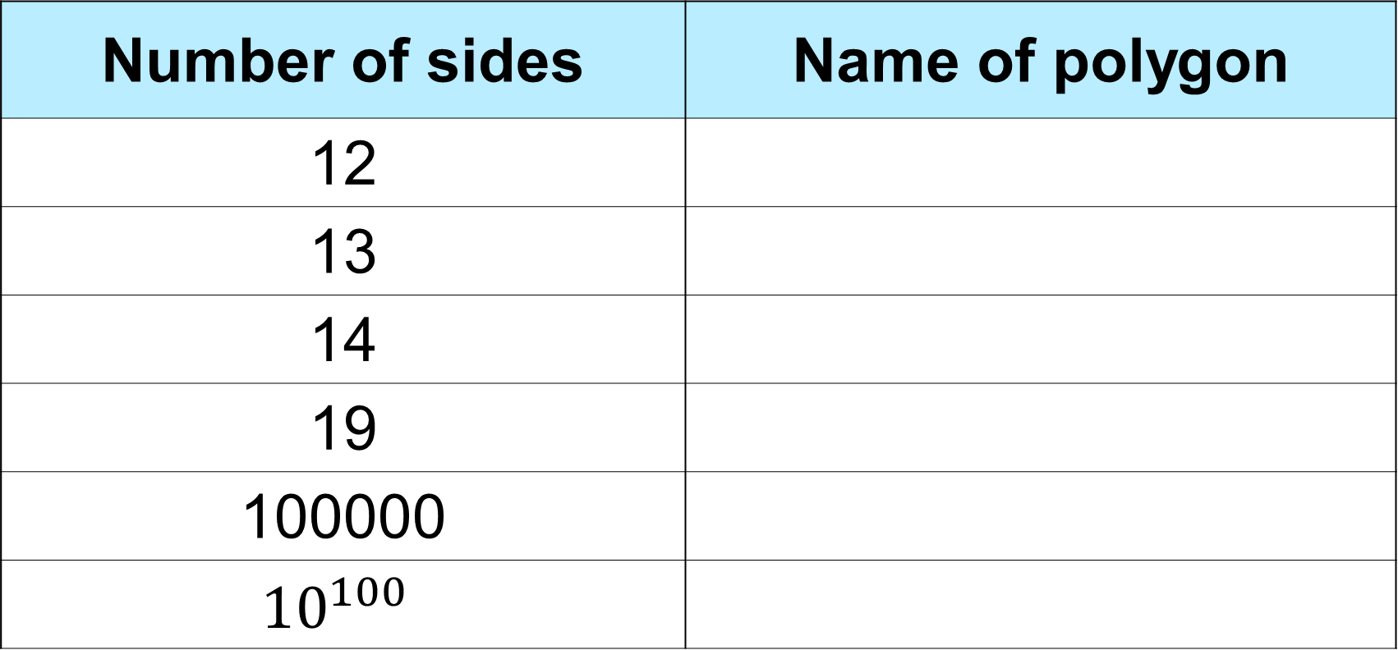
Some of the names get silly.
No need to learn them.
Number of sides | Name of polygon
12
13
14
19
100000
$${10}^{100}$$
Dodecagon
Triskaidecagon
Tetrakaidecagon
Enneadecagon
Megagon
Googolgon

