Slide 1

Intermediate Challenge 4
BRONZE

Slide 2
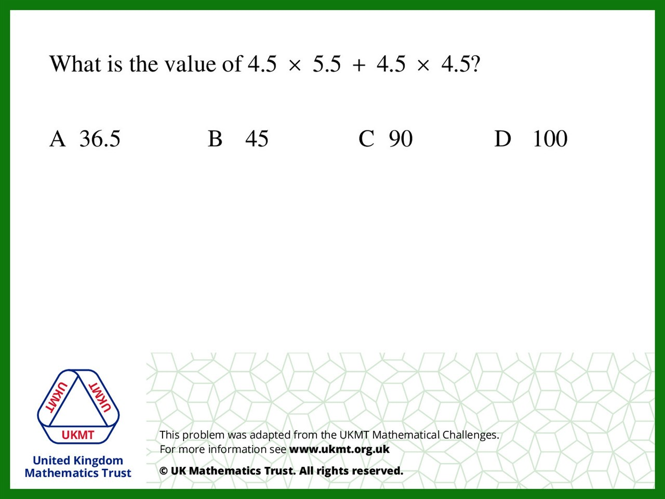
Q1.
4.5 x 5.5 = 24.75
4.5 x 4.5 = 20.25
24.75 + 20.25 = 45

Slide 3
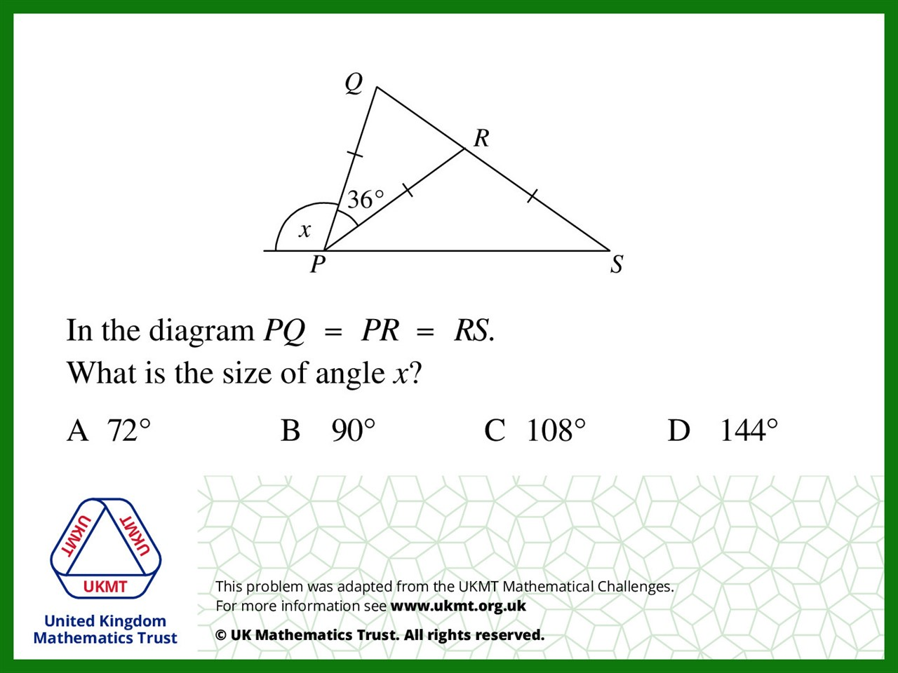
Q2.
180 – 36 = 144
144 ÷ 2 = 72
72 ÷ 2 = 36
36 + 36 = 72
180 – 72 = 108

Slide 4
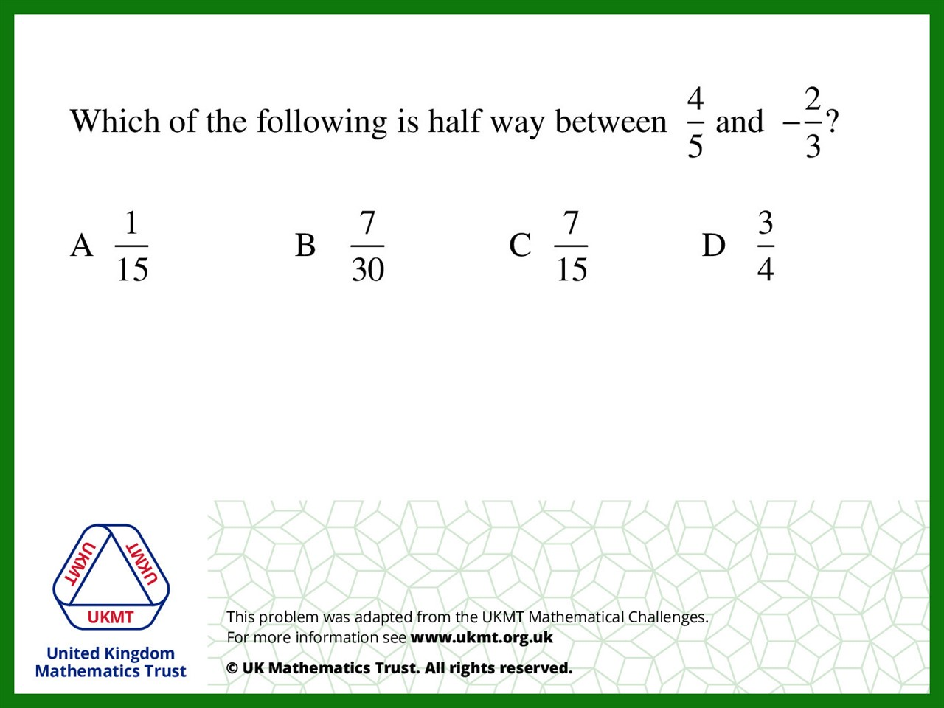

Q3.
$$\frac{4}{5}+−\frac{2}{3}=\frac{12}{15}$$
$$\frac{12}{15}− \frac{10}{15}=\frac{2}{15}$$
$$\frac{2}{15}÷2=\frac{1}{15}$$

Slide 5
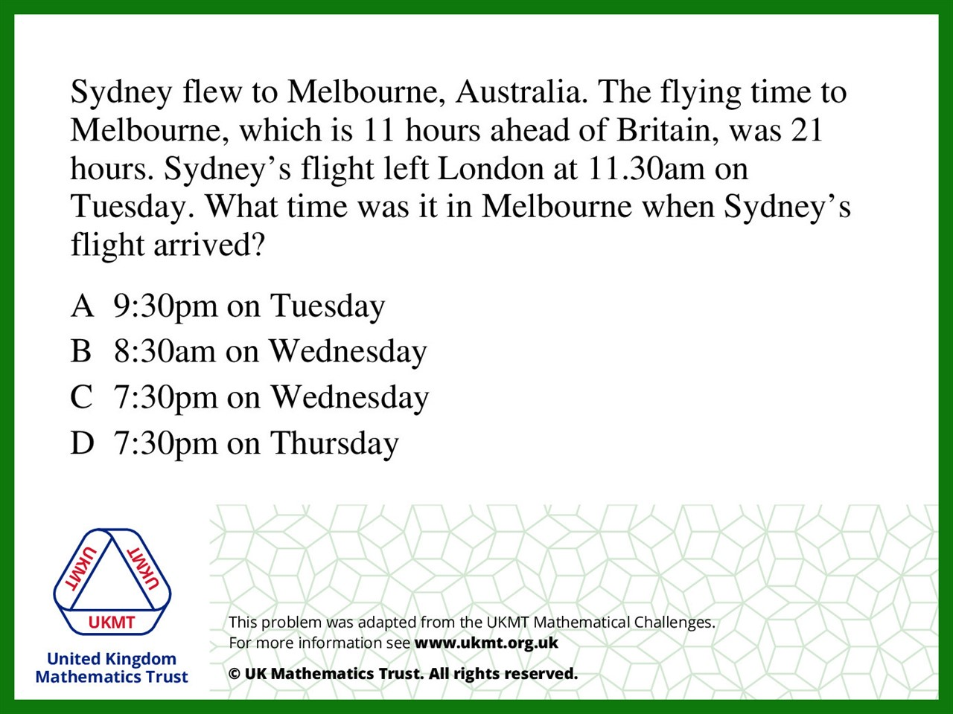
Q4.
11:30am + 11 hours = Tuesday 10:30pm
10:30pm + 21 hours = Wednesday 7:30pm

Slide 6
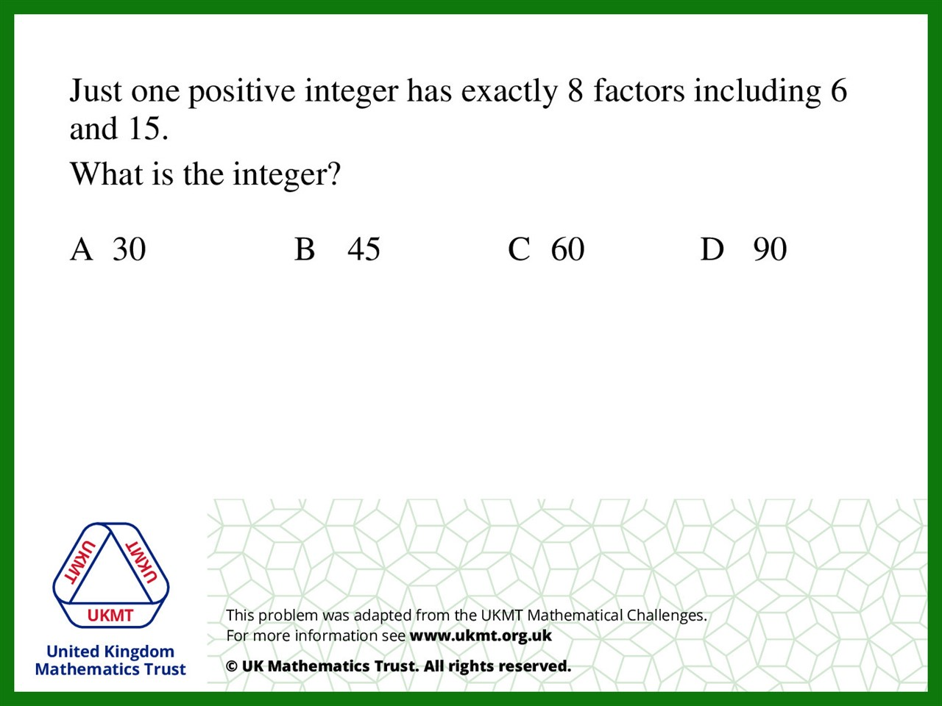
Q5.
30 has 8 factors (1,2,3,5,6,10,15,30) which include, 6 and 15

