Slide 1
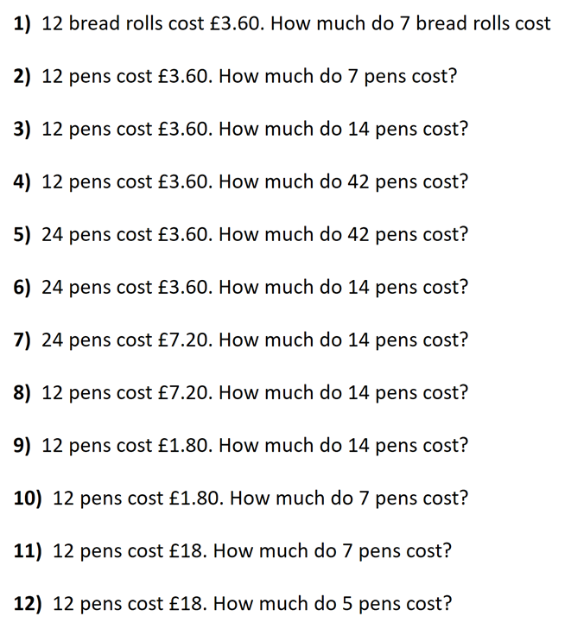
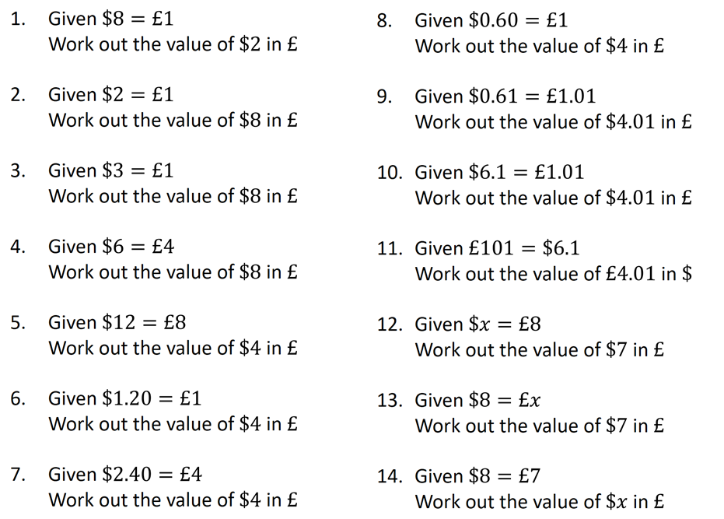

Slide 2
ANSWERS

Slide 3
1) 12 bread rolls cost £3.60. How much do 7 bread rolls cost
2) 12 pens cost £3.60. How much do 7 pens cost?
3) 12 pens cost £3.60. How much do 14 pens cost?
4) 12 pens cost £3.60. How much do 42 pens cost?
5) 24 pens cost £3.60. How much do 42 pens cost?
6) 24 pens cost £3.60. How much do 14 pens cost?
7) 24 pens cost £7.20. How much do 14 pens cost?
8) 12 pens cost £7.20. How much do 14 pens cost?
9) 12 pens cost £1.80. How much do 14 pens cost?
10) 12 pens cost £1.80. How much do 7 pens cost?
11) 12 pens cost £18. How much do 7 pens cost?
12) 12 pens cost £18. How much do 5 pens cost?
£2.10
£2.10
£4.20
£12.60
£6.30
£2.10
£4.20
£8.40
£2.10
£1.05
£10.50
£7.50

Slide 4



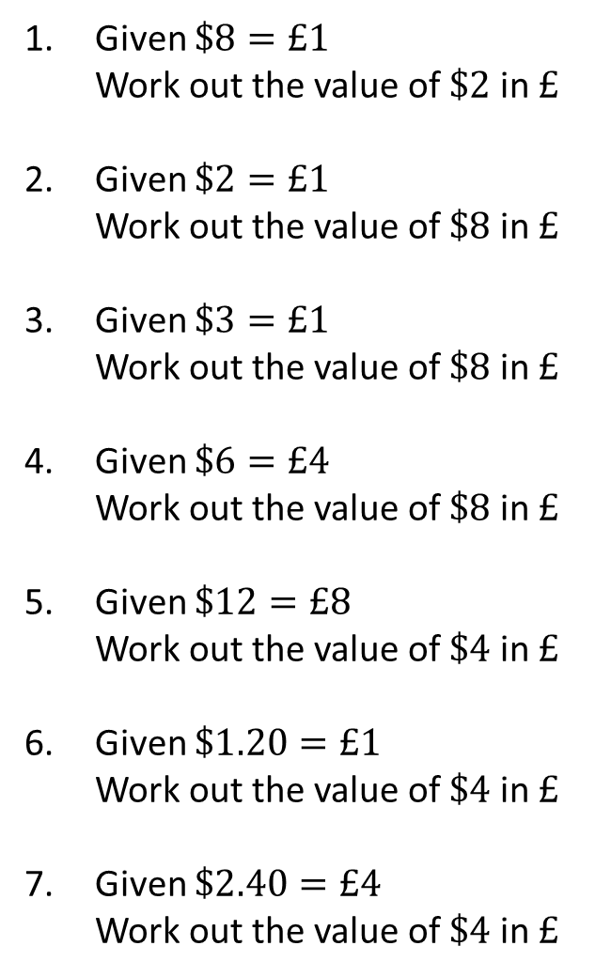




Given $\$8=£1$
Work out the value of $\$2$ in $£$
Given $\$2=£1$
Work out the value of $\$8$ in $£$
Given $\$3=£1$
Work out the value of $\$8$ in $£$
Given $\$6=£4$
Work out the value of $\$8$ in $£$
Given $\$12=£8$
Work out the value of $\$4$ in $£$
Given $\$1.20=£1$
Work out the value of $\$4$ in $£$
Given $\$2.40=£4$
Work out the value of $\$4$ in $£$
$$\$2=£0.25$$
$$\$8=£4$$
$$\$8=£2.67 (2dp)$$
$$\$8=£5.33 (2dp)$$
$$\$4=£2.67 (2dp)$$
$$\$4=£3.33 (2dp)$$
$$\$4=£6.67 (2dp)$$

Slide 5
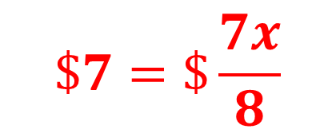

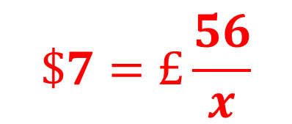
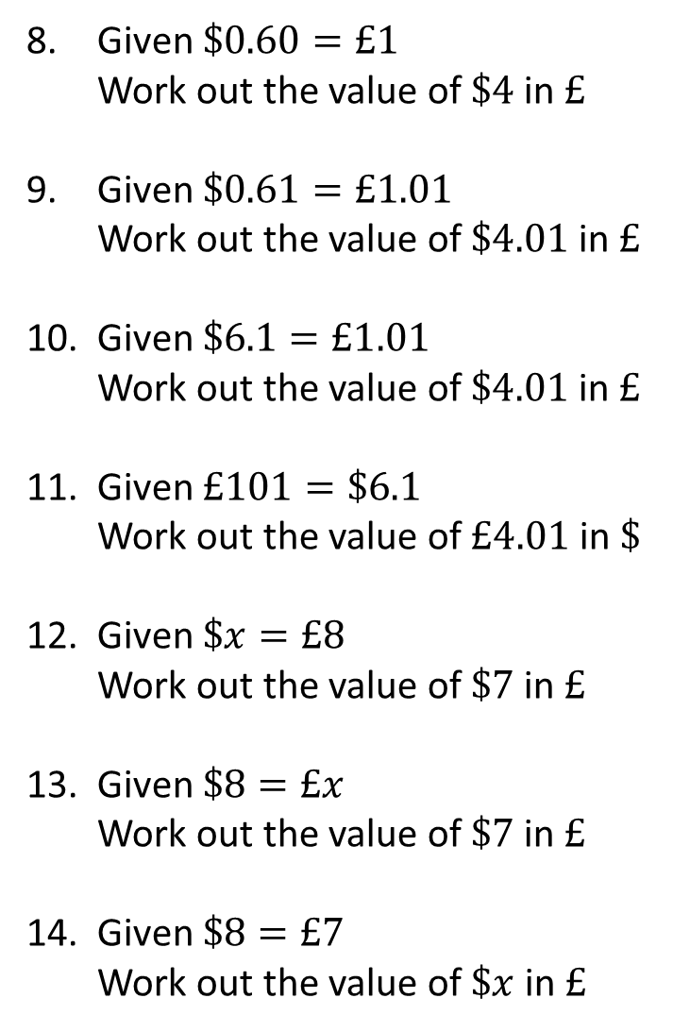



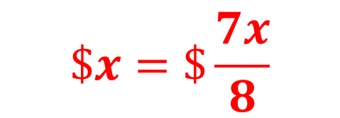
Given $\$0.60=£1$
Work out the value of $\$4$ in $£$
Given $\$0.61=£1.01$
Work out the value of $\$4.01$ in $£$
Given $\$6.1=£1.01$
Work out the value of $\$4.01$ in $£$
Given $£101=\$6.1$
Work out the value of $£4.01$ in $\$$
Given $\$x=£8$
Work out the value of $\$7$ in $£$
Given $\$8=£x$
Work out the value of $\$7$ in $£$
Given $\$8=£7$
Work out the value of $\$x$ in $£$
$$\$4=£6.67 (2dp)$$
$$\$4.01=£6.64(2dp)$$
$$\$4.01=£0.66(2dp)$$
$$£4.01=\$0.24(2dp)$$
$$\$7=£\frac{56}{x}$$
$$\$7=\$\frac{7x}{8}$$
$$\$x=\$\frac{7x}{8}$$

