Slide 1
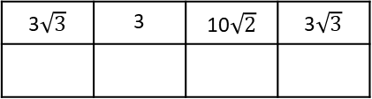
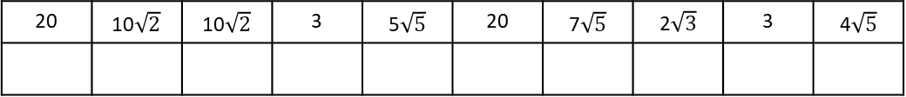
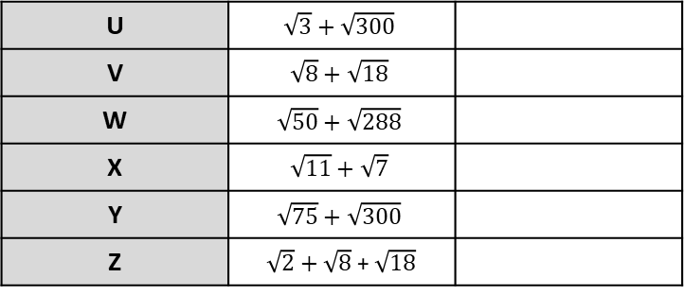
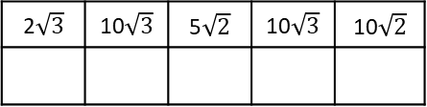
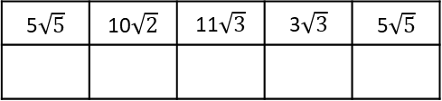
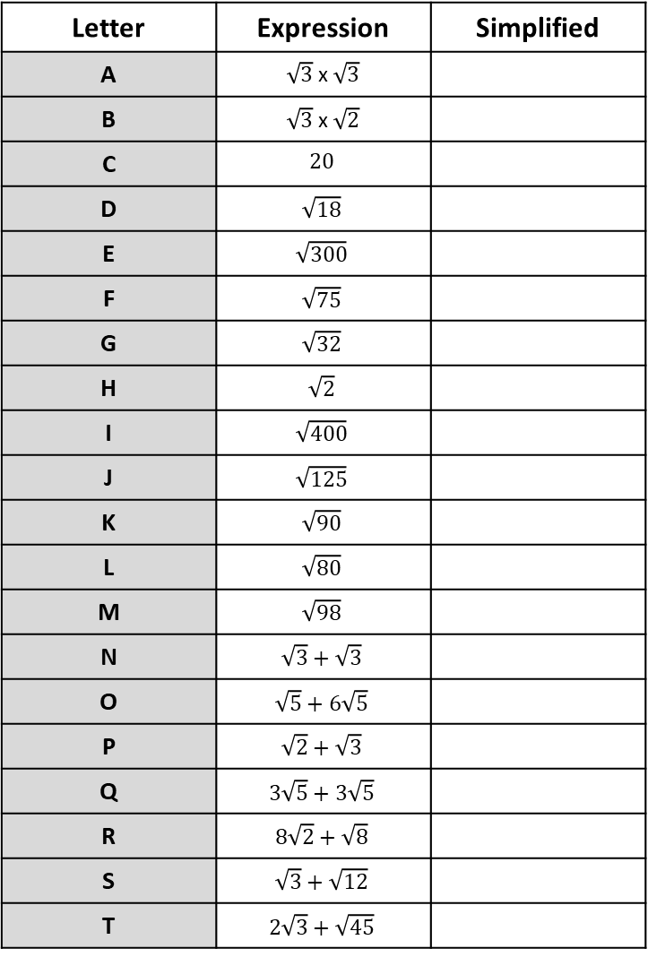
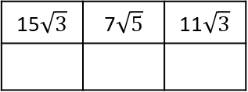
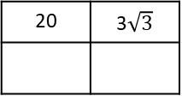

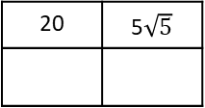

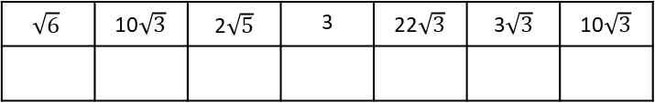
Letter | Expression | Simplified
A | $\sqrt{3}$ x $\sqrt{3}$
B | $\sqrt{3}$ x $\sqrt{2}$
C | $$20$$
D | $$\sqrt{18}$$
E | $$\sqrt{300}$$
F | $$\sqrt{75}$$
G | $$\sqrt{32}$$
H | $$\sqrt{2}$$
I | $$\sqrt{400}$$
J | $$\sqrt{125}$$
K | $$\sqrt{90}$$
L | $$\sqrt{80}$$
M | $$\sqrt{98}$$
N | $$\sqrt{3}+\sqrt{3}$$
O | $$\sqrt{5}+6\sqrt{5}$$
P | $$\sqrt{2}+\sqrt{3}$$
Q | $$3\sqrt{5}+3\sqrt{5}$$
R | $$8\sqrt{2}+\sqrt{8}$$
S | $$\sqrt{3}+\sqrt{12}$$
T | $$2\sqrt{3}+\sqrt{45}$$
U | $$\sqrt{3}+\sqrt{300}$$
V | $$\sqrt{8}+\sqrt{18}$$
W | $$\sqrt{50}+\sqrt{288}$$
X | $$\sqrt{11}+\sqrt{7}$$
Y | $$\sqrt{75}+\sqrt{300}$$
Z | $\sqrt{2}+\sqrt{8}$ + $\sqrt{18}$
17$\sqrt{2}$ | 2 | 15$\sqrt{3}$
3$\sqrt{3}$ | 2 | 7$\sqrt{5}$ | 11$\sqrt{3}$ | 4$\sqrt{5}$ | 3$\sqrt{2}$
15$\sqrt{3}$ | 7$\sqrt{5}$ | 11$\sqrt{3}$
2$\sqrt{3}$ | 10$\sqrt{3}$ | 5$\sqrt{2}$ | 10$\sqrt{3}$ | 10$\sqrt{2}$
5$\sqrt{5}$ | 10$\sqrt{2}$ | 11$\sqrt{3}$ | 3$\sqrt{3}$ | 5$\sqrt{5}$
3
3$\sqrt{3}$ | 3 | 10$\sqrt{2}$ | 3$\sqrt{3}$
?
$$\sqrt{6}$$ | 10$\sqrt{3}$ | 2$\sqrt{5}$ | 3 | 22$\sqrt{3}$ | 3$\sqrt{3}$ | 10$\sqrt{3}$
20 | 5$\sqrt{5}$
20 | 3$\sqrt{3}$
20 | 10$\sqrt{2}$ | 10$\sqrt{2}$ | 3 | 5$\sqrt{5}$ | 20 | 7$\sqrt{5}$ | 2$\sqrt{3}$ | 3 | 4$\sqrt{5}$

Slide 2
ANSWERS

Slide 3
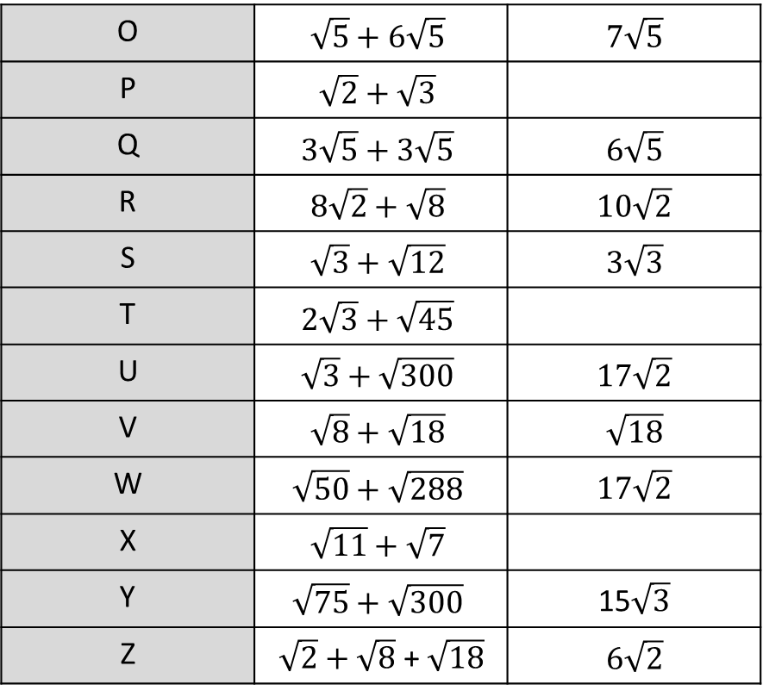
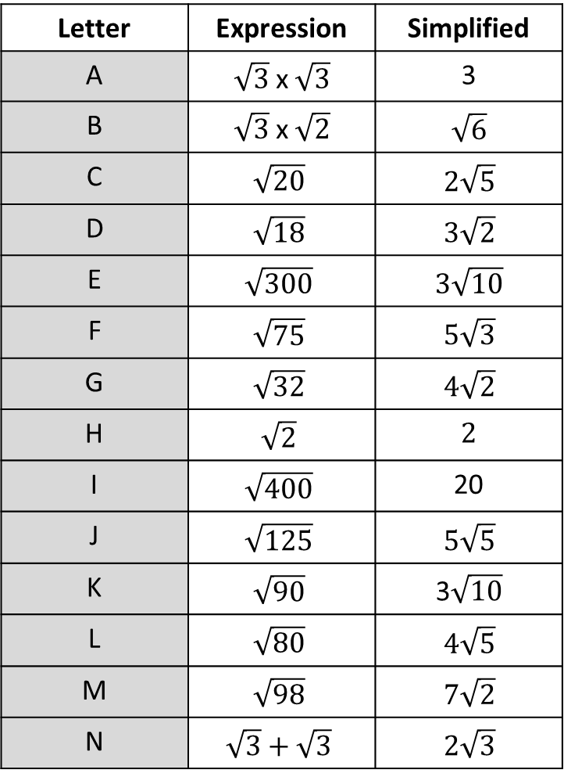
Letter | Expression | Simplified
A | $\sqrt{3}$ x $\sqrt{3}$ | 3
B | $\sqrt{3}$ x $\sqrt{2}$ | $$\sqrt{6}$$
C | $$\sqrt{20}$$ | $$2\sqrt{5}$$
D | $$\sqrt{18}$$ | $$3\sqrt{2}$$
E | $$\sqrt{300}$$ | $$3\sqrt{10}$$
F | $$\sqrt{75}$$ | $$5\sqrt{3}$$
G | $$\sqrt{32}$$ | $$4\sqrt{2}$$
H | $$\sqrt{2}$$ | $$2$$
I | $$\sqrt{400}$$ | 20
J | $$\sqrt{125}$$ | $$5\sqrt{5}$$
K | $$\sqrt{90}$$ | 3$\sqrt{10}$
L | $$\sqrt{80}$$ | $$4\sqrt{5}$$
M | $$\sqrt{98}$$ | $$7\sqrt{2}$$
N | $$\sqrt{3}+\sqrt{3}$$ | $$2\sqrt{3}$$
O | $$\sqrt{5}+6\sqrt{5}$$ | $$7\sqrt{5}$$
P | $$\sqrt{2}+\sqrt{3}$$
Q | $$3\sqrt{5}+3\sqrt{5}$$ | $$6\sqrt{5}$$
R | $$8\sqrt{2}+\sqrt{8}$$ | $$10\sqrt{2}$$
S | $$\sqrt{3}+\sqrt{12}$$ | $$3\sqrt{3}$$
T | $$2\sqrt{3}+\sqrt{45}$$
U | $$\sqrt{3}+\sqrt{300}$$ | $$17\sqrt{2}$$
V | $$\sqrt{8}+\sqrt{18}$$ | $$\sqrt{18}$$
W | $$\sqrt{50}+\sqrt{288}$$ | $$17\sqrt{2}$$
X | $$\sqrt{11}+\sqrt{7}$$
Y | $$\sqrt{75}+\sqrt{300}$$ | 15$\sqrt{3}$
Z | $\sqrt{2}+\sqrt{8}$ + $\sqrt{18}$ | $$6\sqrt{2}$$

Slide 4
