Slide 1
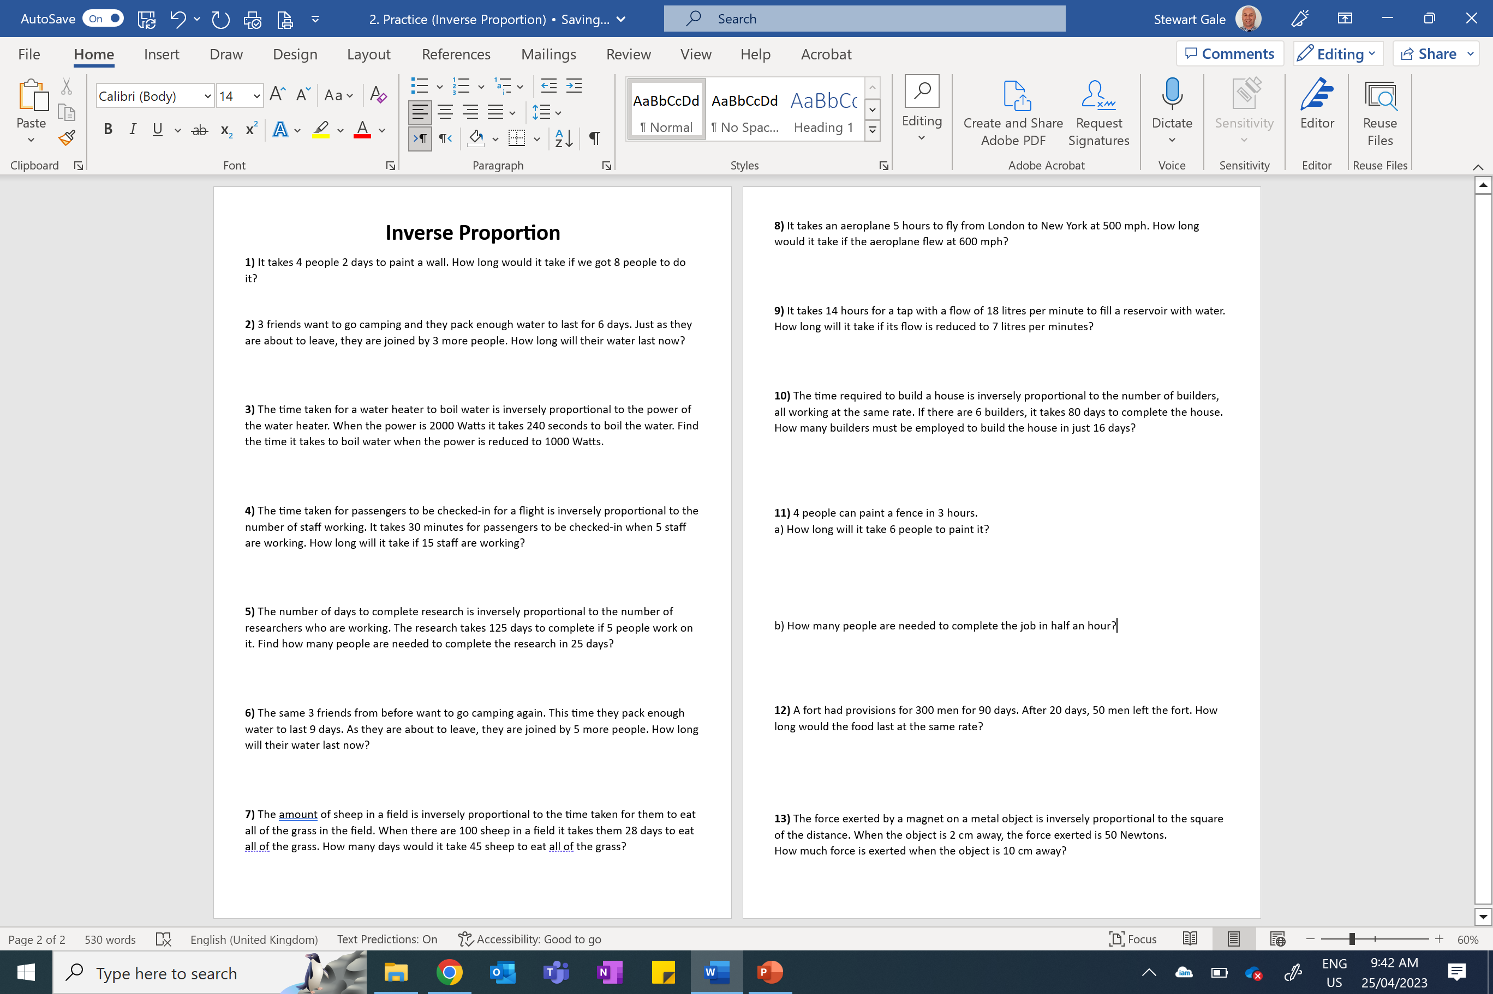

Slide 2
ANSWERS

Slide 3
1) It takes 4 people 2 days to paint a wall.
How long would it take if we got 8 people to do it?
1 day

Slide 4
2) 3 friends want to go camping and they pack enough water to last for 6 days. Just as they are about to leave they are joined by 3 more people. How long will their water last now?
3 days

Slide 5
3) The time taken for a water heater to boil water is inversely proportional to the power of the water heater. When the power is 2000 Watts it takes 240 seconds to boil the water. Find the time it takes to boil water when the power is reduced to 1000 Watts.
480 seconds

Slide 6
4) The time taken for passengers to be checked-in for a flight is inversely proportional to the number of staff working. It takes 30 minutes for passengers to be checked-in when 5 staff are working.
How long will it take if 15 staff are working?
10 minutes

Slide 7
5) The number of days to complete research is inversely proportional to the number of researchers who are working. The research takes 125 days to complete if 5 people work on it. Find how many people are needed to complete the research in 25 days.
25 people

Slide 8
6) The same 3 friends from before want to go camping again. This time they pack enough water to last 9 days. As they are about to leave they are joined by 5 more people. How long will their water last now?
3.375 days or 3 complete days

Slide 9
7) The amount of sheep in a field is inversely proportional to the time taken for them to eat all of the grass in the field. When there are 100 sheep in a field it takes them 28 days to eat all of the grass.
How many days would it take 45 sheep to eat all of the grass?
62.222…. or 63 days

Slide 10
8) it takes an aeroplane 5 hours to fly from London to New York at 500 mph. How long would it take if the aeroplane flew at 600 mph?
250 minutes

Slide 11
9) It takes 14 hours for a tap with a flow of 18 litres per minute to fill a reservoir with water.
How long will it take if its flow is reduced to 7 litres per minutes?
36 hours

Slide 12
10) The time required to build a house is inversely proportional to the number of builders, all working at the same rate. If there are 6 builders, it takes 80 days to complete the house. How many builders must be employed to build the house in just 16 days?
30 builders

Slide 13
11)
a) 4 people can paint a fence in 3 hours.
How long will it take 6 people to paint it?
2 hours
b) How many people are needed to complete the
  job in half an hour?
24 people

Slide 14
12) A fort had provisions for 300 men for 90 days.
After 20 days, 50 men left the fort.
How long would the food last at the same rate?
300 x 90 = 27000 days of food (for one person)
First 20 days, 300 x 20 = 6000 days of food eaten
27000 – 6000 = 21000 days of food left
300 – 50 = 250 people left after the 50 leave
21000/250 = 84 days of food left.

Slide 15
13) The force exerted by a magnet on a metal object
is inversely proportional to the square of the distance.
When the object is 2 cm away, the force exerted is
50 Newtons.
How much force is exerted when the object is 10 cm away?
2 Newtons

