Slide 1
Integration Introduction
Chapter 13
(Part 1 of 3)

Slide 2
Integration
Integration is the opposite process
of differentiation.

Slide 3
Differentiation
Integration
Multiply by the power
Increase power by 1
Increase power by 1
Reduce power by
1
Divide by the
new power
Divide by the
new power

Slide 4
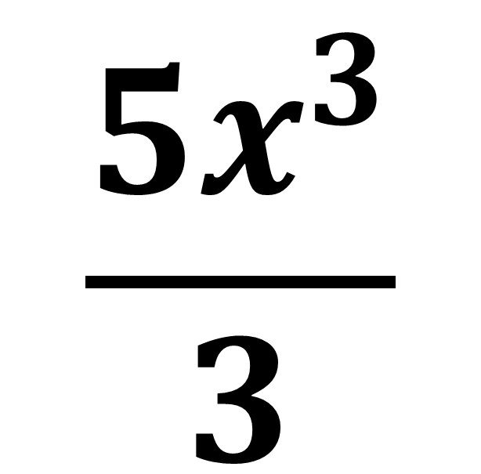
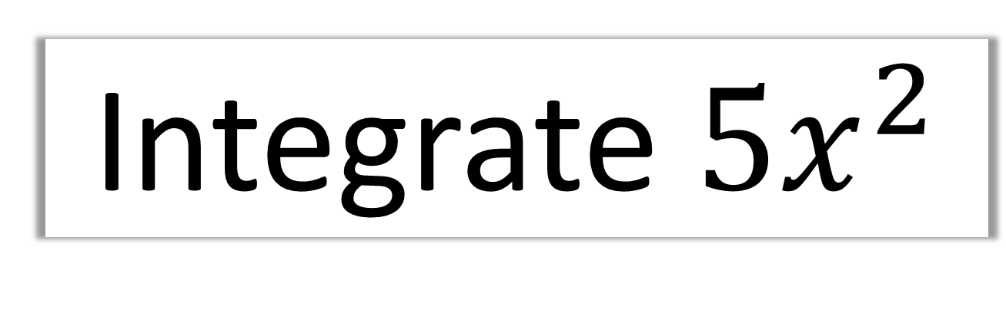
Integrate $5x^{2}$
$$\frac{{5x}^{3}}{3}$$

Slide 5
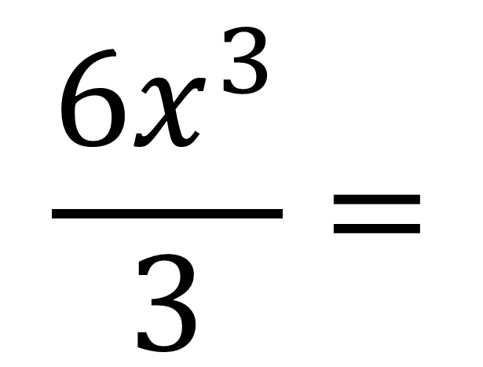
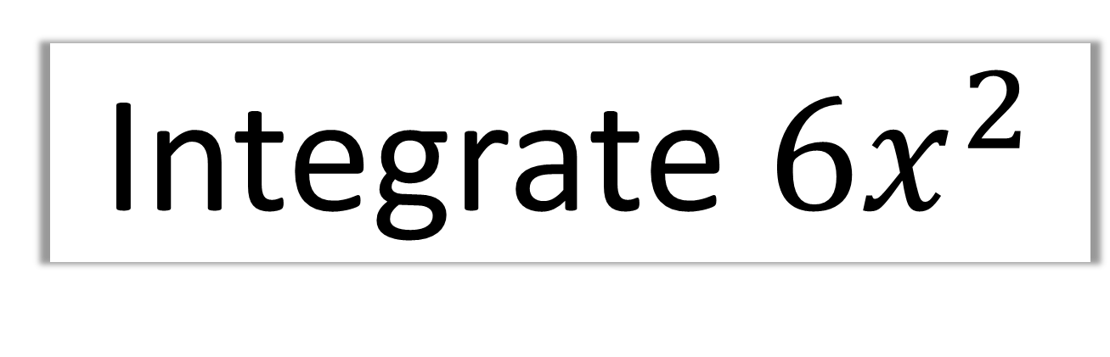
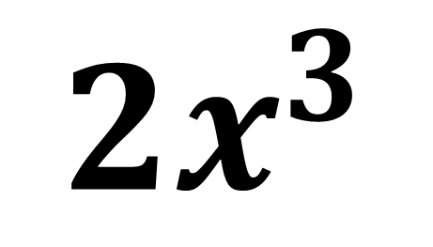
Integrate $6x^{2}$
$$\frac{{6x}^{3}}{3}=$$
$${2x}^{3}$$

Slide 6
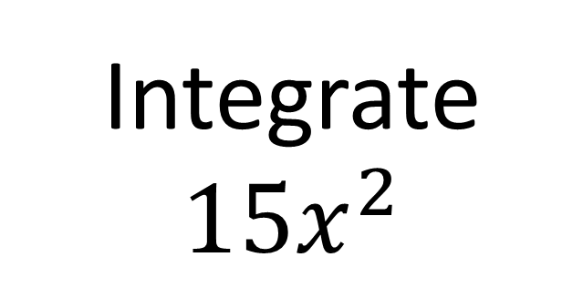
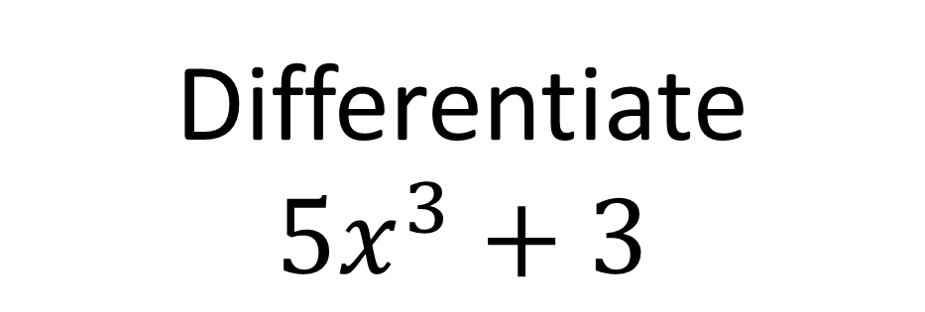
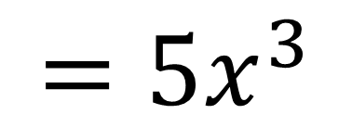
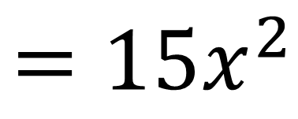
However, there is a complication!
Differentiate
$$5x^{3}+3$$
Integrate $15x^{2}$
$$=15x^{2}$$
$$=5x^{3}$$
The constant disappeared!

Slide 7
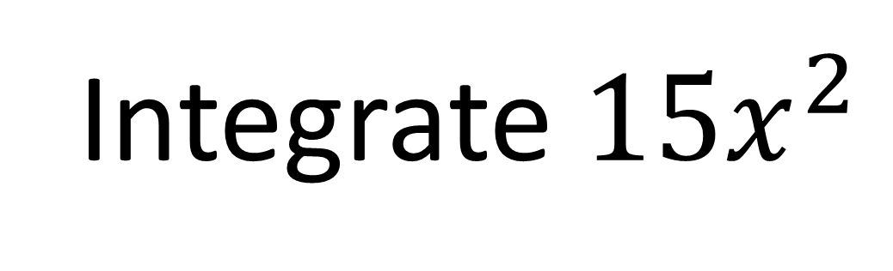
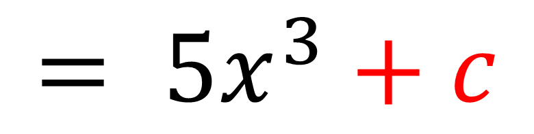
After integration you need to write
+ 𝑐 to show there may be a constant.
Integrate $15x^{2}$
$$= 5x^{3}+c$$

Slide 8
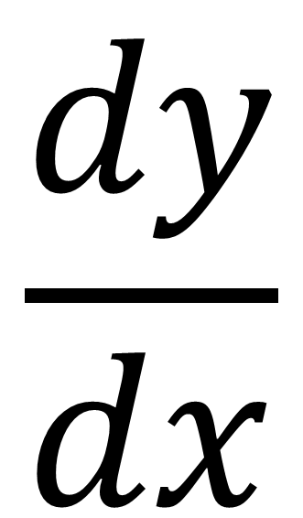
Notation
y
$$\frac{dy}{dx}$$
Integrate

Slide 9
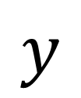
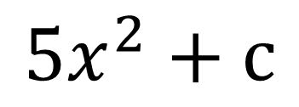
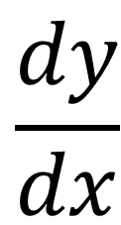
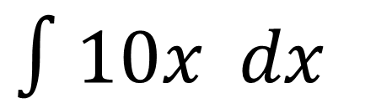
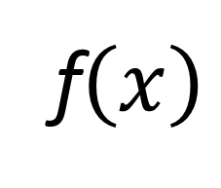
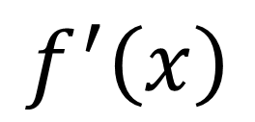
Other Notation
Gradient
Equation
$$\frac{dy}{dx}$$
$$y$$
$$f^{′}\left(x\right)$$
f$\left(x\right)$
$∫10x dx$
$${5x}^{2}+c$$

Slide 10
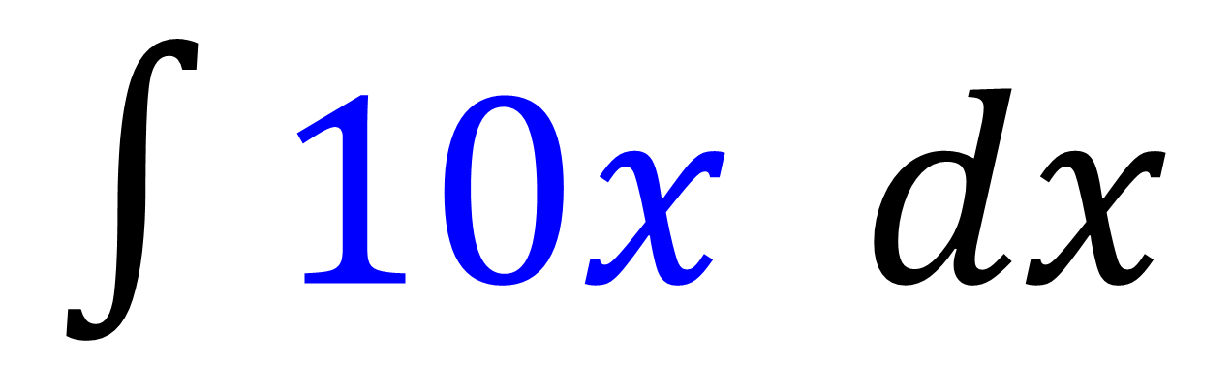
Integral Sign
$∫10x dx$
Expression
to integrate
With respect to x
Integrate

Slide 11
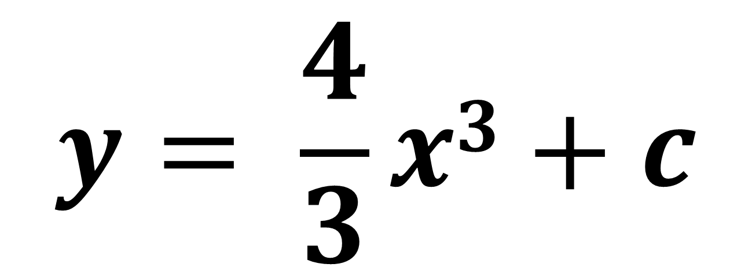
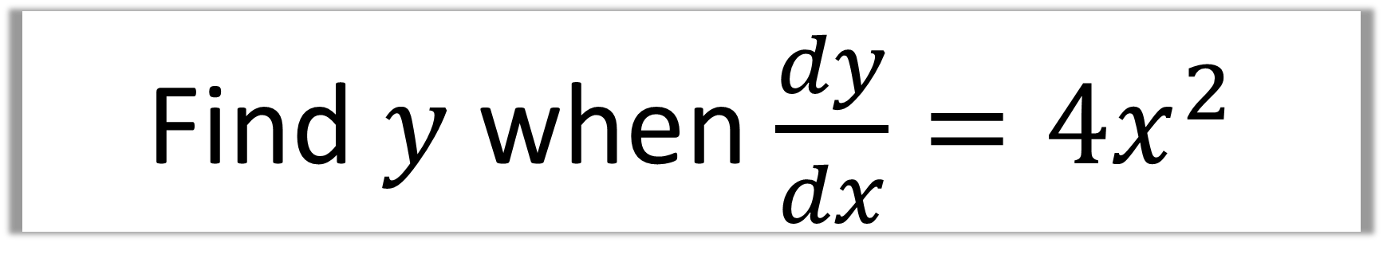
Find $y$ when $\frac{dy}{dx}=4x^{2}$
$$y= \frac{4}{3}x3+c$$

Slide 12
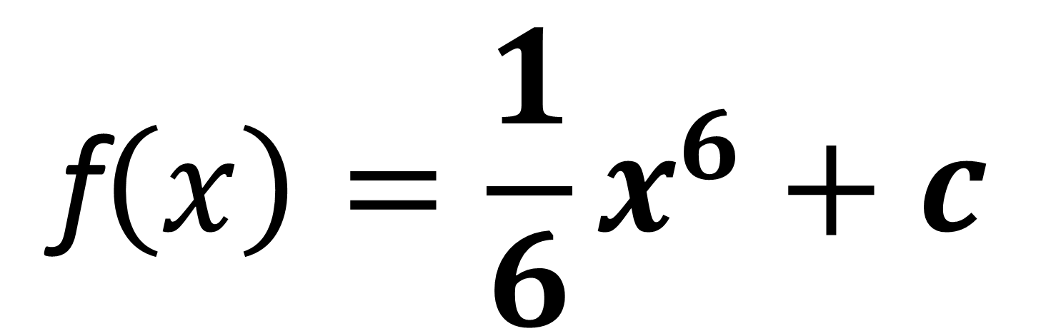
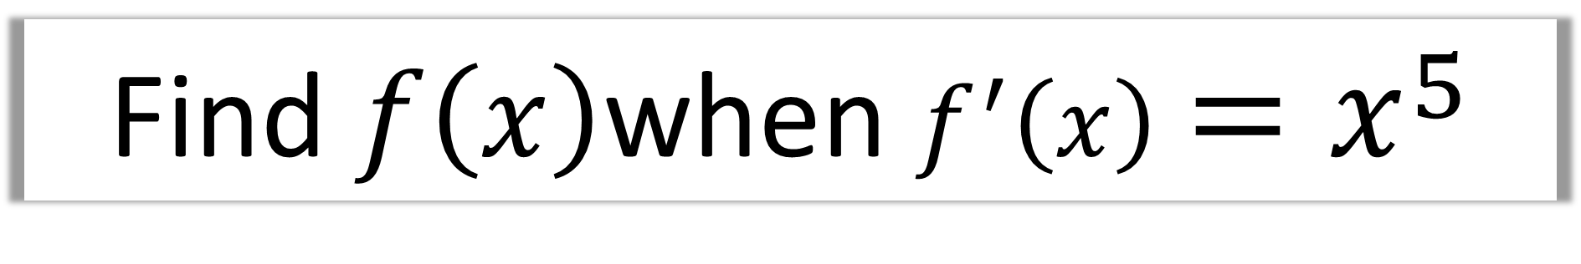
Find $f\left(x\right)$when $f^{′}\left(x\right)=x^{5}$
$$\text{f}\left(x\right)=\frac{1}{6}x^{6}+c$$

Slide 13
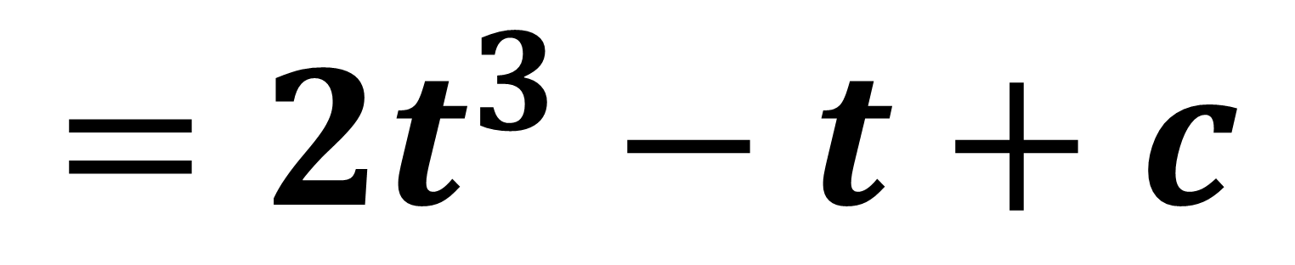
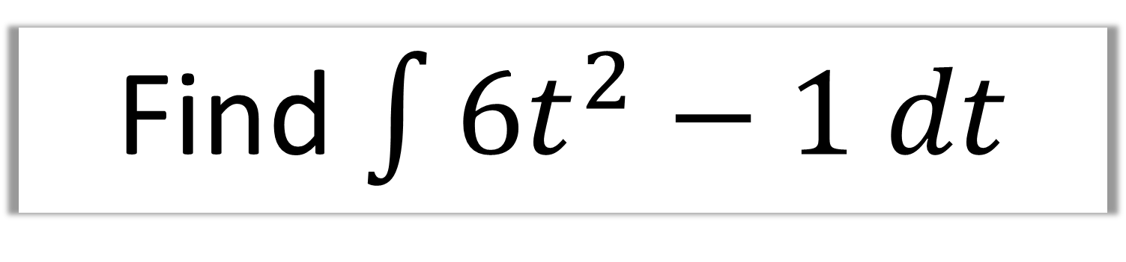
Find $\int{6t^{2}−1 dt}$
$$=2t^{3}−t+c$$

Slide 14
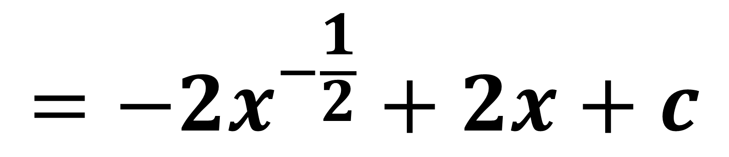
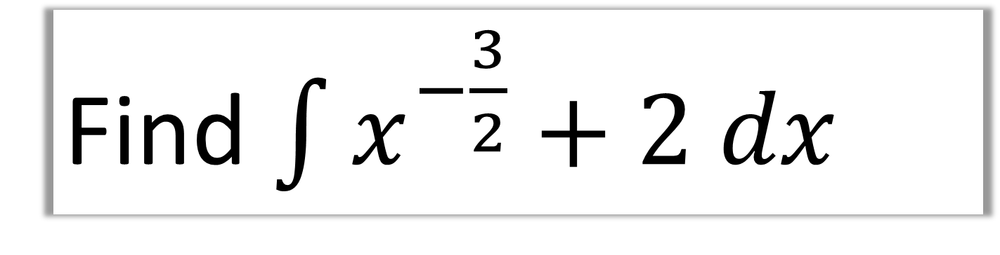
Find $\int{x^{−\frac{3}{2}}+2 dx}$
$$=−2x^{−\frac{1}{2}}+2x+c$$

Slide 15
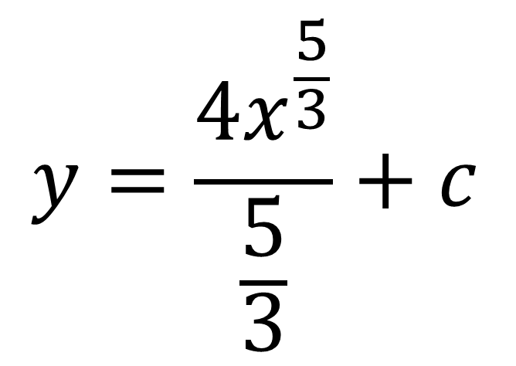
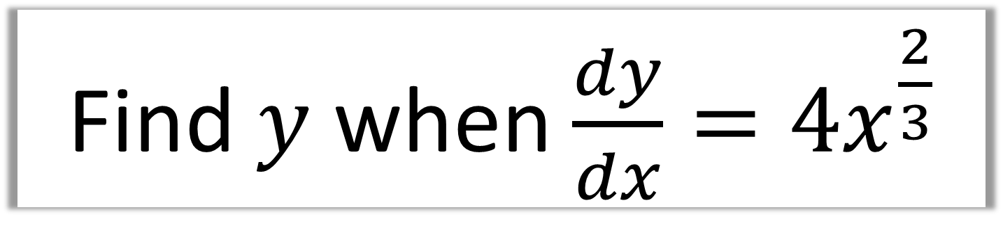
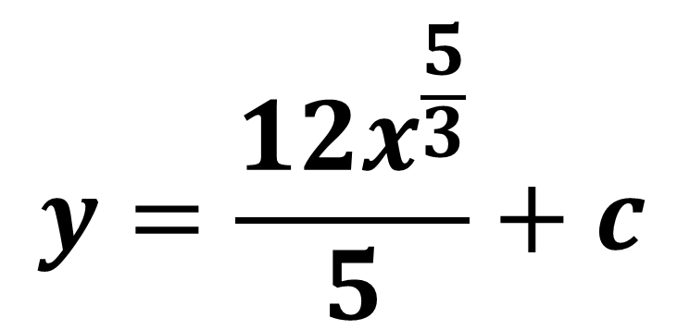
Find $y$ when $\frac{dy}{dx}=4x^{\frac{2}{3}}$
$$y=\frac{{4x}^{\frac{5}{3}}}{\frac{5}{3}}+c$$
$$y=\frac{{12x}^{\frac{5}{3}}}{5}+c$$

Slide 16
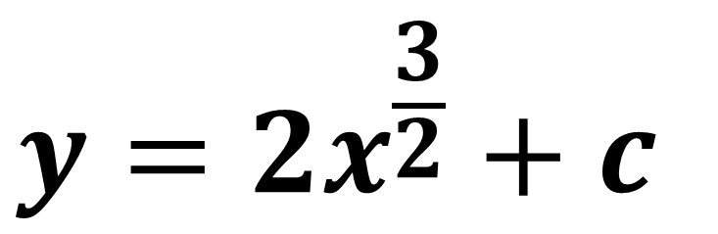
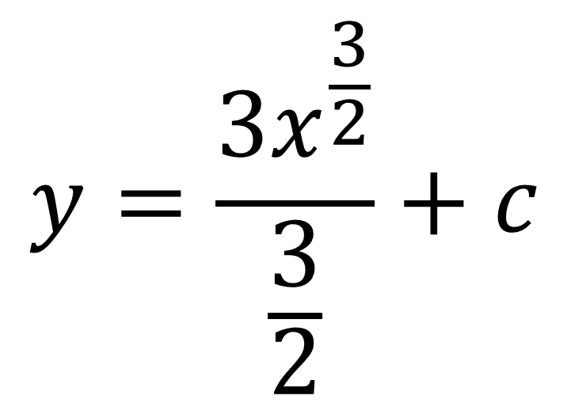
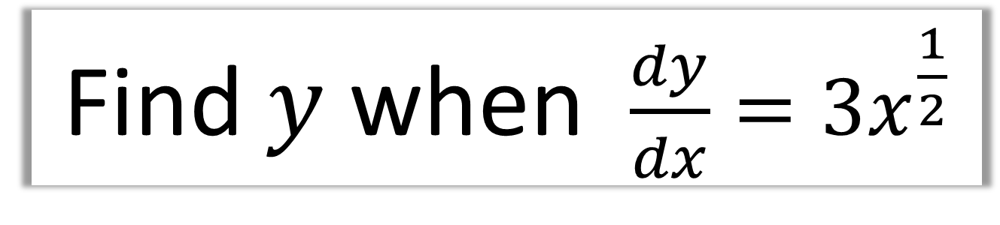
Find $y$ when $\frac{dy}{dx}=3x^{\frac{1}{2}}$
$$y=\frac{3x^{\frac{3}{2}}}{\frac{3}{2}}+c$$
$$y=2x^{\frac{3}{2}}+c$$

Slide 17
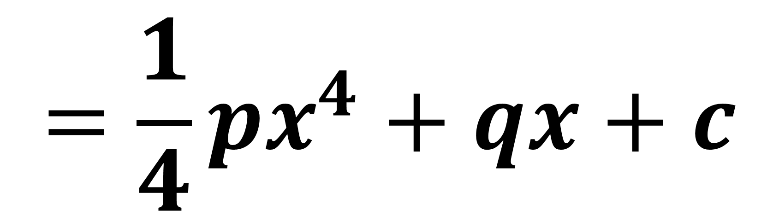
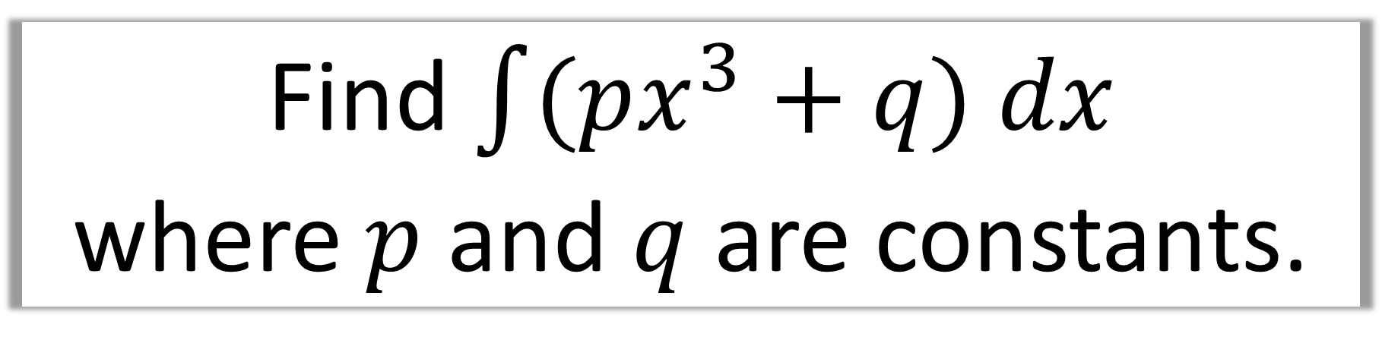
Find $\int{(px^{3}+q) dx}$
where $p$ and $q$ are constants.
$$=\frac{1}{4}px^{4}+qx+c$$

Slide 18
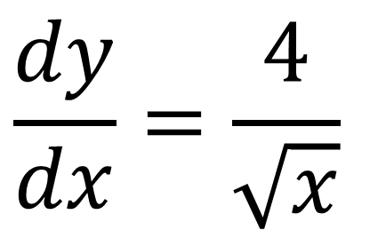
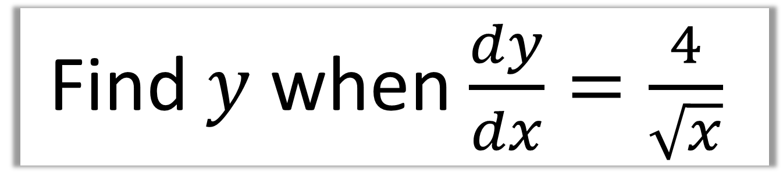
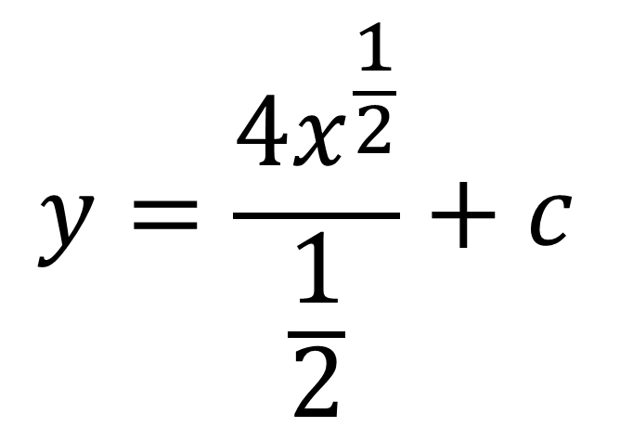
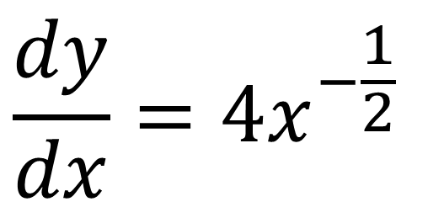
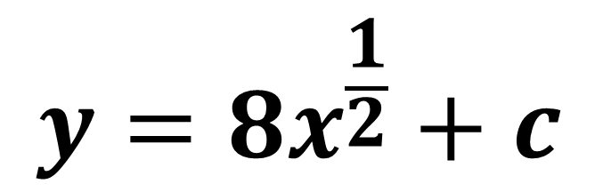
Find $y$ when $\frac{dy}{dx}=\frac{4}{\sqrt{x}}$
$$y=\frac{{4x}^{\frac{1}{2}}}{\frac{1}{2}}+c$$
$$\frac{dy}{dx}=\frac{4}{\sqrt{x}}$$
$$\frac{dy}{dx}=4x^{−\frac{1}{2}}$$
$$y=8x^{\frac{1}{2}}+c$$

Slide 19
Finding the value of c
If you are given a co-ordinate
that passes through y,
then you must calculate
the value of the constant c.

Slide 20
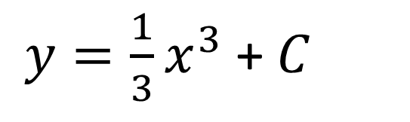
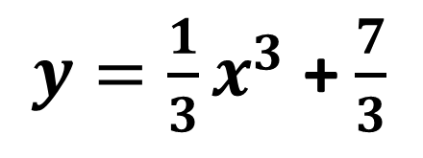
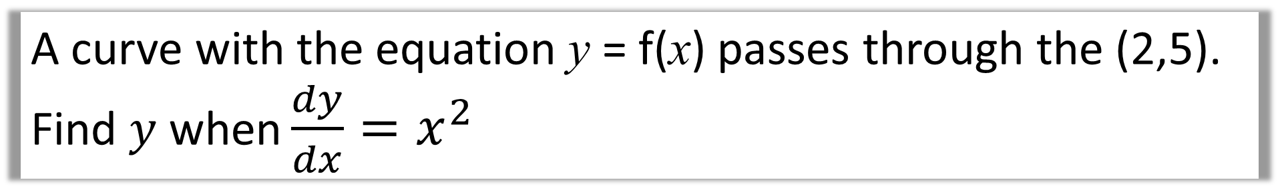
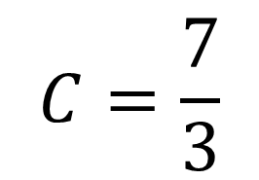
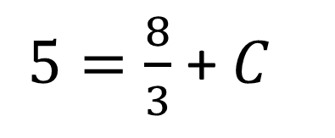
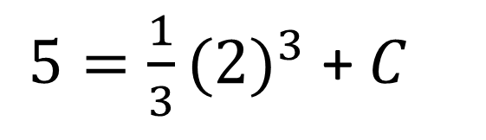
A curve with the equation y = f(x) passes through the (2,5).
Find $y$ when $\frac{dy}{dx}=x^{2}$
$y=\frac{1}{3}x^{3}$ + $C$
$y=\frac{1}{3}x^{3}$ +$\frac{7}{3}$
$5=\frac{1}{3}{(2)}^{3}$ + $C$
$5=\frac{8}{3}$ + $C$
$$C=\frac{7}{3}$$

Slide 21
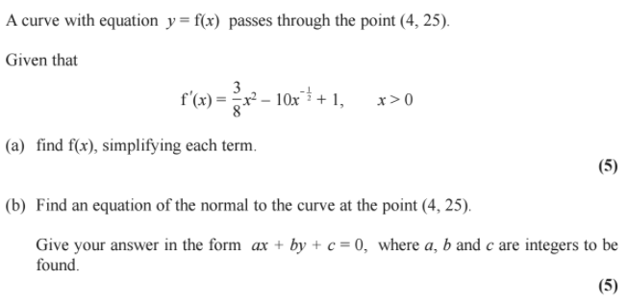

Slide 22
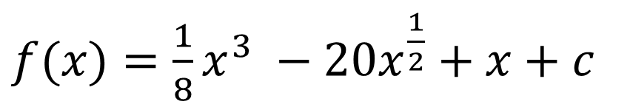
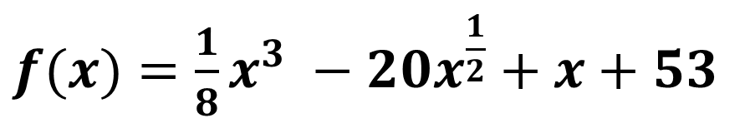

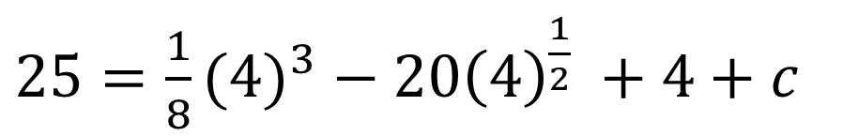
$f(x)=\frac{1}{8}x^{3} −20x^{\frac{1}{2}}+x+c$
a)
$25=\frac{1}{8}{(4)}^{3} − 20{\left(4\right)}^{\frac{1}{2}} +4+c$
$f(x)=\frac{1}{8}x^{3} −20x^{\frac{1}{2}}+x+53$
$c=53$

Slide 23








$f^{′}\left(4\right)=\frac{3}{8}{\left(4\right)}^{2} −10{\left(4\right)}^{−\frac{1}{2}}+1$
$$y−25=−\frac{1}{2}\left(x−4\right)$$
b)
$$f^{′}\left(4\right)=2$$
$$y=−\frac{1}{2}x+27$$
Tangent Gradient $=2$
$$2y=−x+54$$
Normal Gradient $=−\frac{1}{2}$
$$x+2y −54=0$$

