Slide 1
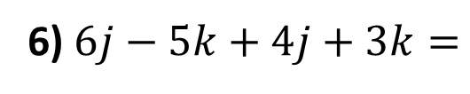
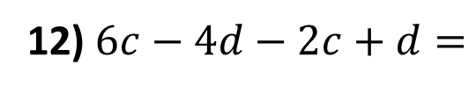
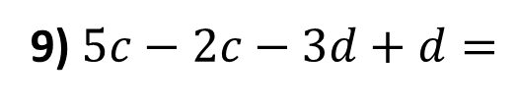
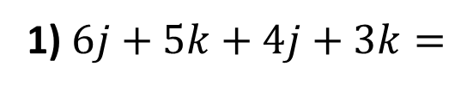
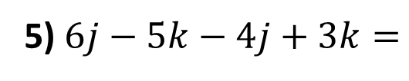
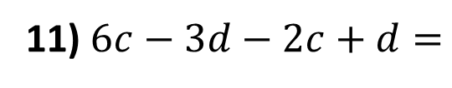
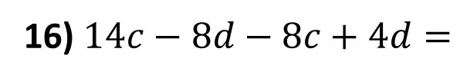
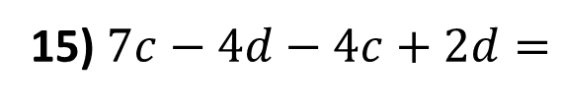
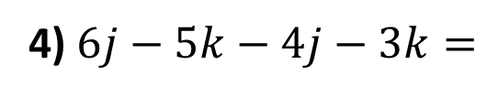
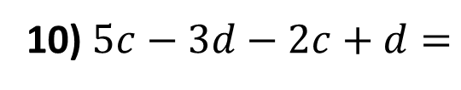
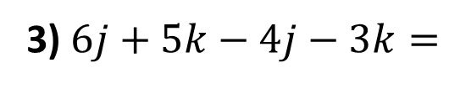
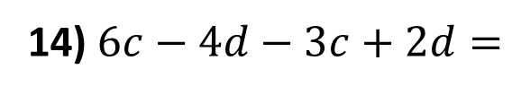
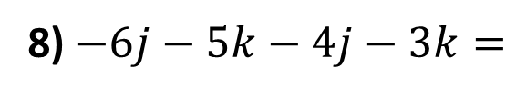
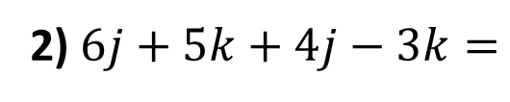
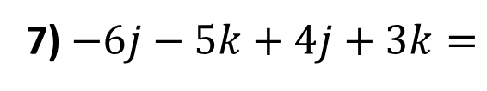
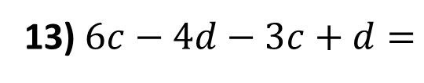
Simplify the following expressions.
1) $6j+5k+4j+3k=$
9) $5c−2c−3d+d=$
2) $6j+5k+4j−3k=$
10) $5c−3d−2c+d=$
3) $6j+5k−4j−3k=$
11) $6c−3d−2c+d=$
4) $6j−5k−4j−3k=$
12) $6c−4d−2c+d=$
5) $6j−5k−4j+3k=$
13) $6c−4d−3c+d=$
6) $6j−5k+4j+3k=$
14) $6c−4d−3c+2d=$
7) $−6j−5k+4j+3k=$
15) $7c−4d−4c+2d=$
8) $−6j−5k−4j−3k=$
16) $14c−8d−8c+4d=$

Slide 2
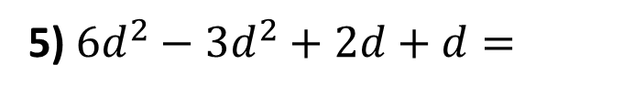
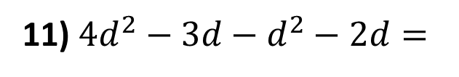
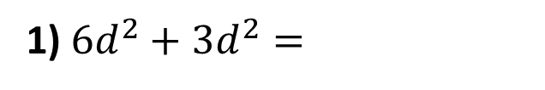
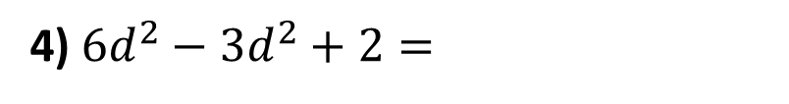
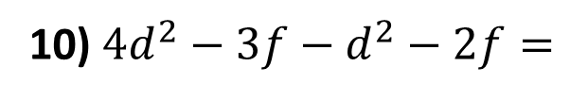
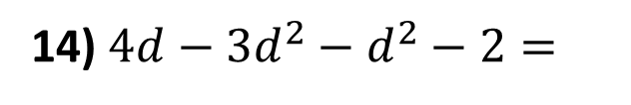
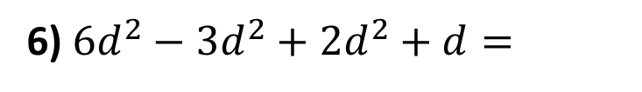
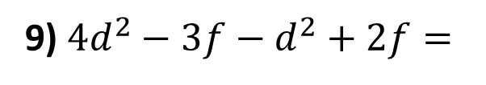
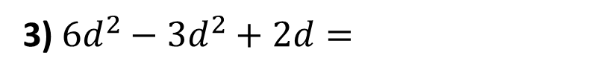
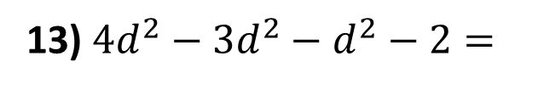
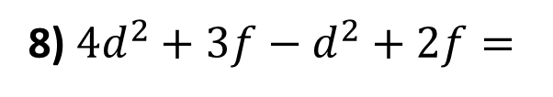
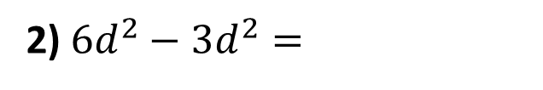
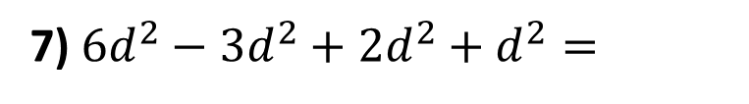
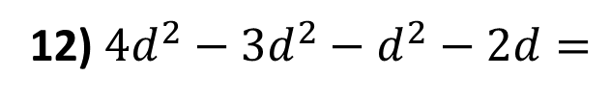
Simplify the following expressions.
8) $4d^{2}+3f−d^{2}+2f=$
1) $6d^{2}+3d^{2}=$
9) $4d^{2}−3f−d^{2}+2f=$
2) $6d^{2}−3d^{2}=$
3) $6d^{2}−3d^{2}+2d=$
10) $4d^{2}−3f−d^{2}−2f=$
4) $6d^{2}−3d^{2}+2=$
11) $4d^{2}−3d−d^{2}−2d=$
5) $6d^{2}−3d^{2}+2d+d=$
12) $4d^{2}−{3d}^{2}−d^{2}−2d=$
6) $6d^{2}−3d^{2}+2d^{2}+d=$
13) $4d^{2}−{3d}^{2}−d^{2}−2=$
7) $6d^{2}−3d^{2}+2d^{2}+d^{2}=$
14) $4d−{3d}^{2}−d^{2}−2=$

Slide 3
ANSWERS

Slide 4


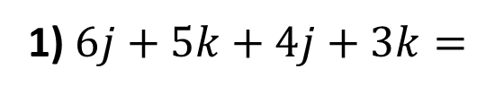

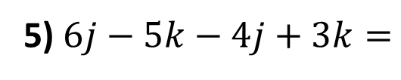





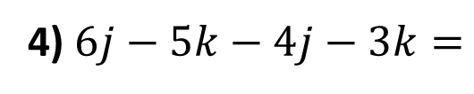


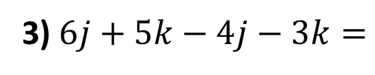


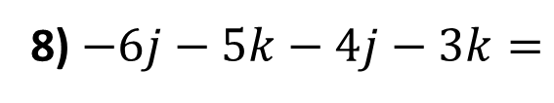

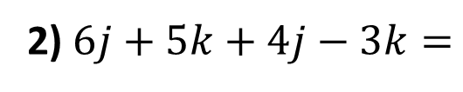
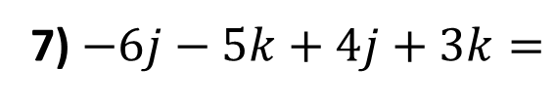



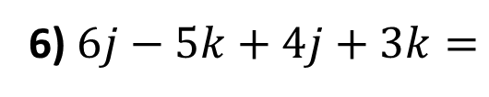
Simplify the following expressions.
1) $6j+5k+4j+3k=$
$$10j+8k$$
9) $5c−2c−3d+d=$
$$3c−2d$$
2) $6j+5k+4j−3k=$
$$10j+2k$$
10) $5c−3d−2c+d=$
$$3c−2d$$
3) $6j+5k−4j−3k=$
$$2j+2k$$
11) $6c−3d−2c+d=$
$$4c−2d$$
4) $6j−5k−4j−3k=$
$$2j−8k$$
12) $6c−4d−2c+d=$
$$4c−3d$$
5) $6j−5k−4j+3k=$
$$2j−2k$$
13) $6c−4d−3c+d=$
$$3c−3d$$
6) $6j−5k+4j+3k=$
$$10j−2k$$
14) $6c−4d−3c+2d=$
$$3c−2d$$
7) $−6j−5k+4j+3k=$
$$−2j− 2k$$
15) $7c−4d−4c+2d=$
$$3c−2d$$
8) $−6j−5k−4j−3k=$
$$−10j−8k$$
16) $14c−8d−8c+4d=$
$$6c−4d$$

Slide 5

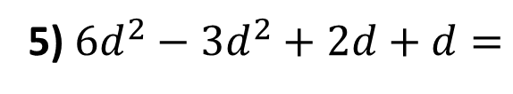
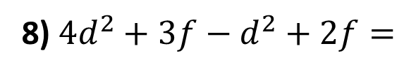
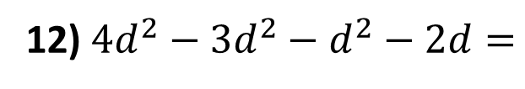
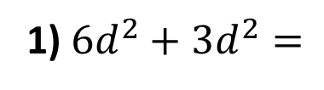





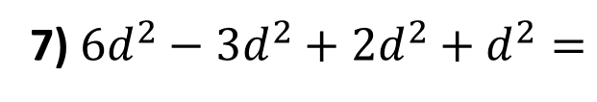
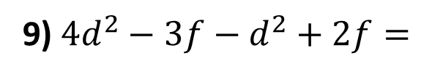

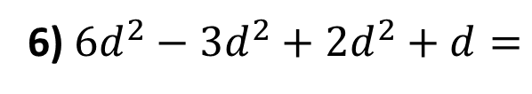
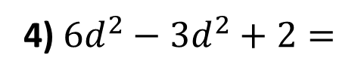
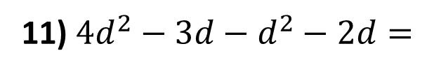
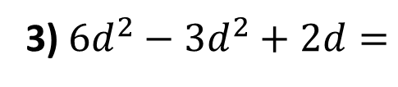


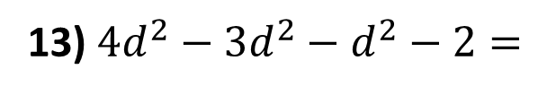


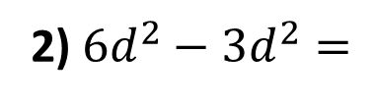





Simplify the following expressions.
1) $6d^{2}+3d^{2}=$
$${9d}^{2}$$
8) $4d^{2}+3f−d^{2}+2f=$
${3d}^{2}+5f$
2) $6d^{2}−3d^{2}=$
${3d}^{2}$
9) $4d^{2}−3f−d^{2}+2f=$
${3d}^{2}−f$
3) $6d^{2}−3d^{2}+2d=$
${3d}^{2}+2d$
10) $4d^{2}−3f−d^{2}−2f=$
${3d}^{2}−5f$
4) $6d^{2}−3d^{2}+2=$
${3d}^{2}+2$
11) $4d^{2}−3d−d^{2}−2d=$
${3d}^{2}−5d$
5) $6d^{2}−3d^{2}+2d+d=$
$${3d}^{2}+3d$$
12) $4d^{2}−{3d}^{2}−d^{2}−2d=$
$−2d$
6) $6d^{2}−3d^{2}+2d^{2}+d=$
${5d}^{2}+d$
13) $4d^{2}−{3d}^{2}−d^{2}−2=$
$−2$
7) $6d^{2}−3d^{2}+2d^{2}+d^{2}=$
$${6d}^{2}$$
14) $4d−{3d}^{2}−d^{2}−2=$
$$4d−{4d}^{2}−2$$

